Slide 1
Vocabulary Diversity
And
Most Used Words
by Candidate.
2024 US Presidential Elections

Slide 2
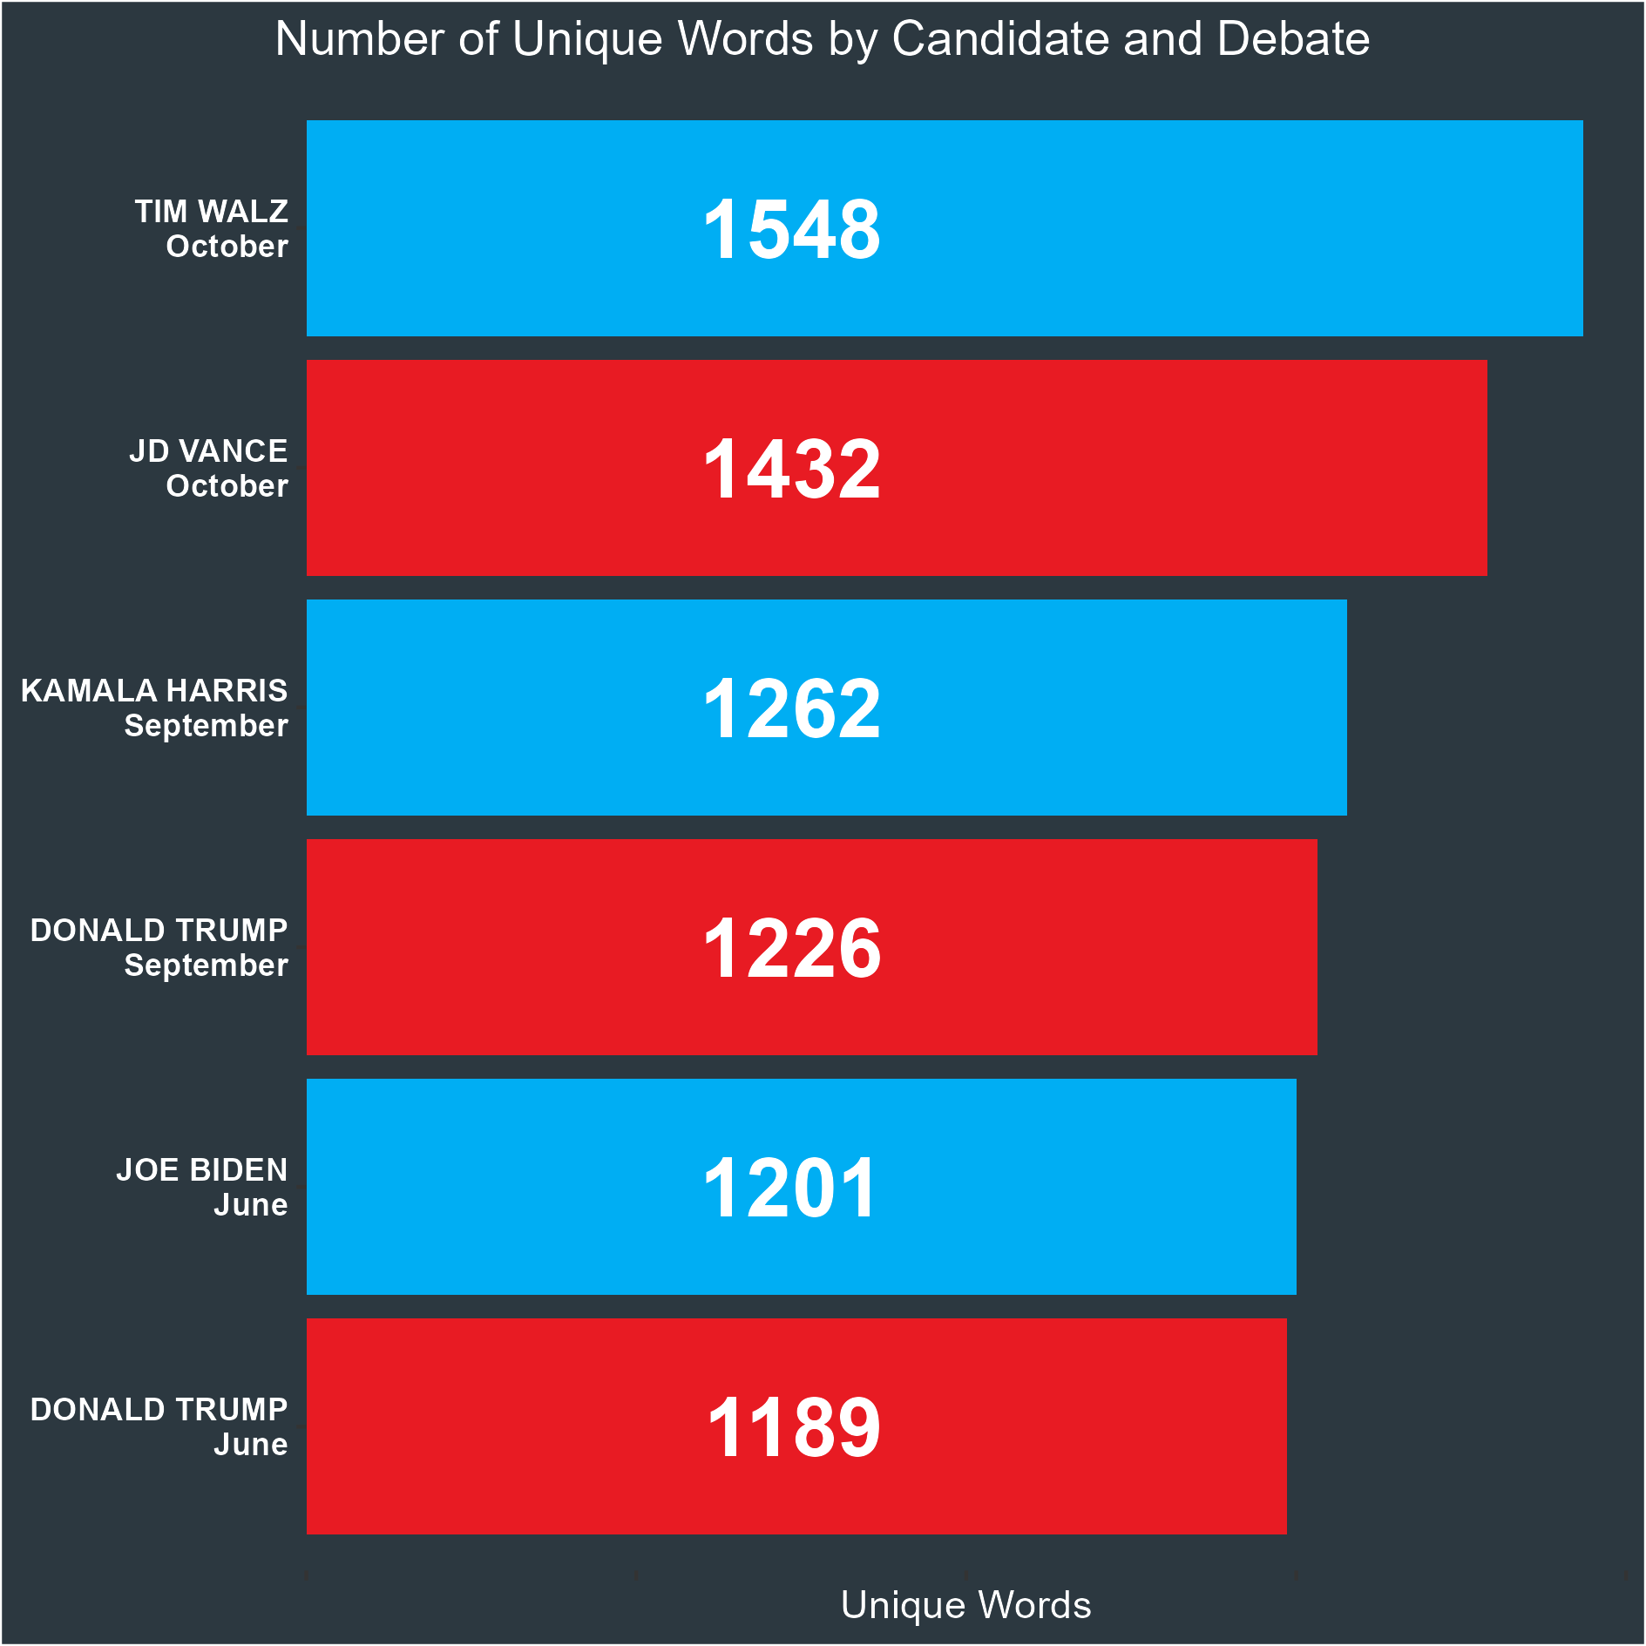

Slide 3
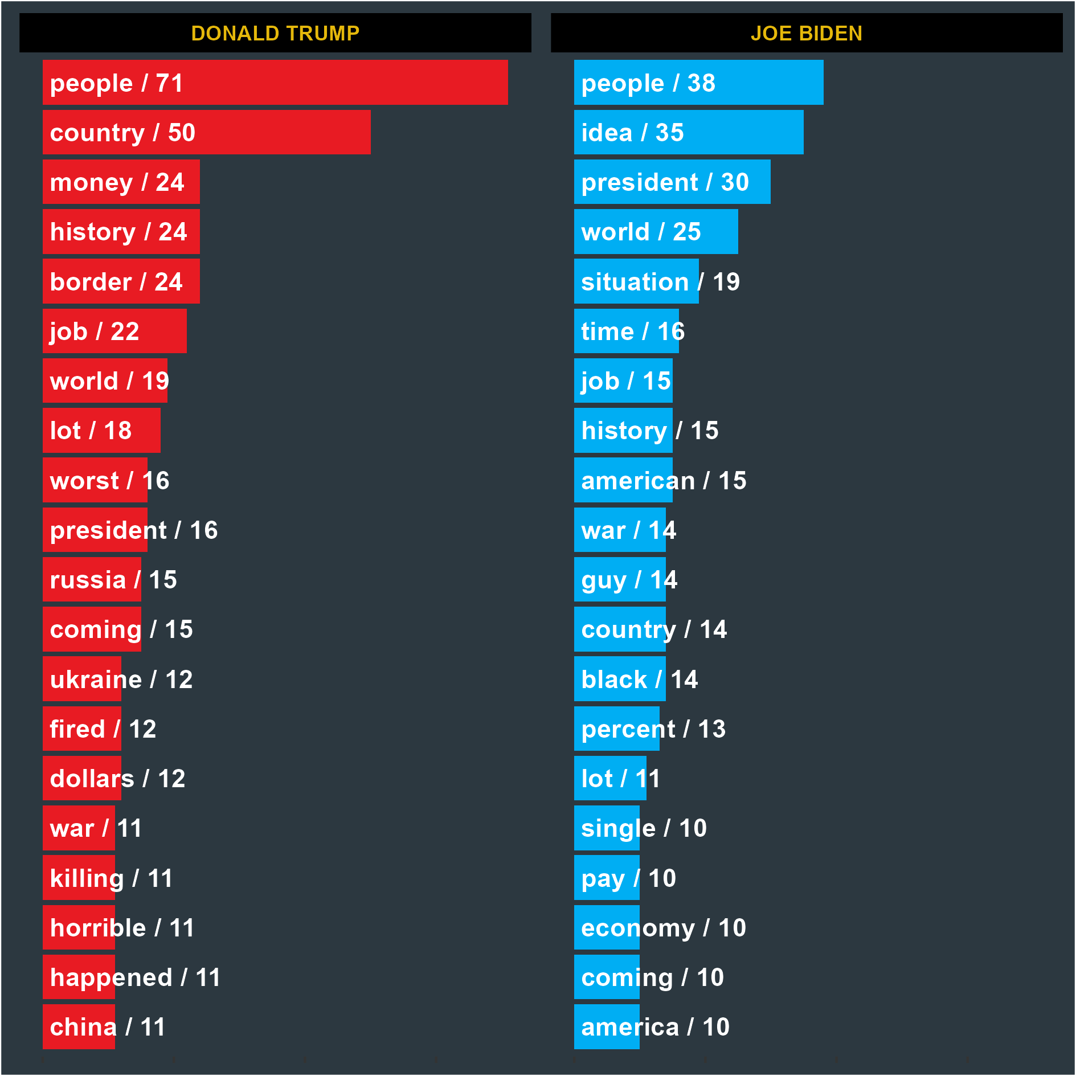
First Presidential Debate (June 27, 2024). Most Used Words

Slide 4
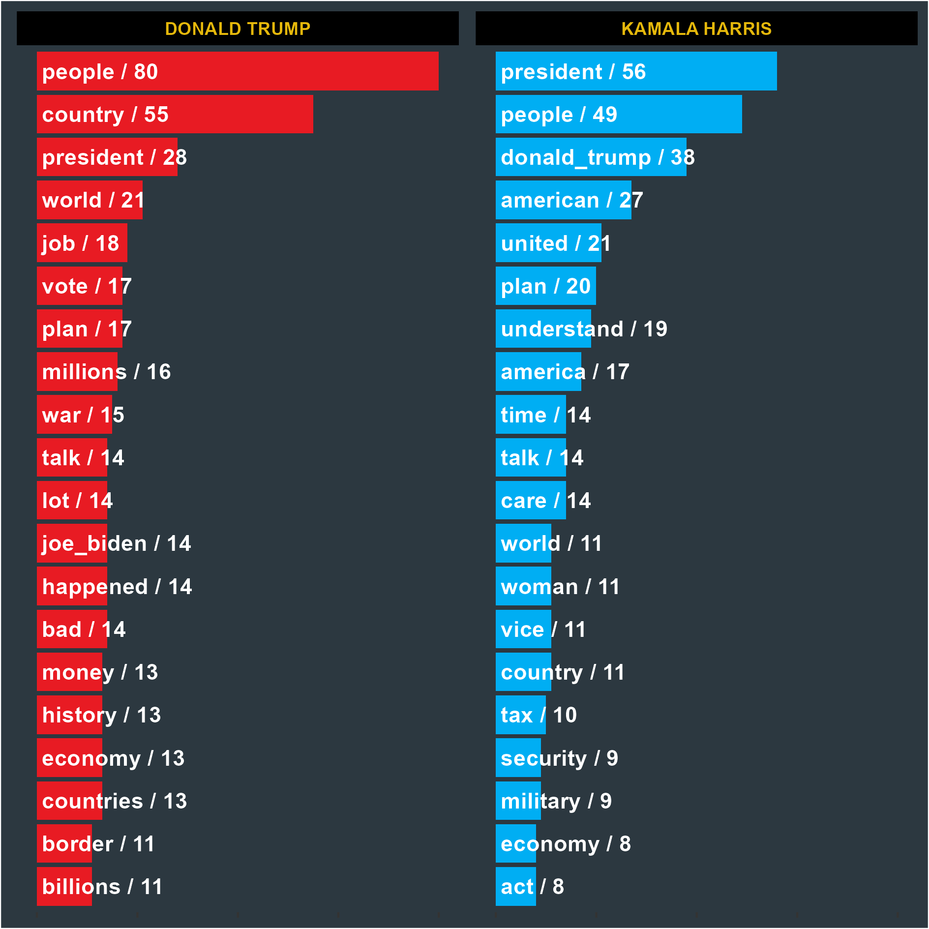
Second Presidential Debate (September 10, 2024). Most Used Words

Slide 5
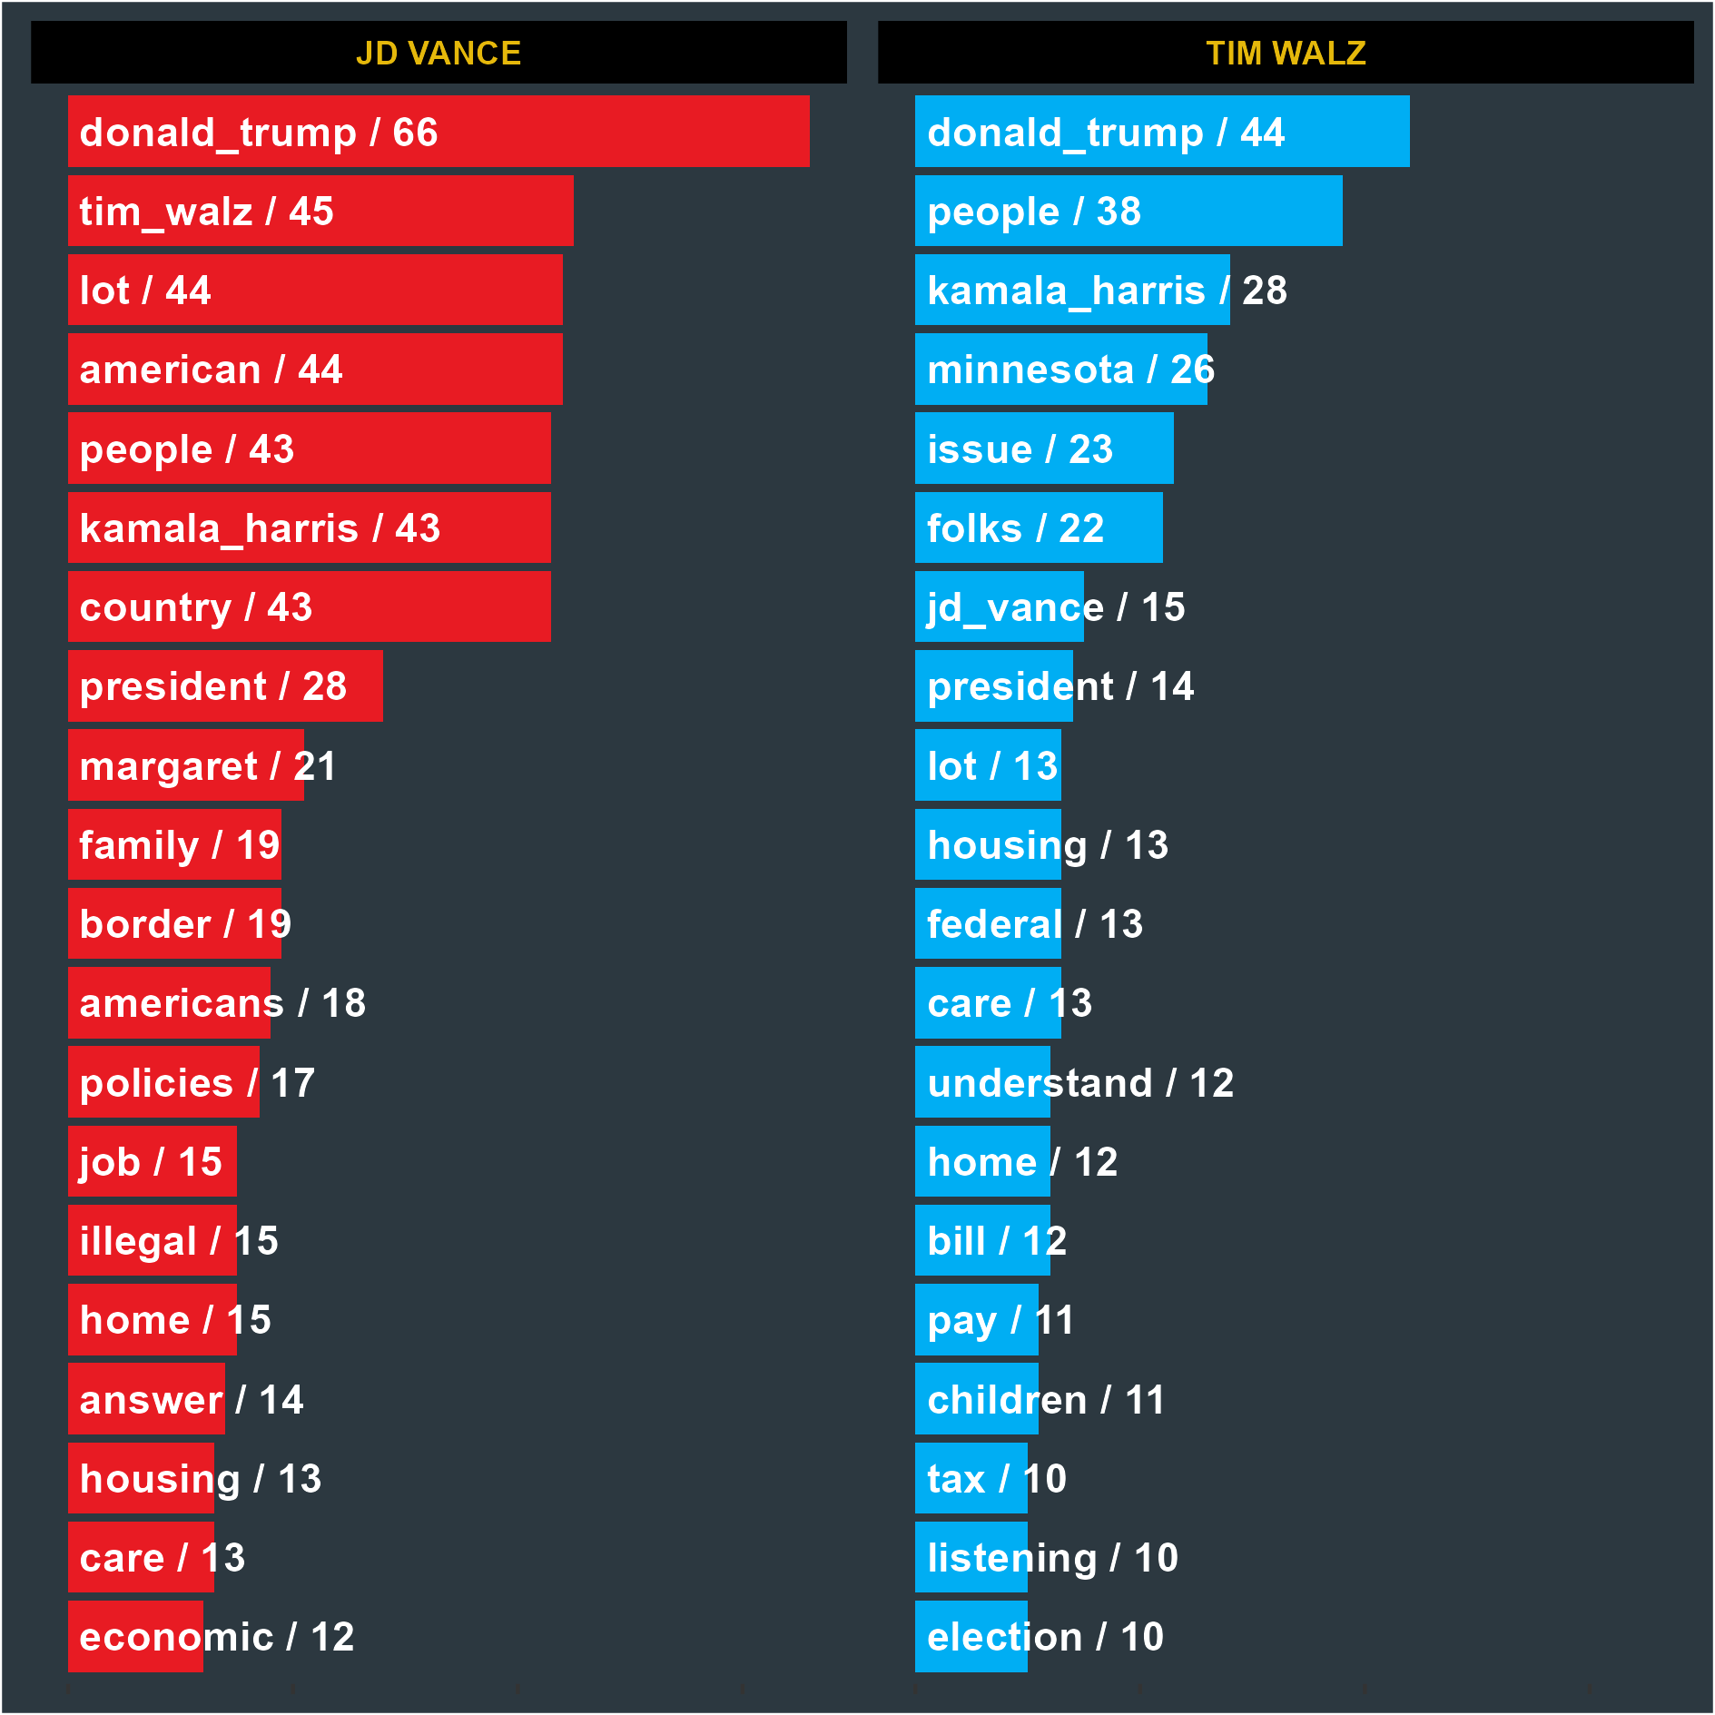
Vice Presidential Debate (October 1, 2024). Most Used Words

