Slide 1
R Programming Language
Sentiment Analysis
Using Tidyverse and Shiny
Sentiment by Sentence
Synthesis of the Results

Slide 2
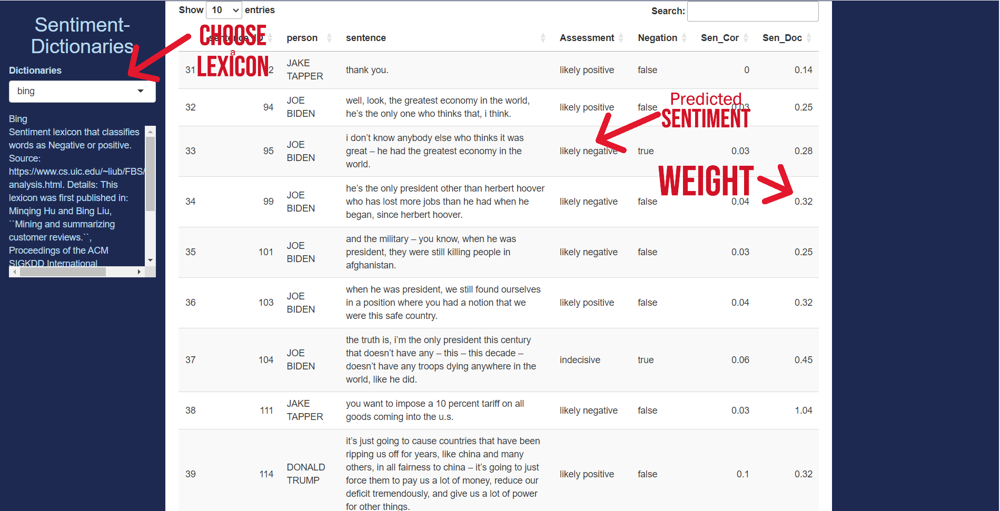
Our Shiny App to analyse the 2024 Presidential debates has a new tab: Vocabulary Usage
A new section, Synthesis of the Vocabulary, contains tools to observe discourses as a whole

Slide 3
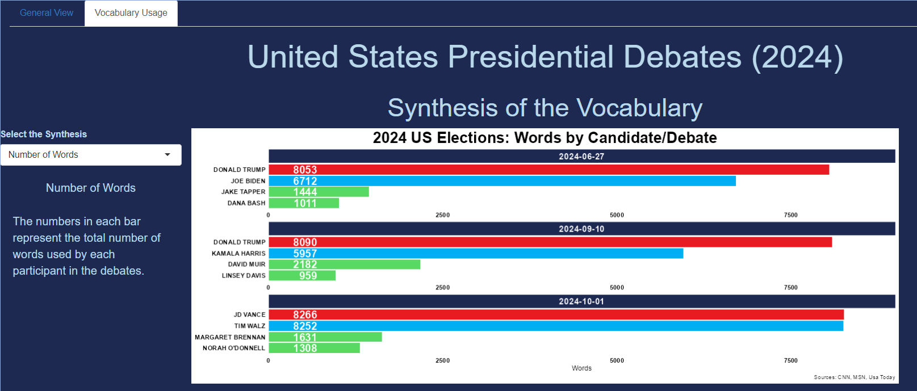
Each selection has a corresponding explanation and a visual

Slide 4
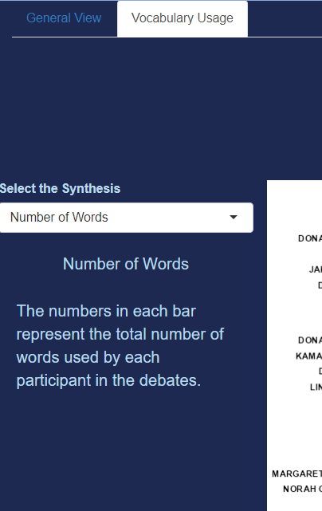
Number of Words answers the question how many words did each candidate use?

Slide 5
The visual shows with numbers and bars the answer to that question for each debate
For instance, in the first debate, Trump pronounced 8053 words, while Biden only 6712

Slide 6
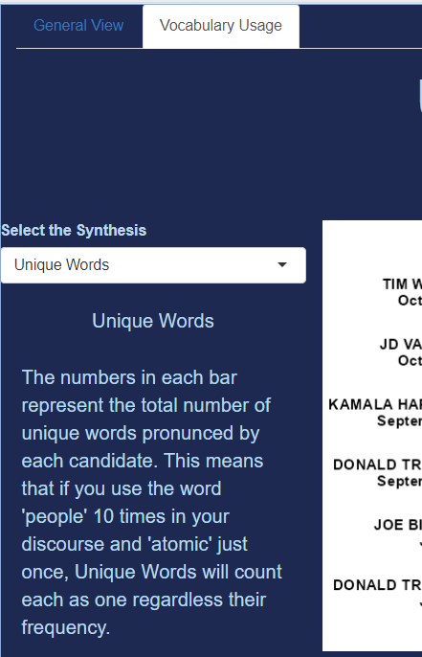
Unique Words answers the question how many individual words did each candidate use?

Slide 7
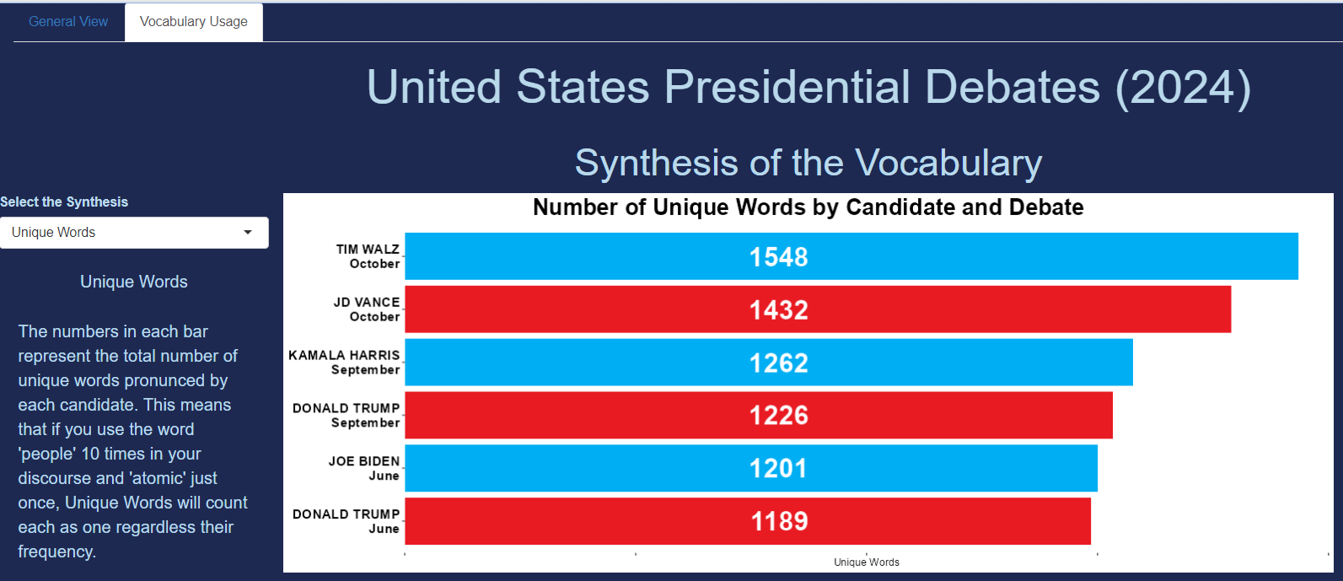
A bar graph contains the answer

Slide 8
Tim Waltz showed his eloquence with 1548 distinct words. Trump, however, used 1189 words to express his thoughts in the first debate

Slide 9
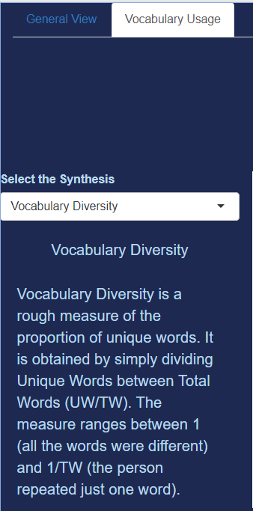
Vocabulary Diversity shows the proportion of Unique Words in the Number of Words

Slide 10
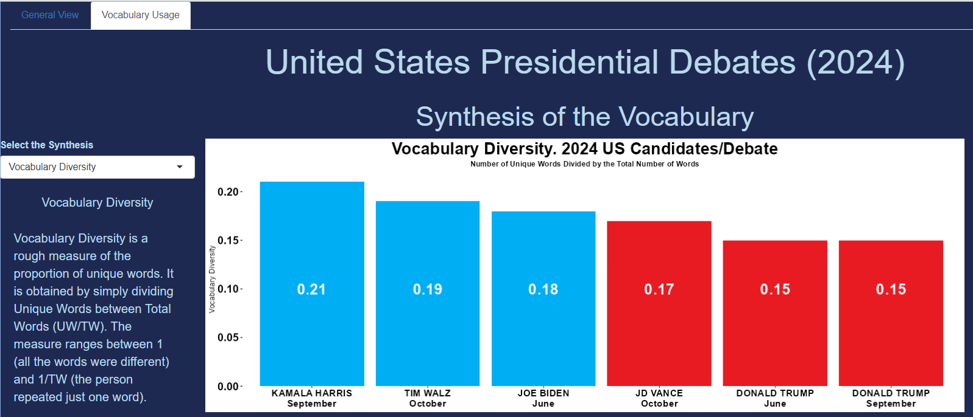
In general, Democrats had a more diverse vocabulary than their Republican opponents

Slide 11
Thank you
Next steps:
TF-IDF (most important words)
Bi-grams: are they useful in the detection of negative sentiments?
Visit the project:
https://github.com/ortizpalanques1/debates_US_2024

