Slide 1
R Programming Language
Sentiment Analysis
Using Tidyverse and Shiny
Sentiment by Sentence
Synthesis of the Results

Slide 2
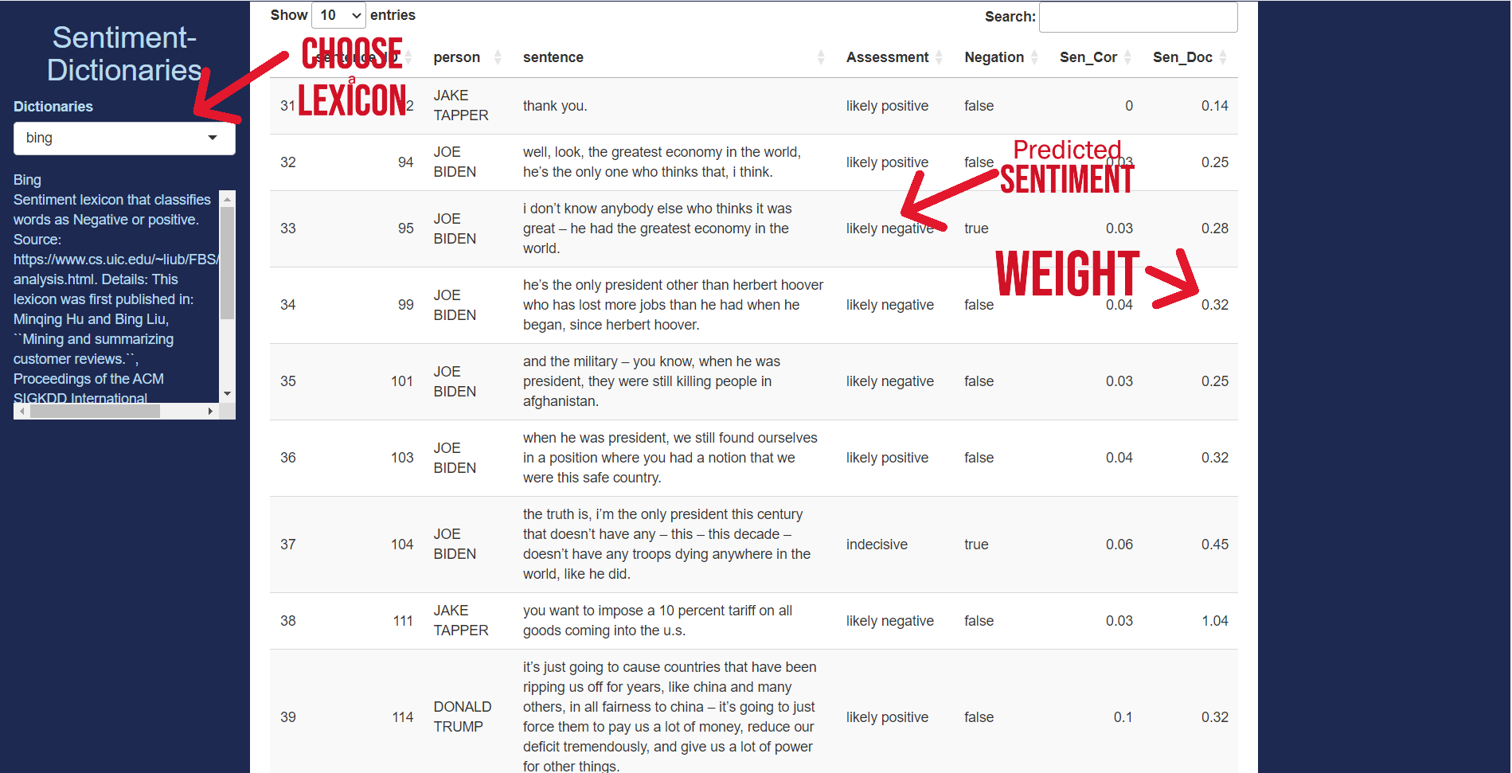
Now we can analyze whether a sentence is likely to be positive or negative using a Sentiment Dictionary
A new section, Synthesis of the Vocabulary, contains tools to observe discourses as a whole

Slide 3
Sentences containing sentiments are evaluated and a weight is assigned

Slide 4
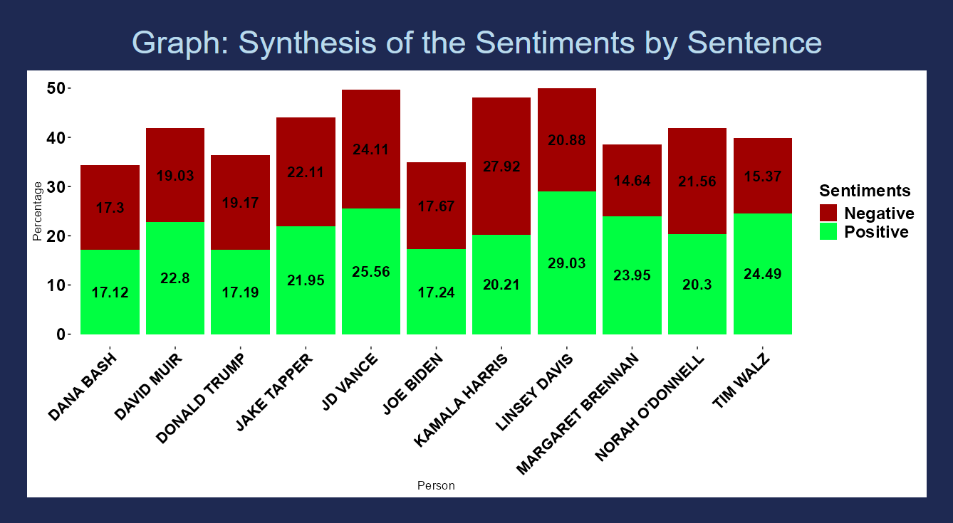
A synthetic graph is created with ggplot
The green bar is the addition of the weights of all the positive sentences and the red bar of the negative ones

Slide 5
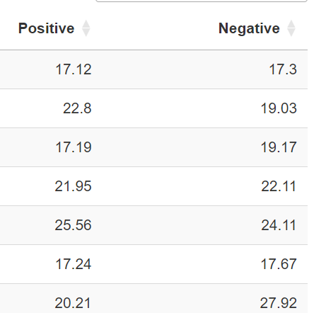
The same values are represented in a table

Slide 6
Thank you
Next steps:
Filter words inside a dictionary
Create a tab for Thematic Analysis
Visit the project:
https://github.com/ortizpalanques1/debates_US_2024

