Slide 1
R Programming Language
Sentiment Analysis
Using Tidyverse and Shiny
Editing the dictionary
Editing the values

Slide 2
A problem when working with sentiment analysis is the unexpected results.
Some words do not represent the sentiment.
Some sentences carry a sentiment different than its words.

Slide 3
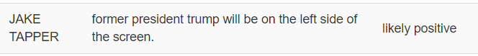
Let’s see an example when the word does not carry the expected sentiment
“Trump,” in this case, means the name of the president and not the “trump card” or a “dependable person.”
We must tell the program not to evaluate this word.

Slide 4
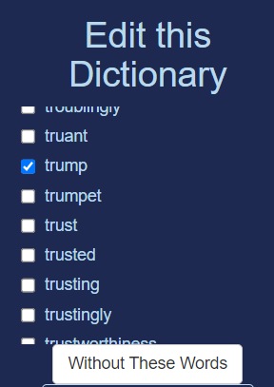
In the area “Edit this dictionary,” the researcher can check the unwanted words:
1
Check the words
2
Click here

Slide 5
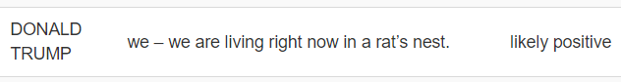
The second possibility is that the sentence carries a different sentiment than that expected by the word
In this case “right” is evaluated as positive, but the sentence is clearly negative.

Slide 6
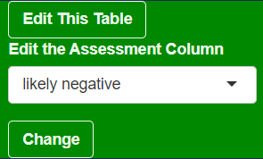
For case like this, we use the Edit this Table section

Slide 7

Once you have selected the right sentiment, it is changed in the table.
All these editing features create new graphics and resume tables. You can download them as csv at any point in your research.

Slide 8
Thank you
Next steps:
Create a tab for Thematic Analysis
Visit the project:
https://github.com/ortizpalanques1/debates_US_2024

