Slide 1

Term Frequency
And
Inverse Document Frequency
$$(TF×IDF)$$
by Candidate.
2024 US Presidential Elections

Slide 2
TF IDF
The importance of a word inside a document depends on two things: 1. How frequent is its use inside that document, and 2. How particular is it in relation to the other documents of the corpus. Both questions are addressed by the TF-IDF value; where TF stands for term frequency and IDF for inverse document frequency

Slide 3
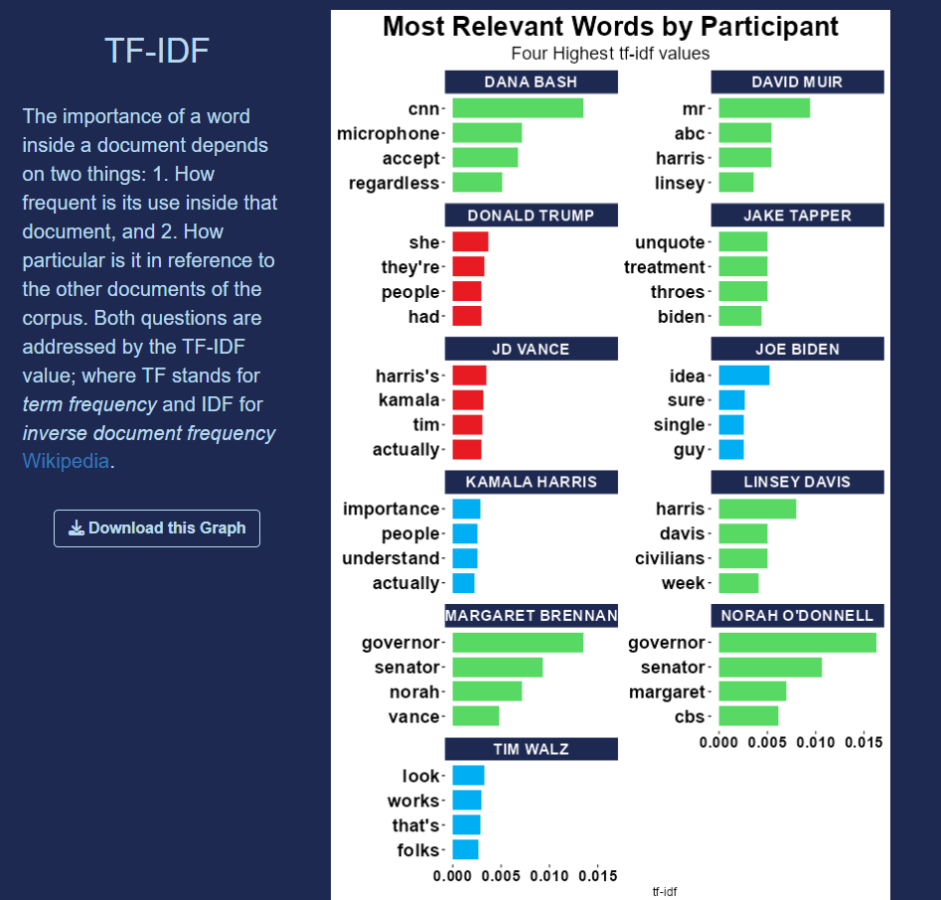
Our app can now generate a graph with the highest TF*IDF values for each document (author in this case).
You can download it as a png file.

Slide 4
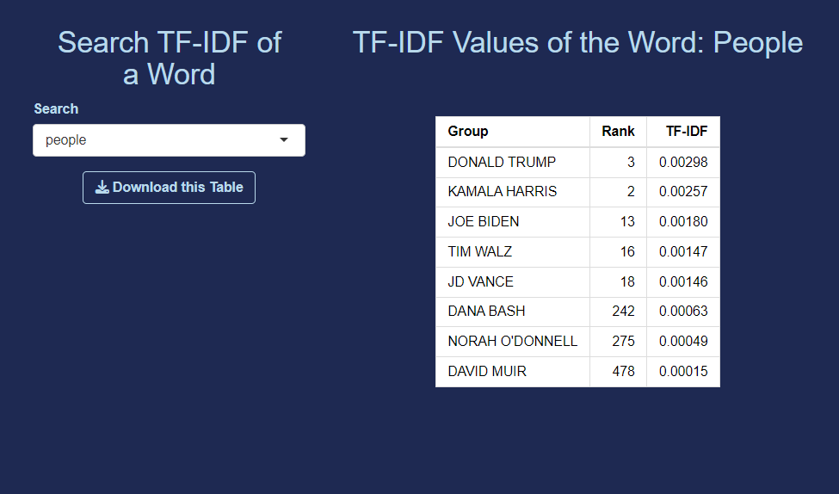
Alternatively, you can search for each word and get its rank and TF*IDF value inside each author. It is possible to download a csv file with the table.

