Slide 1
ECOS:
Ecological Congruity Object-Scene database
https://sites.google.com/view/ecosdatabase/home
Javier Ortiz-Tudela and Carlos González-García
Notes:
Size 40 header; size 20 body
<number>

Slide 2
Database structure:
7 outdoor scene categories (i.e., beach, desert, road, savanna, seabed, mountain and sports center)
10 instances of each scene category.
94 real world objects
Notes:
Size 40 header; size 20 body
<number>

Slide 3
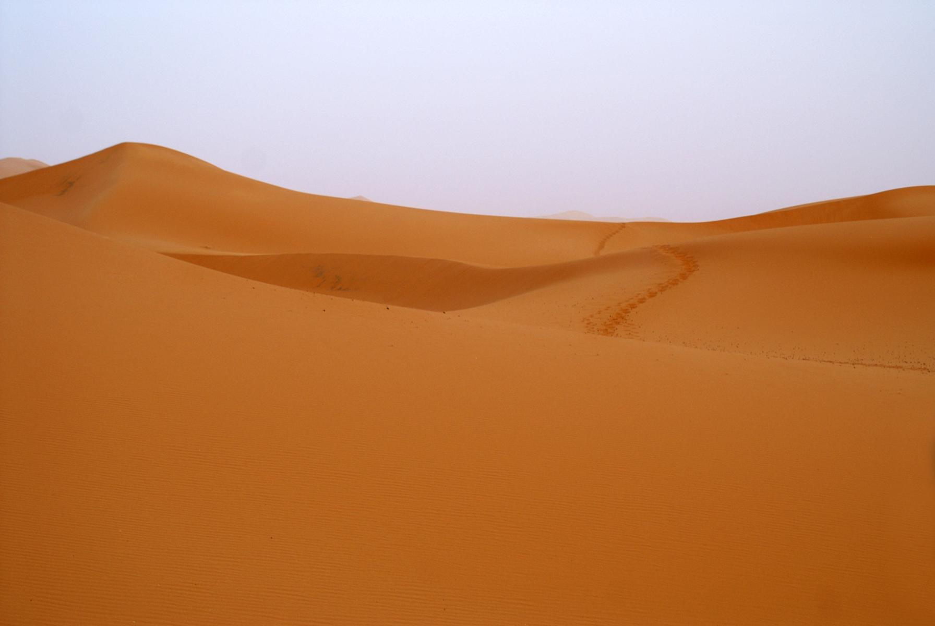
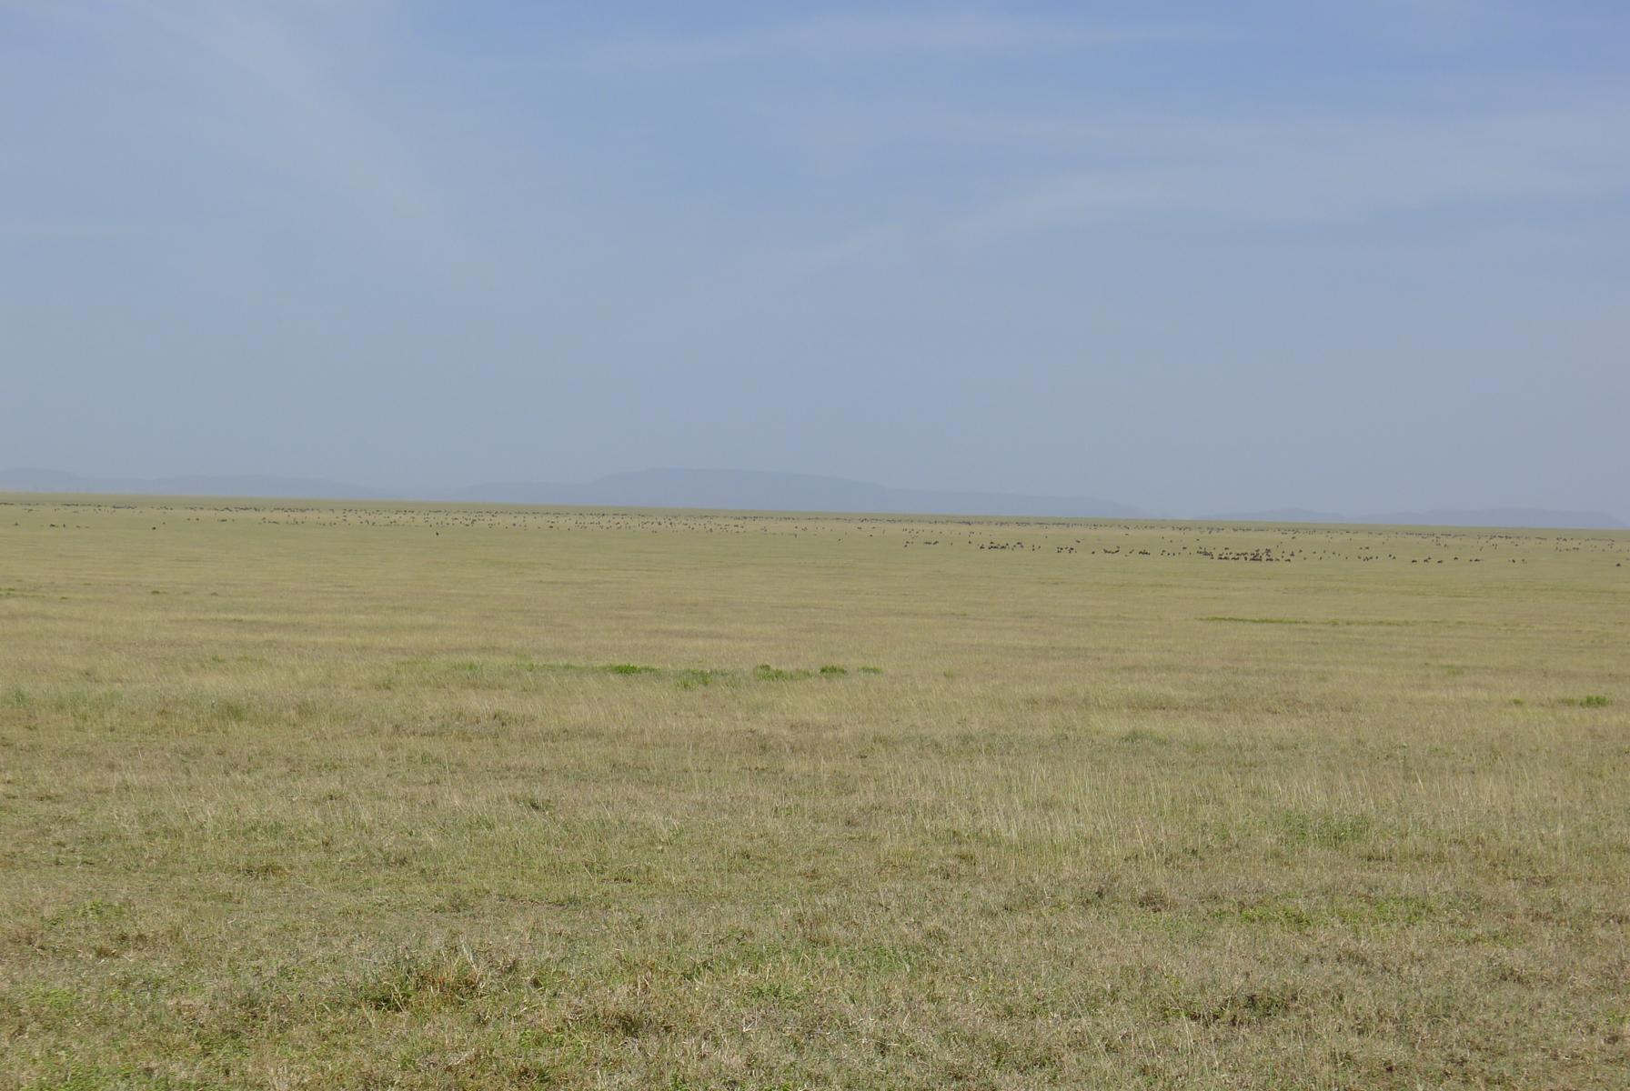
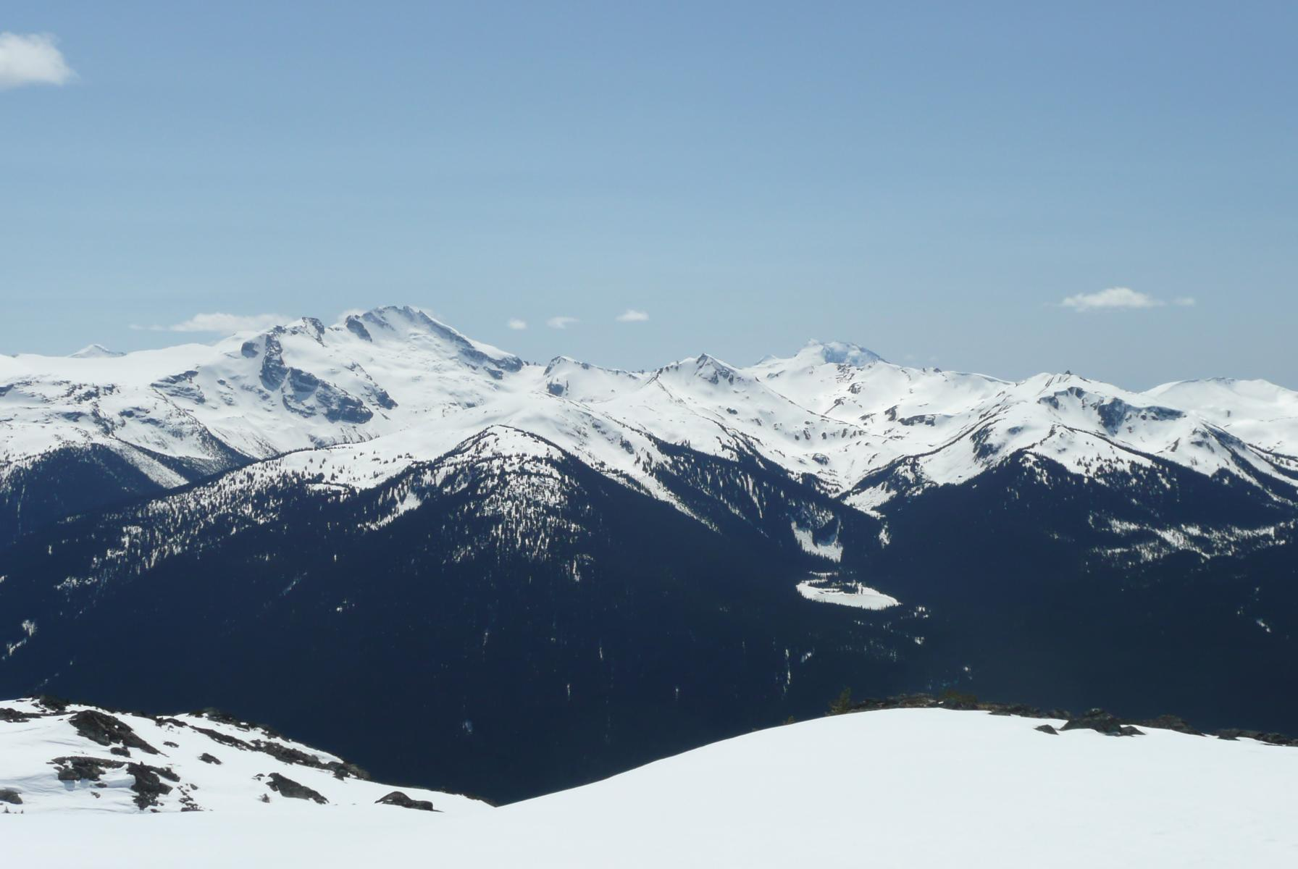
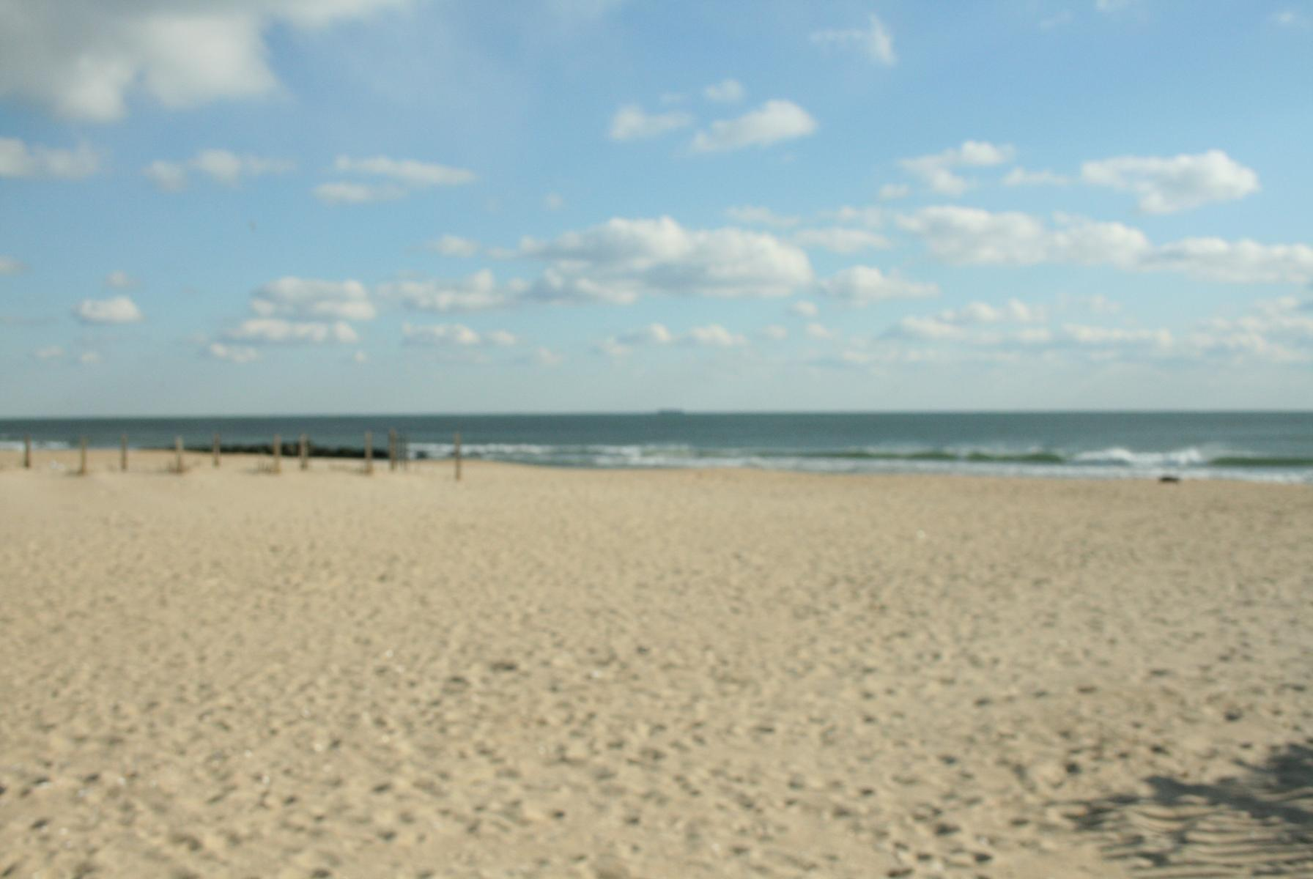
Examples
Notes:
Size 40 header; size 20 body
<number>

Slide 4
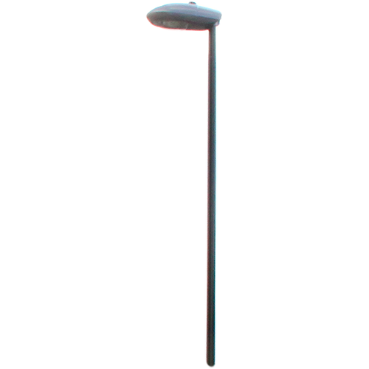
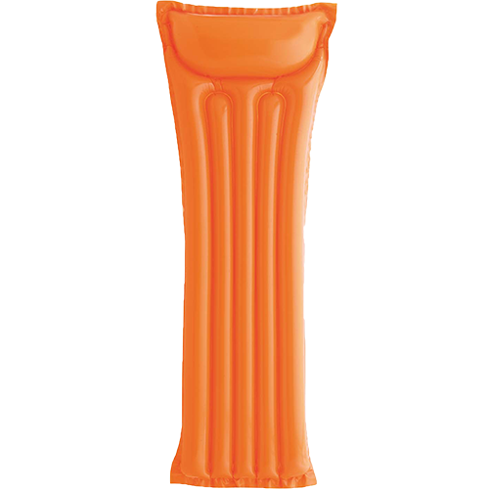
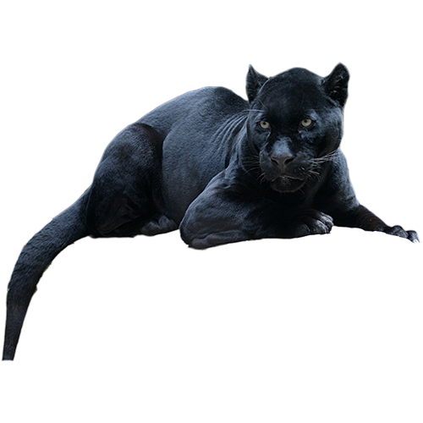
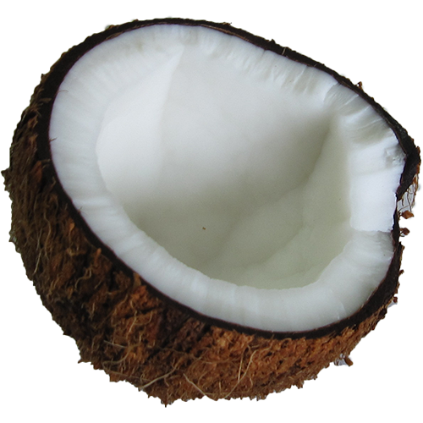
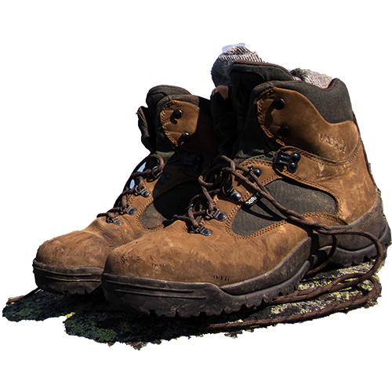
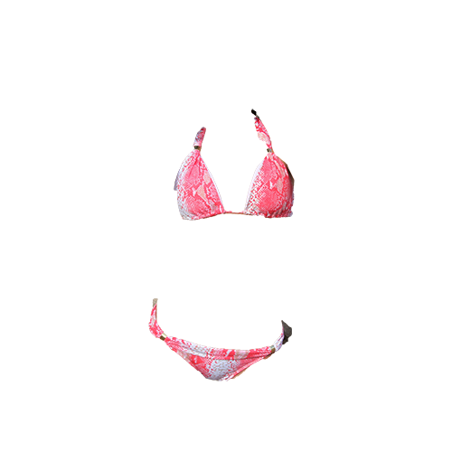
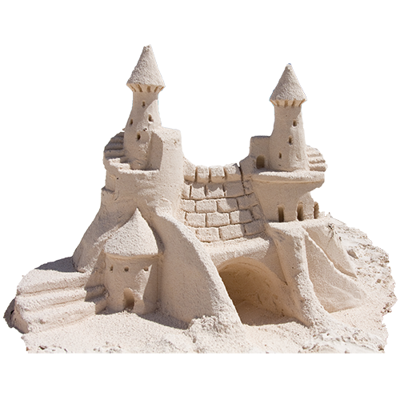
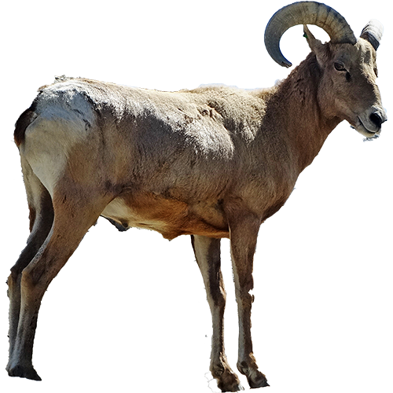

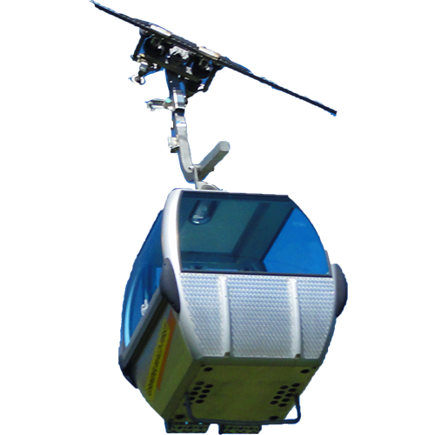
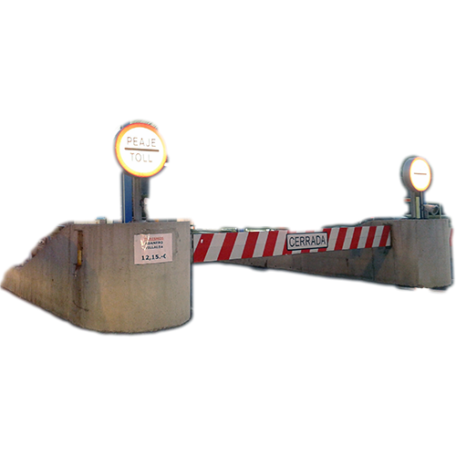
Examples
Notes:
Size 40 header; size 20 body
<number>

Slide 5
Stim validation
-100
100
Notes:
Size 40 header; size 20 body
<number>

Slide 6
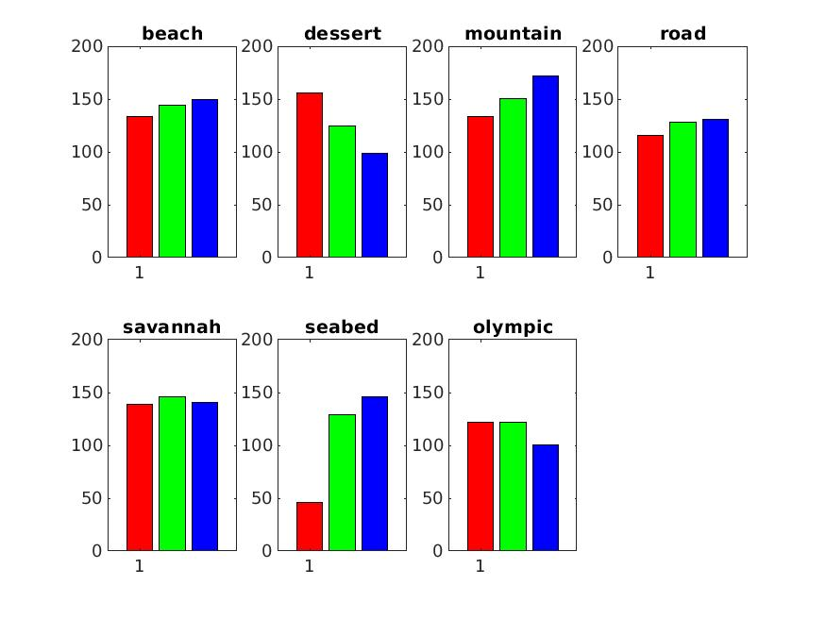
Low-level information:
Color
mean RGB levels for all of the images.
Notes:
Size 40 header; size 20 body
<number>

Slide 7
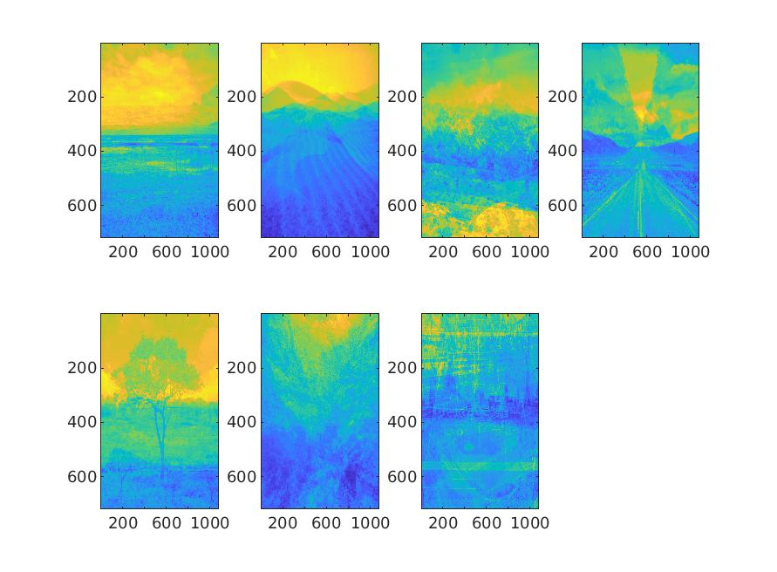
Low-level information:
Color
Average “image” per category
Notes:
Size 40 header; size 20 body
<number>

Slide 8
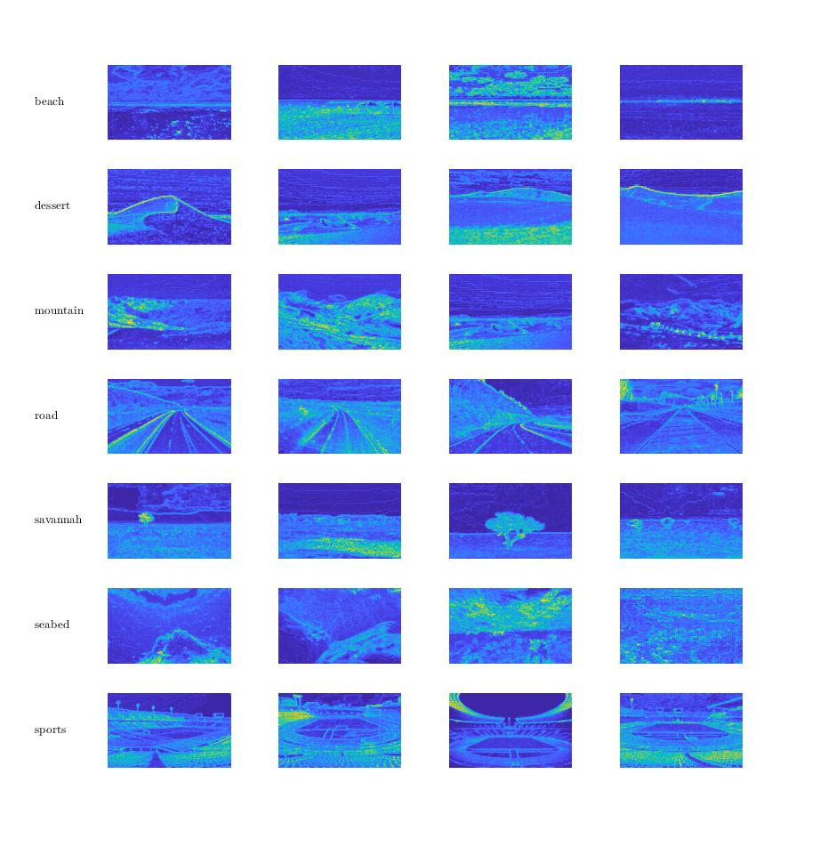
Low-level information:
Saliency
Saliency maps of scenes
Notes:
Size 40 header; size 20 body
<number>

Slide 9
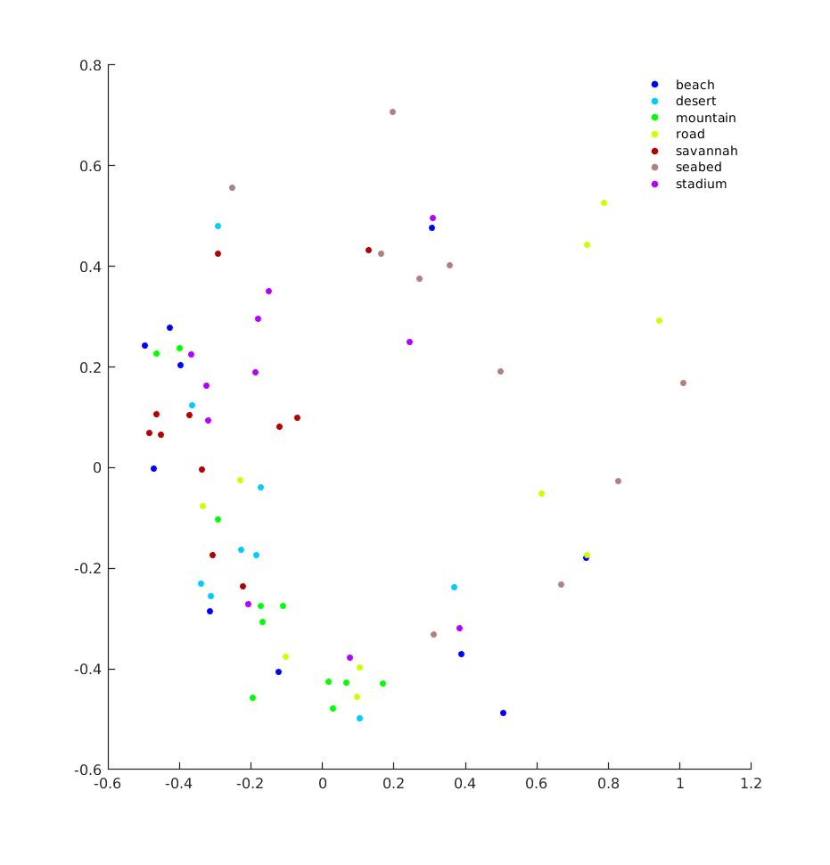
Low-level information:
Saliency
MDS
Notes:
Size 40 header; size 20 body
<number>

Slide 10
Low-level information:
Anything else?
Notes:
Size 40 header; size 20 body
<number>

Slide 11
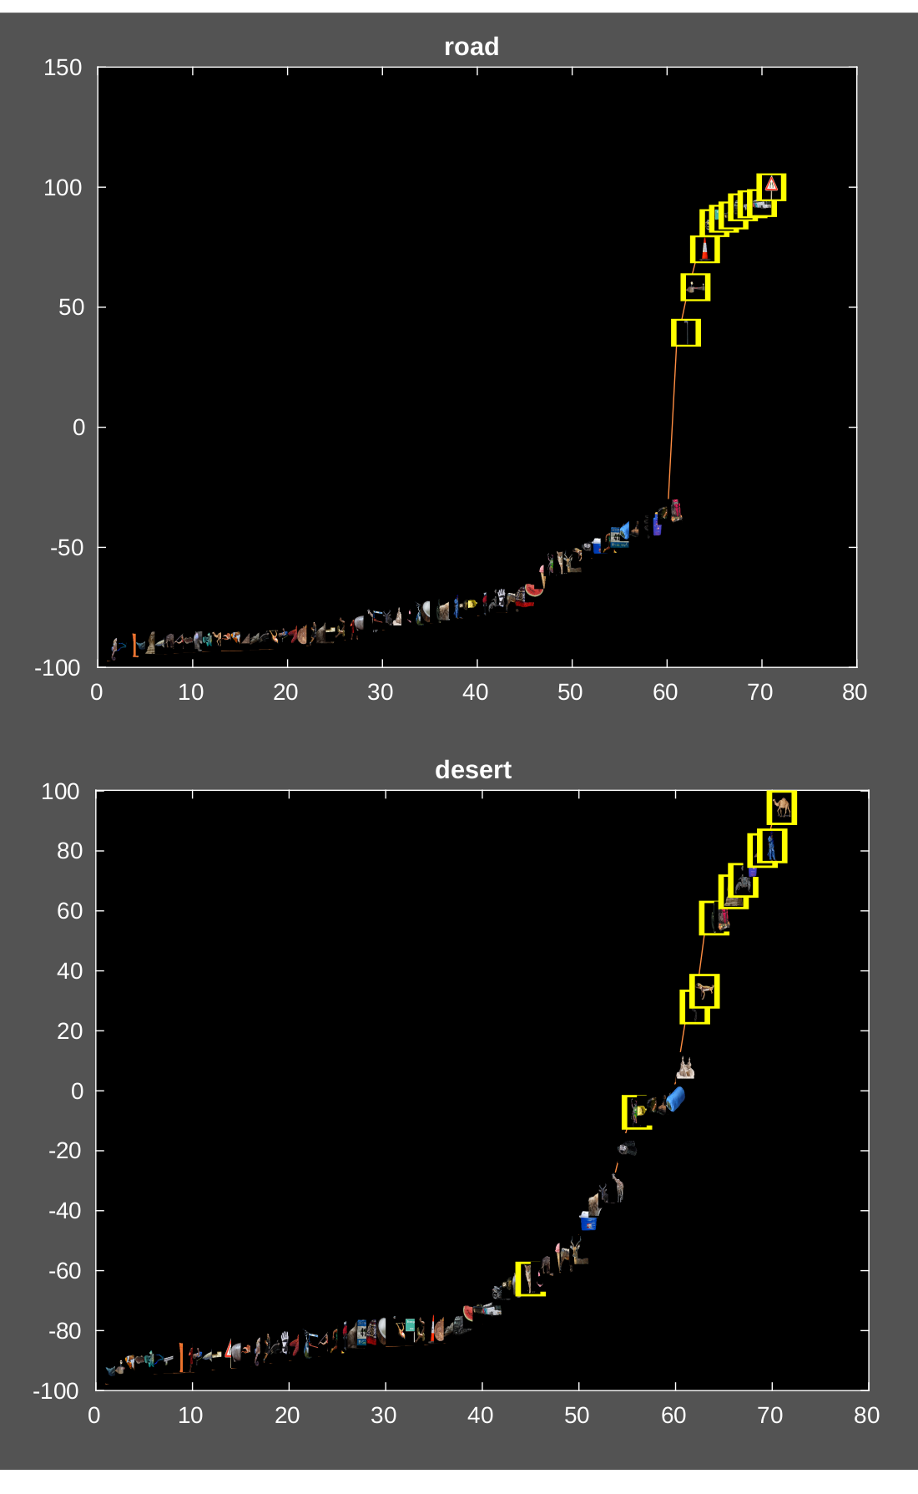
High-level information:
Scene profile across objects
Notes:
Size 40 header; size 20 body
<number>

Slide 12
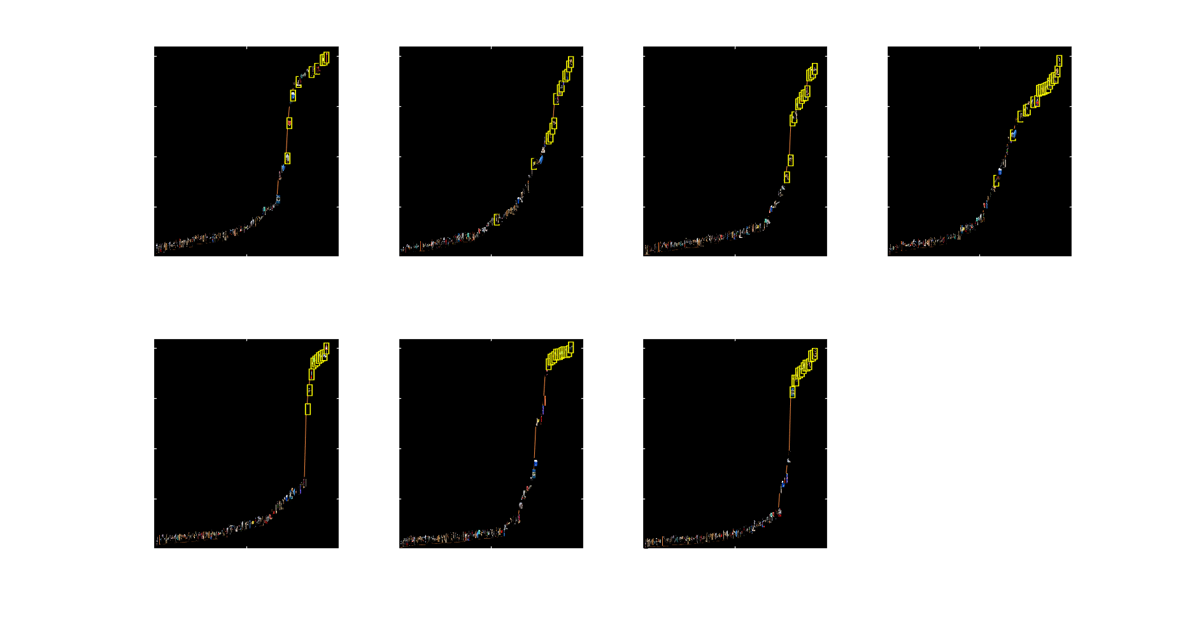
High-level information:
Scene profile across objects
Notes:
Size 40 header; size 20 body
<number>

Slide 13
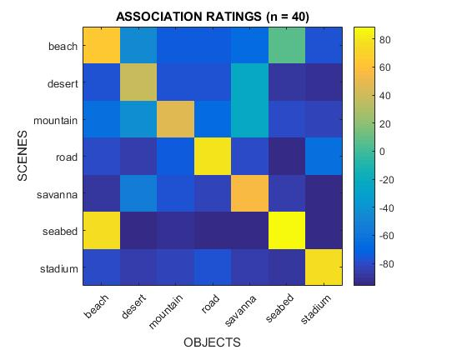
High-level information:
Scene profile across objects (correlation)
Notes:
Size 40 header; size 20 body
<number>

Slide 14
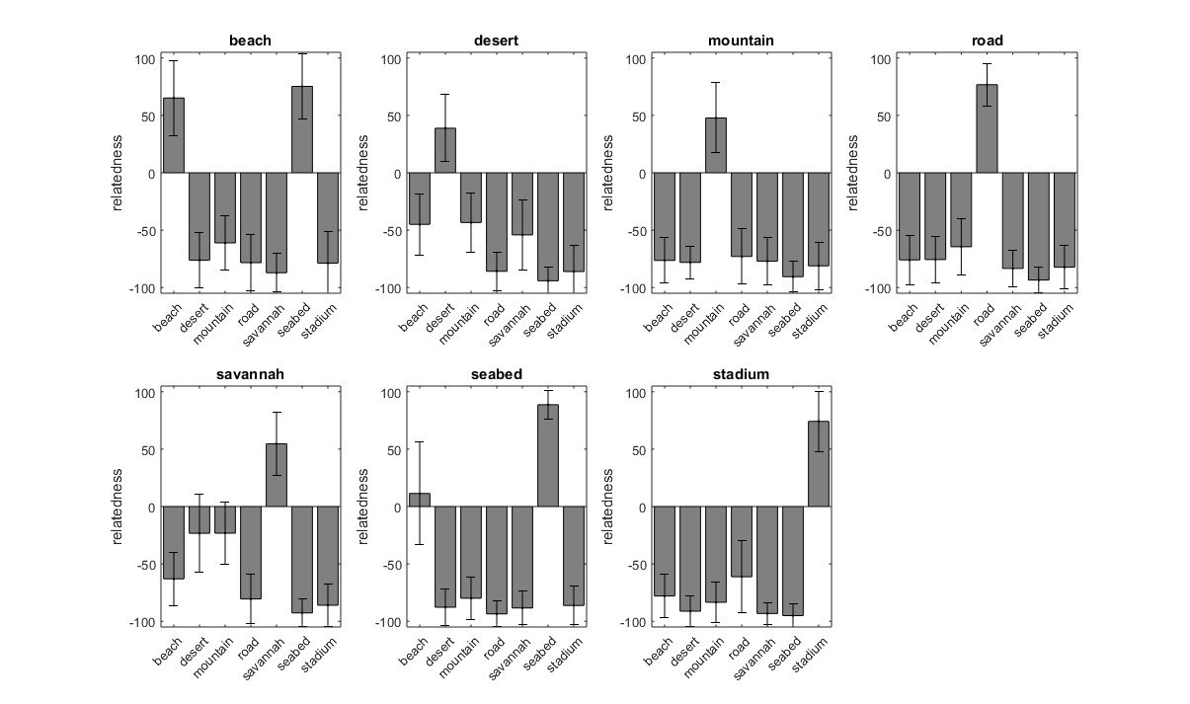
High-level information:
Ratings (scene by object category -a priori-)
Notes:
Size 40 header; size 20 body
<number>

Slide 15
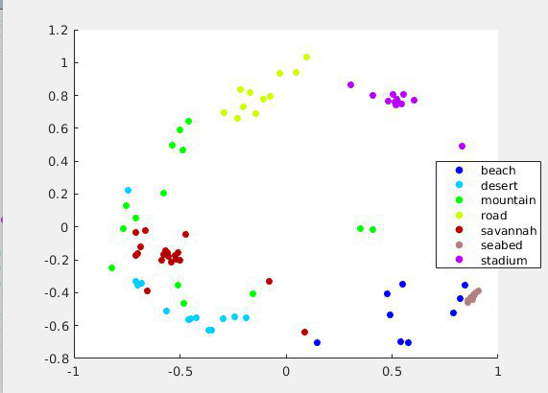
High-level information:
Object profile across scenes
Notes:
Size 40 header; size 20 body
<number>

Slide 16
Hig-level analyses:
Ideas?
Notes:
Size 40 header; size 20 body
<number>

Slide 17
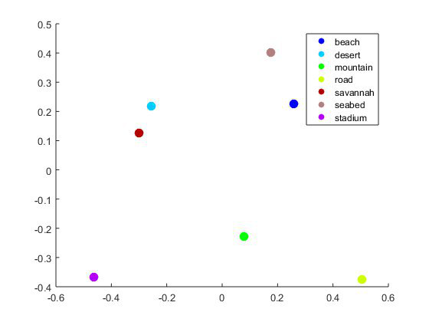
High-level information:
Scene profile across objects (MDS)
Notes:
Size 40 header; size 20 body
<number>

