Slide 1


Introduction into fMRI analysis. PsyMsc4 (Goethe 2021):
Software Installation
Javier Ortiz-Tudela and Francesco Pupillo

Slide 2
Software Installation
Matlab
SPM
ITK-Snap

Slide 3
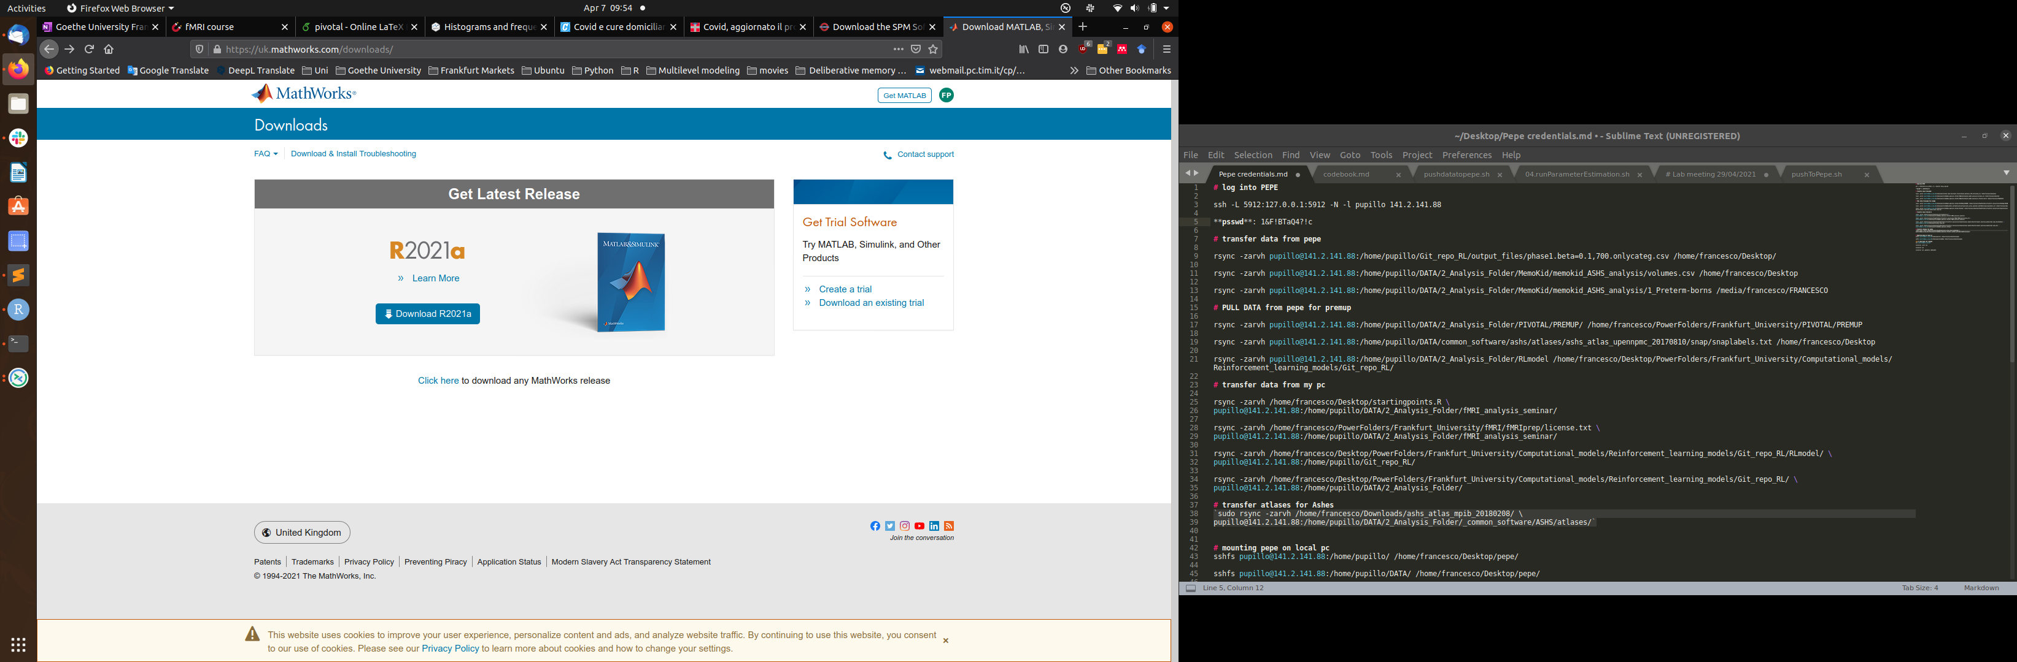
Matlab
Follow the step-by-step guide at
https://www.rz.uni-frankfurt.de/72309152/TAH_Schnellstartanleitung.pdf
To download Matlab and activate it with your HRZ account

Slide 4
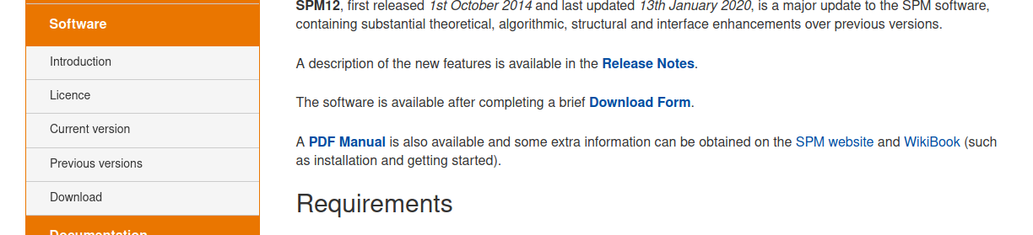
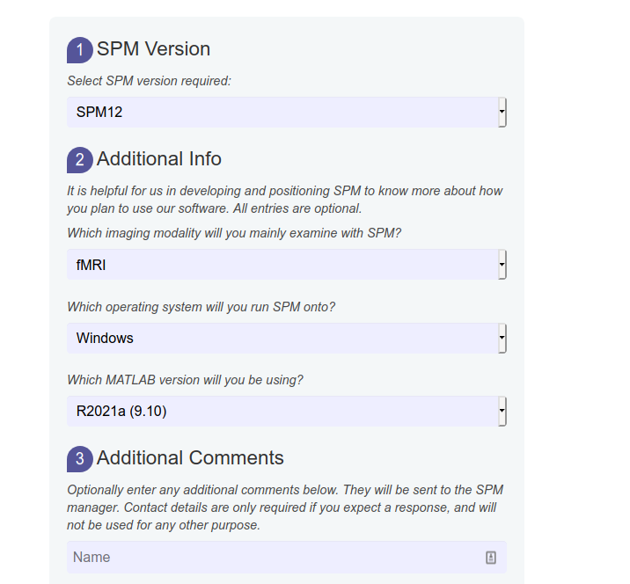
SPM
Go to https://www.fil.ion.ucl.ac.uk/spm/software/spm12/
1. Select “Download”
2. Fill the fields and proceed to the download
3. To install it, follow the instructions at https://en.wikibooks.org/wiki/SPM#Installation

Slide 5
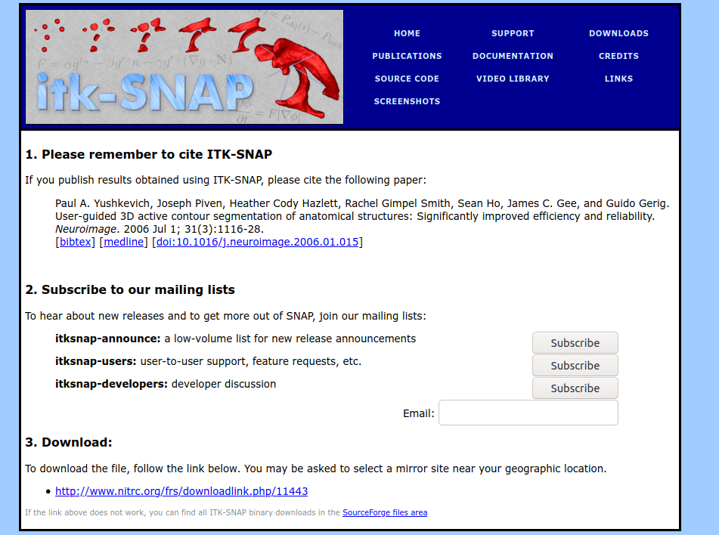
ITK-Snap
Go to http://www.itksnap.org/pmwiki/pmwiki.php?n=Downloads.SNAP3
After selecting the latest version (3.8.0) and your operative system, submit the form and go to the download page.
Click on the download link
After the file has been downloaded, start the executable file downloaded to install ITK-Snap

Slide 6
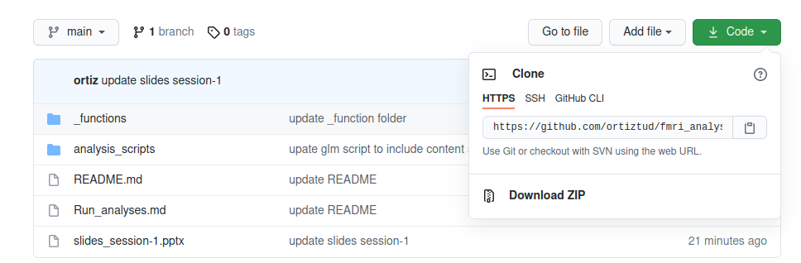
Know our repository
https://github.com/ortiztud/fmri_analysis_intro
Click on “Code” and then on “Download Zip” to download the content of the repository

Slide 7
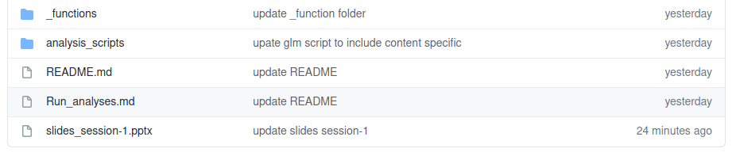
Know our repository
https://github.com/ortiztud/fmri_analysis_intro
The repository contains the slides of the sessions, exercises, functions and scripts that we will use during the course.

Slide 8
The Datasets
https://hessenbox-a10.rz.uni-frankfurt.de/getlink/fiQwmjTQaXvs2a7eHFexJS1J/
Content-specific Dataset
Process-specific Dataset
Spatial Datset

Slide 9
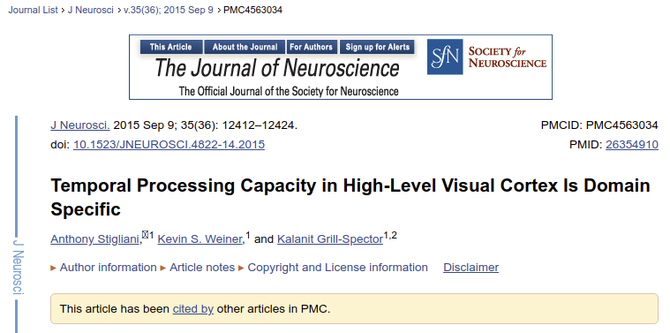
Content-specific Dataset
An example of how to investigate brain activity related to the processing of different domains (faces, places, body-parts)

Slide 10
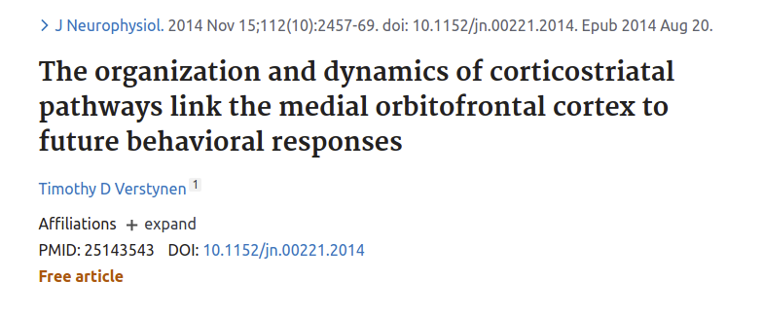
Process-specific Dataset
This dataset allows to look at brain activity during a Stroop task and identify brain regions underlying processing of congruent vs incongruent infomation

Slide 11

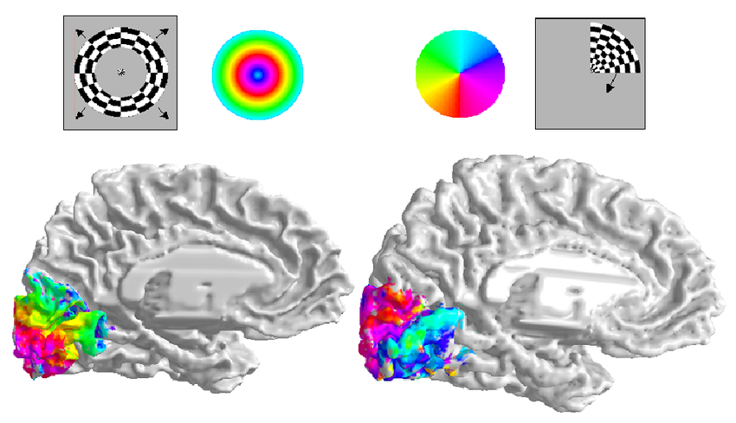
Spatial Dataset
Retinotopical dataset. High-resolution
(7T) brain data topographically distributed.

Slide 12
… any question?
ortiztudela@psych.uni-frankfurt.de
pupillo@psych.uni-frankfurt.de

