Slide 1


Introduction into fMRI analysis. PsyMsc4 (Goethe 2021):
Inference II.
Hands-on exercises.
Javier Ortiz-Tudela and Francesco Pupillo

Slide 2
Basics of MRI and preprocessing.
Hands-on exercises.
What will we do today?
Group-level analysis.

Slide 3
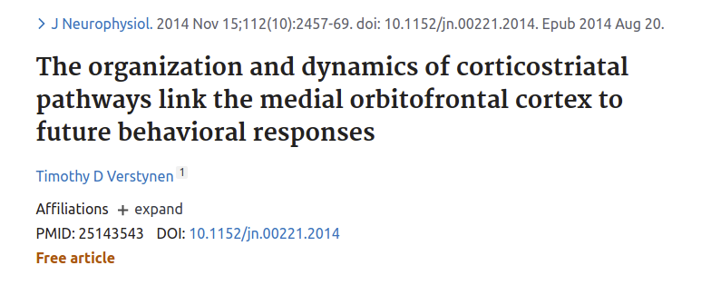
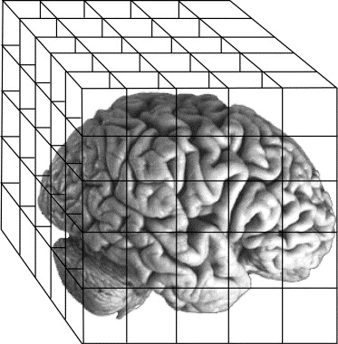
Recap of the exercises from last week
Congruent
Incongruent
Neutral
Beta maps
Contrast maps
(per participant)
(...)
(...)
Group

Slide 4
Group-level analysis
Same as in the previous session, we have already built SPM’s group level pipeline into a MATLAB function that we can call with a wrapper. Find a template wrapper at:
~/fmri_analysis_intro/analysis_scripts/session-univariate/univ_wrapper_template.m
And the contrast function is named:
univariate_03_group_level()
In MATLAB, type:
help function_name
to learn how to use them.

