Slide 1



Introduction into fMRI analysis. PsyMsc4 (Goethe 2021).
Javier Ortiz-Tudela and Francesco Pupillo

Slide 2
Who is this seminar for?

Slide 3
What is this seminar for?

Slide 4
How is this seminar structured?

Slide 5

Part I. Basics of MRI

Slide 6
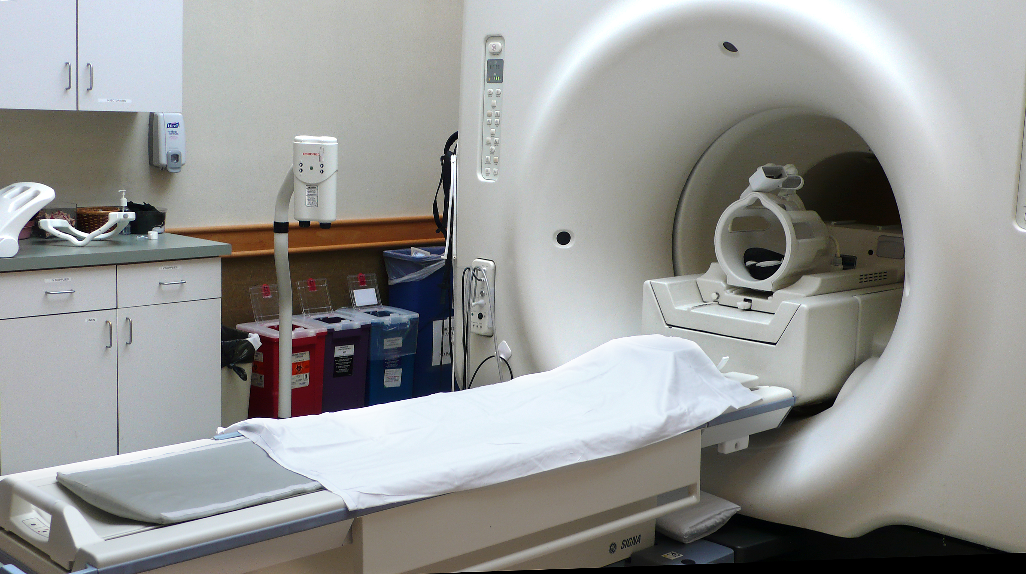
Here are the basics of MR imaging

Slide 7
Here are the basics of MR imaging
Scanner
Coil
Bed

Slide 8
Here are the basics of MR imaging
Scanner =
big magnet + radio frequency transmitter
Very big and very strong!
CAUTION!!
Very loud and annoying!
CAUTION!!

Slide 9
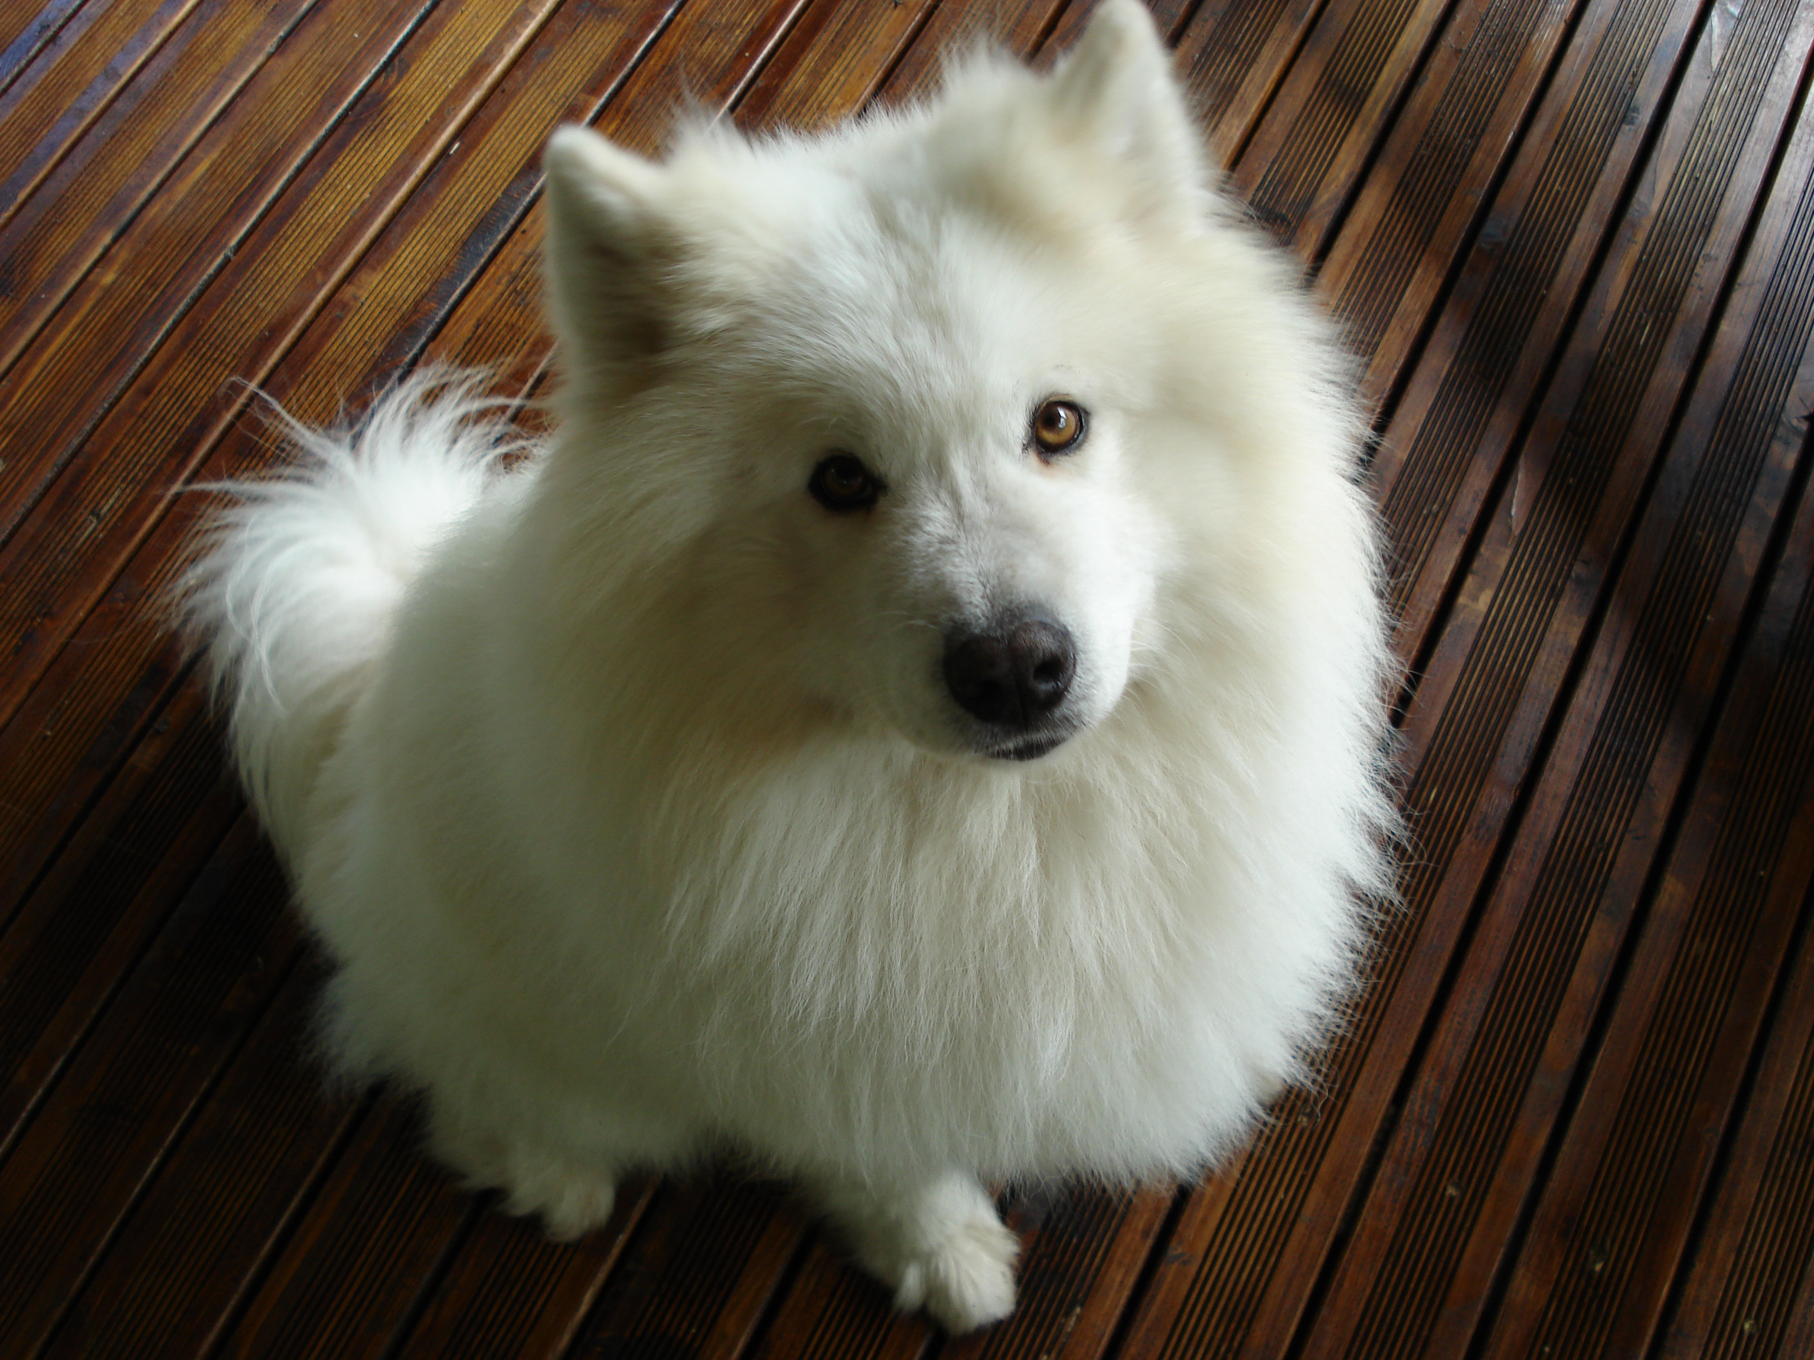
Here are the basics of MR imaging
Scanner =
big magnet + radio frequency transmitter
MAGNETIC FIELD
Hidrogen protons
When you put something inside a magnetic field, its H protons align (their spin) to the magnetic field.

Slide 10
Here are the basics of MR imaging
Scanner =
big magnet + radio frequency transmitter
MAGNETIC FIELD
Hidrogen protons
An RF pulse can tilt the orientation of the proton (‘s spin)

Slide 11
Here are the basics of MR imaging
Scanner =
big magnet + radio frequency transmitter
MAGNETIC FIELD
Coil =
RF receiver
Hidrogen protons
When the RF pulse stops, the proton goes back to normal emitting another RF signal.

Slide 12
Here are the basics of MR imaging
Scanner =
big magnet + radio frequency transmitter
MAGNETIC FIELD
Hidrogen protons
Different points in space have different relaxation times, and we can use those differences to reconstruct what is inside the scanner.

Slide 13

So… What are MR images?
If we zoom in, we can see that images are composed of pixels.

Slide 14
So… What are MR images?

Slide 15
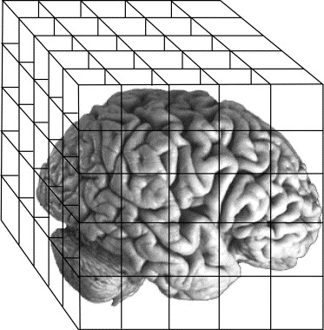
So… What are MR images?
When we have a 3D image, we talk about voxels.

Slide 16
So… What are MR images?
Voxel size determines our image resolution: smaller = better.
Resolution is (partly) dependent on the strength of the magnetic field.
Common resolutions for different strengths:
1.5 Tesla ~ 3x3x3
3 Tesla ~ 2x2x2
7 Tesla ~ 0.8x0.8x.0.8

Slide 17
Part II. Types of MR images

Slide 18
Types of MR images*
Anatomical images
Functional images
*For the purpose of this seminar only these two types will be covered since they are essential for standard fMRI analysis.

Slide 19
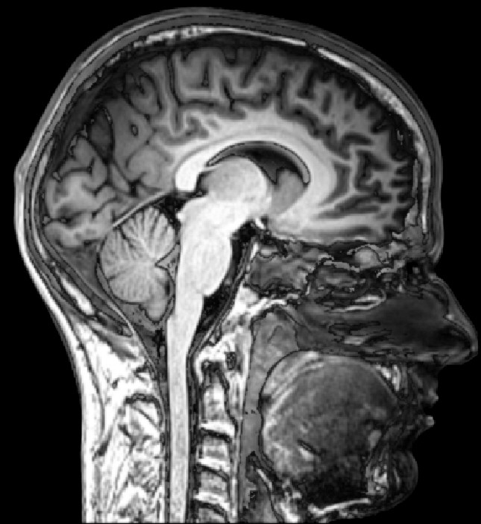
Types of MR images*
Anatomical images
(T1w)
Functional images
Aim:
Structure
Feats:
Good spatial resolution.
Task free.
Slow acquisition
(~5 min full brain)
Differences in signal strength caused by different tissue types.

Slide 20
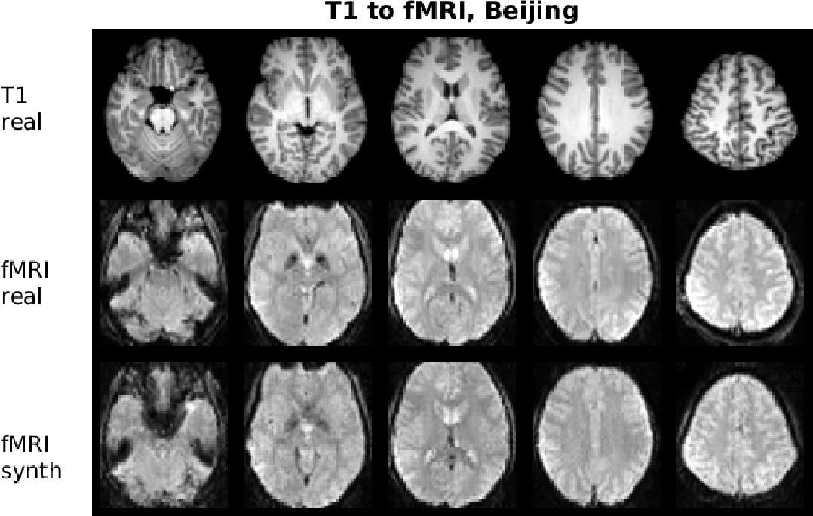
Types of MR images*
Functional images
T2*
Anatomical images
Aim:
Activity
Feats:
“Good” time resolution.
Measures blood flow.
Task sensitive.
Fast acquisition
(~2s full brain)
Differences in signal strength caused by distortions in the magnetic field.

Slide 21
Types of MR images*
Anatomical images
Functional images
How to distinguish them?
Inverse contrast!

Slide 22
Types of MR images*
Anatomical images
Functional images
How to distinguish them?
Inverse contrast!
T1w:
Grey matter – dark
White matter - bright
T2:
Grey matter – bright
White matter - dark

Slide 23
Types of MR images*
Anatomical images
Functional images
How to distinguish them?
Functional images have (usually) lower spatial resolution.
Gain in time resolution!
time

Slide 24
Types of MR images*
Anatomical images
Functional images
How to distinguish them?
TR = time to sample the entire field (to collect one brain volume).
time
TR
TR
TR
TR
TR
TR
TR
TR
TR
TR
TR
TR

Slide 25
Part II. Recap

Slide 26
Part III. Image preprocessing

Slide 27
Preprocessing.
Why?
MR images as a reconstruction problem > This process is never perfect.
Distortions in MR images can be grouped in two types: temporal and spatial.

Slide 28
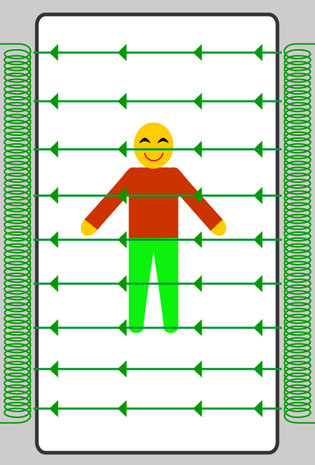
Preprocessing.
Why?
MR images as a reconstruction problem > This process is never perfect.
Distortions in MR images can be grouped in two types: temporal and spatial.
If collecting this entire volume takes 2s (TR=2s), it means that the top slice was acquired ~2 after the bottom one!
0s
Acquisition order
TRs

Slide 29
Preprocessing.
Why?
MR images as a reconstruction problem > This process is never perfect.
Distortions in MR images can be grouped in two types: temporal and spatial.
If collecting this entire volume takes 2s (TR=2s), it means that the bottom slice was acquired ~2 after the top one!
0s
Acquisition order
TRs
Time
0s
TRs

Slide 30
Preprocessing.
Why?
MR images as a reconstruction problem > This process is never perfect.
Distortions in MR images can be grouped in two types: temporal and spatial.
Slice time correction
0s
Acquisition order
TRs
Time
0s
TRs

