Slide 1

Introduction into fMRI analysis. PsyMsc4 (Goethe 2022).
Pipeline for Univariate analysis of fMRI.
Recap of the first four sessions
Javier Ortiz-Tudela and Francesco Pupillo

Slide 2
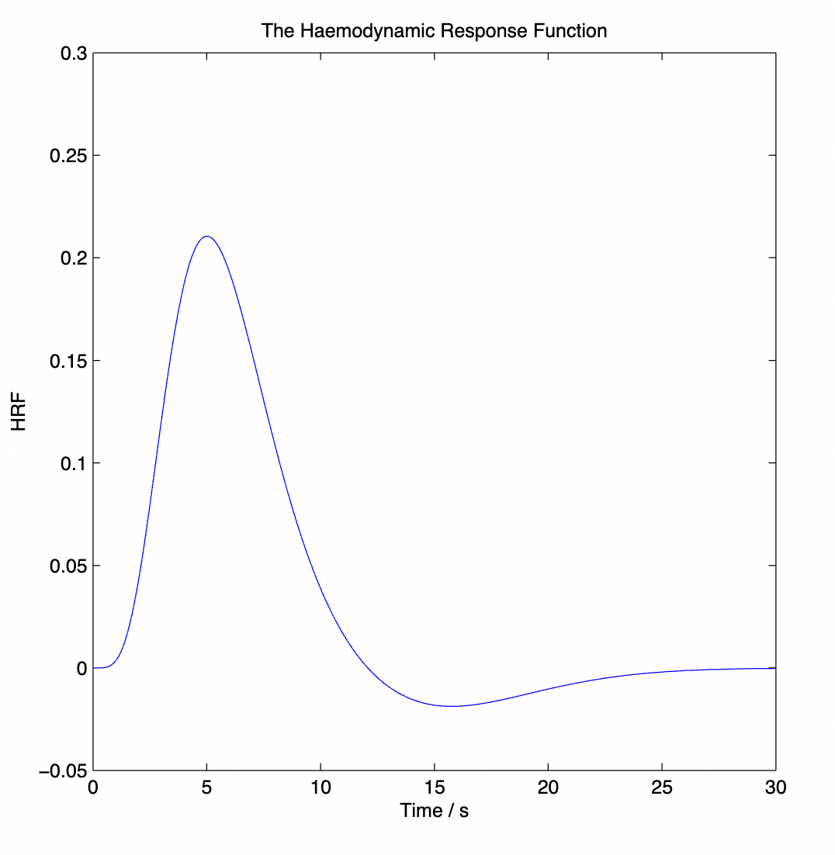
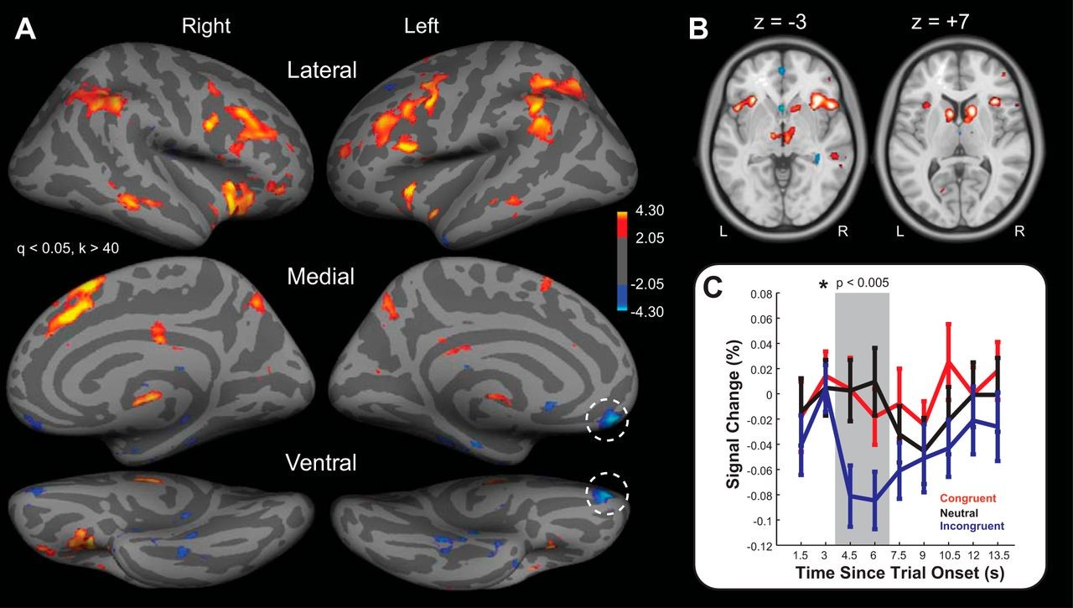
Pipeline for Univariate analysis of fMRI
From BOLD signal
To statistical map

Slide 3
Pipeline for Univariate analysis of fMRI
From BOLD signal
To statistical map
Turn BOLD signal into betas (GLM)

Slide 4
Pipeline for Univariate analysis of fMRI
From BOLD signal
To statistical map
Turn BOLD signal into betas (GLM)
Compute contrasts of interest (per participant)

Slide 5
Pipeline for Univariate analysis of fMRI
From BOLD signal
To statistical map
Turn BOLD signal into betas (GLM)
Compute contrasts of interest (per participant)
Run group level analysis

Slide 6
Pipeline for Univariate analysis of fMRI
From BOLD signal
To statistical map
Turn BOLD signal into betas (GLM)
Compute contrasts of interest (per participant)
Run group level analysis
What do I need?
- Timing of events
(e.g., sub-001_task-stroop_events.mat)
- Confounds regressors
(e.g., sub-*_desc-confounds_SPM.txt)
What do I get?
- Beta maps
(e.g., betas/beta_0001.nii)
- Design parameters file
(e.g., betas/SPM.mat)

Slide 7
Pipeline for Univariate analysis of fMRI
From BOLD signal
To statistical map
Turn BOLD signal into betas (GLM)
Compute contrasts of interest (per participant)
Run group level analysis
What do I need?
- Timing of events
(e.g., sub-001_task-stroop_events.mat)
- Confounds regressors
(e.g., sub-*_desc-confounds_SPM.txt)
What do I get?
- Beta maps
(e.g., betas/beta_0001.nii)
- Design parameters file
(e.g., betas/SPM.mat)
What do I need?
- Beta maps
(e.g., betas/beta_0001.nii)
- Design parameters file
(SPM.mat)
What do I get?
- Contrast maps
(e.g., betas/con_0001.nii)
- T maps
(e.g., betas/spmT_0001.nii)

Slide 8
Pipeline for Univariate analysis of fMRI
From BOLD signal
To statistical map
Turn BOLD signal into betas (GLM)
Compute contrasts of interest (per participant)
Run group level analysis
What do I need?
- Timing of events
(e.g., sub-001_task-stroop_events.mat)
- Confounds regressors
(e.g., sub-*_desc-confounds_SPM.txt)
What do I get?
- Beta maps
(e.g., betas/beta_0001.nii)
- Design parameters file
(e.g., betas/SPM.mat)
What do I need?
- Beta maps
(e.g., betas/beta_0001.nii)
- Design parameters file
(SPM.mat)
What do I get?
- Contrast maps
(e.g., betas/con_0001.nii)
- T maps
(e.g., betas/spmT_0001.nii)
What do I need?
- Contrast maps
(e.g., betas/con_0001.nii)
- Design parameters file
(SPM.mat)
What do I get?
- Contrast maps
(e.g., ouputs/group_level/inc-con/ con_0001.nii)
- T maps
(e.g., ouputs/group_level/inc-con/spmT_0001.nii)
- Design parameters file (group level)
(e.g., ouputs/group_level/inc-con//SPM.mat)

Slide 9
Pipeline for Univariate analysis of fMRI
From BOLD signal
To statistical map
Where does the BOLD signal come from?
What types of MR images can be acquired?
How to threshold a statistical map?
How to interpret it?

