Slide 1


Introduction into fMRI analysis. PsyMsc4 (Goethe 2022):
Inference.
Hands-on exercises.
Javier Ortiz-Tudela and Francesco Pupillo

Slide 2
Basics of MRI and preprocessing.
Hands-on exercises.
What will we do today?
Contrasts.

Slide 3
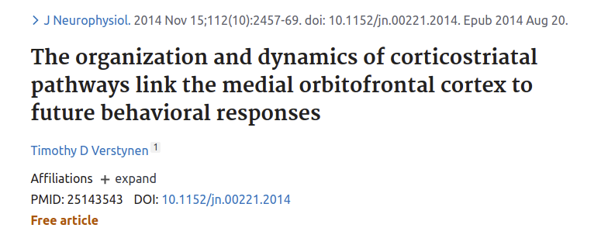
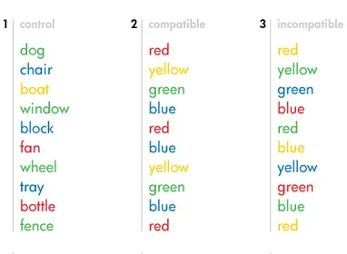
Recap of the exercises from last week
Process-specific dataset:
This dataset contains brain activity during a Stroop task.
Neutral
Congruent
Incongruent
Figure from: https://www.simplypsychology.org/

Slide 4
Recap of the exercises from last week
Neutral
Congruent
Incongruent
What have you already done?
- Extracted onset times from a BIDS structured dataset and convert them into .mat files for SPM.
- Extracted confounds information from fMRIPrep’s outputs and convert them in .txt files for SPM.
- Run GLM to compute full brain beta estimates.
Figure from: https://www.simplypsychology.org/

Slide 5
Recap of the exercises from last week
Neutral
Congruent
Incongruent
Potential problems you might have run into:
- Did you have some corrupted / missing data files? - > How did you solve this? What can cause missing data?
- Did some of the functions crash when looking for certain files? - > How did you solve this?
- Was the GLM computation aborted due to some file missing (i.e., tpl-MNI152NLin2009cAsym_label-GM_bin.nii)? - > How did you solve this? Do you know what this file is?
Figure from: https://www.simplypsychology.org/

Slide 6
Recap of the exercises from last week
Neutral
Congruent
Incongruent
Decision that you had to make:
- Did you exclude some participants from your analysis? - > Which criteria did you chose?
- Did you include all the functional runs in your analysis? - > If not, why?
- How many nuissance regressors did you include in your model? - > Did the number of beta maps match what you expected?
Figure from: https://www.simplypsychology.org/

Slide 7
Recap of the exercises from last week
Neutral
Congruent
Incongruent
Questions / Problems?
Figure from: https://www.simplypsychology.org/

Slide 8
Contrast analysis
Up until now we have run the basic steps of most task-fMRI analysis (i.e., obtaining beta estimates).
fMRI analysis are very rarely run on raw activity signals and voxel-wise beta estimates are generally preferred as a finer measure of task-related brain activity.
Once we have obtained beta estimates, we need to decide which kind of analysis we want to carry out.
Neutral
Congruent
Incongruent
Figure from: https://www.simplypsychology.org/

Slide 9
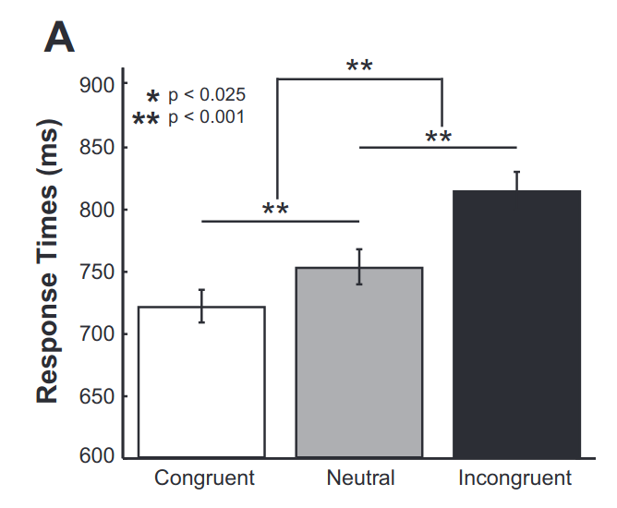
Contrast analysis
This dataset contains brain data from participants performing a Stroop task.
Task:
“Name the color of the ink”.
Stimuli:
Visually presented words with the same font type and size but different colors. Some of the words refer colors.
Results:
Neutral
Congruent
Incongruent
In this case we will run a mass-univariate contrast analysis (suited for overall differences between experimental conditions).

Slide 10
Contrast analysis
QUESTION:
Which questions would it be possible with this dataset?
This dataset contains brain data from participants performing a Stroop task.
Task:
“Name the color of the ink”.
Stimuli:
Visually presented words with the same font type and size but different colors. Some of the words refer colors.
Results:
Neutral
Congruent
Incongruent
In this case we will run a mass-univariate contrast analysis (suited for overall differences between experimental conditions).

Slide 11
Contrast analysis
Here are a few examples:
- Can we find brain regions that are more active for congruent than neutral trials?
- Can we find brain regions that are less active for congruent and neutral than incongruent trials?
QUESTION:
Which questions would it be possible to answer with this dataset?
Task:
“Name the color of the ink”.

Slide 12
Contrast analysis
Here are a few examples:
- Can we find brain regions that are more active for congruent than neutral trials?
- Can we find brain regions that are less active for congruent and neutral than incongruent trials?
We always need a set of conditions and a direction.
We will specify these with contrast vectors.
QUESTION:
Which questions would it be possible to answer with this dataset?
Task:
“Name the color of the ink”.

Slide 13
Contrast analysis
Here are a few examples:
- Can we find brain regions that are less active for incongruent than neutral trials?
- Can we find brain regions that are less active for congruent and neutral than incongruent trials?
We always need a set of conditions and a direction.
We will specify these with contrast vectors.
QUESTION:
Which questions would it be possible to answer with this dataset?
Task:
“Name the color of the ink”.
Congruent | Incongruent | Neutral
0 | -1 | 1
-1 | 2 | -1

Slide 14
Contrast analysis
Same as in the previous session, we have already built SPM’s contrast pipeline into a MATLAB function that we can call with a wrapper. Find a template wrapper at:
~/fmri_analysis_intro/analysis_scripts/session-univariate/univ_wrapper_template.m
And the contrast function is named:
univariate_02_contrast()
In MATLAB, type:
help function_name
to learn how to use them.

