Slide 1



Introduction on
Machine learning classifiers
Javier Ortiz-Tudela and Francesco Pupillo
<number>
Notes:
Size 40 header; size 20 body
<number>

Slide 2
Introduction. .
Glosary:
Classification: Predict the type (i.e., class) of pattern that underlies a given dataset.
Decoding: From a given (brain) signal, figure out what caused the signal.
MVPA (multivoxel/multivariate pattern analysis): Collection of analyses that use several sources of variance in the data to study it.
Class: Each “pattern” that we want find (we need at least two).
Observations: Each one of the items inside a class that we will use in our analysis.
Features: Each element inside an observation.
<number>
Notes:
Size 40 header; size 20 body
<number>

Slide 3
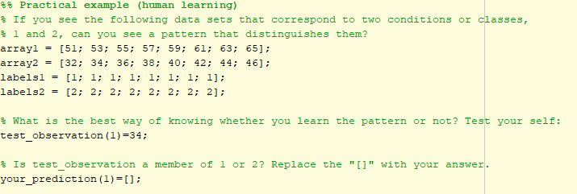
Introduction._____________________________________________
<number>
Notes:
Size 40 header; size 20 body
<number>

Slide 4
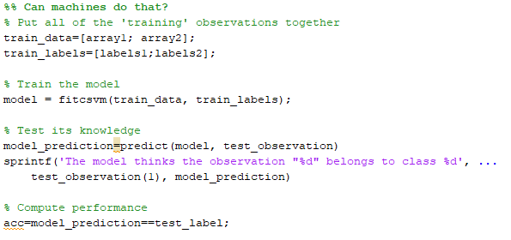
Introduction. .
<number>
Notes:
Size 40 header; size 20 body
<number>

Slide 5
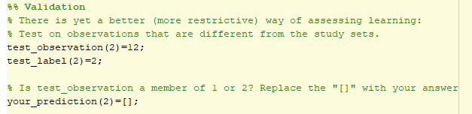
Introduction. Validation on independent dataset .
<number>
Notes:
Size 40 header; size 20 body
<number>

Slide 6
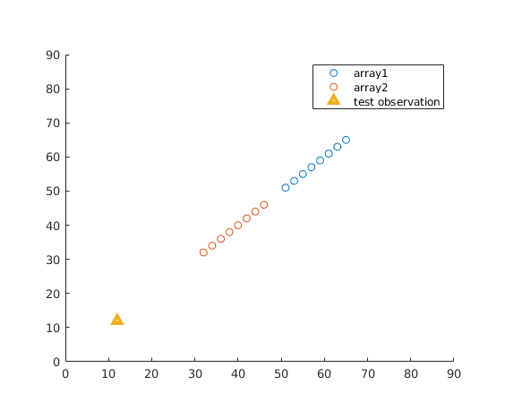
Introduction. Validation on independent dataset .
Decision boundary
<number>
Notes:
Size 40 header; size 20 body
<number>

Slide 7
Introduction. Validation on independent dataset .
Decision boundary
Why is independent validation necessary?
Shows generalizability
Avoids overfitting
<number>
Notes:
Size 40 header; size 20 body
<number>

Slide 8
Introduction. Validation on independent dataset .
What can we do when we have limited data? Cross-validation.
Different cross-validation schemes allow for different (levels of) control or put more or less weight on the number of observations. Most common approaches:
Even/Odd observations (2 folds).
Leave one (observation/chunk) out.
<number>
Notes:
Size 40 header; size 20 body
<number>

Slide 9
Introduction. Validation: Leave one (chunk) out .
Original data set
First fold
Second fold
Third fold
Fourth fold
1
1
Train
Test
Train
Test
Train
Test
Train
Test
2
2
1
1
1
1
1
2
1
2
1
2
1
1
2
1
2
1
1
2
2
2
2
2
2
1
2
1
2
1
2
2
1
2
1
2
2
1
2
2
1
1
2
2
2
2
2
2
1
1
2
2
1
1
1
1
1
1
2
2
2
2
2
1
1
1
2
1
1
1
1
1
1
2
2
2
1
2
Each observation has been validated on an independent dataset
Bonus task: Try to set up a leave-one-out cross-validation scheme in the tutorial script.
<number>
Notes:
Size 40 header; size 20 body
<number>

Slide 10
Introduction. .
Time for a break.
Questions?
<number>
Notes:
Size 40 header; size 20 body
<number>

Slide 11
Second part: .
Classification in fMRI.
Questions from previous section?
<number>
Notes:
Size 40 header; size 20 body
<number>

Slide 12
Second part: .
Classification in fMRI.
What can we use classification for? Just a few examples
Fine grained localization: where in the brain it is possible to distinguish between class A and class B? (e.g., stimulus categories? Stimulus identity?).
Representational content: what type of information is represented? (e.g., low level features vs. Categorical information? Detailed vs. Coarse representations?
Temporal dynamics: From and until when is a given type of information available? (note: BOLD signal might not be the best measure for small time scales).
<number>
Notes:
Size 40 header; size 20 body
<number>

Slide 13
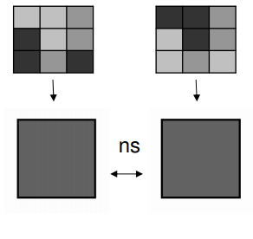
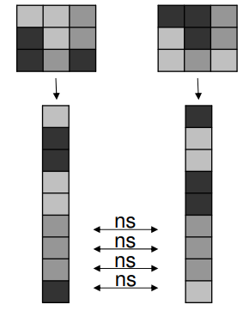
Classification in fMRI. Why? .
Univariate:
Multivariate:
<number>
Notes:
Size 40 header; size 20 body
<number>

Slide 14
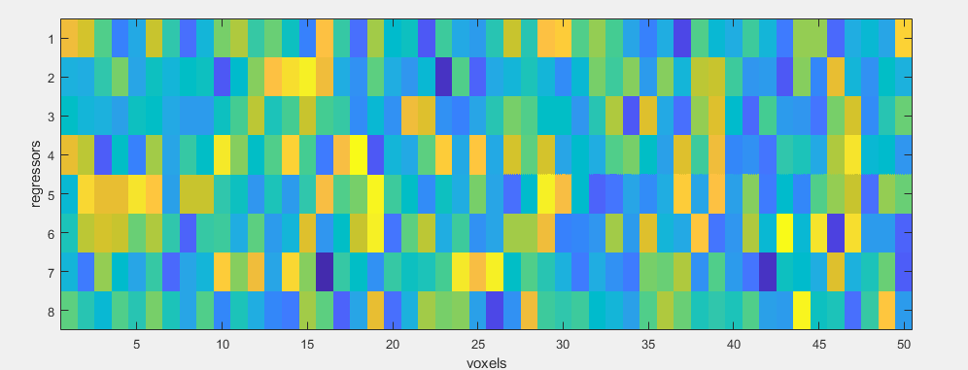
Classification in fMRI? .
Class: Each “pattern” that we want find (we need at least two). In cognitive neuroscience classes are usually cognitive states (e.g., memory traces, task sets, representations).
Observations: Each one of the items inside a class that we will use in our analysis. Beta values (regressors in our GLM) of each condition.
Features: Each element inside an observation. Individual voxels (either in our ROI or in the entire brain).
8 observations x 50 features
8 observations x
1 feature
1
1
2
2
1
2
2
1
<number>
Notes:
Size 40 header; size 20 body
<number>

Slide 15
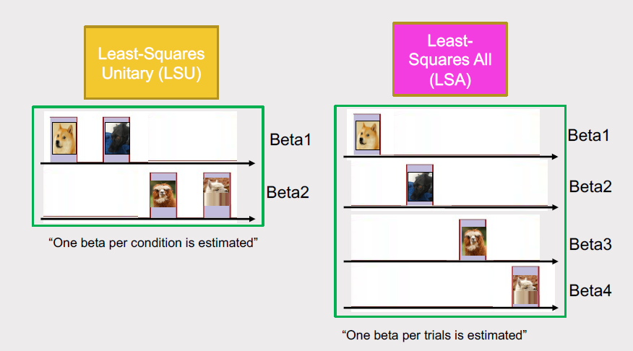
Classification in fMRI? .
8 observations x 50 features
8 observations x
1 feature
1
1
2
2
1
2
2
1
Engineers be like:
“The number of observations must be bigger than the number of features”
<number>
Notes:
Size 40 header; size 20 body
<number>

Slide 16
GLM estimation. A very quick recap.
Single-trial estimates (with appropriate methods) render better performance for multivariate analysis than condition-level estimates.
Mumford, et al. (2012). Neuroimage; Turner, et al. (2012). NeuroImage;
Arco et al., (2018), JoNM
<number>
Notes:
Size 40 header; size 20 body
<number>

Slide 17
Simulated experiment.
Participants are exposed to circles and triangles in two different colors. They need to indicate the color of the shape by pressing one of two buttons.
Shapes are shown sequentially for 2 seconds and there’s a variable interval between shapes that ranges between 3s-15s.
Notes:
Size 40 header; size 20 body
<number>

Slide 18
Notes:
Size 40 header; size 20 body
<number>

Slide 19
Back to classification. .
Once we have our beta values. What do we do with them?
First decision: what do I want to classify?
Depending on the classes you select (i.e., the question that you ask the classifier), you can get different types of information.
Red vs. green?
or
Circles vs. triangles?
100%
?%
<number>
Notes:
Size 40 header; size 20 body
<number>

Slide 20
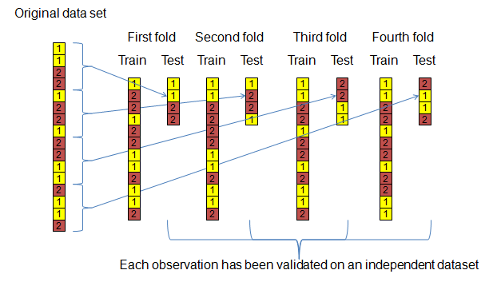
Back to classification. .
Once we have our beta values. What do we do with them?
Second decision: how will I validate my classifier?
The validation method can also add information (on top of controlling for biases; e.g., cross classification). In fMRI the standard method is leave-one-run-out: one scanning run is held for testing and training is performed with the remaining ones.
Run 1
Run 2
Run 3
Run 4
<number>
Notes:
Size 40 header; size 20 body
<number>

Slide 21
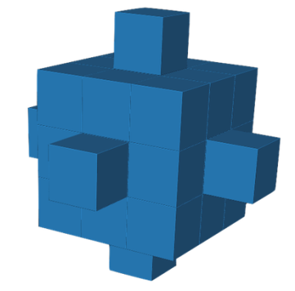
Back to classification. .
Once we have our beta values. What do we do with them?
Third decision: which voxels will I use (i.e., feature selection)? Two main approaches to consider:
Region of interest (ROI): Only voxels within a given ROI are used in the analysis. ROIs can be defined either anatomically (e.g., right TPJ, left CA1) or functionally (e.g., only voxels that response more to faces than to houses). Functional localizers can be set up as an independent task (e.g., FFA localizer, retinotopy).
Searchlight: a small cluster of voxels is selected for classification; the classification accuracy of that cluster is assigned to the central voxel in the cluster; then, an adjacent cluster is selected and the process is repeated until the entire brain (or ROI) is covered.
<number>
Notes:
Size 40 header; size 20 body
<number>

Slide 22
Back to classification. Freely available toolboxes .
Fourth decision: how do I want to do it?
CoSMoMVPA. Oosterhof, Connolly, & Haxby, (2016). Frontiers in neuroinformatics. Multimodal environment. Works with matrices of data; requires the user to arrange datsets.
Matlab-based.
The Decoding Toolbox (TDT). Hebart, Görgen, & Haynes. (2015). Frontiers in neuroinformatics.
SPM-based. Works with beta maps (.nii) and SPM.mat from SPM; minimal user intervention for standard analysis.
Matlab-based.
PyMVPA. Hanke, Halchenko, Sederberg, Hanson, Haxby, & Pollmann, (2009). Neuroinformatics.
Python-based.
<number>
Notes:
Size 40 header; size 20 body
<number>

Slide 23
.
Quick practical exercise.
<number>
Notes:
Size 40 header; size 20 body
<number>

Slide 24
Representational Similarity Analysis (RSA; Kriegeskorte, Mur and Bandettini, 2008)
.
Using similarity between activity patterns to infer representational structure.
Condition 1
Condition 2
Condition 3
Condition 1
More similar
Less similar
<number>
Notes:
Size 40 header; size 20 body
<number>

Slide 25
Representational Similarity Analysis (RSA)
.
Using similarity between activity patterns to infer representational structure.
Condition 1
Condition 2
Condition 3
Condition 1
More similar
Less similar
During condition 1 y 2, our ROI is representing the same thing; during condition 3 is representing something else.
<number>
Notes:
Size 40 header; size 20 body
<number>

Slide 26
Representational Similarity Analysis (RSA)
.
Glossary of RSA jargon:
- Similarity = correlation / degree of overlap in activity patterns of a given brain region.
- Dissimilarity (a.k.a., representational distance): Degree of non-overlap in activity patterns of a given brain region. Quite often is 1 – correlation.
- RDM: Representational Dissimilarity Matrix. Pair-wise matrix of dis(similarity) values.
Condition 1
Condition 2
Condition 3
Condition 1
More similar
Less similar
<number>
Notes:
Size 40 header; size 20 body
<number>

Slide 27
.
Quick practical exercise.
<number>
Notes:
Size 40 header; size 20 body
<number>

