Slide 1

Introduction into fMRI analysis. PsyMsc4 (Goethe 2022).
Session 1.
Multivariate analysis.
Javier Ortiz-Tudela and Francesco Pupillo

Slide 2
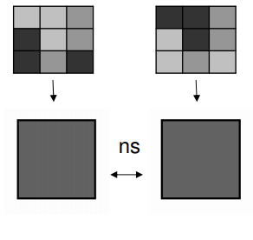
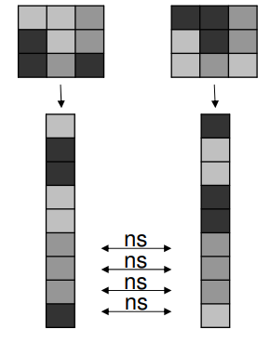
Multivariate in fMRI. Why?
Univariate:
Multivariate:
2
Notes:
Size 40 header; size 20 body
2

Slide 3
Multivariate in fMRI. What for?
Fine grained localization: where in the brain is it possible to distinguish between class A and class B? (e.g., stimulus categories? stimulus identity?).
Representational content: what type of information is represented? (e.g., low level features vs. categorical information? detailed vs. coarse representations?
Temporal dynamics: From and until when is a given type of information available? (note: BOLD signal might not be the best measure for small time scales).
3
Notes:
Size 40 header; size 20 body
3

Slide 4
Multivariate in fMRI. Two umbrella approaches.
Classification.
Representational Similarity Analysis.
4
Notes:
Size 40 header; size 20 body
4

Slide 5
Classification in fMRI. Key concepts (jargon).
Classifying: Predict the type (i.e., class) of pattern that underlies a given dataset.
Decoding: From a given (brain) signal, figure out what caused the signal.
MVPA (multivoxel/multivariate pattern analysis): Collection of analyses that use several sources of variance in the data to study it.
Class: Each “pattern” that we want find (we need at least two).
Observations: Each one of the items inside a class that we will use in our analysis.
Features: Each element inside an observation.
5
Notes:
Size 40 header; size 20 body
5

Slide 6
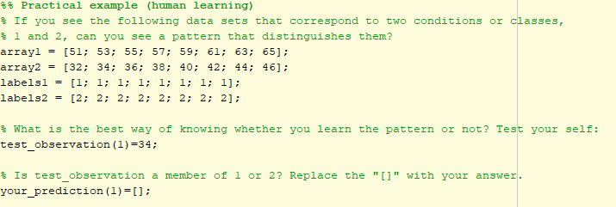
Introduction to machine learning classifiers.
6
Notes:
Size 40 header; size 20 body
6

Slide 7
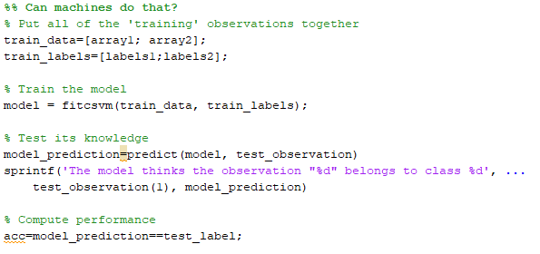
Introduction to machine learning classifiers.
It very likely that the classifier agrees with your prediction. Do you know which pattern has it learned?
7
Notes:
Size 40 header; size 20 body
7

Slide 8
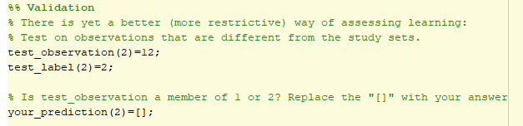
Introduction to machine learning classifiers.
Validation is the process of using fine-tuned tests to discover the pattern that the algorithm has learned.
Let’s do an exercise on independent validation.
8
Notes:
Size 40 header; size 20 body
8

Slide 9
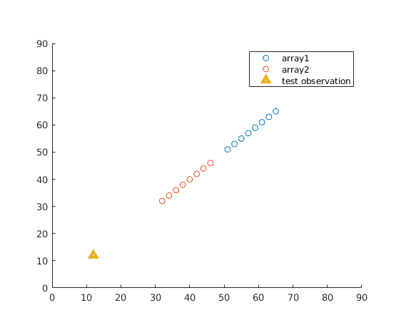
Introduction to machine learning classifiers.
Decision boundary
9
Notes:
Size 40 header; size 20 body
9

Slide 10
Introduction to machine learning classifiers.
Decision boundary
Why is independent validation necessary?
Shows generalizability (avoids overfittings)
Avoids overfitting
10
Notes:
Size 40 header; size 20 body
10

Slide 11
Introduction to machine learning classifiers.
Decision boundary
Problems:
We need to collect more data to have independent observations?
The information on the testing data is not used to learn.
11
Notes:
Size 40 header; size 20 body
11

Slide 12
Introduction. Validation on independent dataset .
What can we do when we have limited data? Cross-validation.
Different cross-validation schemes allow for different (levels of) control or put more or less weight on the number of observations. Most common approaches:
Even/Odd observations (2 folds).
Leave one (observation/chunk) out.
Let’s do a practical exercise on even/odd cross-validation.
12
Notes:
Size 40 header; size 20 body
12

Slide 13
Introduction. Validation: Leave one (chunk) out .
Original data set
1
1
Train
Test
2
2
1
1
1
2
1
2
2
2
2
1
2
1
2
2
2
2
1
1
1
1
2
2
1
1
1
1
2
2
13
Notes:
Size 40 header; size 20 body
13

Slide 14
Introduction. Validation: Leave one (chunk) out .
Original data set
First fold
Second fold
1
1
Train
Test
Train
Test
2
2
1
1
1
1
1
2
1
1
2
2
2
2
2
2
2
1
2
2
1
1
2
2
2
2
2
2
1
1
1
1
1
1
2
2
2
1
1
1
1
1
1
2
2
2
Notes:
Size 40 header; size 20 body
14

Slide 15
Introduction. Validation: Leave one (chunk) out .
Original data set
First fold
Second fold
Third fold
Fourth fold
1
1
Train
Test
Train
Test
Train
Test
Train
Test
2
2
1
1
1
1
1
2
1
2
1
2
1
1
2
1
2
1
1
2
2
2
2
2
2
1
2
1
2
1
2
2
1
2
1
2
2
1
2
2
1
1
2
2
2
2
2
2
1
1
2
2
1
1
1
1
1
1
2
2
2
2
2
1
1
1
2
1
1
1
1
1
1
2
2
2
1
2
Each observation has been validated on an independent dataset
Bonus task: Try to set up a leave-one-out cross-validation scheme in the tutorial script.
15
Notes:
Size 40 header; size 20 body
15

Slide 16
Time for a break.
Questions?
16
Notes:
Size 40 header; size 20 body
16

Slide 17
Second part:
Classification in fMRI.
17
Notes:
Size 40 header; size 20 body
17

Slide 18
Classification in fMRI. Refining the jargon
Class: Each “pattern” that we want find (we need at least two). In cognitive neuroscience classes are usually cognitive states (e.g., memory traces, task sets, representations).
Observations: Each one of the items inside a class that we will use in our analysis. Beta values (regressors in our GLM) of each condition.
Features: Each element inside an observation. Individual voxels (either in our ROI or in the entire brain).
8 observations x
1 feature
1
1
2
2
1
2
2
1
18
Notes:
Size 40 header; size 20 body
18

Slide 19
Classification in fMRI. Refining the jargon
Class: Each “pattern” that we want find (we need at least two). In cognitive neuroscience classes are usually cognitive states (e.g., memory traces, task sets, representations).
Observations: Each one of the items inside a class that we will use in our analysis. Beta values (regressors in our GLM) of each condition.
Features: Each element inside an observation. Individual voxels (either in our ROI or in the entire brain).
8 observations x
2 feature
1
1
2
1
2
2
2
1.5
2
1.5
2
1
1
2
2
1.5
2
2
1.5
1
1
1
19
Notes:
Size 40 header; size 20 body
19

Slide 20
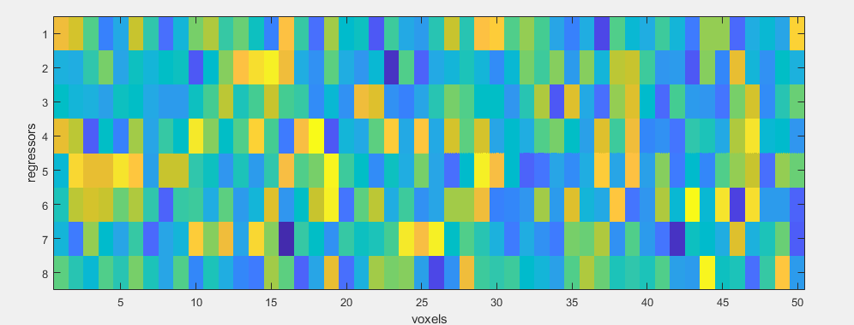
Classification in fMRI. Refining the jargon
Class: Each “pattern” that we want find (we need at least two). In cognitive neuroscience classes are usually cognitive states (e.g., memory traces, task sets, representations).
Observations: Each one of the items inside a class that we will use in our analysis. Beta values (regressors in our GLM) of each condition.
Features: Each element inside an observation. Individual voxels (either in our ROI or in the entire brain).
8 observations x 50 features
8 observations x
1 feature
1
1
2
2
1
2
2
1
20
Notes:
Size 40 header; size 20 body
20

Slide 21
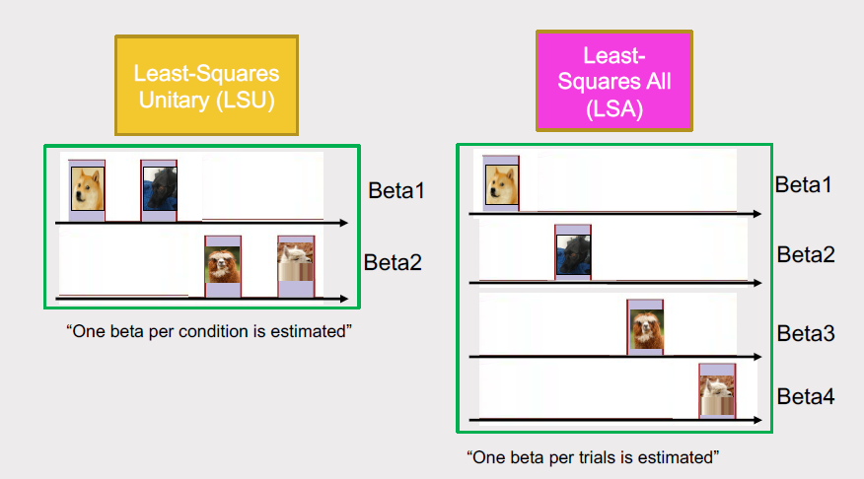
Classification in fMRI.
8 observations x 50 features
Rule of thumb:
“The number of observations must be bigger than the number of features”
Single-trial estimates (with appropriate methods) render better performance for multivariate analysis than condition-level estimates.
Mumford, et al. (2012). Neuroimage; Turner, et al. (2012). NeuroImage
21
Notes:
Size 40 header; size 20 body
21

Slide 22
Classification in fMRI. Hands-on.
Simulated experiment.
Participants are exposed to circles and triangles in two different colors. They need to indicate the color of the shape by pressing one of two buttons.
Shapes are shown sequentially for 2 seconds and there’s a variable interval between shapes that ranges between 3s-15s.
Notes:
Size 40 header; size 20 body
22

Slide 23
Classification in fMRI. Hands-on.
Simulated experiment.
Participants are exposed to circles and triangles in two different colors. They need to indicate the color of the shape by pressing one of two buttons.
Shapes are shown sequentially for 2 seconds and there’s a variable interval between shapes that ranges between 3s-15s.
We have already estimated one beta per trial for a total of 16 trials on a full brain LSA GLM.
Notes:
Size 40 header; size 20 body
23

Slide 24
Classification in fMRI. Hands-on.
Once we have our beta values. What do we do with them?
First decision: what do I want to classify?
Depending on the classes you select (i.e., the question that you ask the classifier), you can get different types of information.
Notes:
Size 40 header; size 20 body
24

Slide 25
Classification in fMRI. Hands-on.
Once we have our beta values. What do we do with them?
First decision: what do I want to classify?
Depending on the classes you select (i.e., the question that you ask the classifier), you can get different types of information.
Red vs. green?
25
Notes:
Size 40 header; size 20 body
25

Slide 26
Classification in fMRI. Hands-on.
Once we have our beta values. What do we do with them?
First decision: what do I want to classify?
Depending on the classes you select (i.e., the question that you ask the classifier), you can get different types of information.
Red vs. green?
100%
26
Notes:
Size 40 header; size 20 body
26

Slide 27
Classification in fMRI. Hands-on.
Once we have our beta values. What do we do with them?
First decision: what do I want to classify?
Depending on the classes you select (i.e., the question that you ask the classifier), you can get different types of information.
Red vs. green?
or
Circles vs. triangles?
100%
?%
27
Notes:
Size 40 header; size 20 body
27

Slide 28
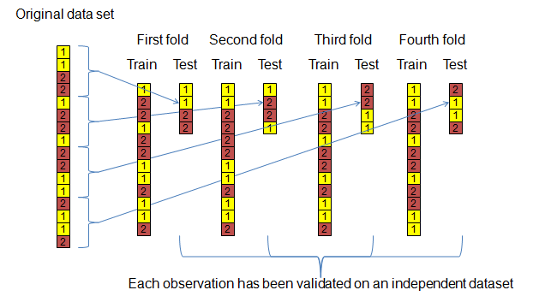
Classification in fMRI. Hands-on.
Second decision: how will I validate my classifier?
The validation method can also add information (on top of controlling for biases; e.g., cross classification). In fMRI the standard method is leave-one-run-out: one scanning run is held for testing and training is performed with the remaining ones.
Run 1
Run 2
Run 3
Run 4
28
Notes:
Size 40 header; size 20 body
28

Slide 29
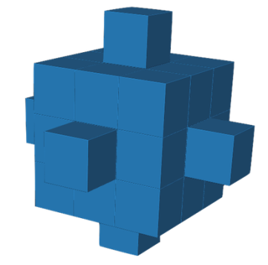
Classification in fMRI. Hands-on.
Third decision: which voxels will I use (i.e., feature selection)? Two main approaches to consider:
Region of interest (ROI): Only voxels within a given ROI are used in the analysis. ROIs can be defined either anatomically (e.g., right TPJ, left CA1) or functionally (e.g., only voxels that response more to faces than to houses). Functional localizers can be set up as an independent task (e.g., FFA localizer, retinotopy).
Searchlight: a small cluster of voxels is selected for classification; the classification accuracy of that cluster is assigned to the central voxel in the cluster; then, an adjacent cluster is selected, and the process is repeated until the entire brain (or ROI) is covered.
29
Notes:
Size 40 header; size 20 body
29

Slide 30
Classification in fMRI. Hands-on.
Fourth decision: how do I want to do it?
CoSMoMVPA. Oosterhof, Connolly, & Haxby, (2016). Frontiers in neuroinformatics. Multimodal environment. Works with matrices of data; requires the user to arrange datsets.
Matlab-based.
The Decoding Toolbox (TDT). Hebart, Görgen, & Haynes. (2015). Frontiers in neuroinformatics.
SPM-based. Works with beta maps (.nii) and SPM.mat from SPM; minimal user intervention for standard analysis.
Matlab-based.
PyMVPA. Hanke, Halchenko, Sederberg, Hanson, Haxby, & Pollmann, (2009). Neuroinformatics.
Python-based.
30
Notes:
Size 40 header; size 20 body
30

Slide 31
Classification in fMRI. Hands-on.
Practical exercise part 2.
Go into breakout rooms and follow the .mlx script. Discuss with your colleagues and try to understand every step.
31
Notes:
Size 40 header; size 20 body
31

Slide 32

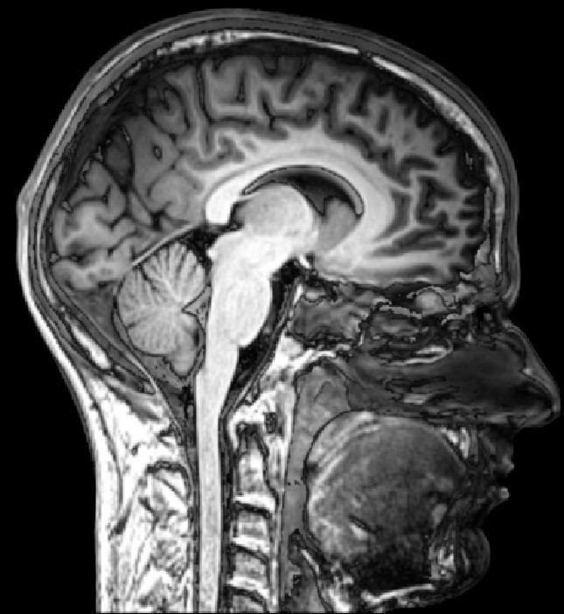
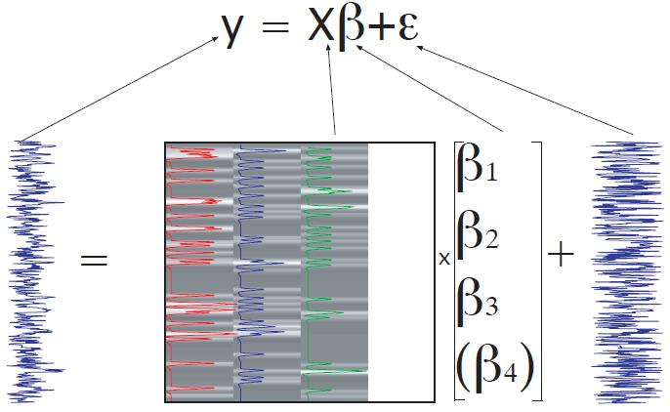
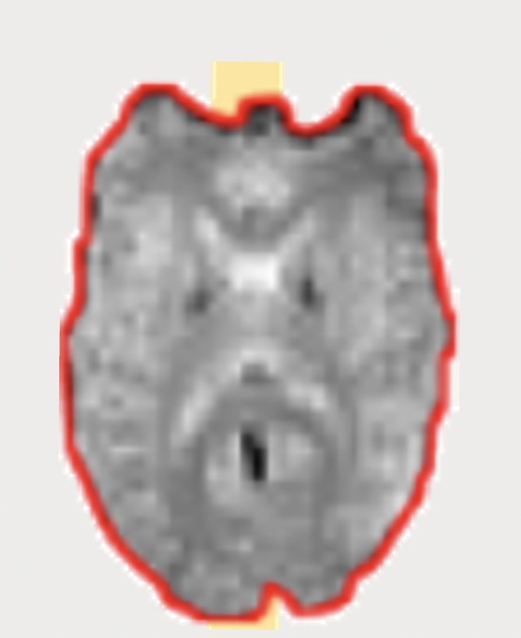
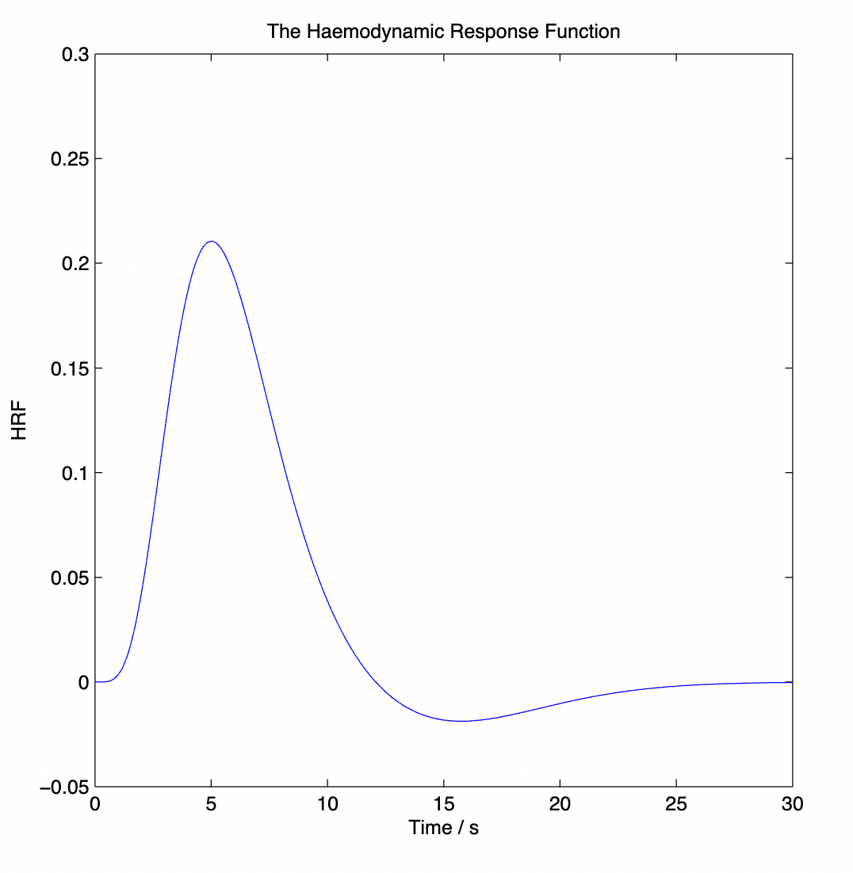
Introduction into fMRI analysis. PsyMsc4 (Goethe 2022).
Magnetic properties of tissue
Anatomical images
Functional images
Preprocessing
GLM
Beta maps
Univariate
Multivariate
Contrasts
Classification
RSA
Group level
Activation maps
Classification accuracy
Similarity measures
32
Notes:
Size 40 header; size 20 body
32

Slide 33
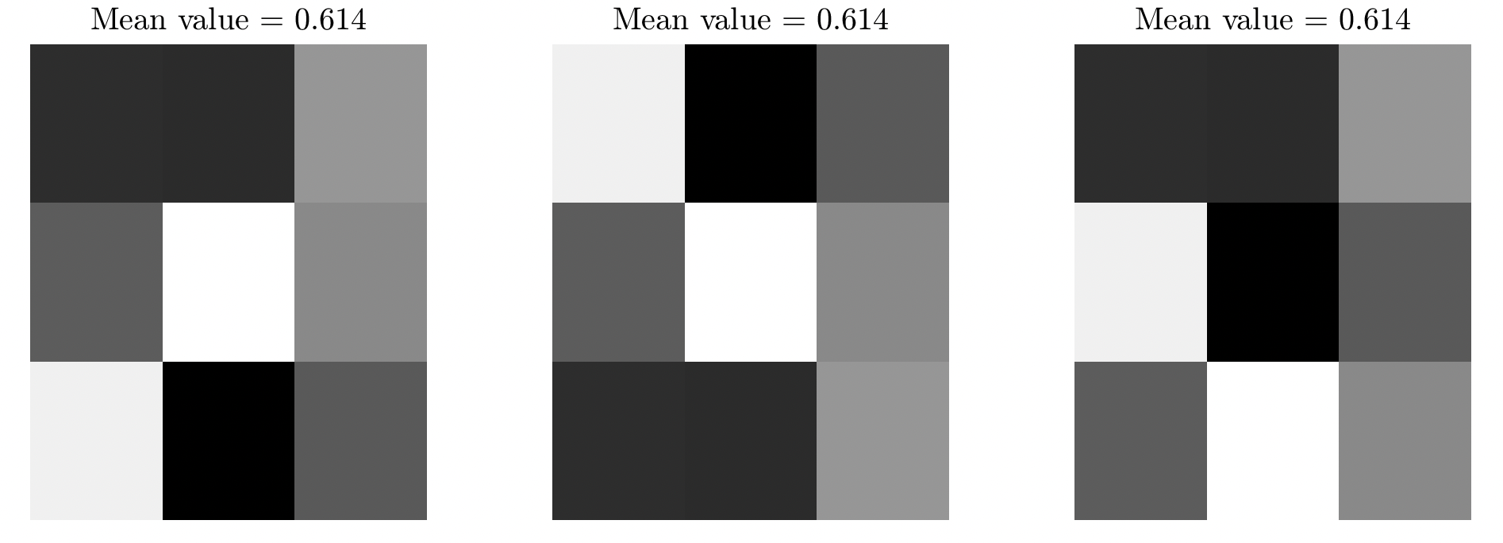
Representational Similarity Analysis (RSA; Kriegeskorte, Mur and Bandettini, 2008)
Using similarity between activity patterns to infer representational structure.
Condition 1
Condition 2
Condition 3
More similar
Less similar
33
Notes:
Size 40 header; size 20 body
33

Slide 34
Representational Similarity Analysis (RSA; Kriegeskorte, Mur and Bandettini, 2008)
Condition 1
Condition 1
Condition 2
Condition 1
Condition 1
Condition 2
Condition 2
Condition 2
Condition 1
Condition 3
(…)
34
Notes:
Size 40 header; size 20 body
34

Slide 35
Representational Similarity Analysis (RSA; Kriegeskorte, Mur and Bandettini, 2008)
Using similarity between activity patterns to infer representational structure.
Condition 1
Condition 2
Condition 3
More similar
R = 0.29
Less similar
R = -.45
During condition 1 y 2, our ROI is representing the same thing; during condition 3 is representing something else.
35
Notes:
Size 40 header; size 20 body
35

Slide 36
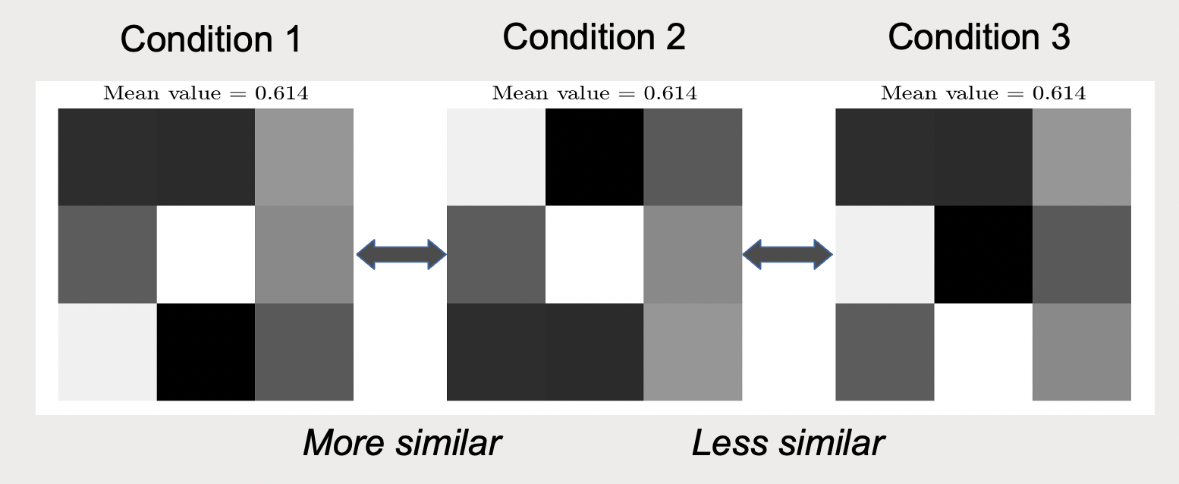
Representational Similarity Analysis (RSA; Kriegeskorte, Mur and Bandettini, 2008)
Glossary of RSA jargon:
- Similarity = correlation / degree of overlap in activity patterns of a given brain region.
- Dissimilarity (a.k.a., representational distance): Degree of non-overlap in activity patterns of a given brain region. Quite often is 1 – correlation.
- RDM: Representational Dissimilarity Matrix. Pair-wise matrix of dis(similarity) values.
36
Notes:
Size 40 header; size 20 body
36

Slide 37
Representational Similarity Analysis (RSA; Kriegeskorte, Mur and Bandettini, 2008)
Practical exercise RSA.
Go into breakout rooms and follow the .mlx script. Discuss with your colleagues and try to understand every step.
37
Notes:
Size 40 header; size 20 body
37

