Slide 1


Introduction into fMRI analysis. PsyMsc4 (Goethe 2022):
Basics of MRI and preprocessing.
Hands-on exercises.
Javier Ortiz-Tudela and Francesco Pupillo

Slide 2
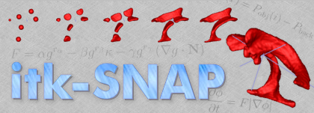
Basics of MRI and preprocessing.
Hands-on exercises.
Let’s explore the raw datasets.
~/<workshop_folder>/<dataset-folder>/BIDS/
Things to look for:
Can you locate anatomical and functional files? Are there any other files the data folders?
Can you see individual voxels? Can you see the value of each voxel?
Can you see the difference between anatomical and functional images?
Can you see the different volumes? Do you notice anything odd when browsing through the volumes?

Slide 3
Basics of MRI and preprocessing.
Hands-on exercises.
Dataset description: Fill in this table.
Dataset | N participants | runs | n_vols functional | resolution anatomicals | n_slices | task
Spatial mapping
Content-specific
Process-specific

Slide 4
Basics of MRI and preprocessing.
Hands-on exercises.
Preprocessing. Many of the steps involved in preprocessing take a long time to compute. We have already run this for you on fMRIPrep. Luckily, fMRIPrep outputs very nice interactive plots with the outputs of the process. Let’s explore them!
~/<workshop_folder>/<dataset-folder>/preproc_data/.
Things to look for:
Can you locate *.html files?
Can you see the distortion correction?
Can you see motion correction output? Try to locate the motion parameters in the fMRIPrep’s output files.
Can you see the anatomical-functional registration?
Locate the methods description.
Compare raw vs preprocessed T1w. Do you see any differences?

