Slide 1
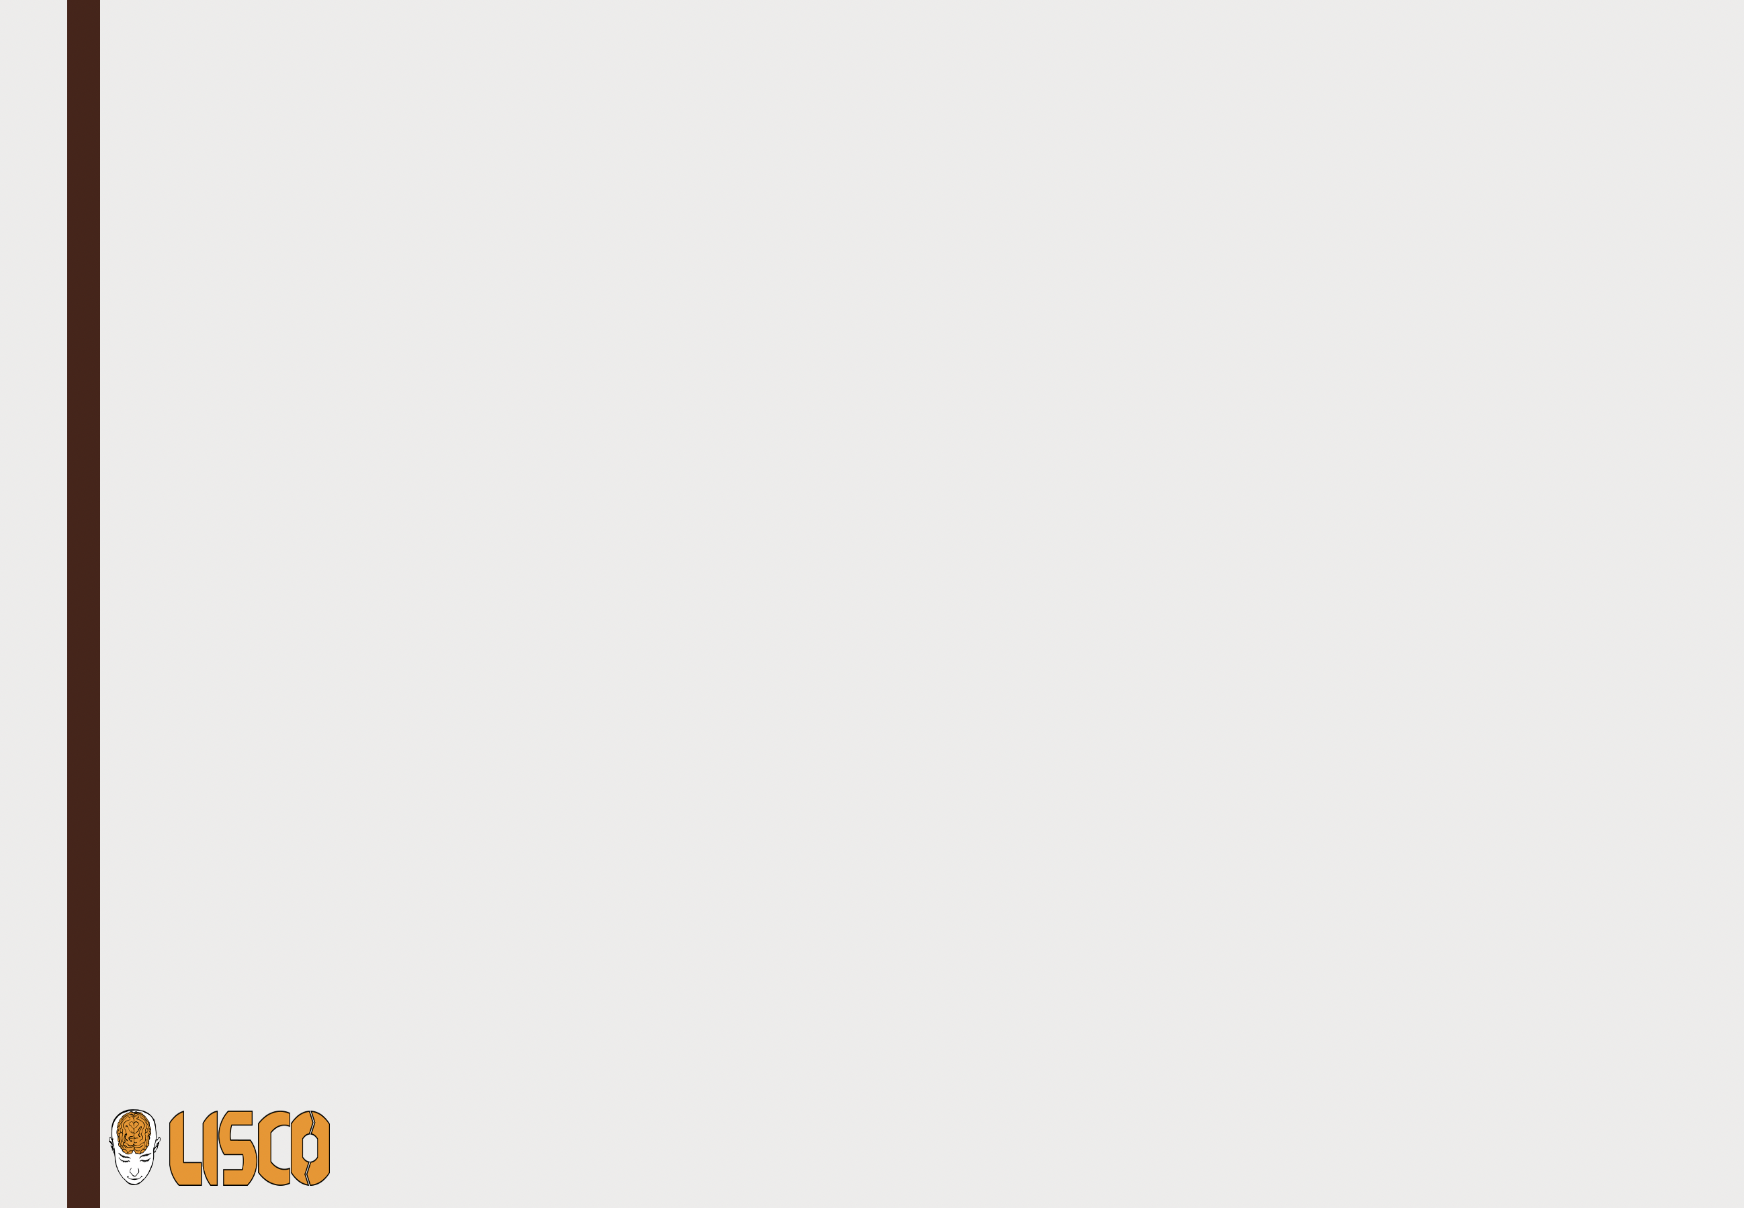

Introduction into fMRI analysis. PsyMsc4 (Goethe 2021):
GLM.
Hands-on exercises.
Javier Ortiz-Tudela and Francesco Pupillo

Slide 2
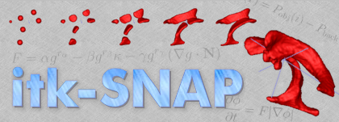
Basics of MRI and preprocessing.
Hands-on exercises.
You can find a detailed guide on:
~/<workshop_folder>/Run_analyses.md/
And wrapper files on:
~/<workshop_folder>/analysis_scripts/Run_analyses.md/
Wrapper scripts are rather simple pieces of code that are used to easily handle more complex scripts. In this case we can use them to run the same functions over multiple participants.
do_complex_stuff script
do_complex_stuff(c) ------------- ----- -------------------- --- ------- ---------------- -------- end
Wrapper script
for c = 1:100 do_complex_stuff(c) end

Slide 3
Basics of MRI and preprocessing.
Hands-on exercises.
Today’s tasks have already been built into MATLAB functions, so we only need to create wrappers around them. The functions that we will be using today are at:
~/<workshop_folder>/_functions/
And are named:
univariate_00_create_cond_files()
univariate_01_create_confounds_files()
univariate_01_glm()
In MATLAB, type:
help(function_name)
to learn how to use them.

