Slide 1
Pseudo-spectral Approach
Physical Space
r – θ – φ
Nonlinear terms
Spectral Space
n – l – m
Spectral derivatives
Use best of both worlds: spectral transforms
Ryan Orvedahl – Rayleigh Hackathon 2021

Slide 2
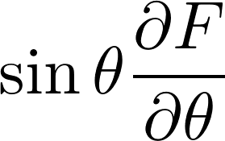
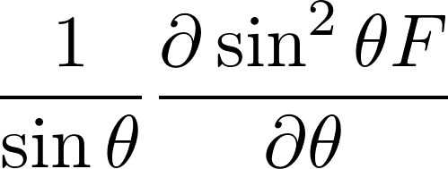
Single Timestep in Rayleigh
A) Spectral Space
r local / in-processor
l, m distributed
1) Time-stepping
2) Linear solve
3) Radial derivatives
B) Hybrid Space
l local / in-processor
r, m distributed
1) θ derivatives
2) Legendre Transforms
Transpose
FFT = fast ~ O( N log N )
LT = slow ~ O( N² )
Transpose
Transpose
C) Physical Space
m local / in-processor
r, l distributed
1) φ derivatives
2) Fourier Transforms
3) Nonlinear Terms
4) Diagnostics
D) Hybrid Space
l local / in-processor
r, m distributed
1) θ derivatives
2) Legendre Transforms
Transpose
Ryan Orvedahl – Rayleigh Hackathon 2021

Slide 3
Spherical Harmonic Transform Library: SHTns
Written in C/C++, fast compared to other SHT libraries
Exploit symmetries and optimizes near poles
Choice of recursion algorithm
On-the-fly option to compute polynomials
Included support for SHTns into Rayleigh
Ryan Orvedahl – Rayleigh Hackathon 2021

Slide 4
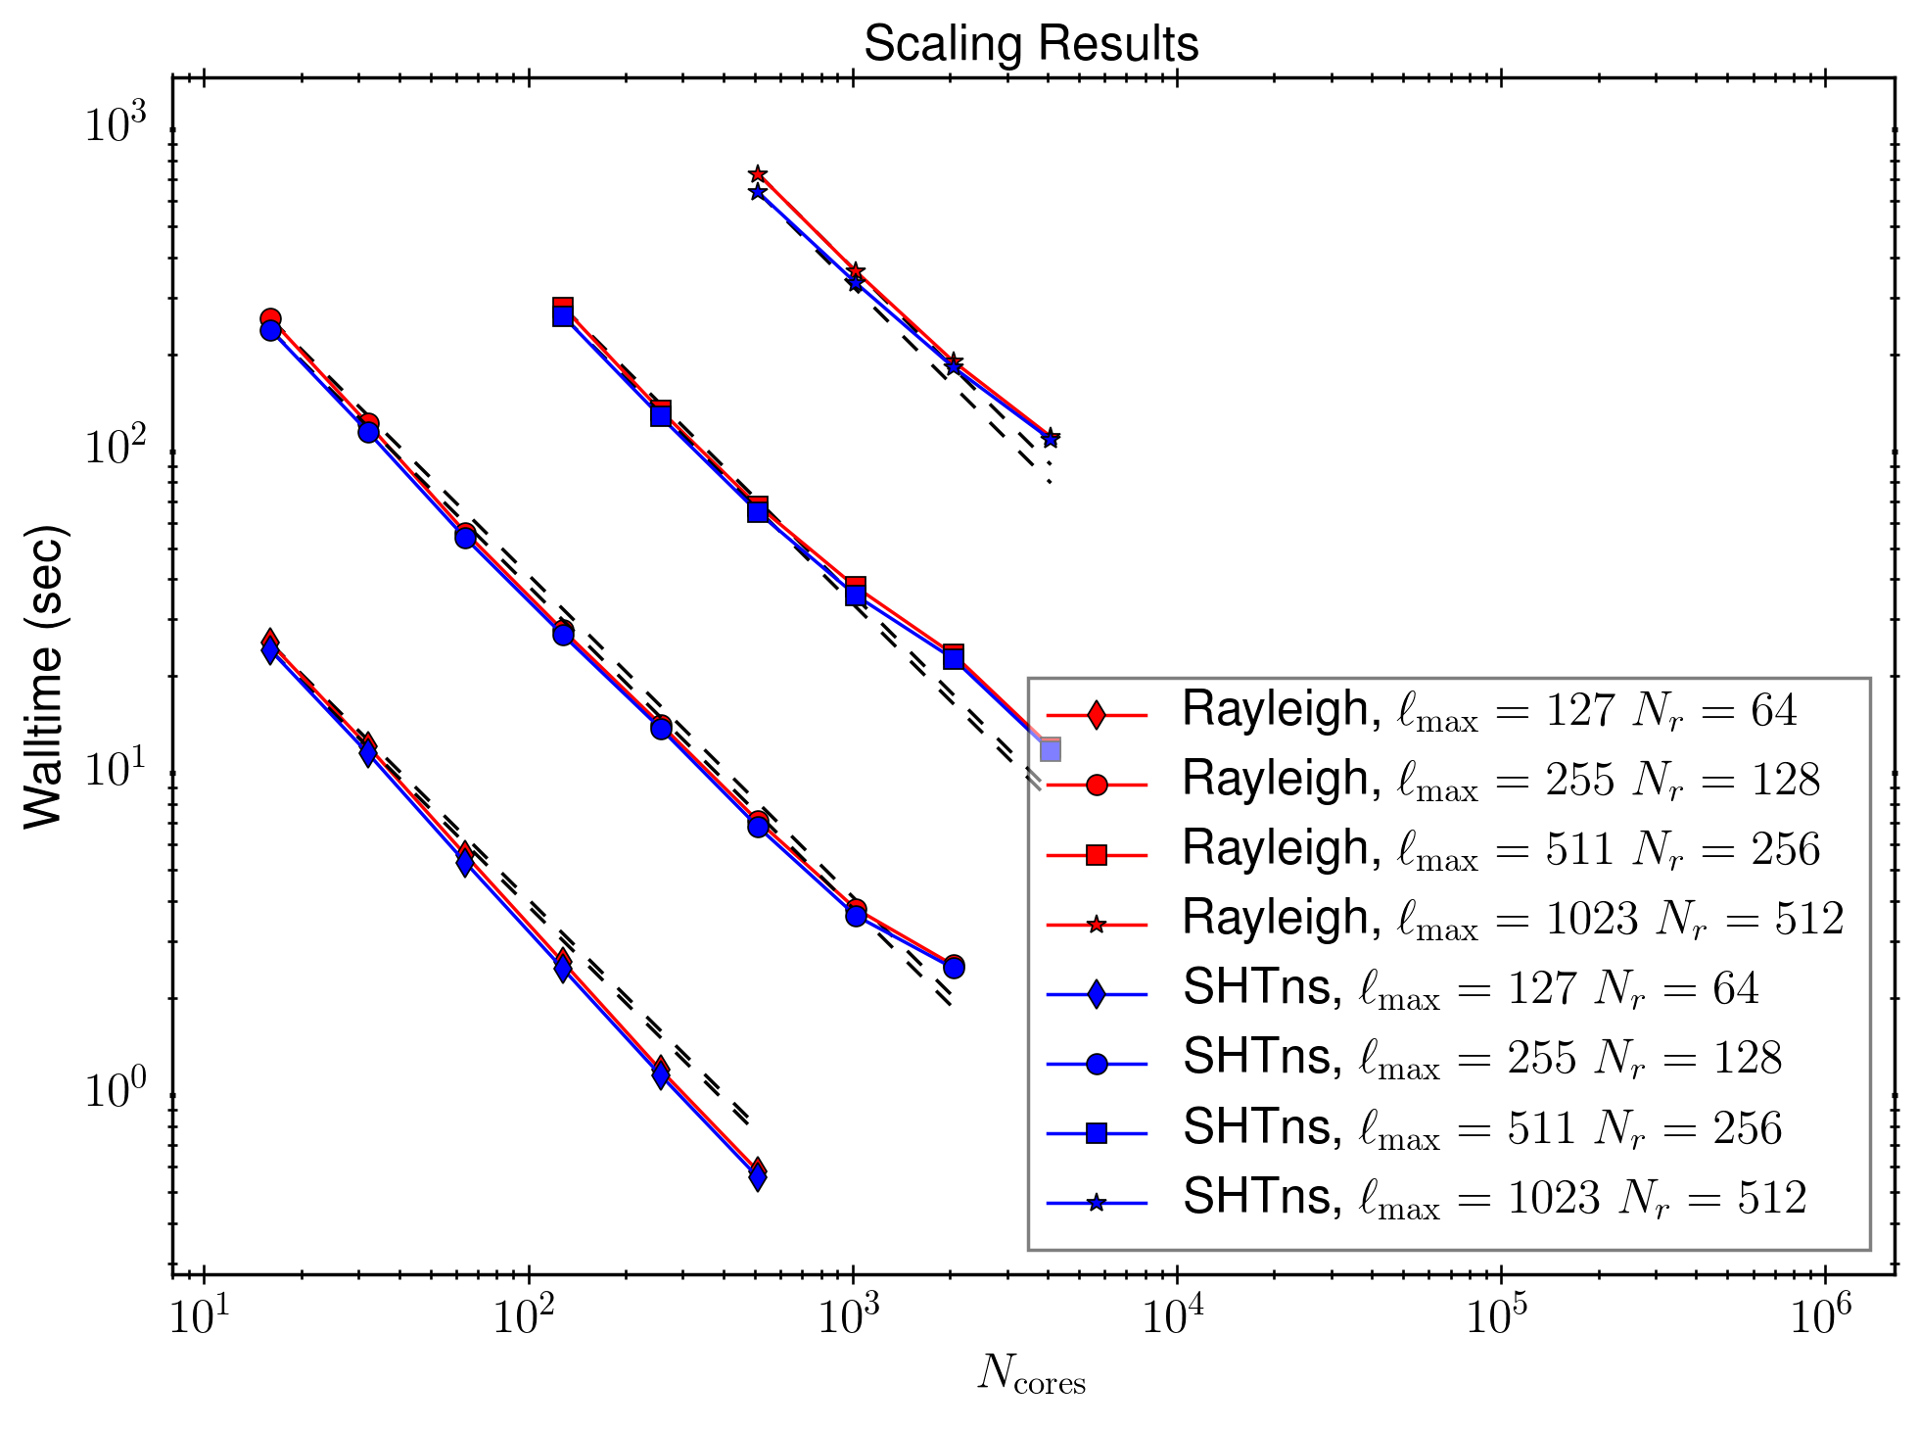
Performance of Rayleigh + SHTns
SHTns includes support for OpenMP
Next step: update OMP in Rayleigh
Ryan Orvedahl – Rayleigh Hackathon 2021

