Slide 1
REAL-time AGE, GENDER & EMOTION Classification based on Face detection and feature extraction using cnn
Dsp softWARE PROJECT
GROUP- C2_01
Members:
Thasin abedin, id: 160021139
Khondokar s. s. prottoy, id:160021165
Saad Ebna Azad, id: 160021122

Slide 2
Abstract
Automatic age, gender & emotion classification has become relevant to an increasing amount of applications, particularly since the rise of social platforms and social media. Still, it is a challenge to detect age, gender and emotion of single or multiple person at the same time. Performance of existing methods on real-world images is still significantly lacking. We propose a simple convolutional neural net architecture that can be used to identify human gender, age & emotion altogether in real-time.

Slide 3
METHODOLOGY
Gather large datasets of labeled images(age, gender & emotion)
Preprocess images to be fed into our CNN model
Build two CNN models one for classifying both age & gender and another for emotion
Train preprocessed image data using those two models
Combine two models to get all three classification at the same time
Include Haar Cascade classifier to detect face
Add video capturing capability for real-time detection

Slide 4
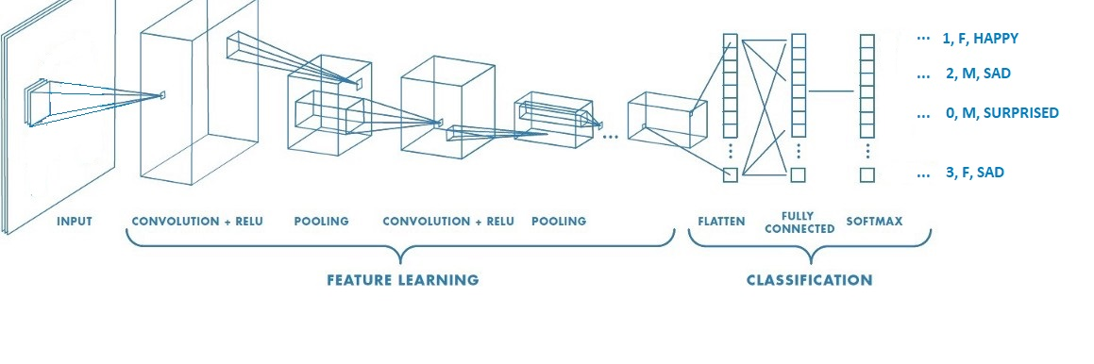
ARCHITECTURE
Fig: An approximate visual representation of our CNN model to classify gender, age & emotion.

Slide 5
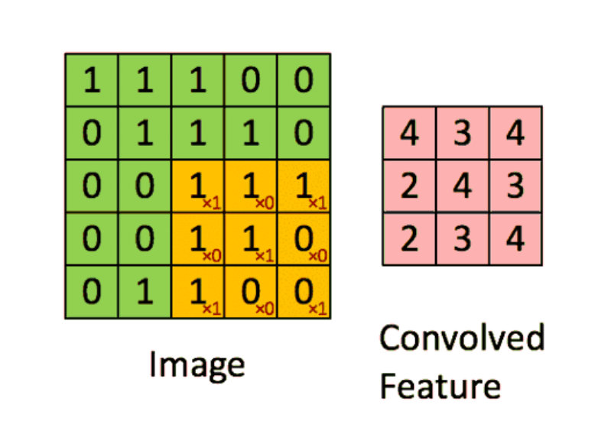
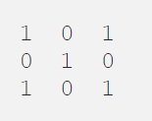
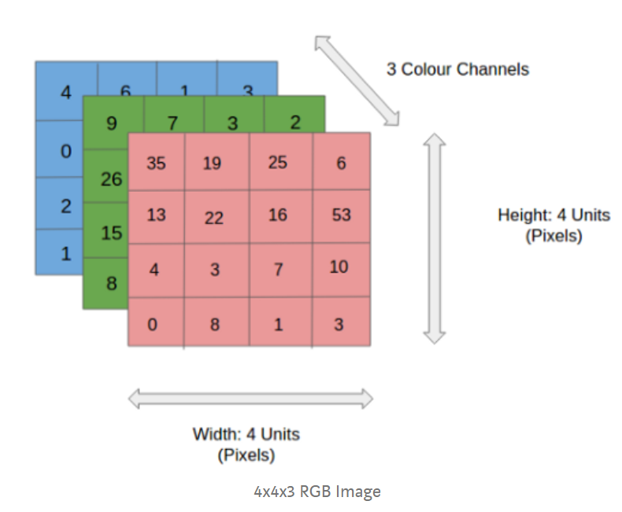
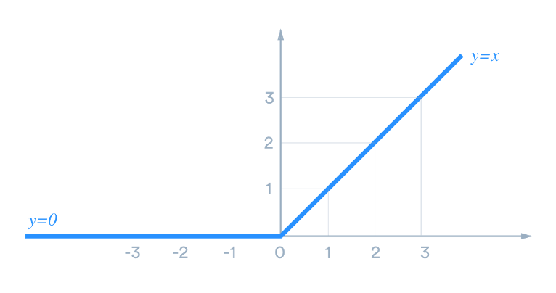
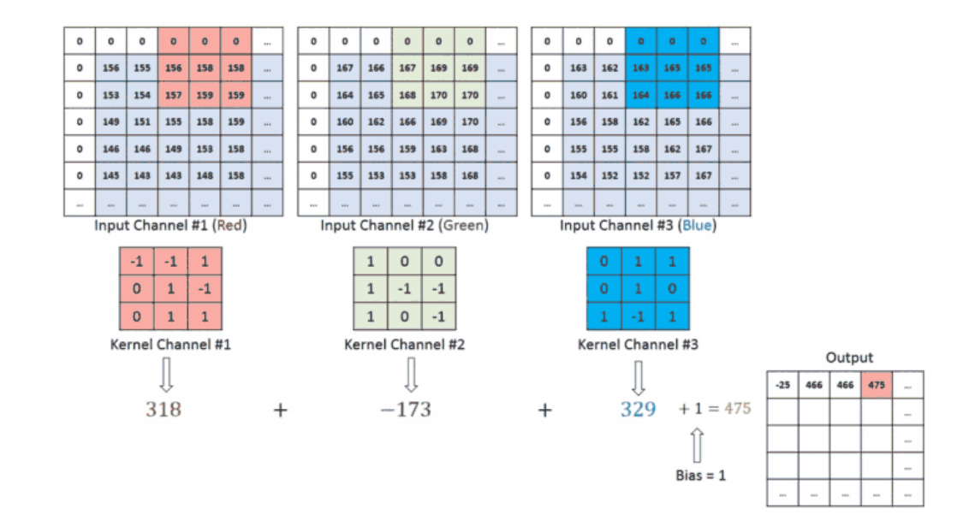
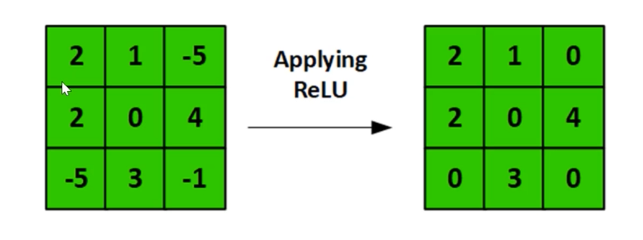
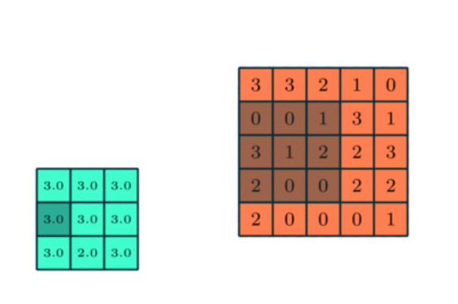
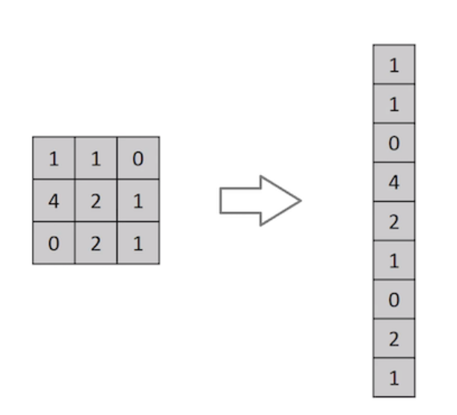
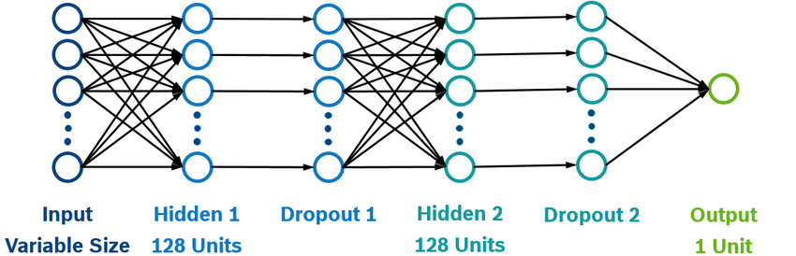

Slide 6
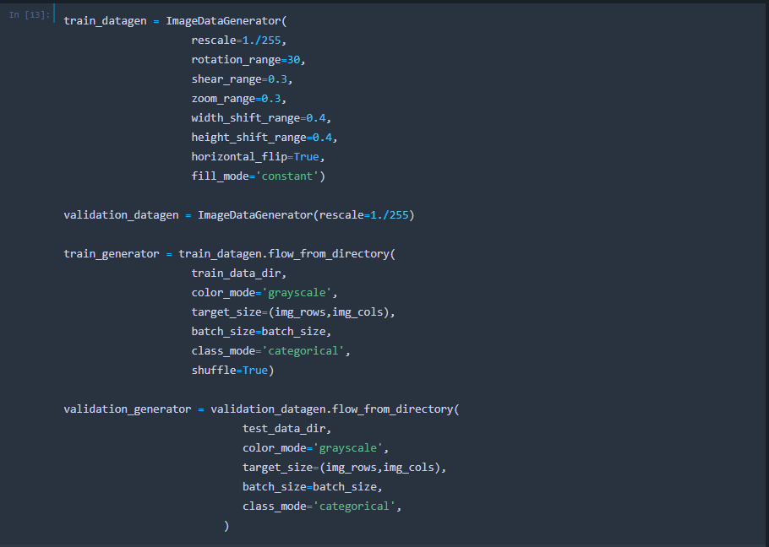
WORKFLOW
Step- 1: Data Preprocessing
After downloading necessary datasets, all of them are loaded using keras datagenerator. Datagenerator preprocesses the image data by resizing, augmenting, shifting to another colour space, rescaling etc. We also converted image data into numpy array for training.
Fig: Our image datagenerator

Slide 7
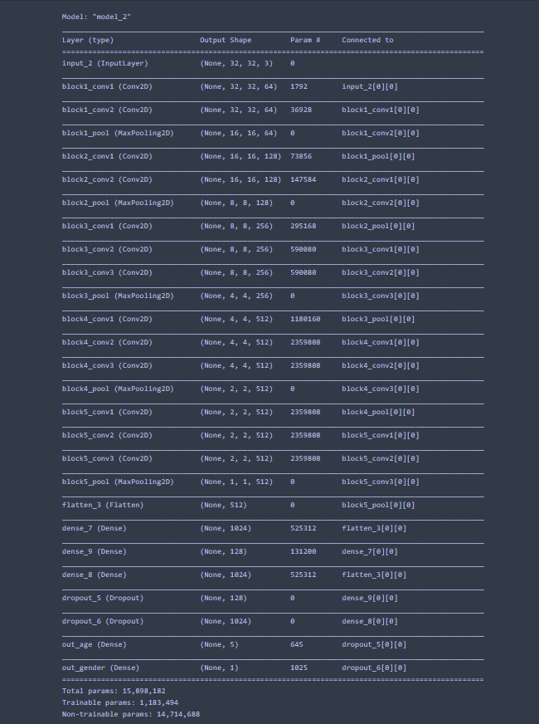
WORKFLOW
Step- 2: Building CNN Models
To train those image data, we built a model for emotion classification from scratch with the help of KERAS. For age & gender detection, we used a previously trained model called VGG16 using transfer learning.
Fig: Summary of Pretrained model VGG16

Slide 8
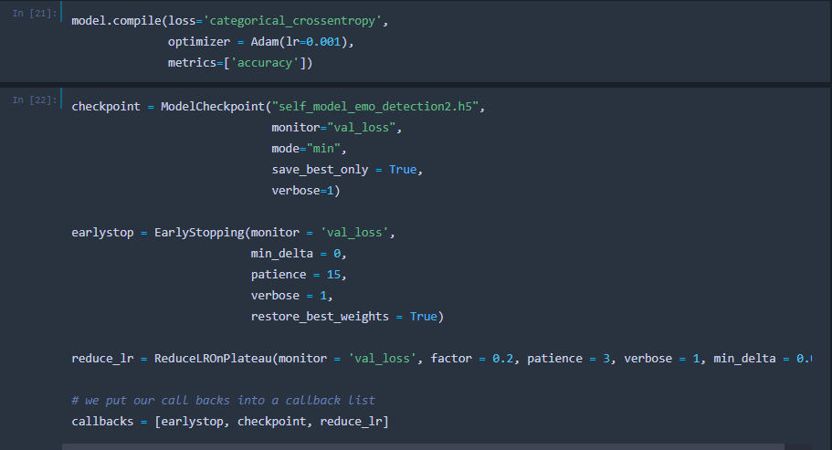
WORKFLOW
Step- 3: Adding Optimizers
During training, NN always calculates errors and backpropagates accordingly to increase accuracy. In our case, we used ‘Cross Entropy’ for loss calculation & ‘ADAM Optimizer’ to update our weights automatically. We also added two monitoring functions called callbacks like early stopping & reduce learning rate in order to reach global minima of the gradient descents to further improve our result.
Fig: Optimizers & callbacks

Slide 9
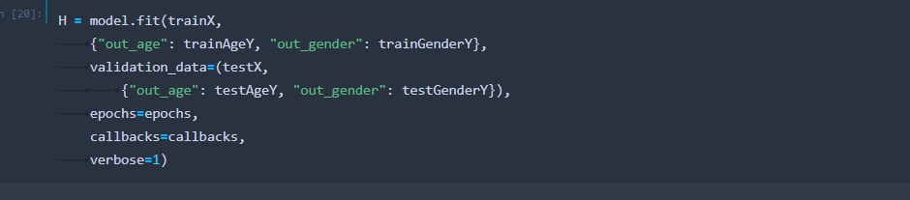
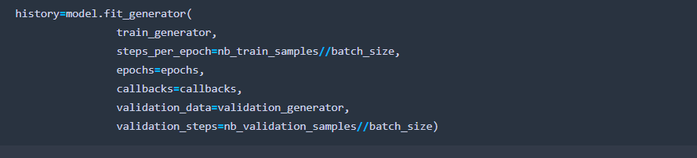
WORKFLOW
Step- 4: Trainning
After downloading necessary datasets, all of them are loaded using keras datagenerator. Datagenerator preprocesses the image data by resizing, augmenting, shifting to another colour space, rescaling etc.
Fig: training module for age & gender
Fig: training module for emotion

Slide 10
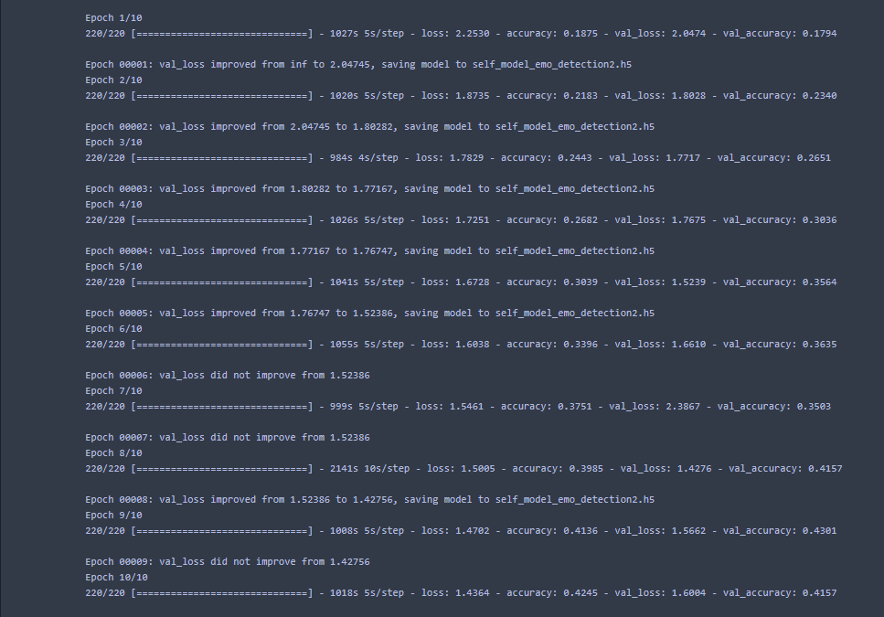
WORKFLOW
Step- 5: Testing
After training, testing will be handled by KERAS itself. It will give validation accuracy by testing the trained model using completely different data.
Fig: Training history showing training & test accuracy

Slide 11
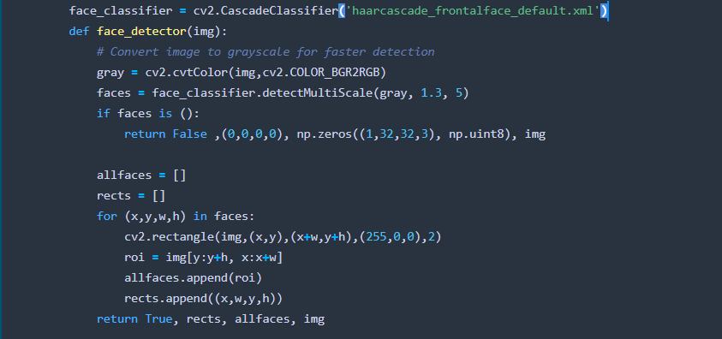
WORKFLOW
Step- 6: Adding Haar Cascade classifier
We added Haar Cascade classifier for face detection. It detects face as soon as possible and helps classifier to understand where to look for.
Fig: Including Haar Cascade

Slide 12
result
In this section, we are going to show you some real world results. Some images were captured by webcam in real-time and some still images were shown to webcam due to lack of people around us in this pandemic situation.
We made our classification processes easier by segmenting ages into different 5 groups.
Age 0 to 14 = Group_0
Age 14 to 25 = Group_1
Age 25 to 40 = Group_2
Age 40 to 60 = Group_3
Age above 60 = Group_4
Gender: Male = M, Female = F
Emotions: ‘Neutral’ , ‘Happy’ , ‘Surprise’ , ‘Sad’ , ‘Angry’ , ‘Fear’

Slide 13
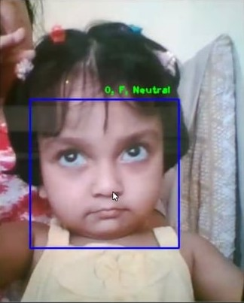
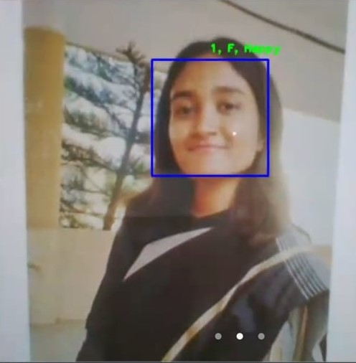
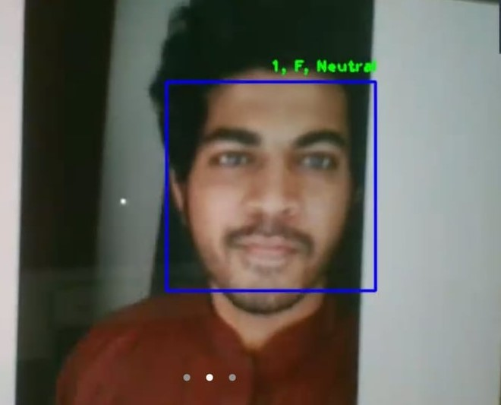
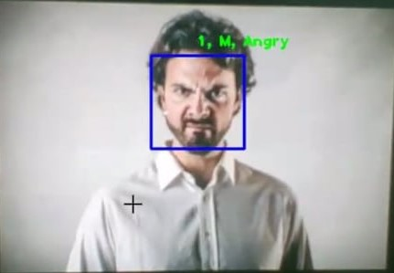
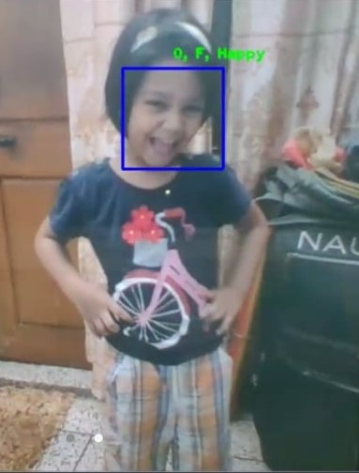
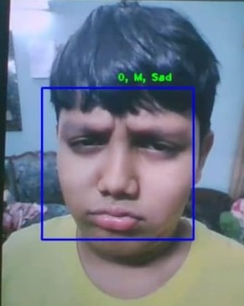
result

Slide 14
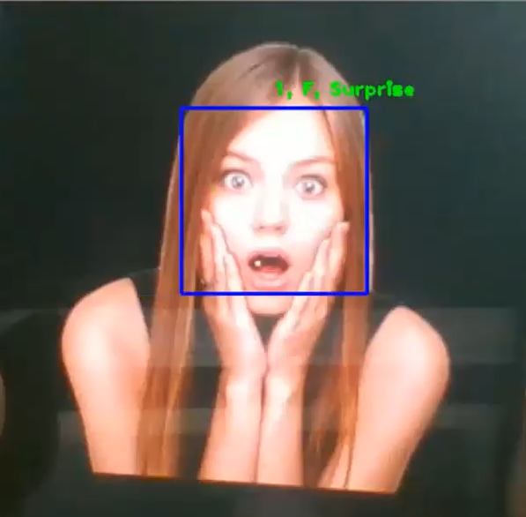
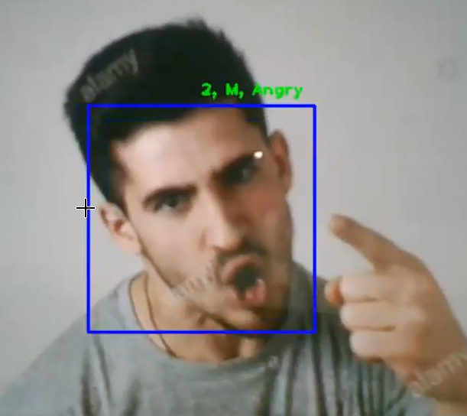
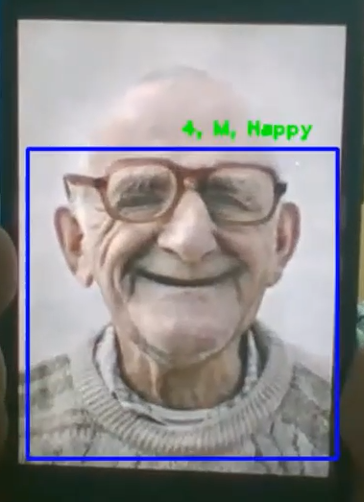
result

Slide 15
Discussion
Our project is a demo version to show the extent upto which ML models can be useful. There are plenty of scopes for improvement. Some of the pros and cons of our project are discussed below:
Pros:
Integrated 3 different difficult tasks that are very tough even for human eyes into a single model
Wide application ranging from using it as surveillance camera to mobile applications
Good result in spite of very limited training time
Cons:
The model detection is perfectly not accurate for commercial use
Lack of computational resources to train the model
Lack of a very large dataset for ML models

Slide 16
THANK YOU

