Slide 1
Study of the Structure of Photonic Crystal Fiber
Submitted by: group 29
student id’s: 160021137,160021139, 160021141,160021161
Supervisor: Reza Khan

Slide 2
Introduction: Photonic crystal fiber is a new kind of optical fiber based on the property of photonic crystals. Now, a photonic crystal is a periodic optical nanostructure that affects the motion of photons in much the same way that ionic lattices affect electrons in solids. So it has the ability to confine light in hollow cores which is not possible in conventional optical fiber. As a result, photonic crystal fiber is taking the place of conventional optical fiber and is showing us a brighter future in the field of optical fiber. Photonic crystal fibers may be considered a subgroup of a more general class of microstructured optical fibers, where light is guided by structural modifications, and not only by refractive index differences. photonic crystal fibers, have a cross-section (normally uniform along the fiber length) microstructured from one, two or more materials. They are arranged periodically over much of the cross-section surrounding a core where light is guided.

Slide 3
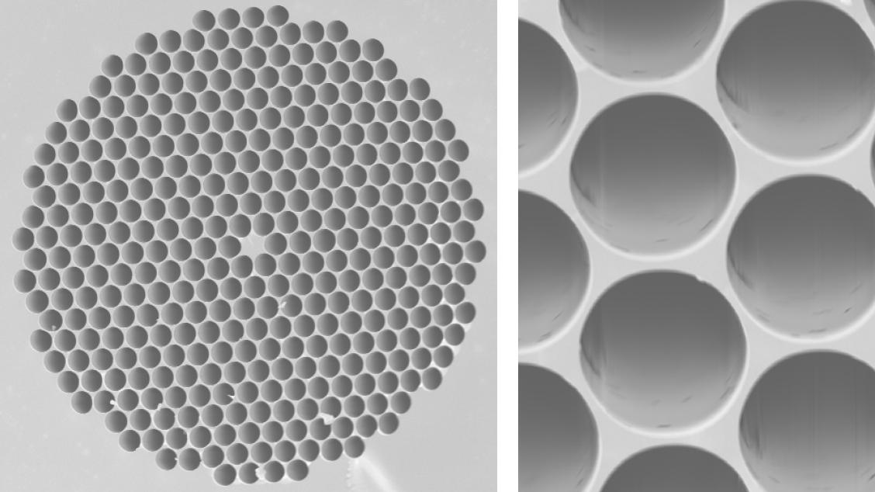
Figure: micrographs of a photonic-crystal fiber

Slide 4
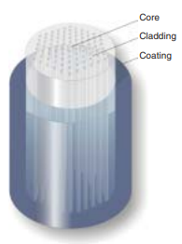
Figure: cross-section of a photonic crystal fiber

Slide 5
Types of PCFs:
Generally, photonic optical fibers are constructed by the same methods as the conventional optical fibers. But they can be divided into two modes of operation, according to their mechanism. The first one is with a solid core, or a core with a higher average index which can operate on the same index-guiding principle as conventional optical fiber . But they can have a much higher effective- refractive index contrast between core and cladding. And so can have much stronger confinement for applications in nonlinear optical devices. And the second one is hollow core PCFs which enables the guidance of the light in the hollow core with lower attenuation than in the solid core.
There are also 1-D PCFs which is also called bragg fiber and 2-D PCFs (index guiding photonic crystal fiber) and 3-D PCFs are also available.

Slide 6
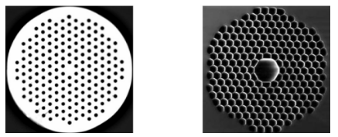
Figure: (left) Solid-core and (right) hollow-core fiber

Slide 7
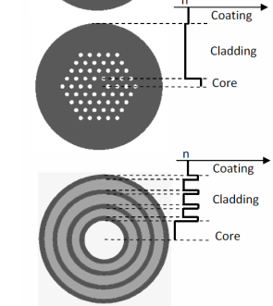
figure: (up) index guiding PCF (2-D PCF)
(down) bragg fiber (1-D PCF)

Slide 8
Different uses of pcf:
Photonic crystal fibers have recently become commercially available to support a rapidly growing range of applications. The uses are:
Used in fiber optic communication.
Photonic crystal fiber lasers.
Used as humidity sensor.
Used as pH sensor.
Used in non linear devices.
Pcf’s are used where high power transmission is required.
Used in highly sensitive gas sensors.

Slide 9
Advantages of using photonic crystal fiber:
Photonic crystal fibers have become very popular by overcoming many of the limitations of the conventional optical fibers. Among many of the advantages of using pcf, some are:
PCFs with larger cores may carry more power than conventional fibers.
It has smaller attenuation than with fiber with solid core.
Larger contrast available for effective-index guidance.
It’s attenuation effects are better than the conventional fibers.
Size of air holes may be tuned to shift point of zero dispersion into visible range of the light.
6. In pcf, light is trapped in the core which provides much better wave guidance to photons.
7. The polymersused in pcf provies a flexible fiber than traditional optical fiber.

Slide 10
Disadvantages of photonic crystal fibers:
Short manufacture length.
High price is one of the biggest disadvantages pf PCFs as it is not very available worldwide.
Confinement loss exists in photonic crystal fiber as there are finite number of air holes in the cladding.

Slide 11
Researches on PCF:
Many researchers have shown interest in PCFs and there are a good number of books about it. Some important books about PCFs are:
Photonic Crystals: Molding the Flow of Light
photonic crystal fibers: properties and aplications
Foundations of Photonic Crystal Fibres
Photonic bandgap structures
Photonic crystal fibers by Bjarklev

Slide 12
Study of the Structure of Photonic Crystal Fiber with High Negative Dispersion Coefficient:
For long distance transport information, its difficult to solve the dispersion compensate for the traditional optical fiber. Its also hard to do practical experiment about this on photonic crystals. The COMSOL software is used for this experiment. The structure is kept as the traditional hexagonal photonic crystal fiber and the negative dispersion coefficient is obtained as larger as possible. This high negative dispersion coefficient will help to reduce the confinement loss that exists in photonic crystal fibers.

Slide 13
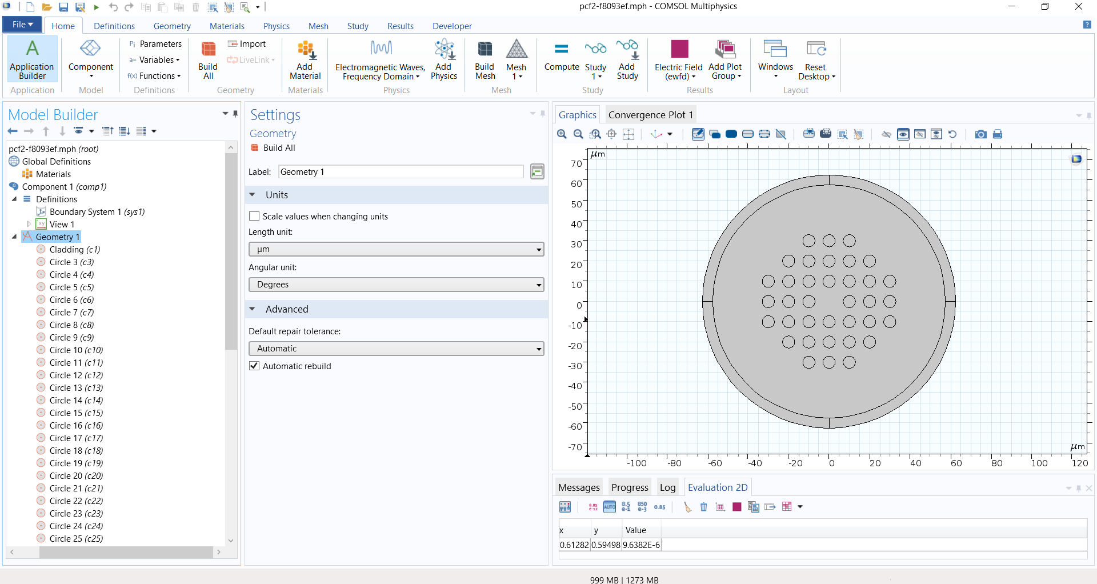
Simulation results of our group:
Figure: Simulation model

Slide 14
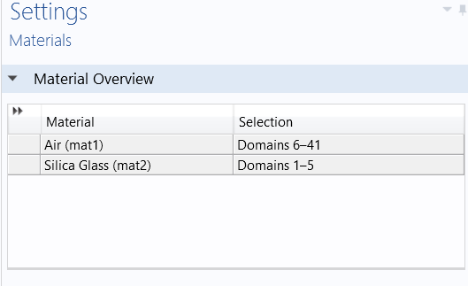
Materials used

Slide 15
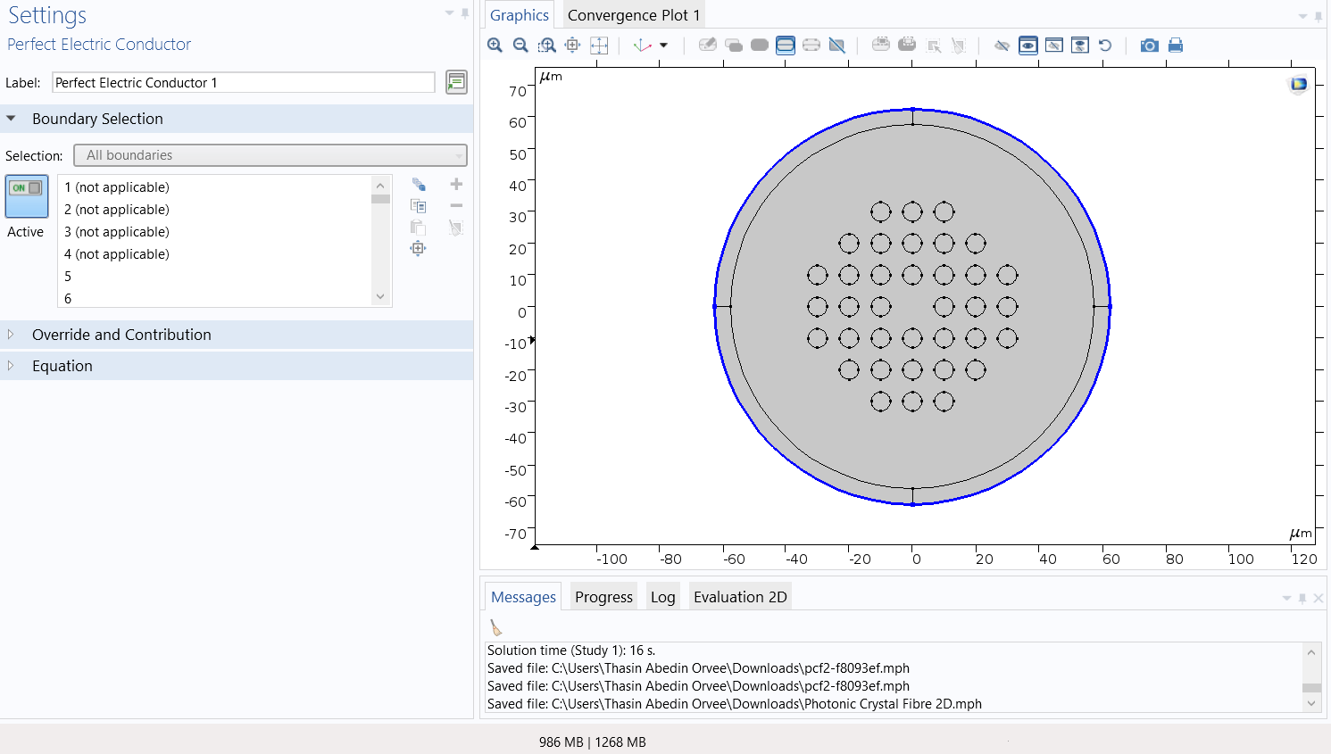
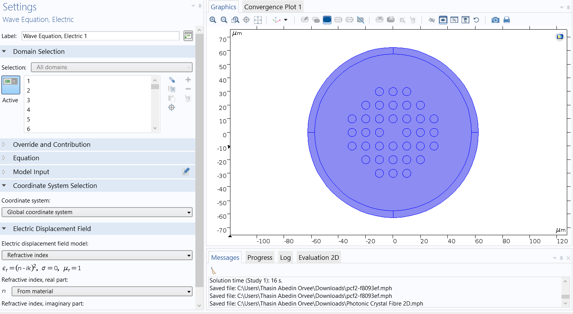
Figure: electromagnetic waves, freuency domain

Slide 16
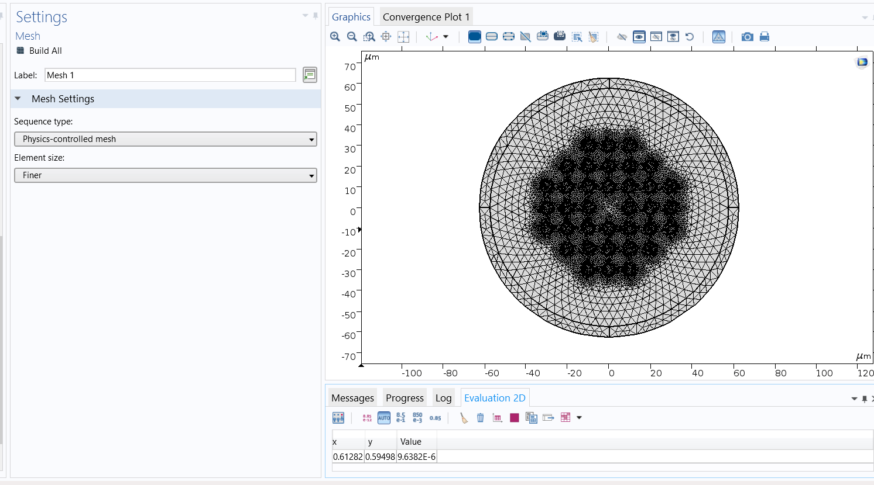
Figure: mesh

Slide 17
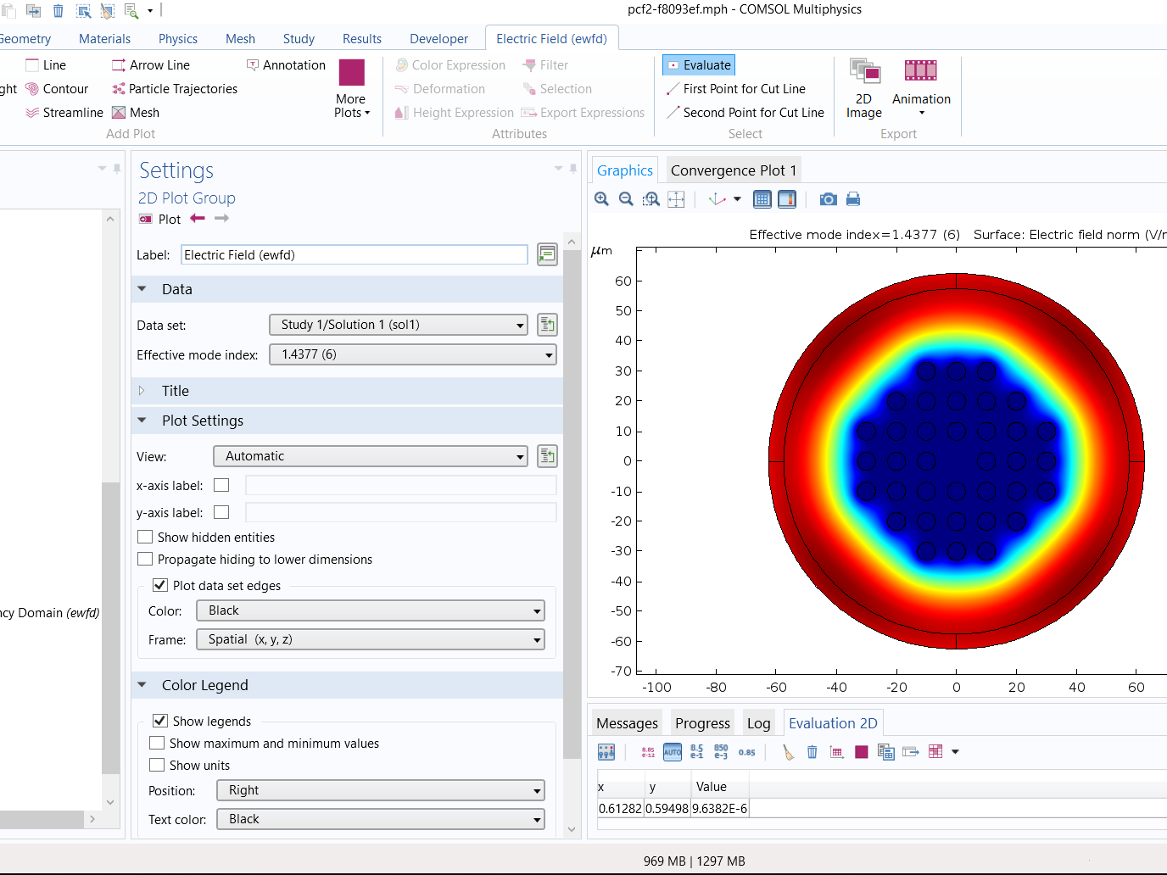
Figure: simulation result

Slide 18
Thank You

