Slide 1
Terahertz frequency generation using Photonic Crystal Fiber
Submitted by
Moumita Khan, 160021137
Thasin Abedin, 160021139
Sadman Sadat Showmik, 160021161
Advisor: Reza Khan

Slide 2
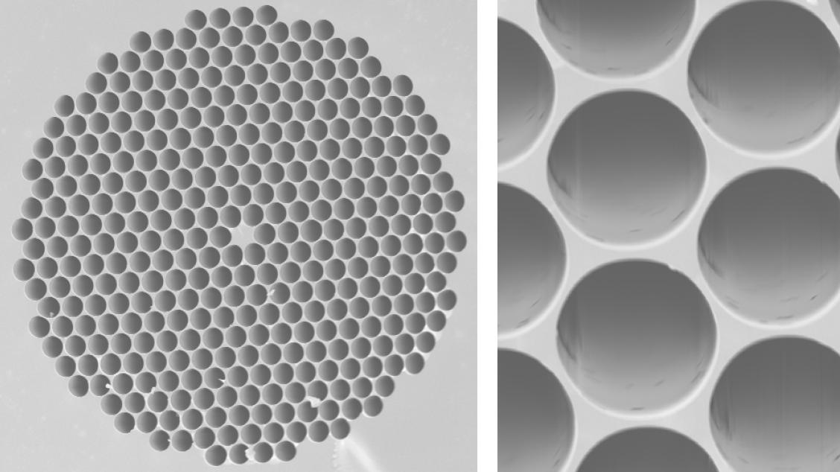
Photonic crystal fibers
Photonic-crystal fiber (PCF) is a new class of optical fiber based on the properties of photonic crystals. Because of its ability to confine light in hollow cores, its different from the conventional optical fibers and much more useful.

Slide 3
Terahertz radiation
Terahertz radiation is also known as submillimeter radiation, terahertz waves, tremendously high frequency. Wavelengths of radiation in the terahertz band correspondingly range from 1 mm to 0.1 mm. Terahertz radiation can penetrate thin layers of materials but is blocked by thicker objects.

Slide 4
THz radiation is characterized by the following unique features:
• It can penetrate through a wide variety of dielectric materials, such as fabric, paper, plastic, leather, and wood.
• It is non-ionizing and has minimal effects on the human body.
• It has very large absorption due to water.
• Metals highly reflect terahertz radiation.

Slide 5
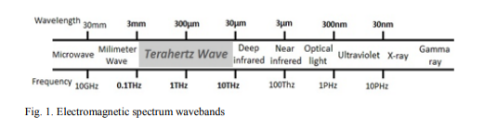
Electromagnetic spectrum wavebands

Slide 6
Sources of terahertz radiation
The soure of terahertz radiation can either be natural or artificial. Terahertz radiation is emitted as part of the black-body radiation from anything with a temperature greater than about 2 Kelvin and this is an example of the natural source. artificial sources of terahertz radiation are the gyrotron, the backward wave oscillator ("BWO"), the organic gas far infrared laser("FIR laser"), Schottky diode multipliers,^{[5]}varactor (varicap) multipliers, quantum cascade laser, the free electron laser (FEL) and many more.

Slide 7
Producing method of terahertz radiation
By the superiority of optoelectronic techniques, the field of terahertz application has extended beyond the laboratory. It is possible to produce terahertz radiation using a combination of two effects: in one effect two laser beams of consecutive frequencies are focused at a semi-conductor and the other effect refers to the separation of photoconductive charge carriers using an ultrafast laser. When these two effects are incorporated with appropriately structured antennas, electromagnetic radiation can be generated across the terahertz region.

Slide 8
The Terahertz Spectrum
Terahertz radiation falls in between infrared radiation and microwave radiation in the electromagnetic spectrum, and it shares some properties with each of these. in the electromagnetic spectrum, terahertz radiation spans from 100 GHz to 10 THz or from 3 mm to 30 µm wavelengths. This radiation has the potential to penetrate via a number of materials.

Slide 9
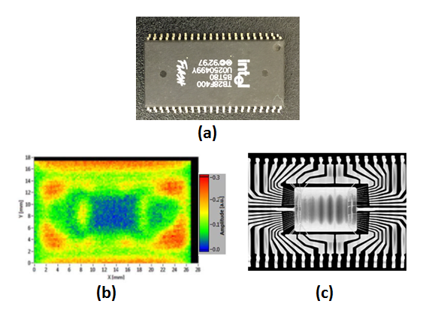
(a) Optical image of an electronic chip. (b) Terahertz transmission image of the chip. (c) X-ray transmission image of the chip. Terahertz has the privilege of being non-ionizing (non-destructive) but the resolution of X-ray is higher.

Slide 10
Usage of terahertz spectrum
The terahertz spectroscopy is used to detect explosives and toxic agents besides detecting illicit drugs like opiates, ecstasy and cocaine. Terahertz spectroscopy is also used in developing and producing pharmaceutical drugs. Not only these, the quality of food that is in air-tight packages can also be tested by this radiation.

Slide 11
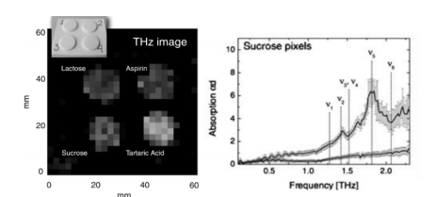
Terahertz technology used for identification of chemical samples

Slide 12
Pcf and terahertz radiation
There are two kinds of photonic crystal fibers (solid core and hollow core). Now, solid-core PCFs experience large material loss that is not suitable for terahertz signal transmission, while hollow-core PCFs limit electromagnetic waves to short propagation distances and have high bending losses that are inversely proportional to the diameter and bending radius of the fiber. Because these undesirable features have slowed the acceptance of solid- and hollow-core PCFs, porous-core fibers have been developed.

Slide 13
Advantages of terahertz radiation
Identify skin cancers too small to see with the naked eye
Many of the complex organic chemicals used in explosives absorb terahertz radiation at particular frequencies, creating a "signature" that detectors can read
Because higher frequencies can carry more bandwidth, terahertz signals could make a sort of super-Bluetooth that could transfer an entire high-definition movie wirelessly in a few seconds

Slide 14
Safety measures
The terahertz region is between the radio frequency region and the optical region generally associated with lasers. Both the IEEE RF safety standard and the ANSI Laser safety standard have limits into the terahertz region. Research is underway to collect data to populate this region of the spectrum and validate safety limits.

Slide 15
Limitations
Although there has been enormous progress in the construction of sources and detectors of terahertz radiation, there are some limitations too. Some of them are:
1. detecting terahertz signals is difficult because blackbody radiation at room temperatures is strong at terahertz frequencies.
2. The big concern for THz imaging is atmospheric transmission. The atmospheric attenuation of the THz domain is much more severe than in the other spectral regions, such as infrared and visible-light regions.

Slide 16
3. selection of appropriate optics in imaging systems is hard in terahertz imaging system.
Despite the limitations, terahertz radiation is helping in the field of science in a great way.

Slide 17
Terahertz technology market
Over the past two decades, terahertz technology has been witnessing significant advancements on the scientific front. The energy carried by terahertz radiation is low enough to pose no risk to any object under investigation. Many manufacturers are currently focused on developing new devices that can send and receive radiation of terahertz frequency range. Terahertz technology has found various application in various fields such as spectroscopy, imaging and communication systems.

Slide 18
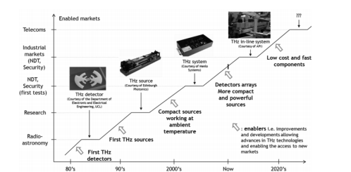
THz technology and market trends

Slide 19
Thank You

