Slide 1
Spec-Driven
Development
in Action
SPEC
PLAN
Using AI to Turn Requirements into Tests and Code
CODE
AI
Denys Pavlenko
Engineering Leader @ Integrity Next
Mentor • Career Coach
linkedin.com/in/dpavlenko
01
Notes:
Open with the promise: this is not a lecture about AI coding. It is a demo of how specifications change the quality and predictability of AI output.

Slide 2
Who trusts
AI-generated code?
Raise your hand if you completely trust everything it generates.
That is exactly the problem we will solve today.
02
Notes:
Ask for hands. Let the awkward silence do some work. Then say: that is exactly the problem I want to solve today.

Slide 3
THE IDEA
Use AI across the workflow
Spec
Plan
Implement
→
→
Most teams use AI only at the implement phase — or to generate a Jira ticket.
Today we use it throughout the entire workflow.
03
Notes:
Do not define Spec-Driven Development yet. Keep the mental model simple: spec, plan, implement. The demo will define the concept by showing it.

Slide 4
FRAMING
Not just better prompts — better constraints
Traditional AI
Spec-Driven AI
Idea
Spec
Prompt
↓
Plan
Tests
Code
Code
Less context. More guessing.
More context. Less guessing.
04
Notes:
This is a quick framing slide before the demo. The core message: we are not asking AI to be smarter; we are reducing ambiguity.

Slide 5
LIVE DEMO
TaskFlow
specs/password-reset.md
Existing application
technical design
acceptance criteria
test scenarios
implementation
change requirement
Today’s feature
Password Reset
Cursor + specs/password-reset.md
05
Notes:
Keep this slide on screen while switching to the live demo. The repository link should not compete for attention here; put it on the final slide.

Slide 6
AFTER THE DEMO
Why did it work?
Better
requirements
Shared
understanding
Controlled
AI output
AI had enough context.
Product, QA and Engineering aligned earlier.
We constrained the solution path.
The quality improvement came from the workflow, not magic.
06
Notes:
Do not overclaim. The demo worked because the problem was constrained and the context was explicit. That is the part teams can repeat.

Slide 7
THE WORKFLOW
Spec → Plan → Implement → Harness
Spec
Plan
Implement
(w/ Testing & Feedback)
Harness
(Feedback flywheel)
→
→
→
↺
Feedback loops turn one-off AI output into a repeatable delivery system.
07
Notes:
Make the Harness explicit: it is the feedback flywheel around tests, app behavior, logs, reviews, and requirement changes.

Slide 8
LESSONS LEARNED
What teams should take away
Build better
Work better
Use AI better
80/20: planning before coding
DEV and QA work in parallel
Reset conversations when they drift
TDD and smaller PRs
Shared (updated) specs reduce rework
Control beats vibe coding
Discipline beats speed theatre
DORA and SPACE to assess
Keep humans in the judgment loop
Quality gates after each step
Retrospectives is key (Harness)
Create skills to automate routine
AI makes delivery faster only when your process can absorb the speed.
08
Notes:
This is the practical summary. Avoid making this a grab bag by grouping lessons into build, work, and AI usage themes.

Slide 9
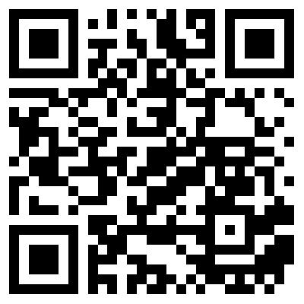
Thank you
Questions?
LinkedIn
GitHub project
linkedin.com/in/dpavlenko
github.com/orwanec/sdd-meetup-demo
09
Notes:
The QR code should point to the GitHub repository, ideally containing slides, specs, and setup instructions. Use a static QR code so it lasts as long as the destination URL exists.

