Slide 1
Posture Recognition and Keypoint Detection in Smart Beds
Human Data Analytics course at the University of Padua
Orkhan Bayramli
18/07/2022

Slide 2
Intro
Dataset and Data collection
General Data Analysis
Posture Recognition – Image Classification
FFNN and CNN
Data Augmentation
Activations
Results
Keypoint Detection
Data Annotation
CNN
Results

Slide 3
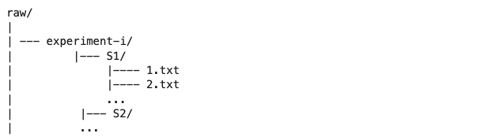
Dataset and Data Collection
Raw Pressure Map Data
Uniformly distributed 32 x 64 sensors
Grayscale images (1 channel)
Sampling frequency of 1Hz
13 subjects with 17 postures
5 common postures: Left, Right, Left fetus, Right Fetus, Supine
Structure of raw dataset in text files:
Python scripts to extract images from the text files to .png format and resizing

Slide 4
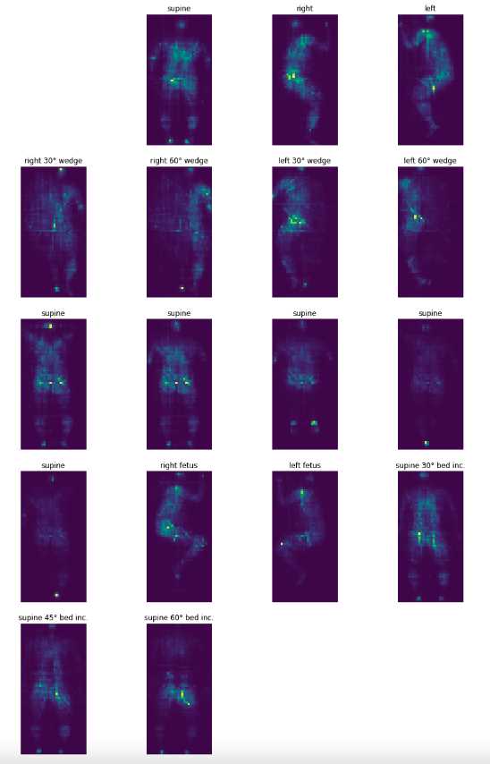
General Data Analysis
Python script to extract images.
First two images are corrupt
2048 data samples
3 postures with number of samples
Left: 490
Right: 490
Supine: 1096
Splitting the dataset
Train: 1480
Validation: 369
Test: 205

Slide 5
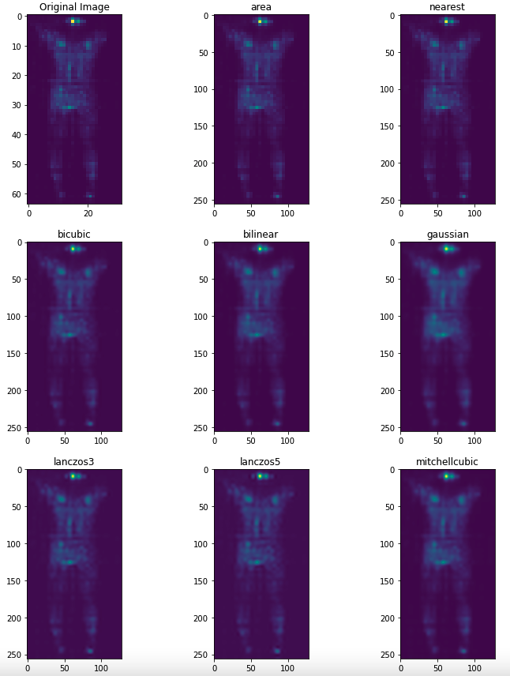
General Data Analysis
Resizing images from 64 x 32 to 256 x 128 matrix.
Test to see which one gives a better result.
Resizing function from the tf.Image API.
Picked the area method.

Slide 6
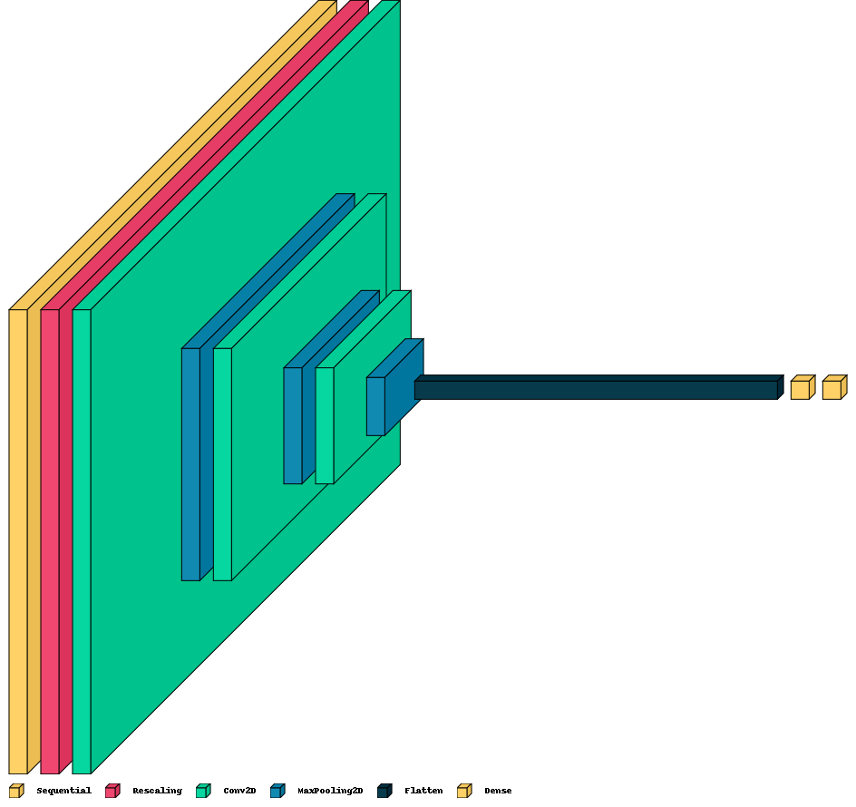
Image Classification (Posture Recognition)
Convolutional Neural Network model
Sequential layer (Data Augmentation)
3 Convolutional layers
3 Maxpooling layers
Flatten
Dense – 128 nodes
Dense – 3 nodes – output layer
ReLU activation
Adam optimizer
Sparse Categorical Cross Entropy loss
Callbacks (EarlyStopping, ReduceLROnPlateau)

Slide 7
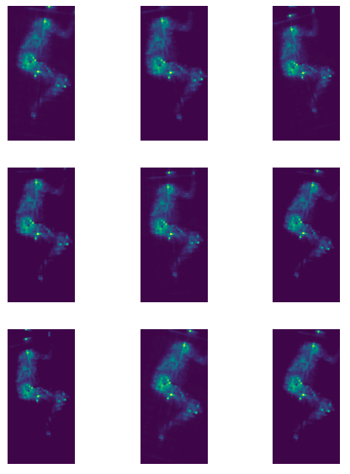
Data Augmentation
Random Rotation: ±5 degrees
Random Zoom: ±10 percent
Random Brightness: ±5 percent
Random Contrast: ±5 percent
Spatial locations are important. Could not use too much augmentation which changes the spatial location e.g., rotation, crop.

Slide 8
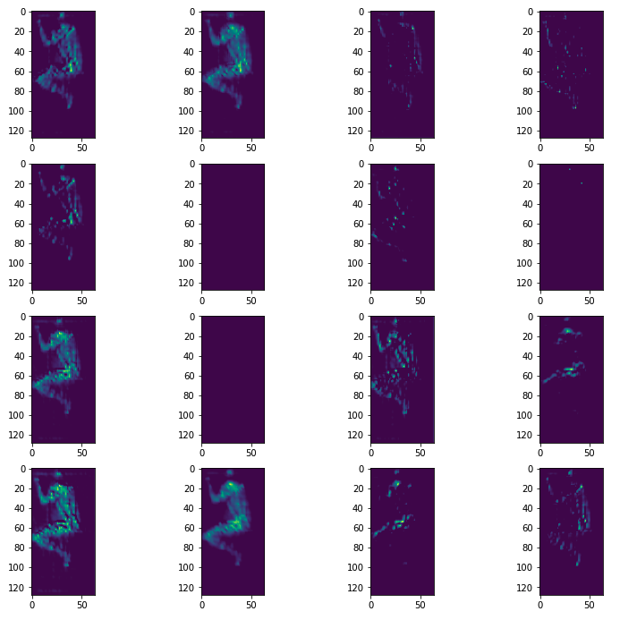
Activations
Results from the second convolutional layer.
Much of weights are active.

Slide 9
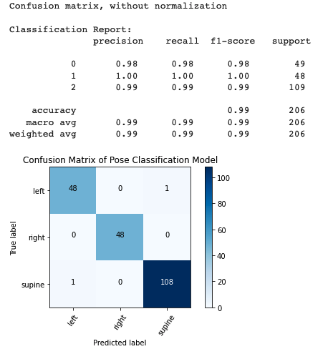
Results
Results performed on the test dataset

Slide 10
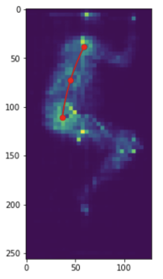
Keypoint detection
Data
350 labelled data samples
Same dataset but only postures:
Left
Right
3 Keypoints
Shoulder
Midbody
Hip
An angle between three points
A line connecting these three points
Python Script to generate the required data format for the model in json.

Slide 11
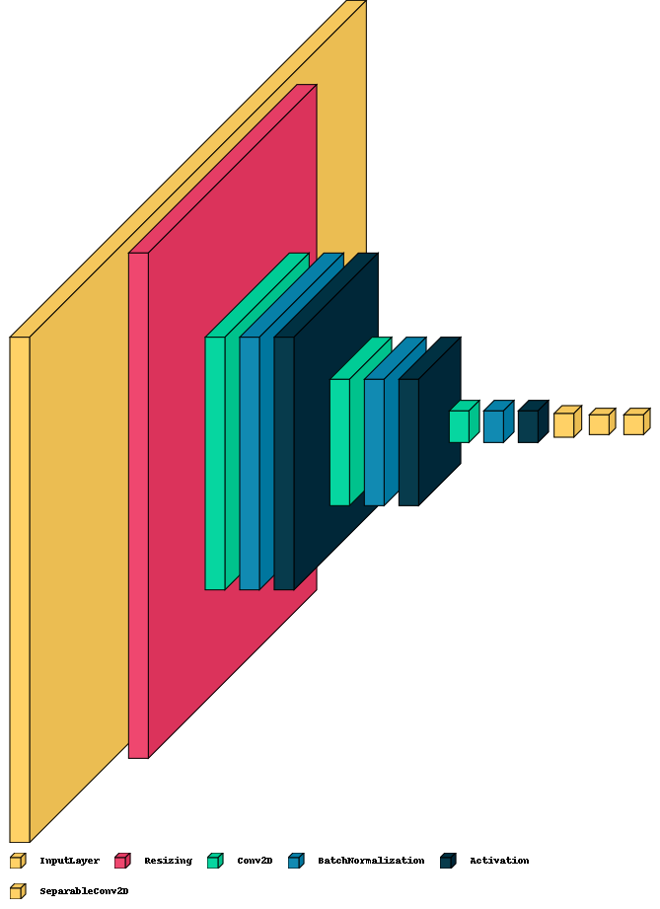
Model
Resizing and Rescaling
Convolutional Layer
BatchNormalization
ReLU and Sigmoid Activation
Mean-Squared Error loss
Adam optimizer

Slide 12
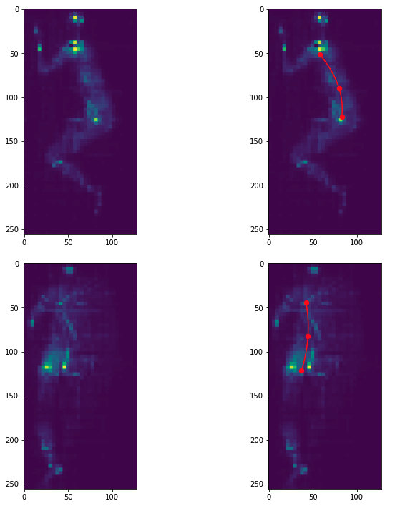
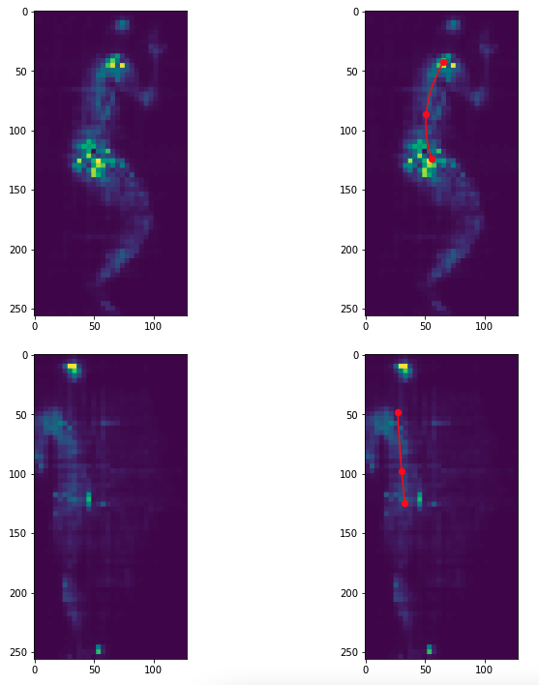
Results
Angles: True Predicted
169.17° 154.83°
178.04° 172.37°
Angles: True Predicted
167.54° 155.54°
174.21° 166.25°

