Slide 1
Events Detection
In collaboration with Elbit

Slide 2
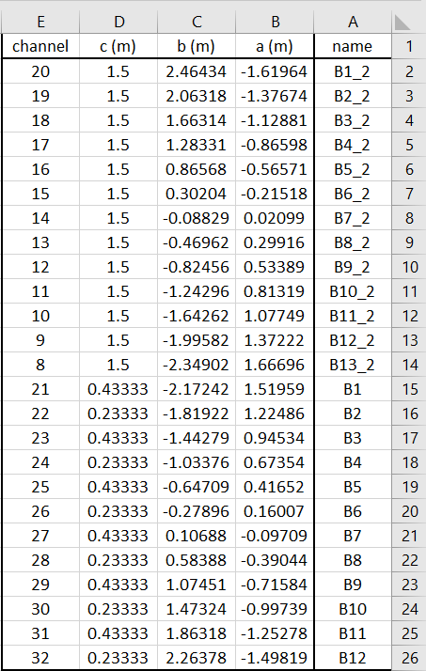
Log Book – Sensors
25 sensors:

Slide 3
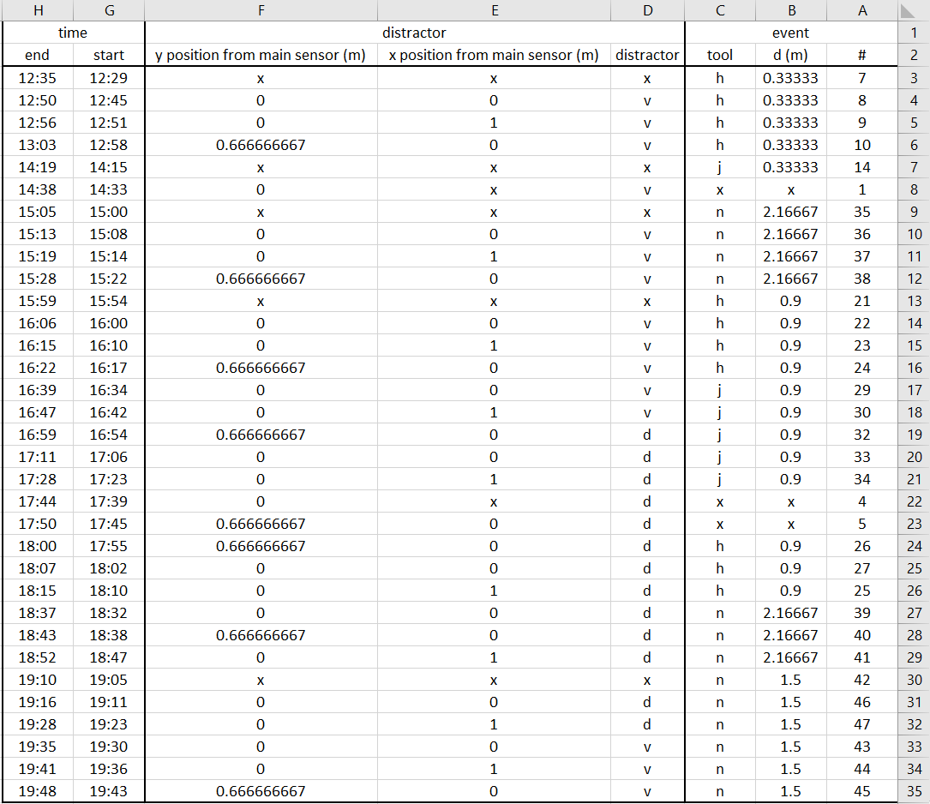
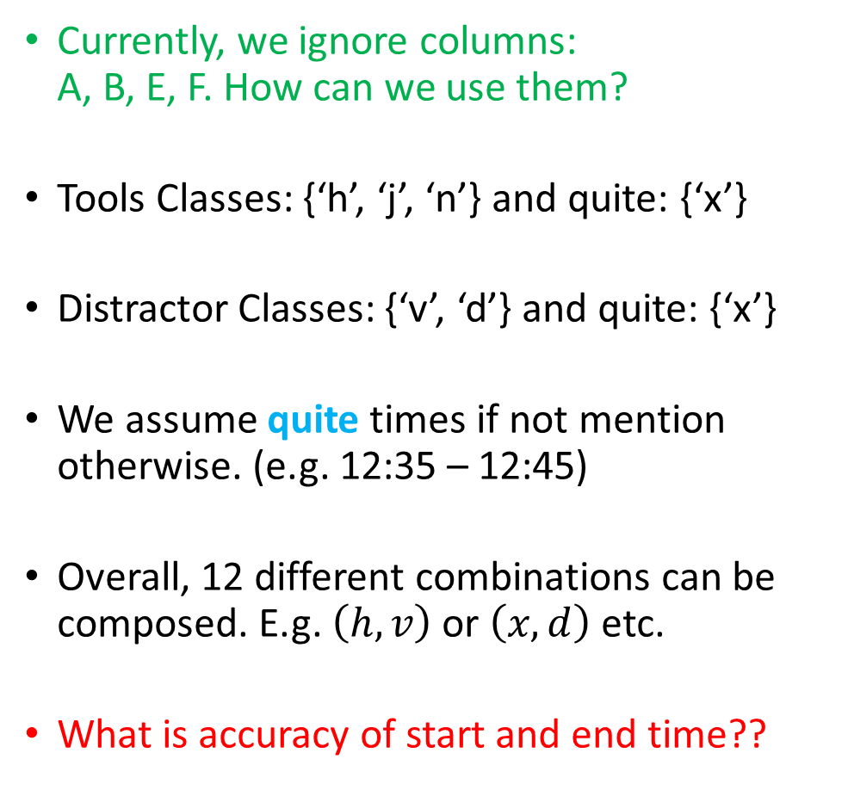
Log Book - Events
Currently, we ignore columns: A, B, E, F. How can we use them?
Tools Classes: {‘h’, ‘j’, ‘n’} and quite: {‘x’}
Distractor Classes: {‘v’, ‘d’} and quite: {‘x’}
We assume quite times if not mention otherwise. (e.g. 12:35 – 12:45)
Overall, 12 different combinations can be composed. E.g. $\left(h,v\right)$ or $\left(x,d\right)$ etc.
What is accuracy of start and end time??

Slide 4
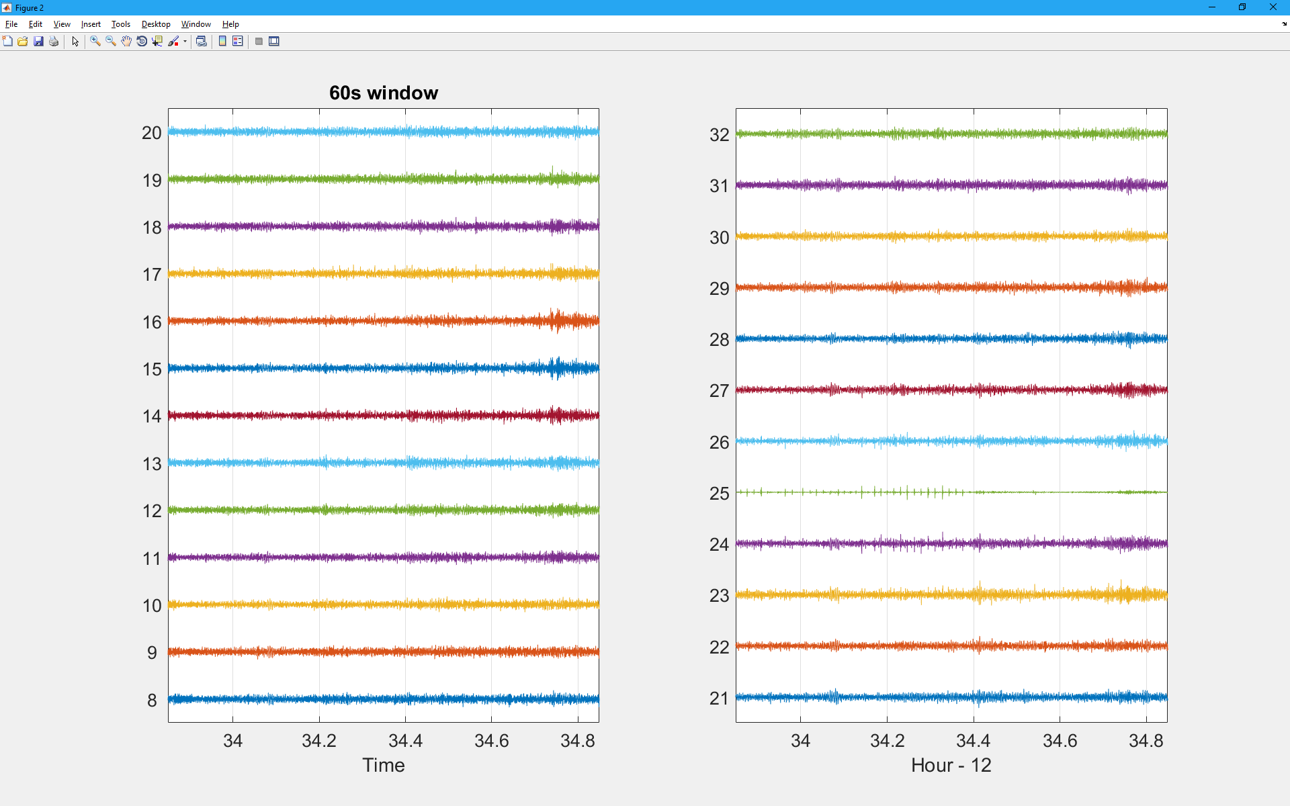
Input Data

Slide 5
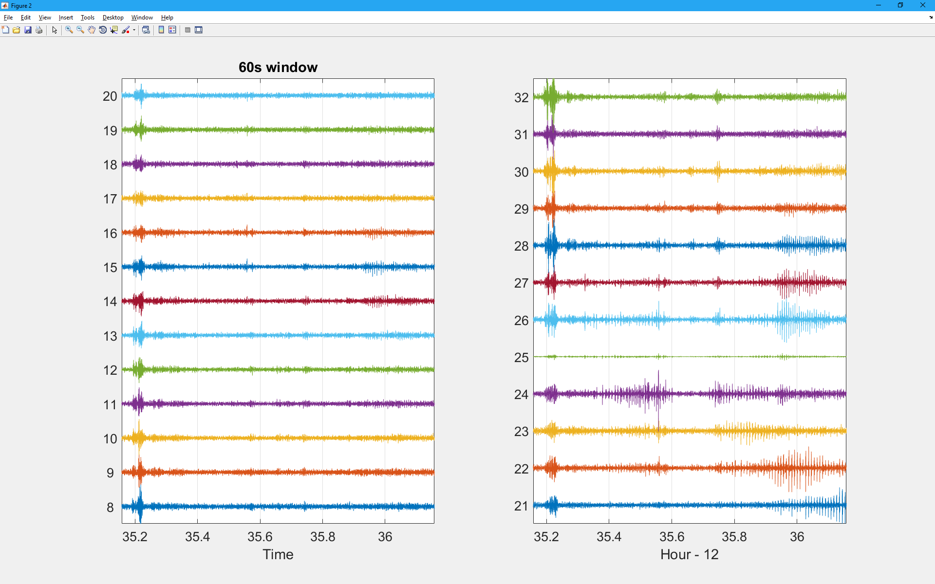
Quite?

Slide 6
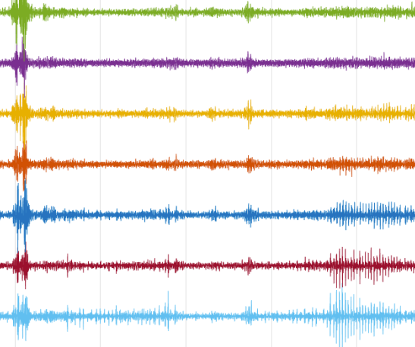

Classification approach – Features selection
The raw data is from a huge dimension
Hours of recording (sampling rate = $2000Hz$)
25 channels
We convert each distinct 5 seconds from the data into a single feature vector, namely: $X_{\left(10000×25\right)}→x_{325×1}$.
Features Selection
All 25 channels
5 Sec

Slide 7
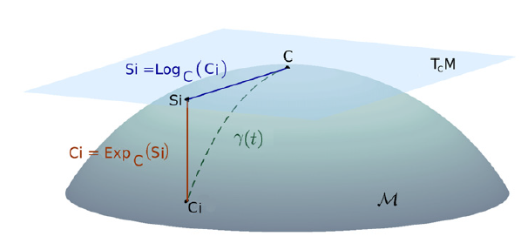
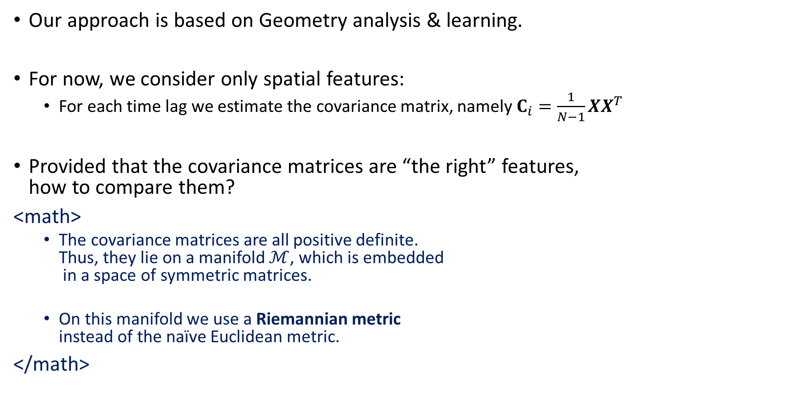
Approach for features selection
Our approach is based on Geometry analysis & learning.
For now, we consider only spatial features:
For each time lag we estimate the covariance matrix, namely $C_{i}=\frac{1}{N−1}XX^{T}$
Provided that the covariance matrices are “the right” features, how to compare them?
<math>
The covariance matrices are all positive definite. Thus, they lie on a manifold $ℳ$, which is embedded in a space of symmetric matrices.
On this manifold we use a Riemannian metric instead of the naïve Euclidean metric.
</math>
Classification of covariance matrices using a Riemannian-based kernel
for BCI applications [A. Barachant et. al.]

Slide 8
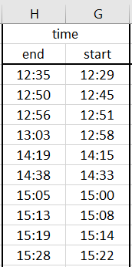
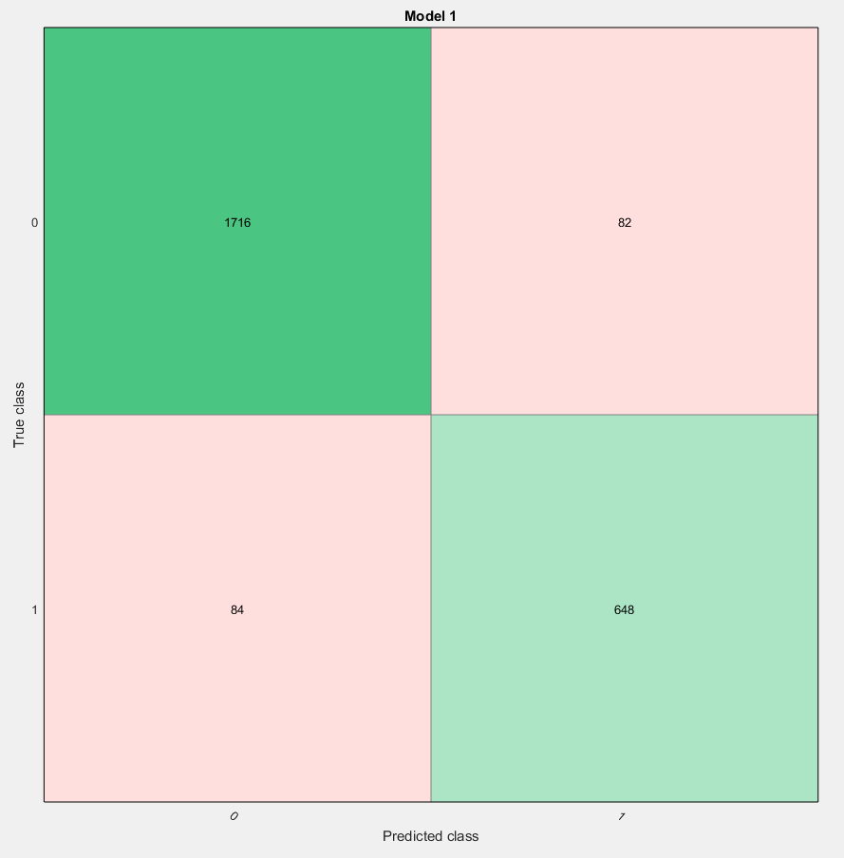
Preliminary Results - Event Detection
12:00 – 15:30
10 events
Class 0 - No event
Class 1 - Event
Overall 93.6%
Initial examination suggests that many errors occur due to coarse labeling.
1716
82
84
648

Slide 9
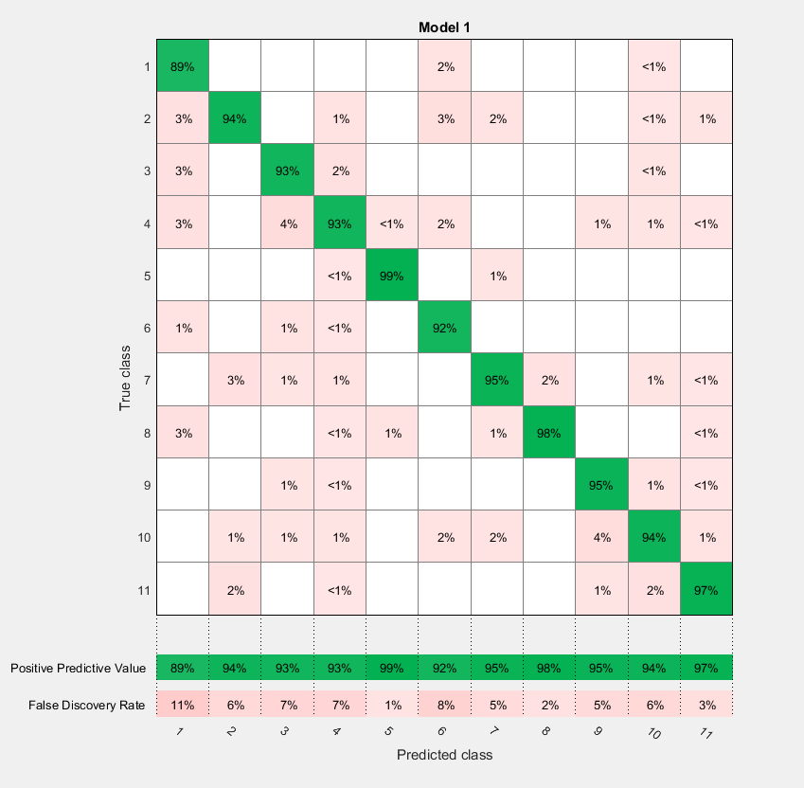
Preliminary Results
No Tool
Removing quiet times. (distractor or tool).
11 Classes.
2,396 samples.
Using off the shelf classifier (Ensemble Subspace Knn) based on our features and metric: 94.8% accuracy.
Tool ‘h’
Tool ‘j’
Tool ‘n’

Slide 10
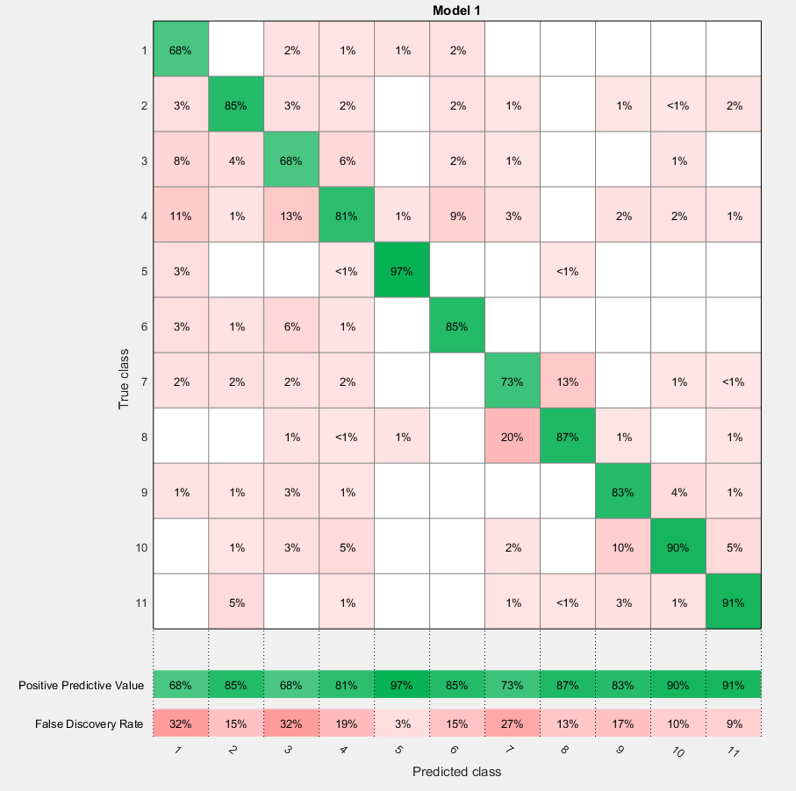
Comparison to Euclidean Metric
No Tool
Tool ‘h’
Removing quite times. (distractor or tool)
11 Classes.
2,396 samples.
Using off the shelf classifier (Ensemble Subspace Knn) based on our features and metric: 84.8% accuracy.
Tool ‘j’
Tool ‘n’

Slide 11
Summary
An early stage solution.
Main result: the discrimination capability of the features and the metric.
Current implementation: detection and classification under supervised setting.
Next step:
Incorporate time using kernels.
New definitions of Riemannian metrics.
Joint time and space geometry analysis.
For discussion
what should be the framework? supervised / unsupervised, available sets of all possible tools and distractors.
Required time resolution
Expected accuracy and labeling reliability

