Slide 1
Events Classification (and more…)

Slide 2
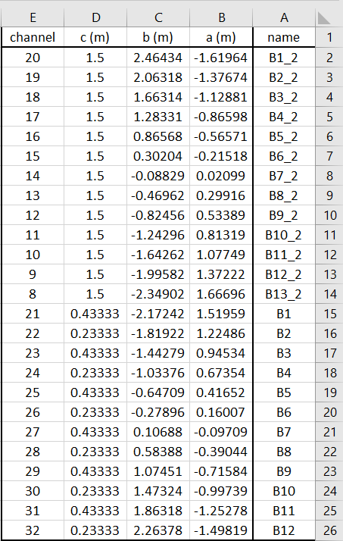
Log Book – Sensors
25 sensors:

Slide 3
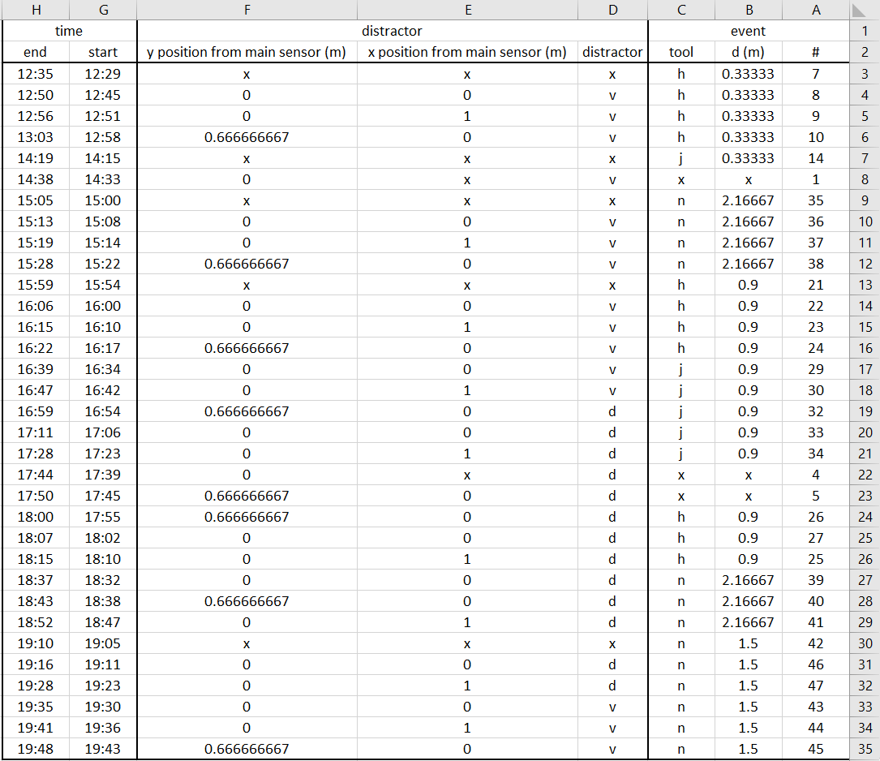
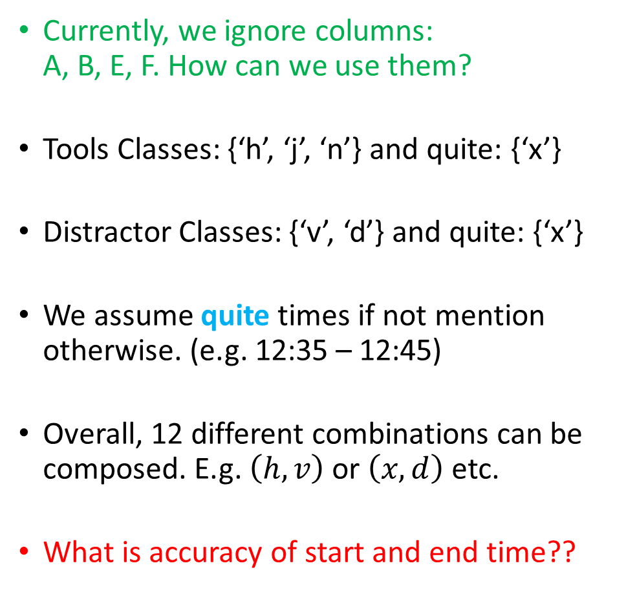
Log Book - Events
Currently, we ignore columns: A, B, E, F. How can we use them?
Tools Classes: {‘h’, ‘j’, ‘n’} and quite: {‘x’}
Distractor Classes: {‘v’, ‘d’} and quite: {‘x’}
We assume quite times if not mention otherwise. (e.g. 12:35 – 12:45)
Overall, 12 different combinations can be composed. E.g. $\left(h,v\right)$ or $\left(x,d\right)$ etc.
What is accuracy of start and end time??

Slide 4
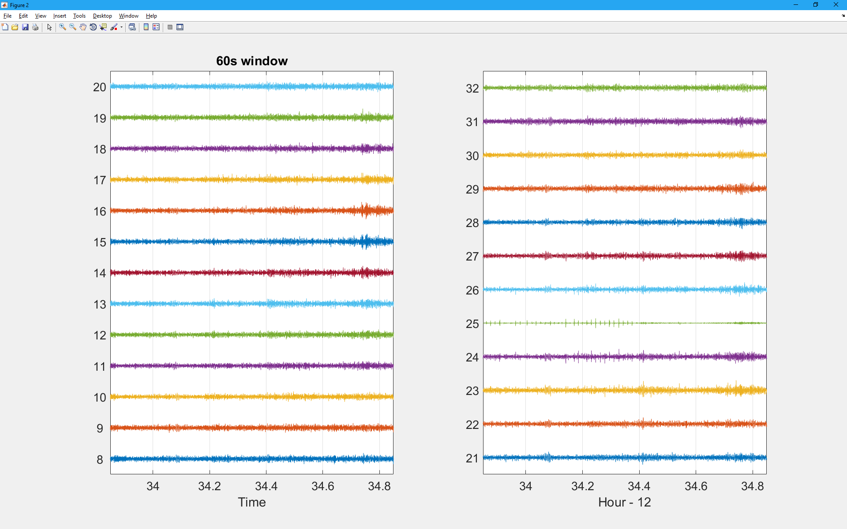
Input Data

Slide 5
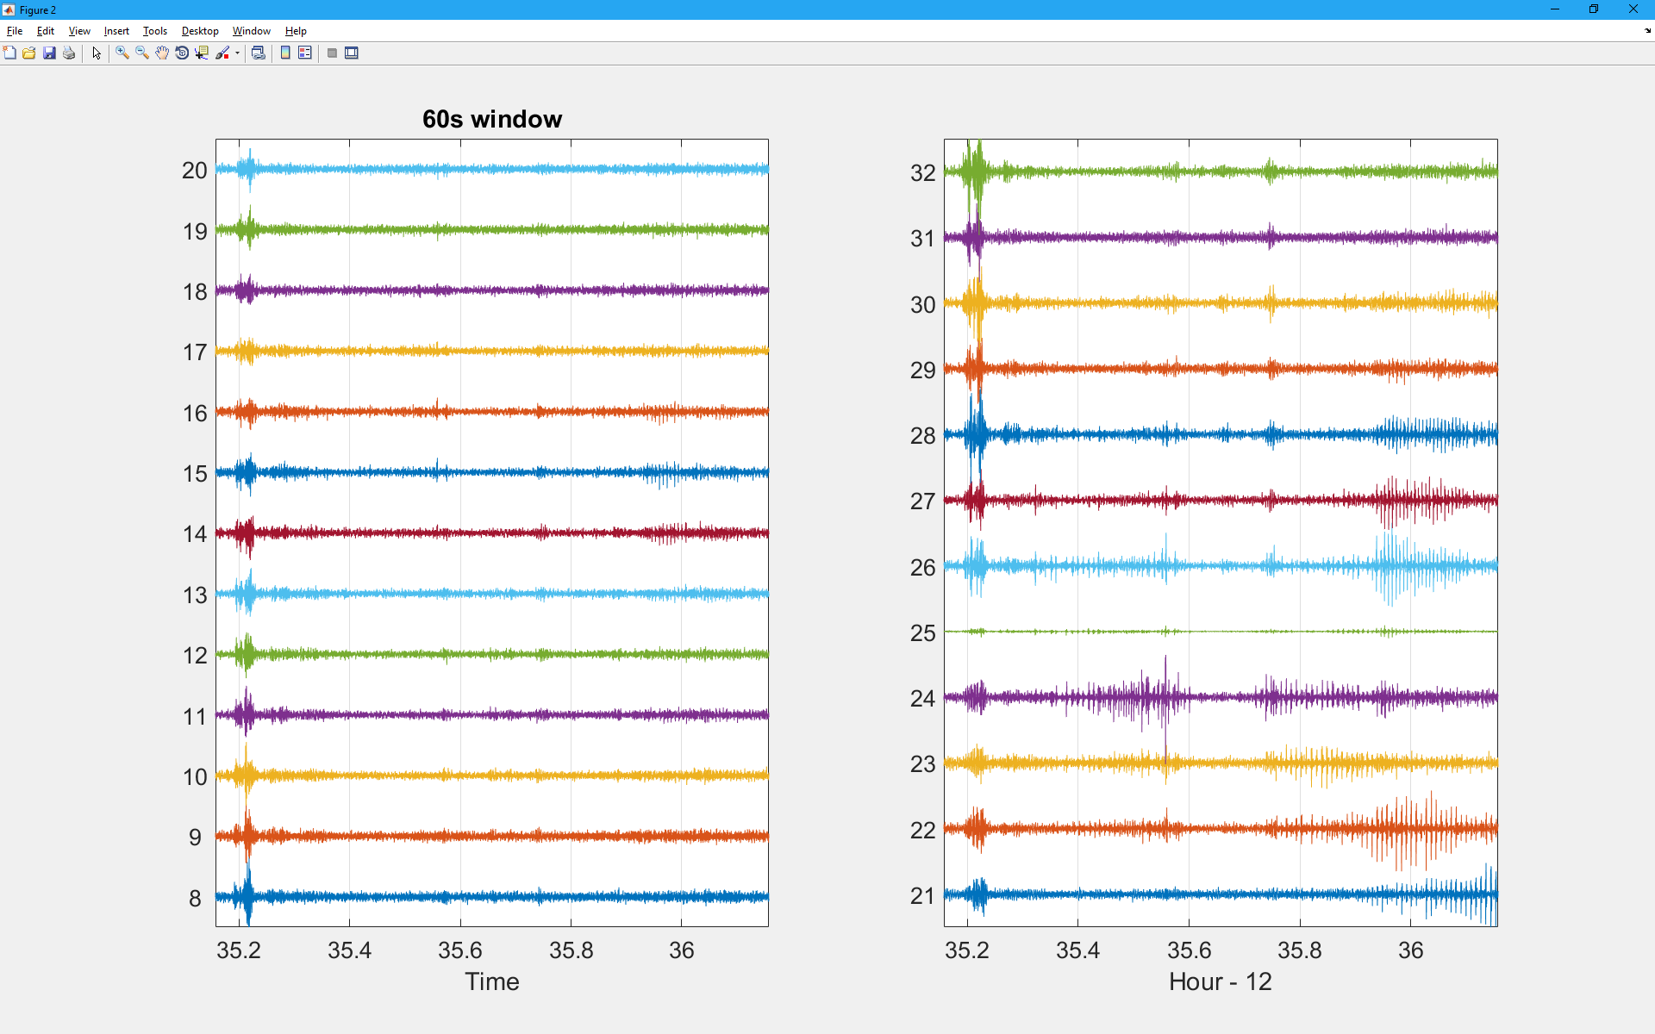
Quite?

Slide 6
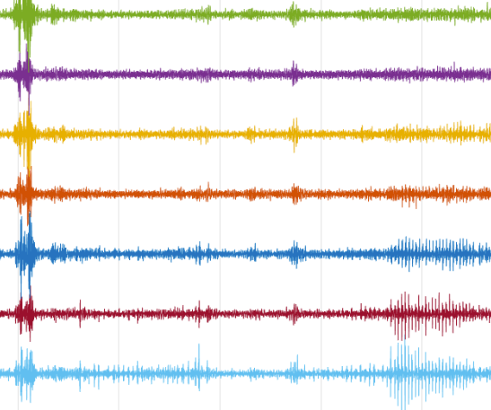
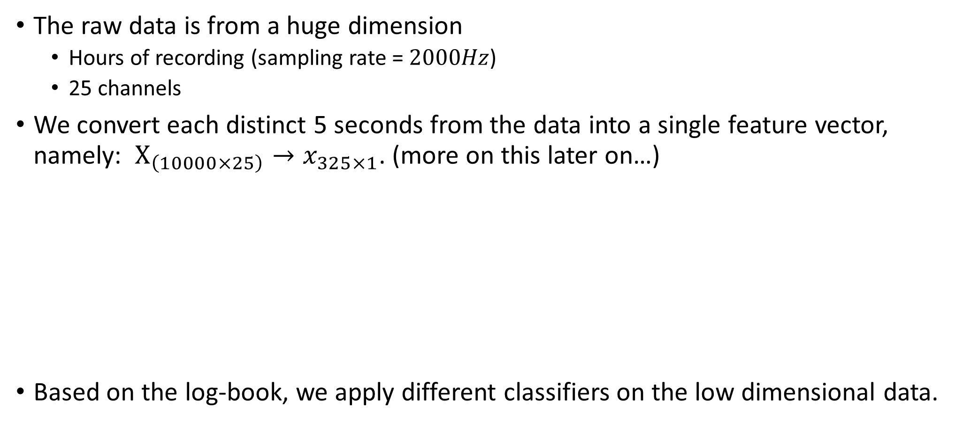
Classification approach – Features selection
The raw data is from a huge dimension
Hours of recording (sampling rate = $2000Hz$)
25 channels
We convert each distinct 5 seconds from the data into a single feature vector, namely: $X_{\left(10000×25\right)}→x_{325×1}$. (more on this later on…)
Based on the log-book, we apply different classifiers on the low dimensional data.
All 25 channels
5 Sec

Slide 7
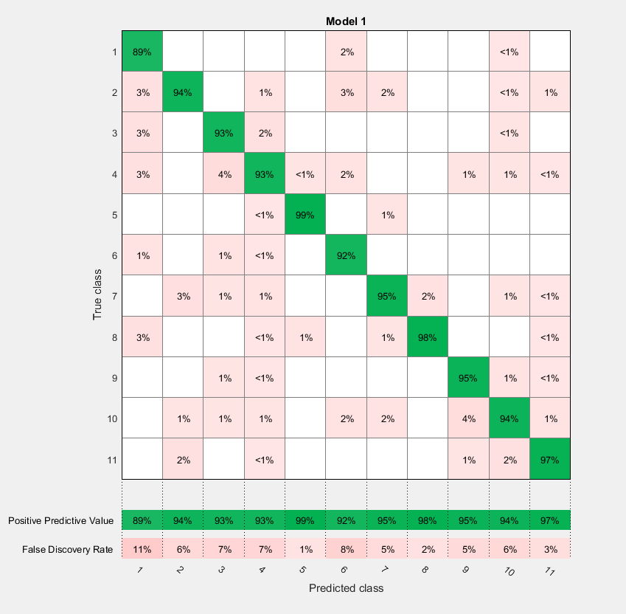
Preliminary Results
No Tool
Removing quite times. (so either distractor or tool is in the log –book).
11 Classes.
2,396 samples.
Using Ensemble Subspace Knn: 94.8% accuracy.
Tool ‘h’
Tool ‘j’
Tool ‘n’

