Slide 1
Events Detection

Slide 2
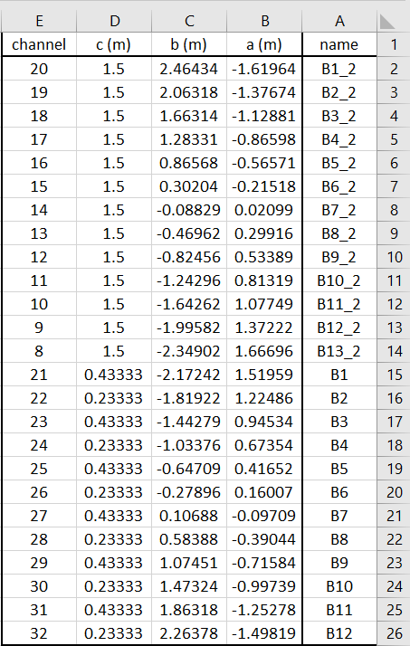
Log Book – Sensors
25 sensors:

Slide 3
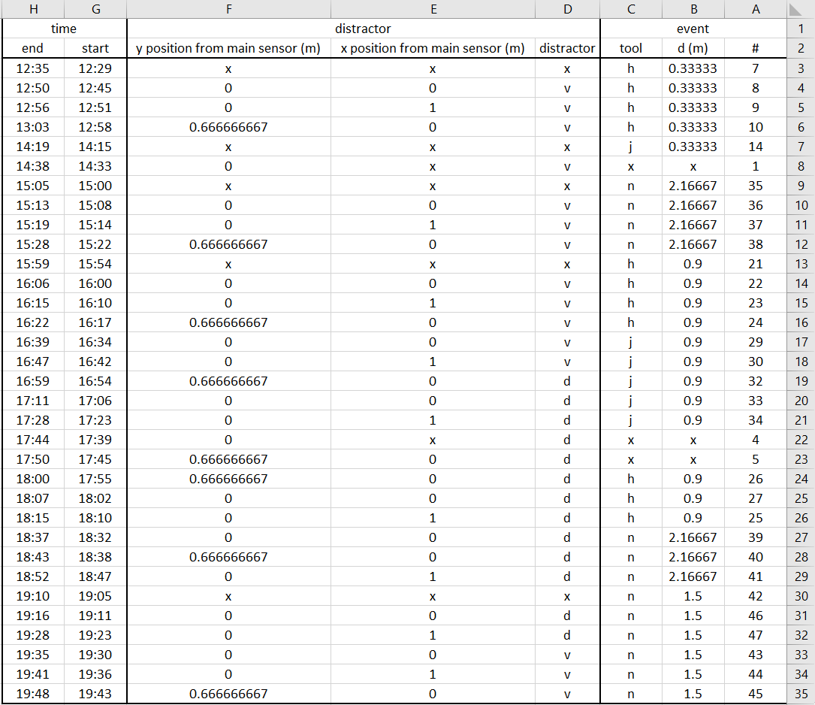
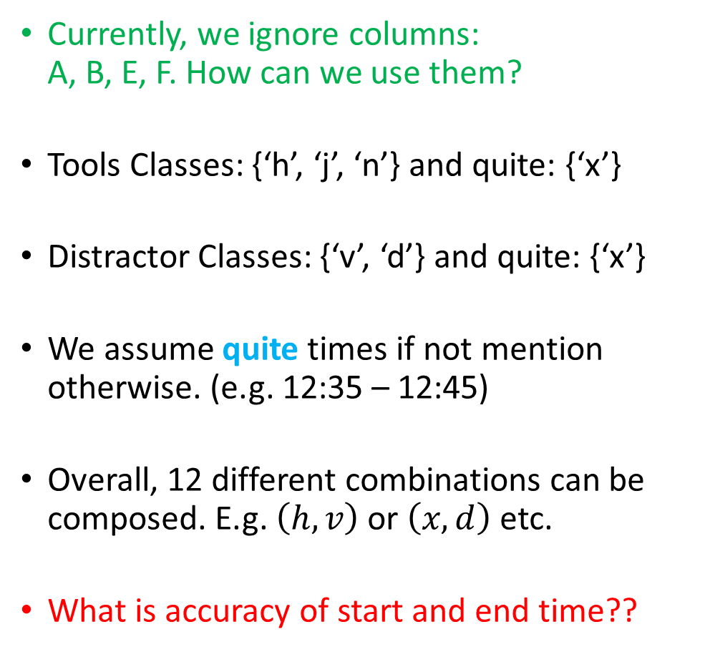
Log Book - Events
Currently, we ignore columns: A, B, E, F. How can we use them?
Tools Classes: {‘h’, ‘j’, ‘n’} and quite: {‘x’}
Distractor Classes: {‘v’, ‘d’} and quite: {‘x’}
We assume quite times if not mention otherwise. (e.g. 12:35 – 12:45)
Overall, 12 different combinations can be composed. E.g. $\left(h,v\right)$ or $\left(x,d\right)$ etc.
What is accuracy of start and end time??

Slide 4
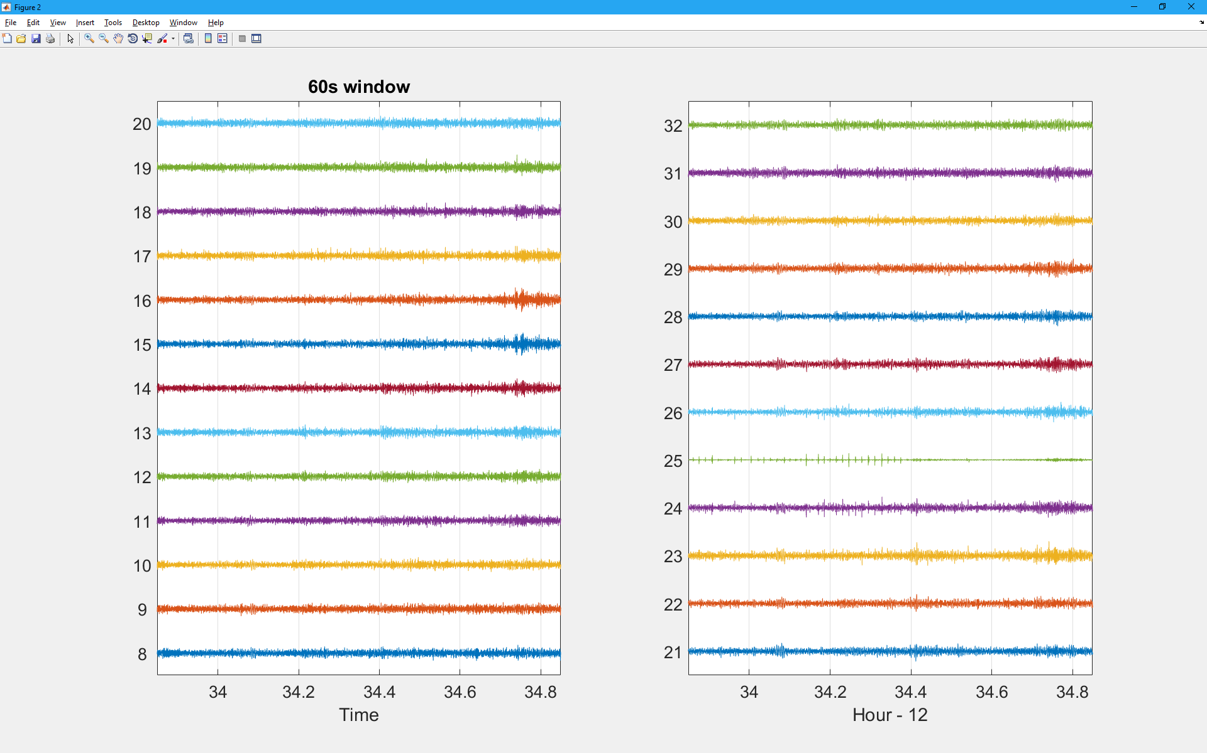
Input Data

Slide 5
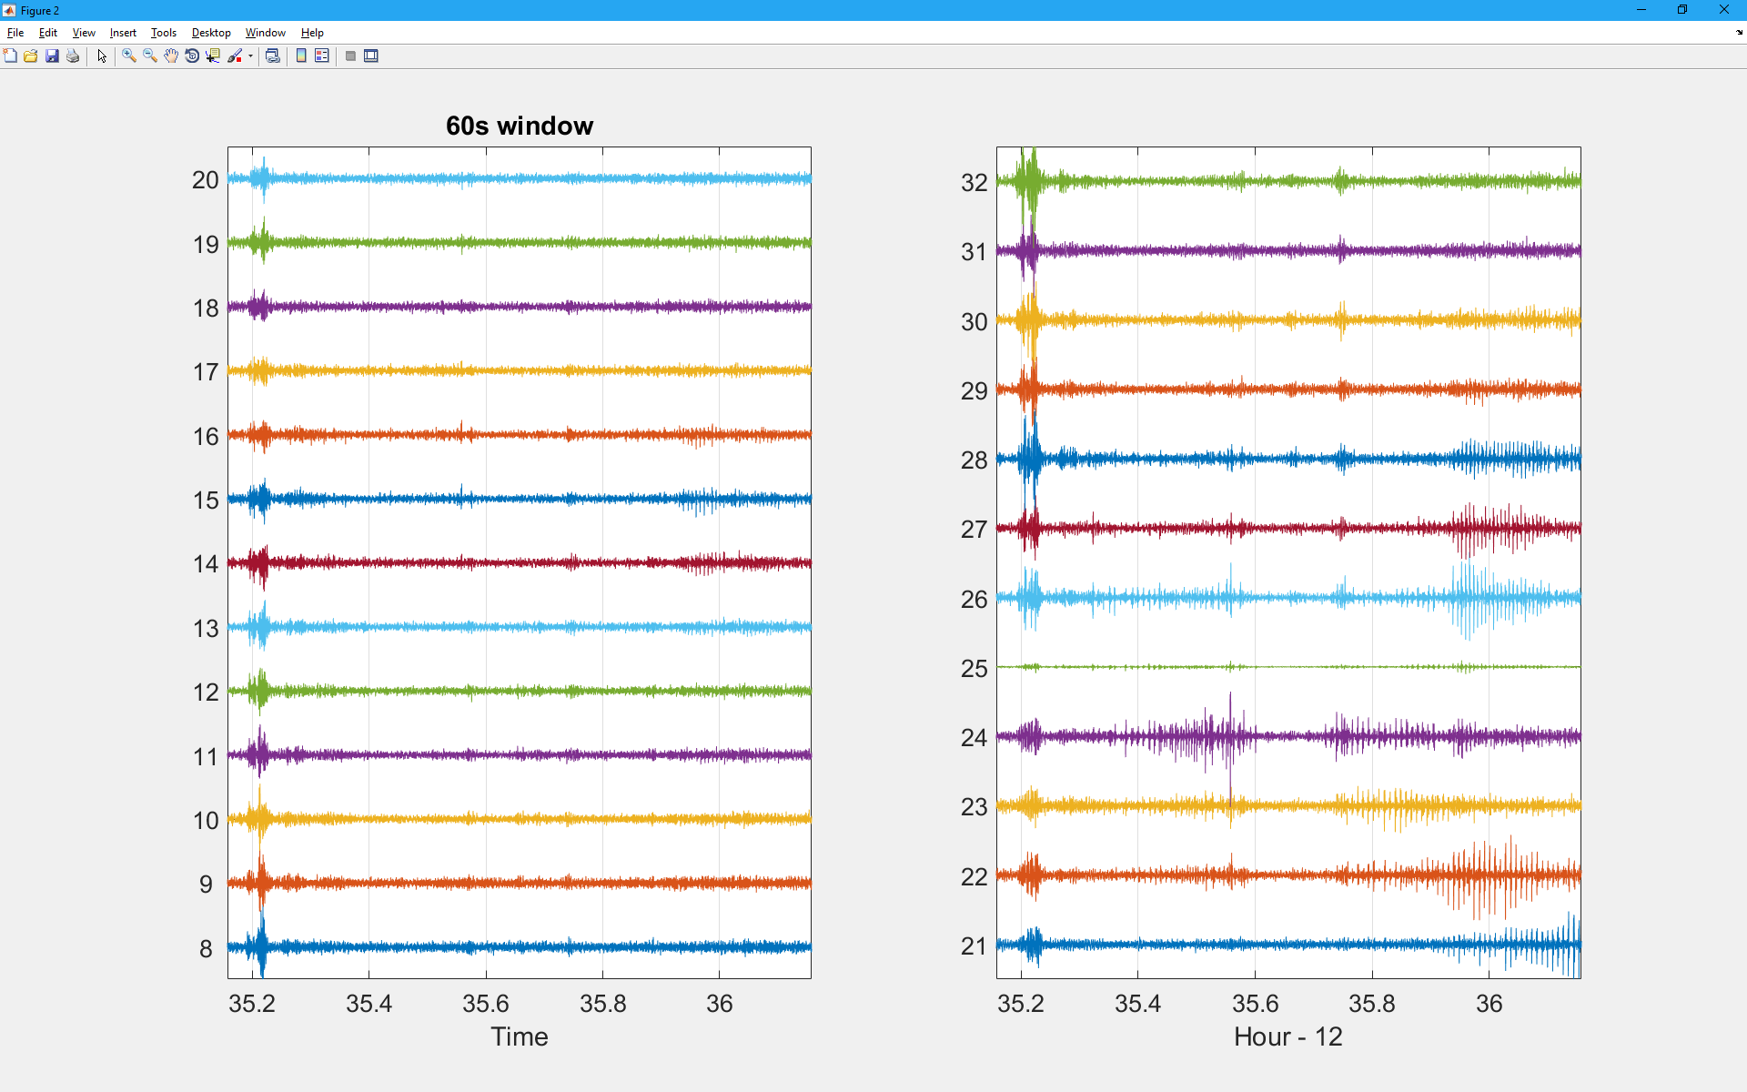
Quite?

Slide 6
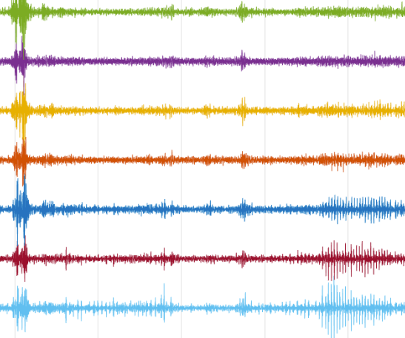

Classification approach – Features selection
The raw data is from a huge dimension
Hours of recording (sampling rate = $2000Hz$)
25 channels
We convert each distinct 5 seconds from the data into a single feature vector, namely: $X_{\left(10000×25\right)}→x_{325×1}$.
Features Selection
All 25 channels
5 Sec

Slide 7
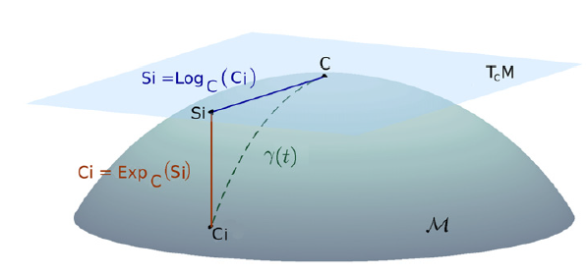
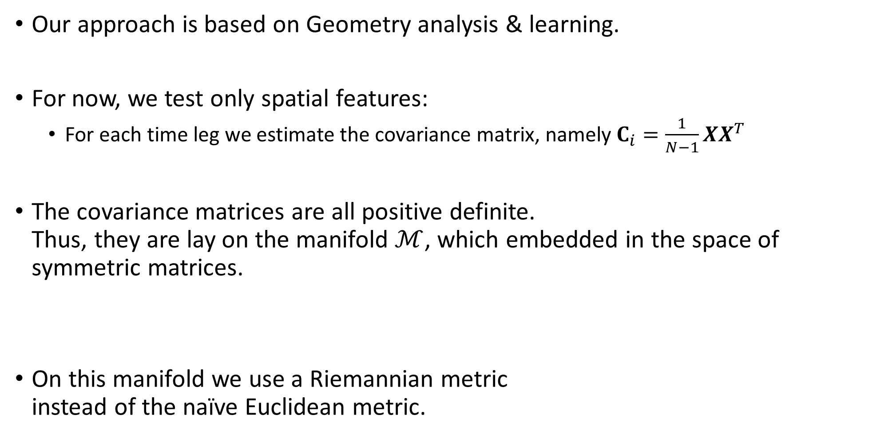
Approach for features selection
Our approach is based on Geometry analysis & learning.
For now, we test only spatial features:
For each time leg we estimate the covariance matrix, namely $C_{i}=\frac{1}{N−1}XX^{T}$
The covariance matrices are all positive definite. Thus, they are lay on the manifold $ℳ$, which embedded in the space of symmetric matrices.
On this manifold we use a Riemannian metric instead of the naïve Euclidean metric.

Slide 8
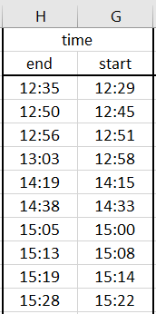
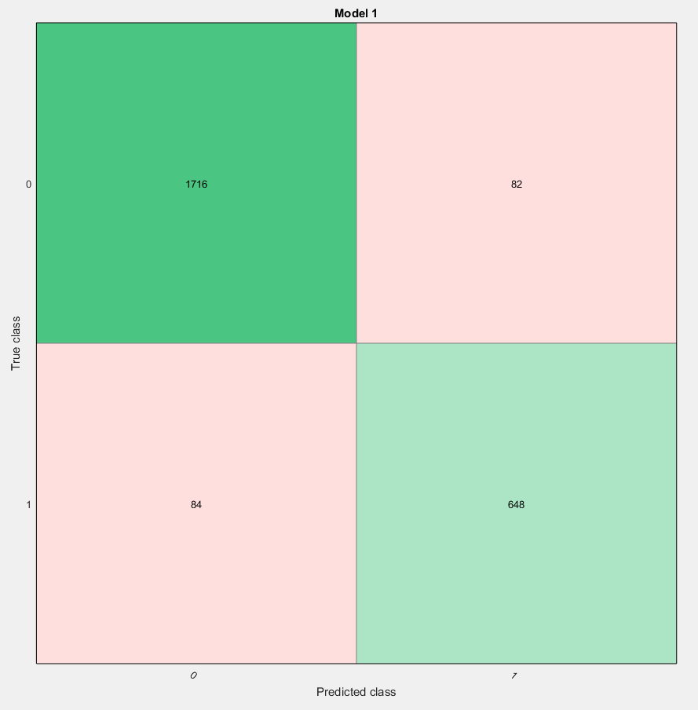
Preliminary Results - Event Detection
12:00 – 13:30
4 events
Class 0 - No event
Class 1 - Event
Overall 93.6%
We assume most error occur due to coarse labeling.

Slide 9
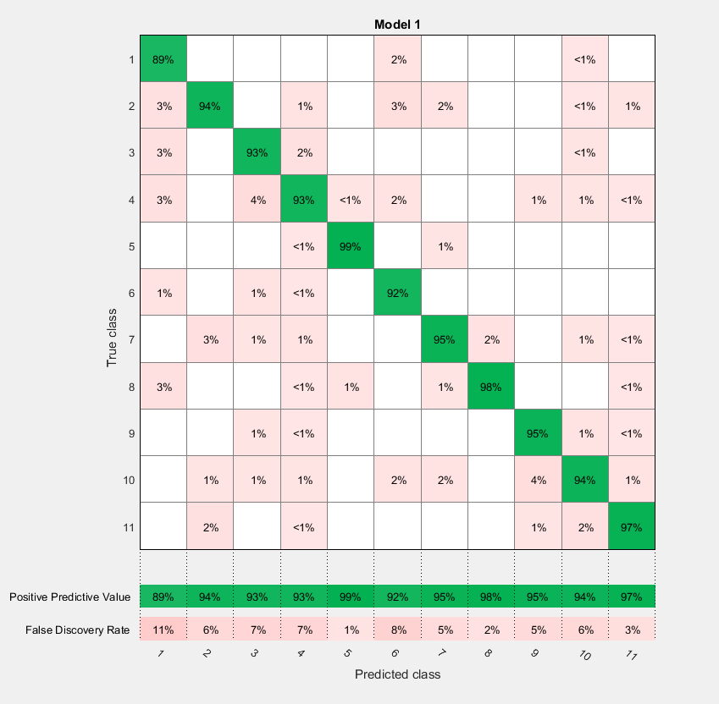
Preliminary Results
No Tool
Removing quite times. (so either distractor or tool is in the log –book).
11 Classes.
2,396 samples.
Using Ensemble Subspace Knn: 94.8% accuracy.
Tool ‘h’
Tool ‘j’
Tool ‘n’

Slide 10
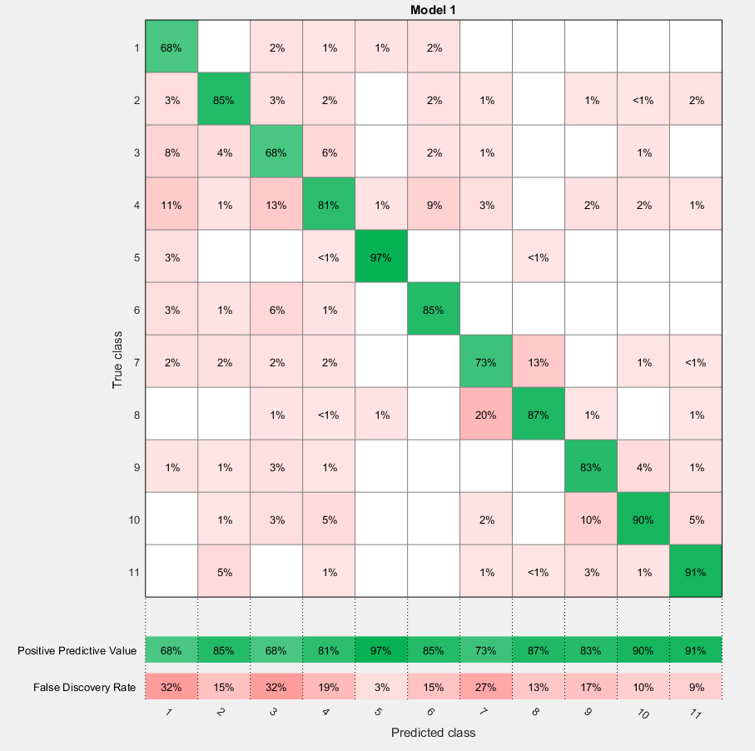
Comparison to Euclidean Metric
No Tool
Tool ‘h’
Removing quite times. (so either distractor or tool is in the log –book).
11 Classes.
2,396 samples.
Using Ensemble Subspace Knn: 84.8% accuracy.
Tool ‘j’
Tool ‘n’

Slide 11
Summary
This is an early stage solution for managing expectations.
Simple approach: detection and classification under supervised setting.
Main result: the discrimination capability of the features and the metric.
Discussion
what should be the framework? supervised / unsupervised, available sets of all possible tools and distractors.
Next step, incorporate time using kernels and new definitions of Riemannian metrics for joint time and space geometry analysis.

