Slide 1
Creating Clickable Hot Spots in Images
OIM3690
Prof. Gordon

Slide 2
Learning Objectives
By the end of this class you will be able to:
Create clickable links (hot spots) in your images using an image map
Create hot spots in your image using positioned <a> tags
Identify the hot spot coordinates of your image using Paint
Identify the hot spot coordinates of your image using online services

Slide 3
Making an Image into a Link
You already know how to do this, right?

Slide 4
Making an Image into a Link
Surround the image with an <a> tag
<a href="http://www.babson.edu">
<img src="http://...jpg" alt="Babson">
</a>

Slide 5
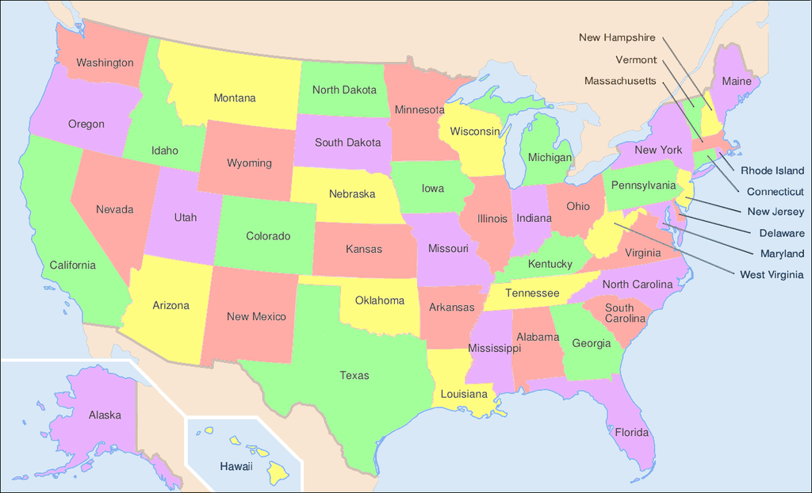
What If I Want To Make Each of the States Into a Link?

Slide 6
Two Solutions
Use an image map
Use style-positioned <a> tags in a <div> with the image as a background

Slide 7
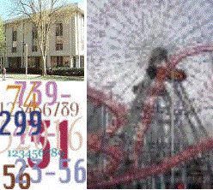
Image Maps
248 pixels
(0,0)
Image size may be expressed in
coordinates
222
pixels
(248,222)

Slide 8
Image Maps
248 pixels
(0,0)
(104,0)
Areas may be expressed in coordinates as well.
Coordinates may be approximate
(96,98)
(0,102)
222 pixels
(96,222)
(248,222)

Slide 9
Area Tag Identifies a Hot Spot
<area shape="rect" coords="0,102,96,222" href="dmgrphcs.htm" alt="demo" />
(0,102)
(96,222)

Slide 10
Area Tag Has Four Required Attributes
shape: The shape of the hot spot
coords: The coordinates of the hot spot relative to the top left corner of the picture
href: Where the browser should go if the user clicks on the hot spot
alt: Text describing the shape

Slide 11
Area Tag Identifies a Hot Spot
<area shape="rect" coords="0,102,96,222" href="dmgrphcs.htm" alt="demog" />
(0,102)
(96,222)

Slide 12
Shapes and Coordinates
Other Shapes
Circle
Polygon
shape="circle" coords="x,y,r"
(x,y)
x,y (center position)
r (radius distance)
r
(x2,y2)
(x1,y1)
(x3,y3)
shape="poly" coords="x1,y1,x2,y2,x3,y3"

Slide 13
The <map> Tag
Surround all the hot spots for an image with <map> and </map> tags
The one attribute of a map is its name
The map may go anywhere in the body
<map name="townareas" >
<area shape="rect" coords="0,0,96,98" href="history.htm" alt="hist"/>
<area shape="rect" coords="0,102,96,222" href="dmgrphcs.htm" alt="demog"/>
<area shape="rect" coords="104,0,248,222" href="attract.htm" alt="attract"/>
</map>

Slide 14
The usemap Attribute
Links the <img> to the map
Refers to the map’s name with a #
Names must match
<map name="townareas" >
<area shape="rect" coords="0,0,96,98" href="history.htm" alt="hist"/>
<area shape="rect" coords="0,102,96,222" href="dmgrphcs.htm" alt="demog"/>
<area shape="rect" coords="104,0,248,222" href="attract.htm" alt="attract"/>
</map>
New Attribute
<img src="townmap.gif" usemap="#townareas" alt="areas" />

Slide 15
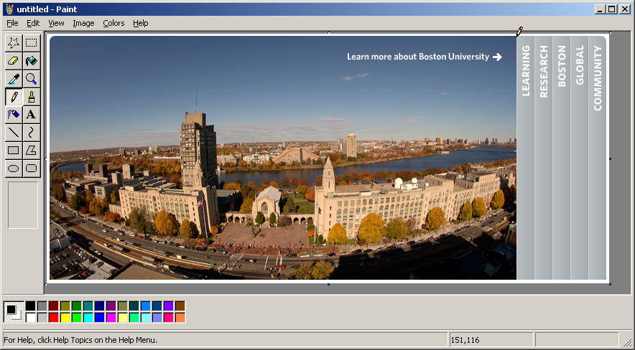
Using Paint to Find Coordinates
Pencil
Coordinates
Image source: http://www.bu.edu

Slide 16
Using Online Image Map Generators
http://www.maschek.hu/imagemap/imgmap
http://www.html-map.com/
https://www.image-map.net/

Slide 17
Using image-map.net
<!-- Image Map Generated by http://www.image-map.net/ -->
<img src="USMap.png" usemap="#image-map">
<map name="image-map">
<area target="" alt="Colorado" title="Colorado" href="https://en.wikipedia.org/wiki/Colorado" coords="266,232,199,178" shape="rect">
<area target="" alt="California" title="California" href="https://en.wikipedia.org/wiki/California" coords="26,120,28,192,72,276,98,282,110,253,58,170,66,132" shape="poly">
</map>

Slide 18
Hot Spots with Image Map

Slide 19
Hotspots With <div> and <a> Tags
Use a <div> with image as a background
Use <a> tags having an absolute position, a width, a height, and no text between the <a> and </a> tags
Doesn’t work with non-rectangular shapes, although you can put several of these together with the same href
<div style="position:relative; height:796px; width:1310px; background:url(https://upload.wikimedia.org/wikipedia/commons/1/1e/Map_of_USA_showing_state_names.png) 0 0 no-repeat;">
<a style="position:absolute; top:329px; left:374px; width:128px; height:106px;" alt="Colorado" href="https://en.wikipedia.org/wiki/Colorado"></a>
<a style="position:absolute; top:215px; left:349px; width:116px; height:96px;" alt="Wyoming" href="https://en.wikipedia.org/wiki/Wyoming"></a>
</div>

Slide 20
Hot Spots with div

Slide 21
Scaling the Image
If you scale the image on the web page, you also need to scale the coordinates of the hot spot
Example
Coordinate for full sized image is (80,200)
Image is styled to 50% of its full size
Hot spot coordinate becomes (40,100)

