Slide 1
Working With Lists
OIM3690
Prof. Gordon

Slide 2
Learning Objectives
By the end of this session, you will be able to
Create bulleted lists
Create numbered lists
Create horizontal lists
Apply styles to lists
Properly create outlines and sub-lists
Use the hover style to display sub-lists

Slide 3
Lists
Lists are used to organize your page
Bulleted (unordered) Lists <ul>… </ul>
Numbered (ordered) Lists <ol> … </ol>
Definition Lists <dl>…</dl> also exist, but we won't use them
You can also nest lists to create an outline

Slide 4
Ordered and Unordered List Lines
Use <li> and </li> to tag lines (items/elements) of the list
Don’t use <p>
Use <br> if you want to force the item to appear over two or more lines

Slide 5
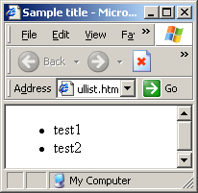
Unordered List Example
<body>
<ul>
<li>test1</li>
<li>test2</li>
</ul>
</body>

Slide 6
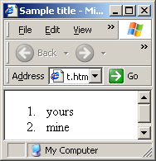
Ordered List Example
<body>
<ol>
<li>yours</li>
<li>mine</li>
</ol>
</body>

Slide 7
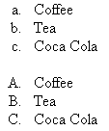
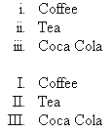

Ordered List Styles
list-style-type:
decimal (default), lower-roman, upper-roman, lower-alpha, upper-alpha

Slide 8
Ordered List Style Example
ol {list-style-type:lower-alpha} In <head><style>section
<ol>
<li>This is item 1</li>
<li>This is item 2</li>
<li>This is item 3</li>
</ol>
Will look like this:
a. This is item 1
b. This is item 2
c. This is item 3
In body section

Slide 9

Unordered List Styles
list-style-type:
disc (default), circle, square, none
list-style-image: url('…'), where the dots are replaced by a file name or web link

Slide 10
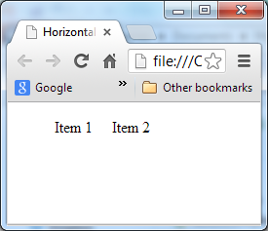
Horizontal Lists Using Float Style
<!DOCTYPE html>
<html>
<head>
<meta … />
<title>Horizontal list</title>
<style type="text/css">
ul {list-style-type:none}
li {float:left; padding:0px 20px 0px 0px}
</style>
</head>
<body>
<ul>
<li>Item 1</li>
<li>Item 2</li>
</ul>
</body>
</html>

Slide 11
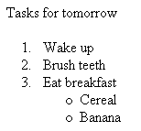
Nesting Lists (Ordered and Unordered)
A nested list (sub-list) must be placed inside a <li></li> pair
Example
<p>Tasks for tomorrow</p>
<ol>
<li>Wake up</li>
<li>Brush teeth</li>
<li>Eat breakfast
<ul>
<li>Cereal</li>
<li>Banana</li>
</ul>
</li>
</ol>
NOTICE

Slide 12
Nesting Lists (Ordered and Unordered)
It is a mistake to nest a list inside another list but not inside a <li></li> pair
WRONG:
<p>Tasks for tomorrow</p>
<ol>
<li>Wake up</li>
<li>Brush teeth</li>
<li>Eat breakfast</li>
<ul>
<li>Cereal</li>
<li>Banana</li>
</ul>
</ol>

Slide 13
Expanding Nested Lists
Style li ul {display:none}
This makes the nested ul disappear
Style li:hover ul {display:block}
The makes the nested ul appear when the cursor hovers over the line it is nested in
Example (look at page and at source): Expanding list
Great trick for navigation menus

Slide 14
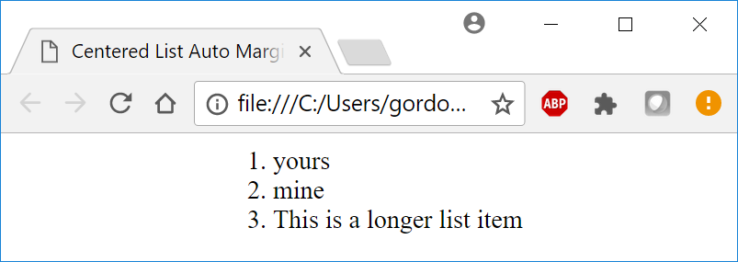
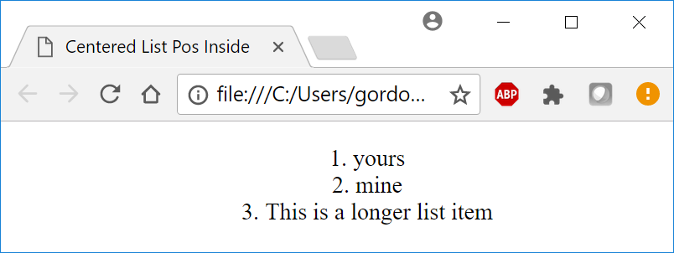
Centering a List: 2 Designs
/*Width is width of longest item on the list */
ol {width:10em; margin: 0px auto 0px auto;}
ol {text-align: center; list-style-position: inside;}

