Slide 1
Working with Links

Slide 2
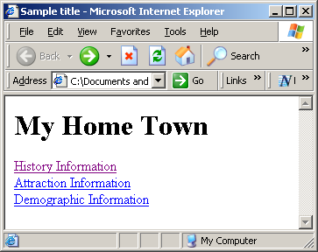
Links
Provide a way for the user to move from page to page thru clicking actions

Slide 3
Linking with the <a> tag
<a> tag syntax <a href="destination">label</a>
Destination: a filename or URL
Label: a link—what the user sees

Slide 4
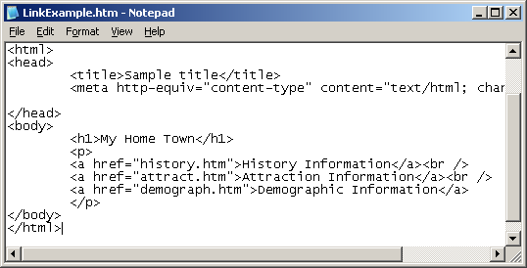
Link Example
Click on
History Information
to go to page
history.htm

Slide 5
More on the <a> tag syntax
<a href="destination">label</a>
This is the second time we’ve seen this form
Reminder: Attributes always go inside the opening tag
Opening Tag
Closing Tag
Attribute Type
Attribute Value

Slide 6
Link Types
Internal Link
A link to another page of the same website
External Link
A link to a page of a different website
My Home Town Website
Sally’s Home
Town Website
Home Town
index.htm
Home Town
index.htm
History
Attractions
Demographics
History
Attractions
Demographics
history.htm
attract.htm
dmgrphcs.htm
history.htm
attract.htm
dmgrphcs.htm

Slide 7
Link Types
Internal Link
e.g., history.htm
Notice absence of http://
External Link
e.g., http://www.site.com/sally/index.htm
This is called an "absolute URL"

Slide 8
More on Internal Links
In most cases, all files are in same folder
<a href="history.htm">History page</a>
Implies history.htm is in same folder as the current page
You can specify a file in a subfolder
<a href="stories/story1.htm">First story</a>
Story1.htm is in the stories subfolder
Or a file in the parent folder
<a href="../up.htm">Click here</a>
DO NOT use a full pathname
BAD:<a href="C:My Documents/mis/test.htm>test file</a>

Slide 9
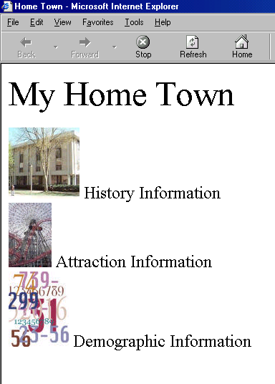
Using Images as Links
Nest the IMG tag as the label inside <a>…</a>
Nested IMG Tag
Examples
<a href="history.htm"><img src="library.jpg" alt="history" /></a>
< a href="attract.htm"><img src="fwheel.jpg“ alt="attract" /></a>
<a href="dmgrphc.htm"><img src="number.jpg“ alt="demog" /></a>

Slide 10
Example
http://wtspring13sec2/gordon/linkExample1.htm

Slide 11
Time Out
Do Part 2 of today’s in-class activity

Slide 12
Linking Within a Page
When a page is loaded into the browser window, the window is positioned at the top of the page.
Browser
Window
Web Page

Slide 13
Linking Within a Page
The vertical scrollbar or <PageDown> key may be used to bring the lower portion into view.
Browser
Window

Slide 14
Linking Within a Page
Click here…
Anchor Link
Alternatively, the id attribute can be used to identify a specific tag on the page. The link to an anchor is called an anchor link. Clicking an anchor link will cause the window to jump to the anchor.
…to position here.
Anchor

Slide 15
Anchor Link Implementation
Anchor Link
<a href="#anchor1"> Go To More Info </a>
href of anchor link starts with #
Anchor
<h2 id="anchor1"> More Info </h2>
Any tag can be an anchor. Just give it an id that matches what comes after the # in the anchor link

Slide 16
A Note About the id Attribute
You can put an id into any tag
Example: <p id="something">
Example: <h2 id="somethingElse">
The id attribute should not have any spaces in it
Example: id="redWine" instead of id="red wine“
You cannot use the same id more than once on a page. Each tag having an id must have a unique id.

Slide 17
More on Anchor Links
Normally, clicking on an anchor link brings the anchor to the top of the window
If the anchor is low on the page, it may not come to the top because the page is scrolled down as far as it can go

Slide 18
Linking to Anchors on Other Pages
Page Link
Anchor Link
Anchor
Anchor links may be used to jump to a specific location on another page.

Slide 19
Linking to Anchors on Other Pages
attract.htm
index.htm
<a href="attract.htm">…</a>
<a href="attract.htm#parks">…</a>
<p id="parks">…</p>

Slide 20
Opening Links in a New Tab
To open a link in a new browser tab, add the following attribute to the <a> tag: target="_blank"
That's an underscore, not a space
Example:
<a href="test.htm" target="_blank">Click here</a>

Slide 21
Link Example
http://wtspring13sec2/gordon/linkExample2.htm

Slide 22
In-Class Activity
Do Part 3 of today’s in-class activity

