Slide 1
Cascading Style Sheets
An Introduction

Slide 2
Why Styles?
Easily change look of a page
Provide consistency in look among pages on a site
Do more than you can with HTML tags

Slide 3
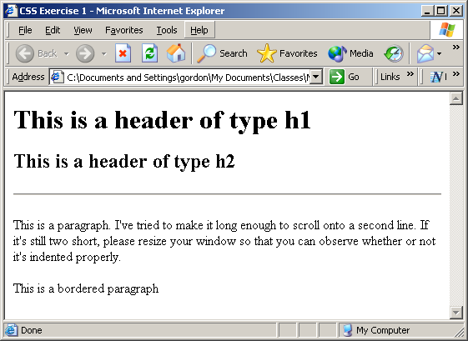
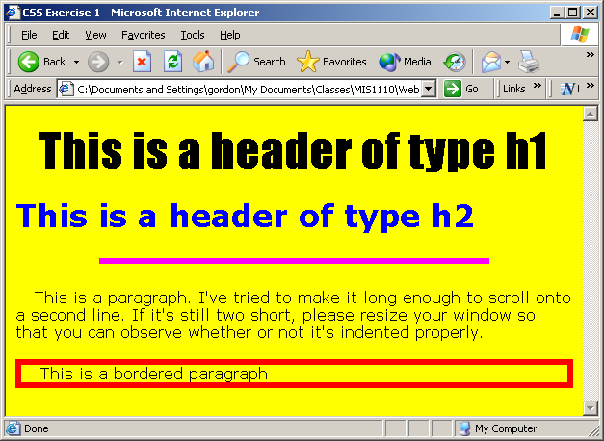
Same Page, Different Styles

Slide 4
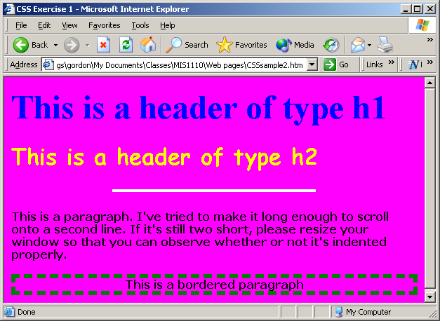
Same Page, Different Styles

Slide 5
Types of Style Declarations
External
Style rules are kept in a separate .css file
Pro: Specify once, apply to entire website
Internal
Style rules in head section of the page
Pros: Style rules appear on page they apply to
In-line
Style rules appear in tag to which they apply
Pro: Easy to see where style applies
Con: Need to repeat styles for each tag

Slide 6
How Styles Cascade
External – most general
Internal – overrides external on page where it appears
In-line – overrides everything else on tag where it appears

Slide 7
We will learn first how to use an INTERNAL style sheet

Slide 8
Creating an Internal Stylesheet
Put rules in the <head> section
Surround rules by <style> </style> tags
<style>
Rules go here
</style>

Slide 9
Syntax of Style Rules: Basic Syntax
selector {property: value; property: value;…}
The simplest selector is a tag name. Examples below:
h1 {color:red;}
The font color of all <h1> heads will be red
p {text-align:center; color:red;}
All paragraphs will be center aligned and their font color will be red
body {background-color:blue; margin: 3px 3px 3px 3px}
The background color for the page will be blue, and margins will be three pixels all around

Slide 10
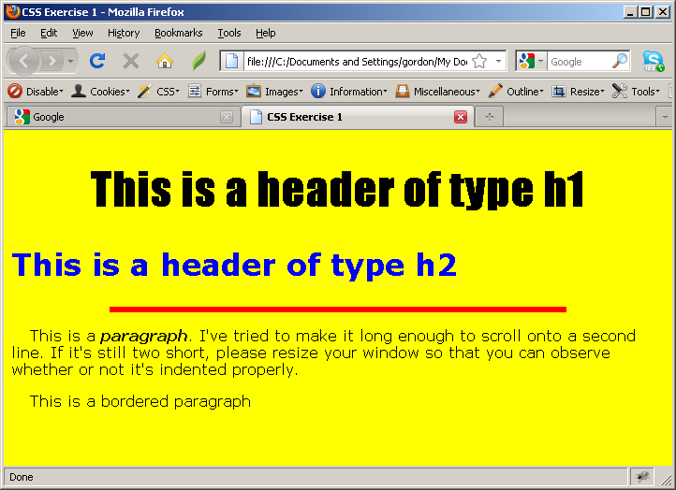
Style Example
<!DOCTYPE html>
<html>
<head>
<title>CSS Exercise 1</title>
<meta http-equiv="content-type" content="text/html; charset=utf-8" />
<style>
body {background-color:yellow;}
h1 {text-align:center; font-family:impact; font-size:36pt}
h2 {font-family:verdana; font-size:24pt; color:blue;}
p {font-family:verdana; font-size:12pt; text-indent:20px;}
hr {width:70%; color:red; height: 6px; background-color:red; border:red}
span {font-weight:800; font-style:italic}
</style>
</head>
<body>
<h1>This is a header of type h1</h1>
<h2>This is a header of type h2</h2>
<hr />
<p>This is a <span>paragraph</span>. I've tried to make it long enough to scroll onto a second line.
If it's still two short, please resize your window so that you can observe whether or not it's
indented properly.</p>
<p>This is a bordered paragraph</p>
</body>
</html>

Slide 11
Font Styles
font-family: 'name'
Example: p {font-family: 'verdana'}
font-style: normal, oblique, italic
font-weight: normal, bold, bolder, lighter, or multiple of 100 (400 is normal)
font-size: size*
Example: h1 {font-size: 30pt}
* Number followed by px (pixels), pt (point), em, or %

Slide 12
More Font Styles
text-transform: capitalize, uppercase, lowercase, none
font-variant: small-caps, or none
text-decoration: underline, overline, line-through, or none

Slide 13
Text Spacing
letter-spacing: normal, or size
word-spacing: normal, or size
white-space: pre, nowrap, normal
line-height: size

Slide 14
Alignment
text-align: left, right, center, justify
Applies to block tags, such as <p> and <h1>, to align the text or images between the open and close tags
To center an image, put it in a block tag and center-align the tag Example: <h6> <img ….> </h6> and use h6 {text-align:center}
Why doesn’t this work: img {text-align:center}
text-indent: size
Indents the first line only of the text in the block

Slide 15
Text Coloring
color: color-value
Values can be:
Color name (see http://www.w3schools.com/cssref/css_colornames.asp)
Hex or RGB value (see http://www.w3schools.com/cssref/css_colors.asp)
Example: h1 {color: blue}

Slide 16
Time Out
Do steps 1-3 of today’s in-class activity (15 mins)

Slide 17
Style Layout Concepts
Every Web page element can be thought of as composed of three invisible boxes
Width
Border
Width
Content
Height
Padding
Border
Margin

Slide 18
Controlling Element Size
To set element content area
width: w, where w is length or %
height: h, where h is length
Lengths need units (eg., 20px or 2 em)
Width % is relative to parent element

Slide 19
Controlling Padding and Margins
Examples by individual dimensions
padding-top:30px
padding-right:10%
padding-bottom:10px
padding-left:15%
Example for all dimensions at once
padding:30px 10% 10px 15%
Shortcut if all dimensions are the same:
padding:30px
Margins work the same way

Slide 20
Controlling Borders
Control width, style, and color of all borders at once: border:5px dotted red
Control one of the borders at a time: border-left:5px dotted red
Same for border-right, border-top, border-bottom
Same style for all 4 borders: border-style:dotted
Works as well for border-width and border-color
Different style for each border: border-style:dotted solid dotted none
Works as well for border-width and border-color
Control a specific border attribute: border-top-color:red
Works also for style or width
Works also for left, right, and bottom

Slide 21
Time Out
Do step 4 of today’s in-class activity (10 mins)

Slide 22
Background Styles
background-color
Just like color
background-image
Value should be url('address')
Example: body {background-image: url('mypic.jpg')}

Slide 23
More on Background Images
background-repeat:
repeat-x, repeat-y, repeat, or no-repeat
background-attachment:
fixed or scroll
background-position: x y
x can be top, center, bottom, %
y can be left, center, right, %

Slide 24
An Example
http://wtspring13sec2/gordon/styleactivity3.htm

Slide 25
Floating Elements
float:left moves an element to the left of the page and lets subsequent elements flow around it
float:right is similar
clear:position, where position is left, right, both, or none keeps an element from flowing around a prior float

Slide 26
An Example
http://wtspring13sec2/gordon/styleactivity4.htm

Slide 27
Time Out
Do step 5 of today’s in-class activity (10 mins)

Slide 28
Cursor styles
cursor:cursor_style (pointer, default, crosshair, move, wait, help, text, progress, auto, e-resize, ne-resize, n-resize, nw-resize)
Example: img {cursor:crosshair} will change the cursor to a crosshair whenever it is moved over an image

Slide 29
A Style Problem
I'd like a border around this <p> but not other <p>s

Slide 30
Three Solutions
In-line style for that paragraph
We will learn about this later
Create a style class and apply it to that paragraph
Create a tag id and apply style to that id

Slide 31
Solution 2: Tag Classes
Almost any tag can have a class as one of its attributes
A class can be used for one or more tags on a page
Think of a class as a group of tags with similar styles
Examples:
<p class="bordered">
<h1 class ="bordered">

Slide 32
Applying a Style to a Class
tag.class {style} or .class {style}
Examples:
p.bord {color:blue}
Every <p> with class="bord" should have a blue colored font
h1.bord {font-size:24pt}
Every <h1> with the class="bord" should have font-size of 24pt
.bord {color:blue}
Every tag of any type with class="bord" should have a blue colored font

Slide 33
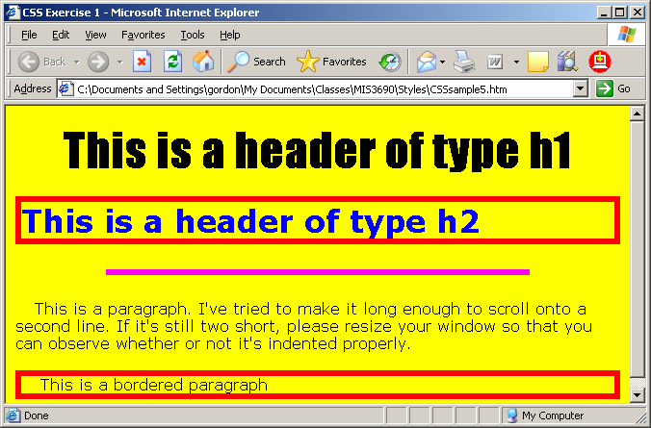
Class Example
<!DOCTYPE html>
<html>
<head>
<title>CSS Exercise 1</title>
<meta http-equiv="content-type" content="text/html; charset=utf-8" />
<style>
body {background-color:yellow;}
h1 {text-align:center; font-family:impact; font-size:36pt}
h2 {font-family:verdana; font-size:24pt; color:blue;}
p {font-family:verdana; font-size:12pt; text-indent:20px;}
hr {width: 70%; color: fuchsia; height: 6px}
.redbord {border:6px solid red}
</style>
</head>
<body>
<h1>This is a header of type h1</h1>
<h2 class="redbord">This is a header of type h2</h2>
<hr />
<p>This is a paragraph. I've tried to make it long enough to scroll onto a second line. If it's still two short, please resize
your window so that you can observe whether or not it's indented properly.</p>
<p class="redbord">This is a bordered paragraph</p>
</body>
</html>

Slide 34
Time Out
Do step 6 of today’s in-class activity (10 mins)

Slide 35
Solution 3: Tag ids
Every tag can have an id
Each id is unique per page. You cannot use the same id in two tags on the same page
Ids are made up of any combination of letters and digits, however ids may not contain spaces
Examples:
<p id="intro">
<p id =“firstSection">

Slide 36
Applying a Style to an Id
Tag#id {style} or #id {style}
Examples:
p#bord {color:blue}
The <p> with id="bord" should have a blue colored font
h1#bord {font-size:24}
The <h1> with the id="bord" should have font-size of 24
#bord {color:blue}
The one tag with id="bord" should have a blue colored font

Slide 37
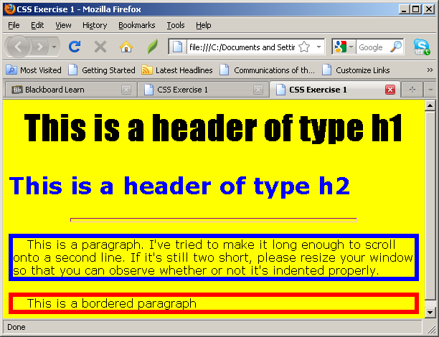
Id Example
<head>
<title>CSS Exercise 1</title>
<meta http-equiv="content-type" content="text/html; charset=utf-8" />
<style>
body {background-color:yellow;}
h1 {text-align:center; font-family:impact; font-size:36pt}
h2 {font-family:verdana; font-size:24pt; color:blue;}
p {font-family:verdana; font-size:12pt; text-indent:20px;}
hr {width: 70%; color: fuchsia; height: 6px}
#bord {border:6px solid red}
#para1 {border:6px solid blue}
</style>
</head>
<body>
<h1>This is a header of type h1</h1>
<h2>This is a header of type h2</h2>
<hr />
<p id="para1">This is a paragraph. I've tried to make it long enough to scroll onto a second line.
If it's still two short, please resize your window so that you can observe whether or not it's
indented properly.</p>
<p id="bord">This is a bordered paragraph</p>
</body>

Slide 38
Classes vs. Ids
Ids are needed for JavaScript, but generally there is no reason to use an id rather than a class for CSS

