Slide 1

Entrepreneurship
An Introduction

Slide 2
What is an Entrepreneur?
Entrepreneur: A person who organizes and manages an enterprise, especially a business, usually with considerable initiative and risk.
  Initiative: Readiness and ability in initiating action.
  Risk: The hazard or chance of loss.
Source: Webster’s College Dictionary (Random House/McGraw Hill)

Slide 3
What is an Entrepreneur?
“An entrepreneur is someone who perceives an opportunity and creates an organization to pursue it.“
Source: The Portable MBA in Entrepreneurship, 2nd Ed.; William D. Bygrave, Editor. John Wiley and Sons Publishers, 1997.

Slide 4
Who is an Entrepreneur?
In the U.S., approximately 4% of the adult population is actively involved in starting a business at any given time.
One out of every two adults has tried to start a business at some time in his or her life.
Source: Entrepreneurship 3rd Ed., Lambing and Kuehl; Prentice Hall; Pg 25

Slide 5
What Does it Take to Be Successful?
“In entrepreneurship, luck is where preparation and opportunity meet.”
Source: The Portable MBA in Entrepreneurship, 2nd Ed.; William D. Bygrave, Editor. John Wiley and Sons Publishers, 1997.

Slide 6
What Does It Take to Be Successful?
“The idea is not what is important. In entrepreneurship; ideas are a dime a dozen. Developing the idea, implementing it, and building a successful business are the important things.”
Source: The Portable MBA in Entrepreneurship, 2nd Ed.; William D. Bygrave, Editor. John Wiley and Sons Publishers, 1997.

Slide 7
What Does It Take to Be Successful?
“Would-be entrepreneurs who are unable to name customers are not ready to start a business. They have only found an idea and have not yet identified a market need.”
Source: The Portable MBA in Entrepreneurship, 2nd Ed.; William D. Bygrave, Editor. John Wiley and Sons Publishers, 1997.

Slide 8
What Does It Take to Be Successful?
Somehow, someday… you are going to have to earn
POSITIVE CASH FLOW.
You need more than a revenue model (but you do need that). You need a VALUE model.

Slide 9
What Does It Take to Be Successful?
Market share is great, but you
can’t pay bills with it.
You can do some financially
stupid things to build
market share.

Slide 10
Where Do You Start?
Think about WHO is going to want your product/service, what they will PAY for it, what you will NEED to carry it off, and how you will MAKE MONEY someday. That is, make a PLAN.
Success depends on
positive cash flow, growth,
and value creation.
Owners and investors who forget that tend to get “naturally deselected.”

Slide 11
The Importance of Value Creation
A successful business is one that delivers value to its customers and creates value for its owners.

Slide 12
The Importance of Value Creation
Value is delivered to your customers when you do something for them
    Better
    Cheaper
    Faster
    Cooler
    Different
  However, it is likely that none of these will work for long, so continuous improvement and innovation are essential.

Slide 13
The Importance of Value Creation
Value is created for the owners when:
  You do more with their money than they could do with it themselves
  You invest in productive activities that earn rates of return greater than their risk-adjusted costs of capital.
  The present value of future cash flows exceeds the startup costs.

Slide 14
The Importance of Value Creation
Value is created by:
  Exploiting proprietary physical resources
  Possessing proprietary knowledge or expertise
  Creating a new or improved product, process, or service
  Staying ahead of the competition through constant improvement and innovation

Slide 15
Revenue Models
Revenue comes from:
  Selling or licensing a product
  Selling or licensing a service
  Creating a transaction pipeline
  Trading products or services
  Selling advertising
  Investing

Slide 16
Planning for Success
Don’t plan a business for today – Plan it for at least a year from now.
  Moore’s Law: Computing power will roughly double every 18 months.
  Bandwidth will continue to increase for most users almost ad infinitum.
  People will live longer and maintain active lifestyles far after retirement.
  Energy sources and consumption patterns will change drastically.
  The world will continue to be a very dangerous place.

Slide 17
Planning for Success
Think about the next paradigm shift that will change business and life:
  Fire
  Agriculture
  Horsepower
  Writing
  Masonry
  Sailpower
  Metallurgy
  Waterpower
  Steam
  …..
  Nuclear
  Internet
  Wireless …

Slide 18
How To Not Get Funded
Have a half-baked idea
Have a meatless business plan
Can’t articulate your value proposition
Can’t identify your market potential
Can’t justify your sales projections
Can’t show your investors an exit
Can’t show your investors a reasonable expectation of a reasonable return on investment
Don’t think about risk
Take no risk yourself
Don’t take time to do your homework
Try to fund a “lifestyle” venture

Slide 19
A Lifestyle Venture
5-year revenue projections under $5 million
Started by people with life-style motives (live your hobby)
90% of all startups
Zero interest to venture capitalists

Slide 20
Funding Your Venture
The hardest funding to raise is the first funding. You are probably on your own.
Later funding gets progressively easier depending on the results you can show to investors and what you need to fund.
BANKS are probably not going to help.
The best funding is INTERNAL funding (reinvested earnings).
PRIVATE EQUITY is the current buzzword for the major capital source for business ventures.

Slide 21
Private Equity Firms
http://en.wikipedia.org/wiki/Private_equity
As of October, 436 new private equity funds had raised a record $300 billion in 2006, providing a huge pool of funds to be invested. (BusinessWeek, Oct. 15, 2006)
These firms are generally very HANDS ON with you and your company.

Slide 22
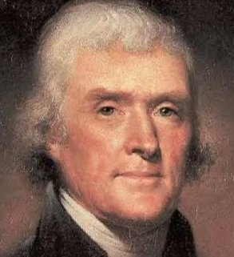
Closing Thoughts
“I find that the harder I work, the more luck I seem to have.” Thomas Jefferson

Slide 23
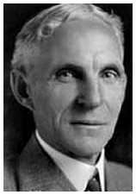
Closing Thoughts
“Whether you think you can, or that you can’t, you are usually right.” Henry Ford

Slide 24
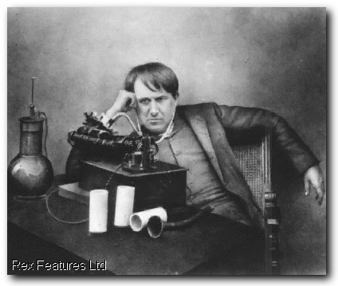
Closing Thoughts
“I have not failed. I have just found 10,000 ways that won’t work.” Thomas Edison

Slide 25
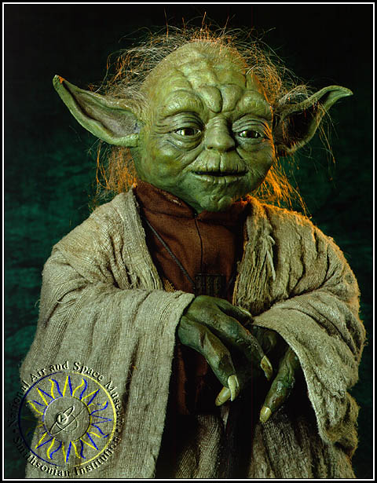
Closing Thoughts
“Do, or do not. There is no ‘try’.” Yoda – The Empire Strikes Back

