Slide 1
Module 2
Global Entrepreneurship

Slide 2
Module 2
Topics
Aspects of Entrepreneurship in
Portugal
United States
The World

Slide 3
Entrepreneurship
World Phenomena
Part Human Dream
Provides Opportunities
Creates Hope

Slide 4
Review

Slide 5
Questions
Why Are Some:
People More Entrepreneurial than Others?
Organizations More Entrepreneurial than Others?
Regions More Entrepreneurial than Others?
Countries More Entrepreneurial than Others?

Slide 6
Global Entrepreneurship Monitor
Any attempt at new business creation (self-employment, new business, expansion of existing business) by individual, team, or established business.
Nascent
Entrepreneurs
Baby-Business
Entrepreneurs
Adults who have taken
some action to create a
new businesses of
under 3 months old
Adults that are
owner/managers of
firms who have paid
wages for 3 – 42 months

Slide 7
Global Entrepreneurship Monitor
Entrepreneurial activity is higher in low income countries and lower in high income countries.
9.8% of the world's new firms expected to create almost 75% of the jobs.
Low/middle-income countries had highest rates of female entrepreneurial activity.
The ratio of opportunity to necessity entrepreneurs is significantly higher in high-income countries than in low/middle-income countries

Slide 8
Total Entrepreneurial Activity by Region
World Average | 9.6
South America | 16.6
North America | 11.1
European Union | 5.4
Non European Union Europe | 5.6
African and Middle East | 13.0
Asia and Oceania | 3.4

Slide 9
Entrepreneurship in the US
90% of all firms are small
20 million small firms
1 million new firms yearly
85% of the new jobs
1 in 25 Americans trying to start a business
1 in 8 thinking about starting a business
Source of export growth and innovation

Slide 10
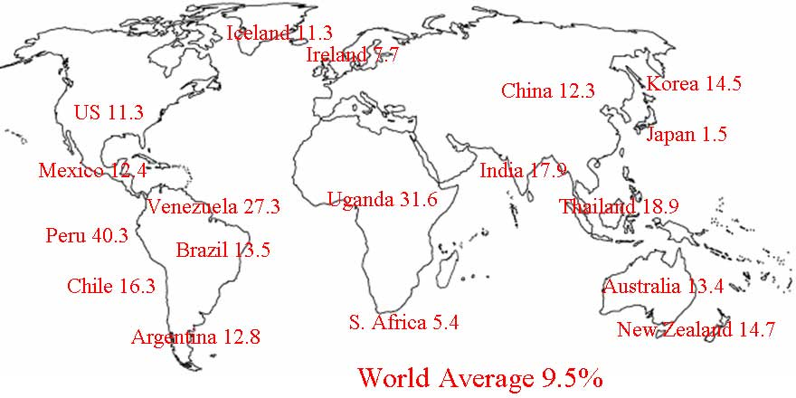
Total Entrepreneurial Activity (TEA)

Slide 11
Assignment
Describe entrepreneurship in Portugal
How does entrepreneurship in Portugal compare
to the world?
What are the obstacles to entrepreneurship in Portugal?
Obstacles to proposed business from Session 1?

Slide 12
Country | Average | 2006 TEA | 2005 TEA | 2004 TEA
Peru | 40.3% | 40.2% |  | 40.3%
China | 14.0% | 16.2% | 13.7%
United States | 11.2% | 10.0% | 12.4% | 11.3%
Norway | 8.4% | 9.1% | 9.2% | 7.0%
Mexico | 7.9% | 5.3% | 5.9%
Ireland | 7.6% | 7.4% |  | 7.7%
Switzerland | 6.7% |  | 6.1%
UK | 6.1% | 5.8% | 6.2% | 6.3%
Spain | 6.1% | 7.3% | 5.7% | 5.2%
Austria | 5.3% |  | 5.3%
France | 5.3% | 4.4% | 5.4% | 6.0%
Denmark | 5.1% | 5.3% | 4.8% | 5.3%
Netherlands | 5.0% | 5.4% | 4.4% | 5.1%
Germany | 4.7% | 4.2% | 5.4% | 4.5%
Portugal | 4.0% |  |  | 4.0%
Italy | 3.9% | 3.5% |  | 4.3%
Belgium | 3.4% | 2.7% | 3.9% | 3.5%

Slide 13
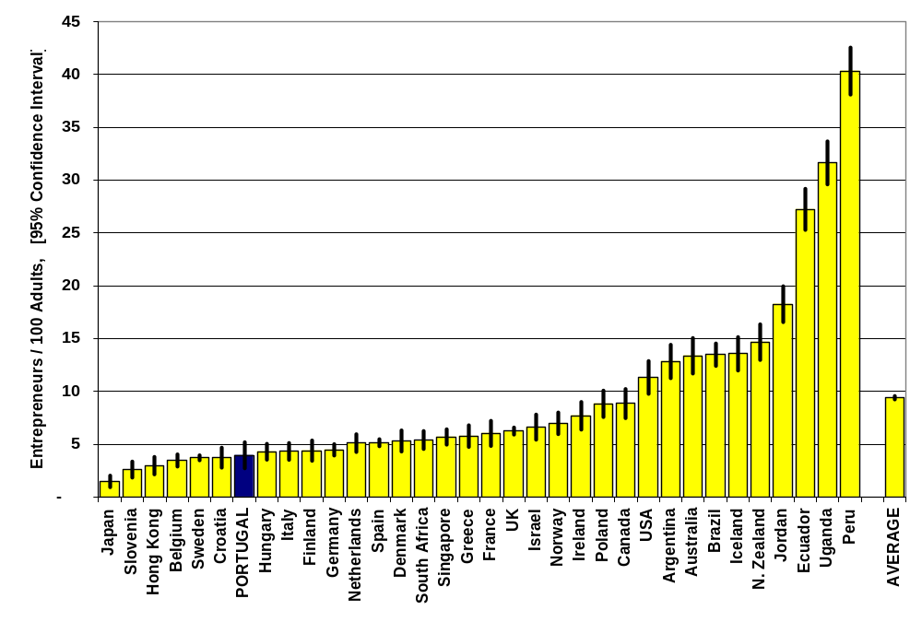
Number of Entrepreneurs by Country

Slide 14
Entrepreneurship in Portugal
Portugal has a low rate of entrepreneurial activity
  Only 4 entrepreneurs for every 100 adults
  Reduction from 7 entrepreneurs per 100 adults in 2001
  Ranked 28th of the 34 countries in GEM 2004
  Ranked 13th of the 16 EU countries in GEM 2004

Slide 15
Entrepreneurship Dynamics: 2001 to 2004
Number of entrepreneurs decreased from 7/100 adults to 4/100 adults (mirrors international reduction in number of entrepreneurs)
Twice as many male than women entrepreneurs in 2001
Almost gender equality in 2004
More nascent entrepreneurs than baby-business entrepreneurs in 2001 and 2004
Entrepreneurs typically driven by opportunity rather than necessity in 2001 and 2004

Slide 16
Key Drivers of Entrepreneurship in Portugal
Financial Support
Government Policies and Programs
Education and Training
KEY DRIVERS OF
ENTREPRENEURSHIP
R&D Transfer
Internal Market Openness
Commercial, Professional and Physical
Infrastructure
Cultural and Social Norms

Slide 17
Key Drivers of Entrepreneurship
in Portugal
Financial Support
  Insufficient overall financial support for entrepreneurship
  Government financial support more adequate, but could be applied more effectively
Government Policies and Programs
  High level of government awareness, but time-consuming bureaucracy and inefficient interactions between agencies and entrepreneurs

Slide 18
Key Drivers of Entrepreneurship
in Portugal
Education and Training
Education system does not
foster needs of entrepreneurship
prepare students to take advantage of business opportunities
promote creative or innovative thinking
Increase university level courses on entrepreneurship

Slide 19
Key Drivers of Entrepreneurship
in Portugal
R&D Transfer
  Good R&D being performed, but weak links between R&D organizations and those wanting to commercially implement the developments
Internal Market Openness
  Portuguese market is open to new and growing firms, but costs to enter new markets may be beyond the capabilities of new and growing firms

Slide 20
Key Drivers of Entrepreneurship
in Portugal
Commercial, Professional and Physical Infrastructure
  Excellent science parks and business incubators
    Increasing entrepreneurship activity
    Increasing likelihood of new firms succeeding
    Facilities should be spread evenly over the country
  Good commercial/professional infrastructure, but cost of access can be beyond new firms

Slide 21
Key Drivers of Entrepreneurship
in Portugal
Cultural and Social Norms
  Entrepreneurship in Portugal is limited by the national culture
  Population reluctant to take risks
  Failed entrepreneurs will not be offered another opportunity
    In contrast, failure is seen as a learning experience in US

Slide 22
20%
Change in Key Drivers 2001 - 2004
Change in Key Drivers 2001 - 2004
Improvement
(2001 - 2004)
15%
10%
5%
Change in Average Satisfaction Score (2001 - 2004)
Financial
Cultural &
Support
Social Norms
0%
Government
Education
R&D Transfer
Internal
Commercial,
Policies and
and Training
Market
Professional
Programmes
Openness
and Physical
-5%
Infrastructure
-10%
Deterioration
(2001 - 2004)
-15%

Slide 23


GEM 2004 Portugal
Sociedade Portuguesa
de Inovação
Nova Forum
Rua Júlio Dinis, no. 242, 208 – 4050-
318 Porto
Tel: 22 607 64 00
Fax: 22 609 91 64
spiporto@spi.pt
www.spi.pt
Rua Marquês de Fronteira 20
1099-038 Lisboa
Tel: 21 382 80 20
Fax: 21 386 57 54
nforum@fe.unl.pt
www.novaforum.pt/html/home.php

Slide 24
COTEC Portugal - Associação Empresarial para a Inovação
Created April 2003 following an initiative of the President of Portugal by a group of companies. President of Portugal is General Assembly President.
COTEC Portugal is a not for profit business association that counts on the support of its associated companies and all agents of the National Innovation System (NIS) to accomplish its goals through the implementation of initiatives in a variety of areas.

Slide 25
COTEC Portugal - Associação Empresarial para a Inovação
Mission Promote competitiveness through development of
culture and practice of innovation
Vision Become key agent of business innovation by
challenging public/private organizations of
the National Innovation System
Strategic - Promote culture of innovation as source of
Themes company competitiveness
- Foster practice of innovation by all the agents of
the NIS
- Influence strategic orientation of Portuguese and
European Innovation Systems

Slide 26
Mind to Market
Creativity
Innovation
Opportunity Recognition
Business Development
Economic Growth

Slide 27
Discussion

