Slide 1

Crude Palm Oil (CPO) Commodity Price and Production Yield Prediction
An Approach using Climate Data and News’ Title Sentiment
By:
Choong En Jun
Github: https://github.com/oryzalee8871/WQD7005_DataMining

Slide 2
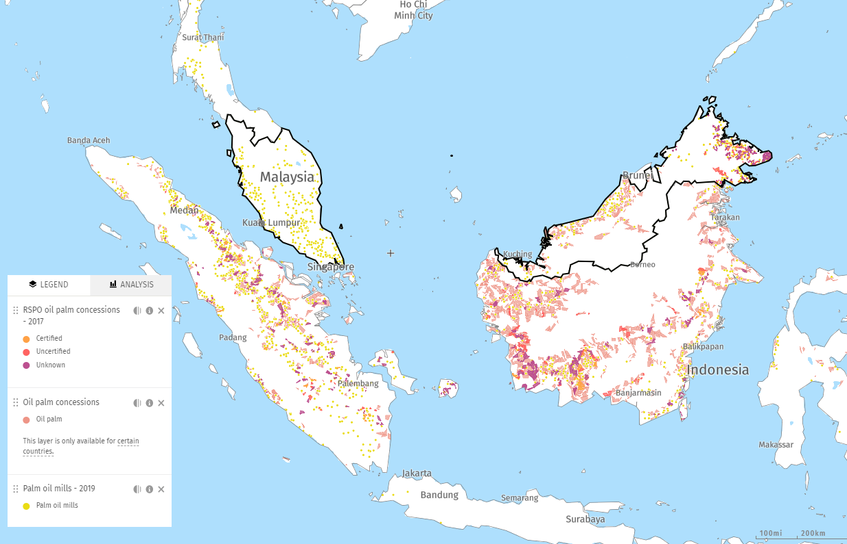
Introduction
The largest derivatives market for CPO is Bursa Malaysian Derivatives.
The prices are affected mainly by demand and supply of CPO, and other external factors such as the prices of cooking oil and oil seeds all around the world.
Climate variability have a direct impact on the supply of CPO, thus indirectly affect the price of CPO futures.
Since Indonesia and Malaysia already have 87% of the production market cap, any climate changes in these two neighboring countries would surely have some sort of impact on the CPO yield, and indirectly so on the CPO futures.
Source: https://www.globalforestwatch.org/

Slide 3
Motivation
According to Santhia (2017)[1], the top palm oil producing nations in 2016 are Indonesia, leading by 34.52 mil MT of palm oil, followed by Malaysia at 17.32 mil MT where the two countries made up 87% of the total palm oil production market. Palm oil trees, like most plants are susceptible to climate changes and local atmospheric variables. As investigated by Oettli et al (2018)[2], woittiez et al (2017)[3] and Kamil & Omar (2016)[4], attributes such as rainfall, temperature, relative humidity, and net solar radiation have shown to affect the yield of oil palm fresh fruit bunches.
Objective
To test the following hypothesis:
Weather data significantly affect / correlate to palm oil production yield
Palm oil industry related news sentiment significantly affect / correlate to CPO commodity prices
References:
[1] Santhia, V. (2017). Essential Palm Oil Statistics 2017. Palm Oil Analytics. [2] Oettli, P., Behera, S. K., & Yamagata, T. (2018). Climate based predictability of oil palm tree yield in Malaysia. Scientific reports, 8(1), 1-13. [3] Woittiez, L. S., van Wijk, M. T., Slingerland, M., van Noordwijk, M., & Giller, K. E. (2017). Yield gaps in oil palm: A quantitative review of contributing factors. European Journal of Agronomy, 83, 57-77. [4] Kamil, N. N., & Omar, S. F. (2016). Climate variability and its impact on the palm oil industry. Oil Palm Ind Econ J, 16(1), 18-30.

Slide 4
WorkFlow
Five Milestones:
Data Aquisition & Web Crawling
DataWarehouse & DataLake Implementation
Data Cleaning using Data
Interpretation and Communication of Insights
Deployment of Web or Mobile App

Slide 5
Data Acquisition and Crawling youtube link: https://youtu.be/m7Lqda_E3Fg
Datasets:
[Investing.com]
Daily Trading Days CPO Prices on Bursa Malaysia market
[en.tutiempo.net]
Daily Monthly Data including temperature of mean, max and min variants, relative humidity and total rainfall.
[mpoc.org.my]
Monthly Malaysia CPO production from 2014 to 2020
[theedgemarkets.com]
Daily palm oil industry news title from 2009 to 2020
Crawler Libraries:
Scrapy
Selenium

Slide 6
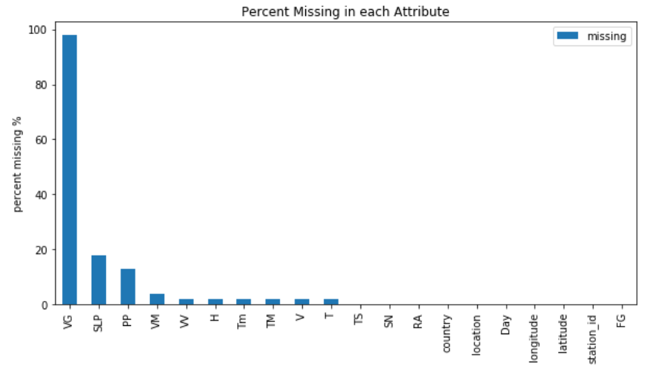
Data warehouse & datalake implementation youtube link 1: https://youtu.be/UUWTioegn8M, youtube link 2: https://youtu.be/If27_zNYkx8
Two approaches:
HIVE Data Warehouse
And MinIO S3 object storage
Data Cleaning youtube link: https://youtu.be/jmdmxU8j08E
Transform scraped news title to data frame
Standardize datatype
Remove irrelevant columns
Handle missing Values
Cleaning Libraries:
Pandas
Example missing values in weather data

Slide 7
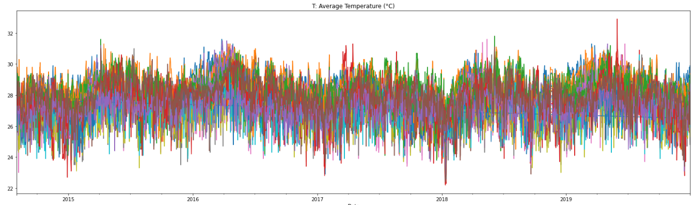
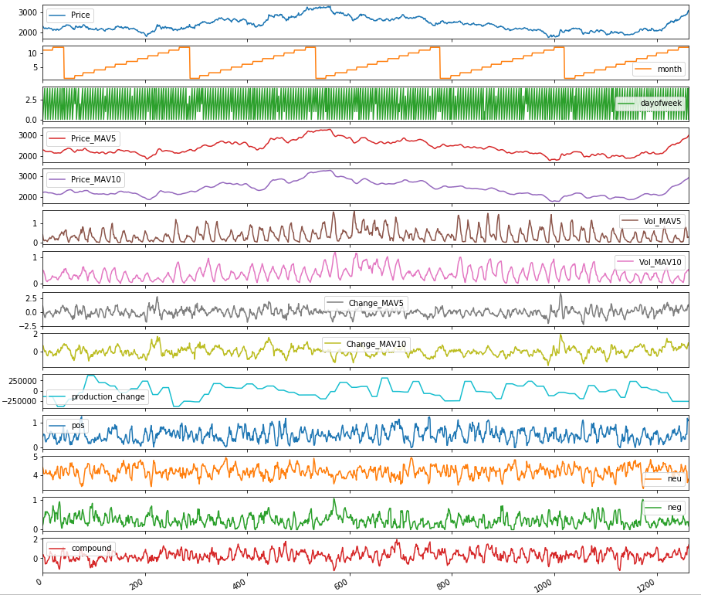
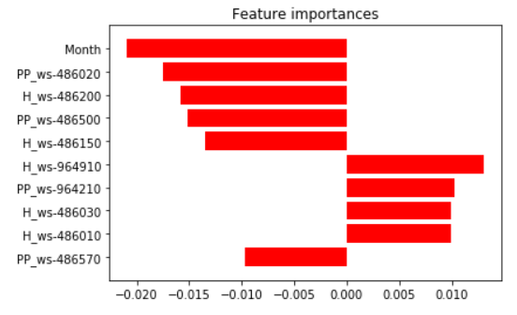
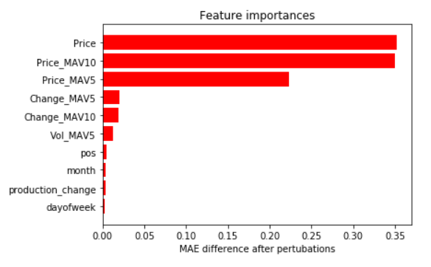
Interpretation and modeling youtube link: https://youtu.be/fMsymKdOsRo
Price action is still the most important feature for prediction of CPO price
Month, Humidity and Precipitation are good predictors for CPO yield
Weather data are cylical
CPO yield prediction CPO Price Prediction

Slide 8
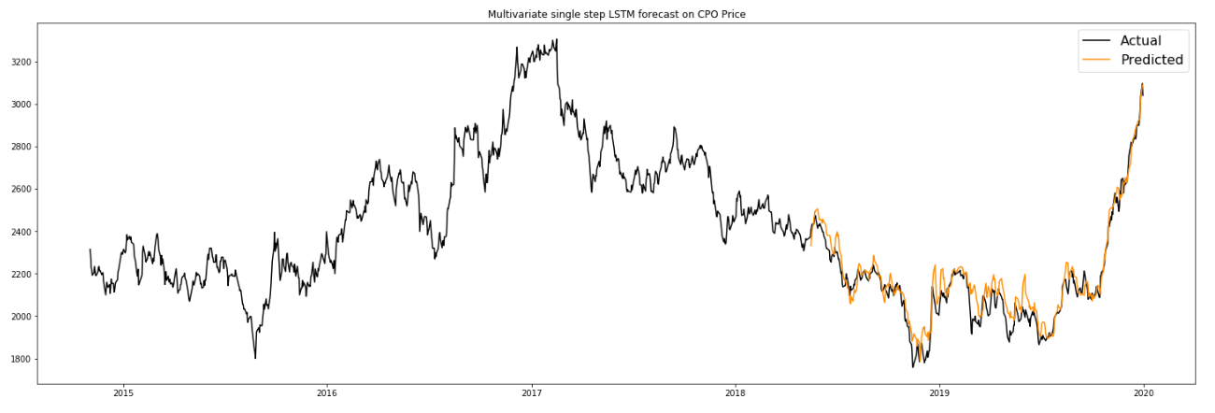
Interpretation and modeling youtube link: https://youtu.be/fMsymKdOsRo
Model: LSTM model for CPO Price Prediction
model = tf.keras.models.Sequential()
model.add(tf.keras.layers.LSTM(64, input_shape=x_train_single.shape[-2:], recurrent_dropout=0.5, activation='relu'))
model.add(tf.keras.layers.Dense(64, activation=tf.nn.relu, kernel_initializer='he_normal'))
model.add(tf.keras.layers.Dropout(0.3))
model.add(tf.keras.layers.Dense(1, activation='linear'))
Modelling Libraries:
Tensorflow 2.2
Scikit-Learn

Slide 9
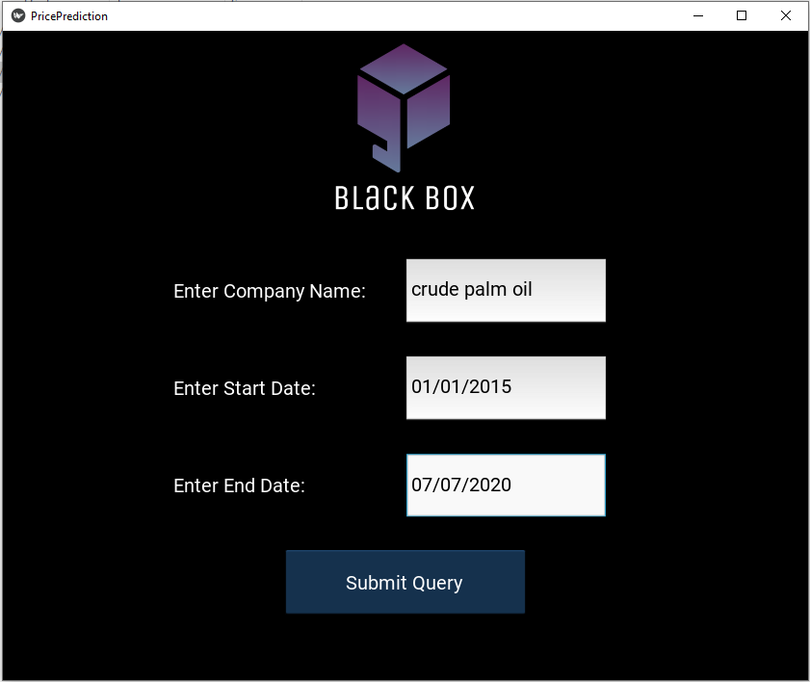
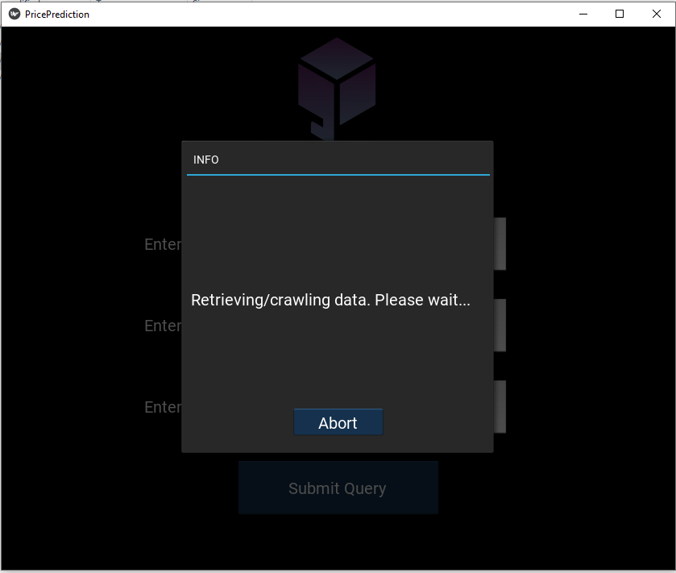
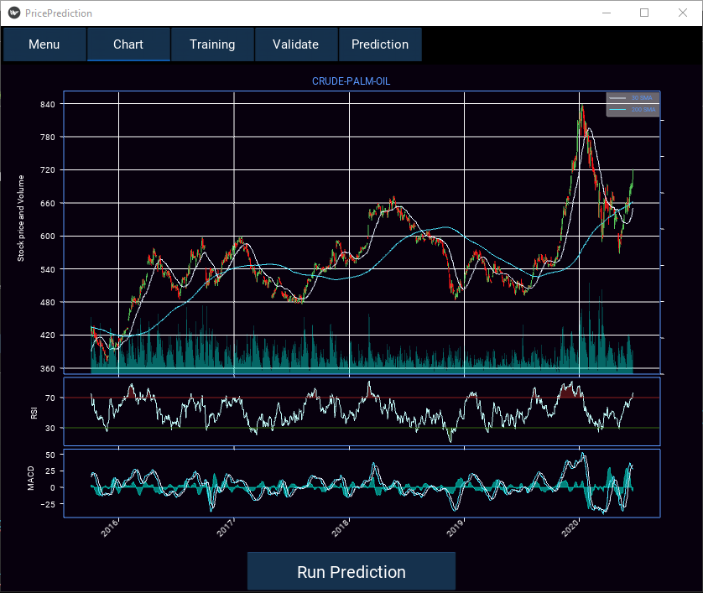
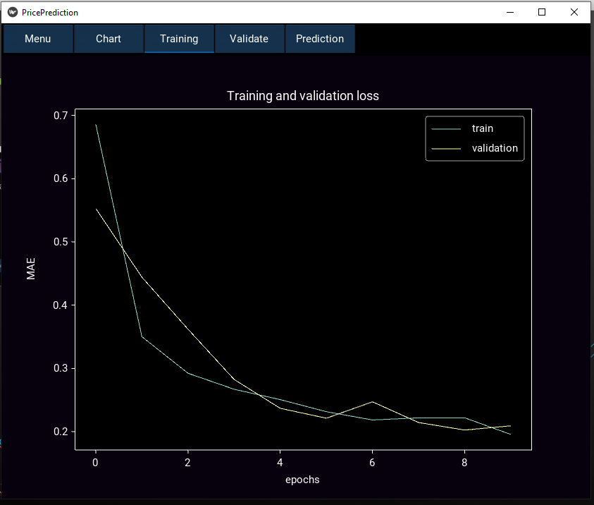
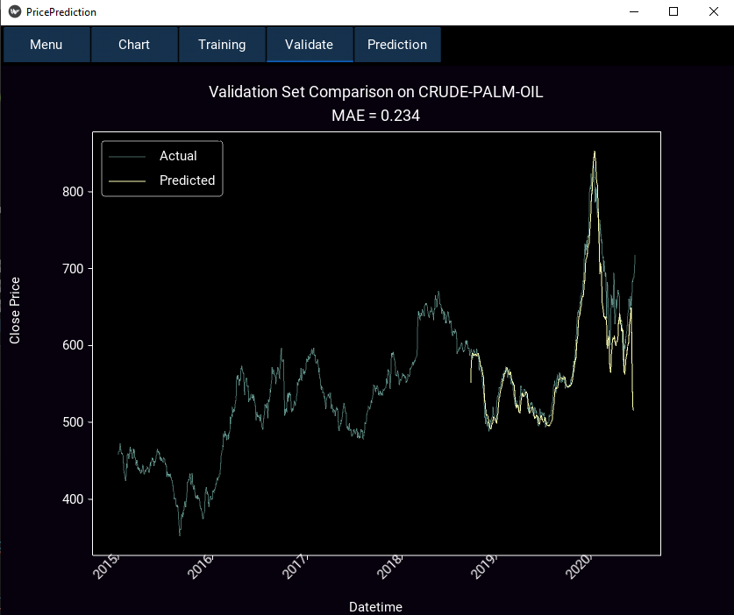
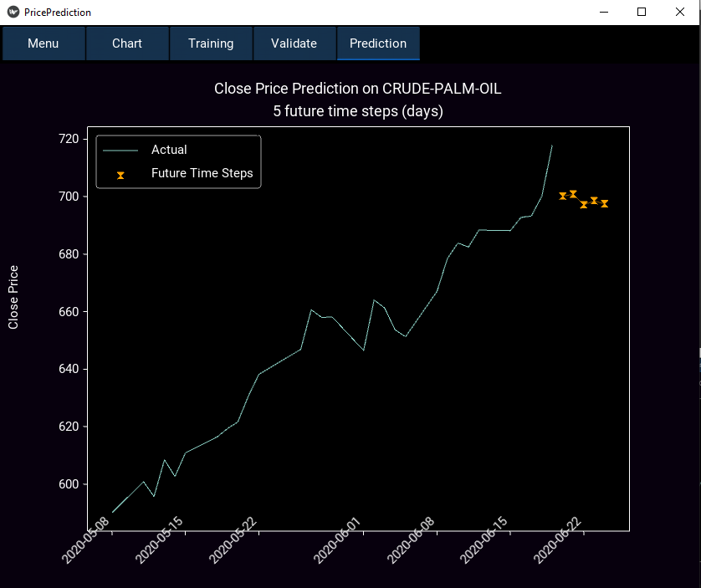
App Deployment youtube link: TBA
ALL IN ONE
Kivy App Deployment on Window
Crawling,
Charting,
Processing
Training
Predicting
App Deploment Libraries:
Kivy
PyInstaller

