Slide 1
KNN

Slide 2
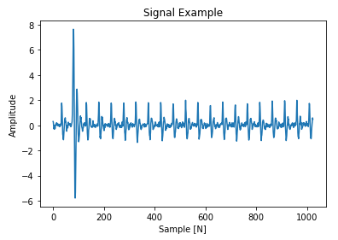
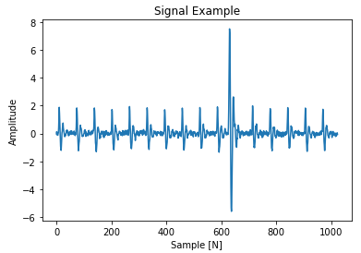

Slide 3



Translation Invariance
Rotation Invariance
Scaling Invariance
Illumination Invariance

Slide 4
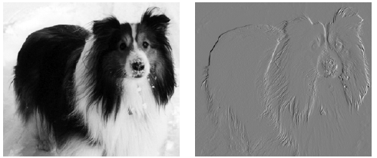
Kernel
1 | -1
1 | -1
1 | -1
1 | -1

Slide 5
Flattening
(for multi-dimensional data)
Next Layer
Pooling Layer
Convolution
Layer
Convolution Layer
(Including activation)
Previous Layer

Slide 6
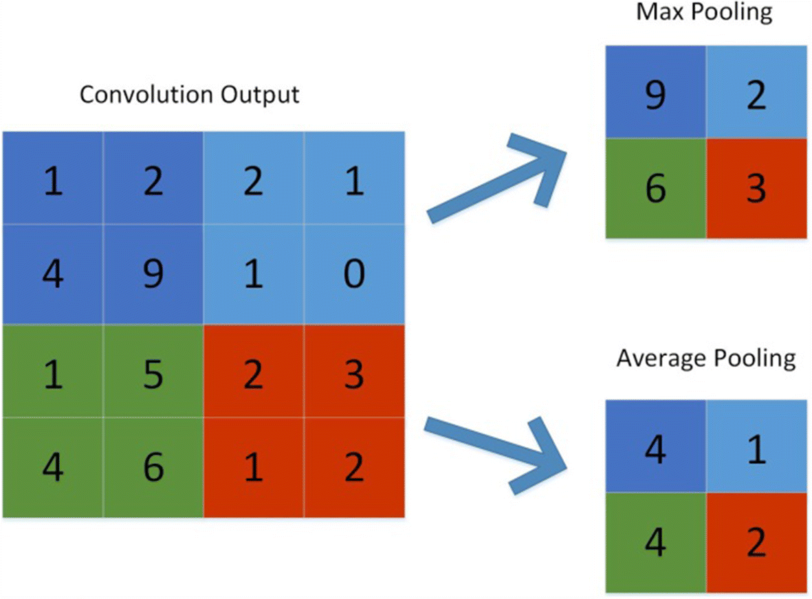

Slide 7
Feature Map 1
Feature Map 2
Input Data
Feature Map 3
N-Filter
Convolution Layer
Feature Map N

