Slide 1
openQA features – capabilities – bugs
Ondrej Holecek /aaannz/
oholecek@suse.com

Slide 2
in between of coffee breaks…
features of openQA
capabilities of openQA tests
what are we still working on

Slide 3
What makes openQA

Slide 4
User focused
Watching the screen

Slide 5
User focused
Watching the screen
Keyboard and mouse input

Slide 6
User focused
Watching the screen
Keyboard and mouse input
→ Virtually limitless test scenarios

Slide 7
Wide range of SUTs
Virtual machines FTW!
  QEMU (x86_64, ARM), libvirt, PowerVM, s390

Slide 8
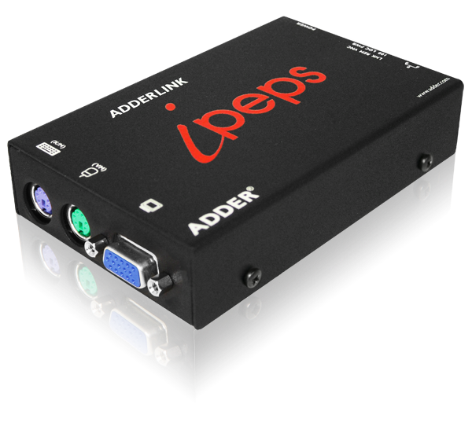
Wide range of SUTs
Virtual machines FTW!
  QEMU (x86_64, ARM), libvirt, PowerVM, s390
Reality still real though
  IPMI, ADDERLink

Slide 9
AI breeding ground (aka multi-machine)
Serial

Slide 10
AI breeding ground (aka multi-machine)
Serial
  validation test jobs
  test job preparing environment for others

Slide 11
AI breeding ground (aka multi-machine)
Serial
  validation test jobs
  test job preparing environment for others
Parallel

Slide 12
AI breeding ground (aka multi-machine)
Serial
  validation test jobs
  test job preparing environment for others
Parallel
  client-server scenarios
  High-Availability testing

Slide 13
AI breeding ground (aka multi-machine)
Serial
  validation test jobs
  test job preparing environment for others
Parallel
  client-server scenarios
  High-Availability testing
→ openQA scheduler does the job management

Slide 14
“Is There Anybody Out There?”
QEMU user networking
  no SUT-SUT communication
  no inbound access
  outbound access allowed

Slide 15
“Is There Anybody Out There?”
QEMU user networking
TAP devices
  manual configuration required
  all-you-can-do

Slide 16
“Is There Anybody Out There?”
QEMU user networking
TAP devices
Open vSwitch
  initial configuration required
  dynamically creates network for MM tests
  SUT-SUT communication
  allows network between worker nodes

Slide 17
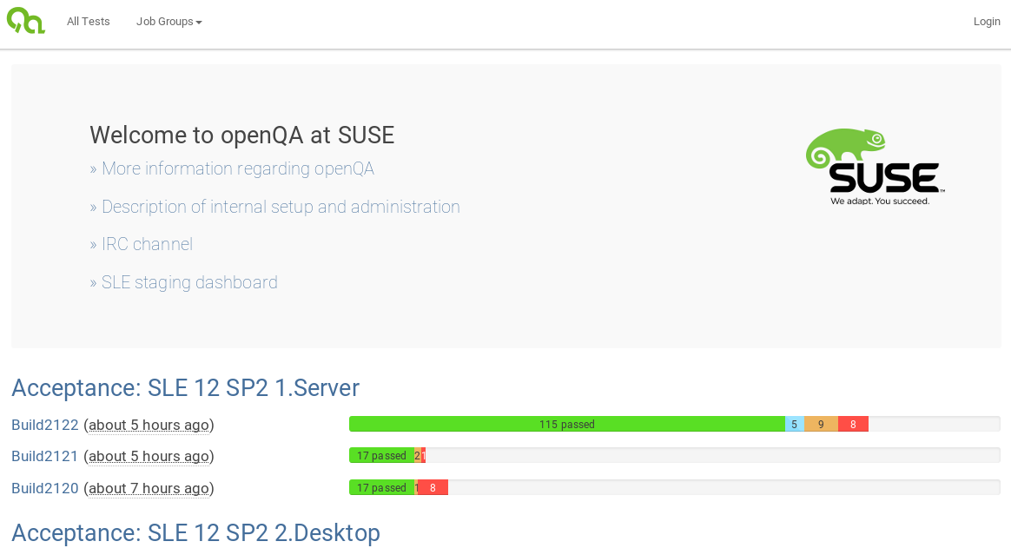
Shiny user interface

Slide 18
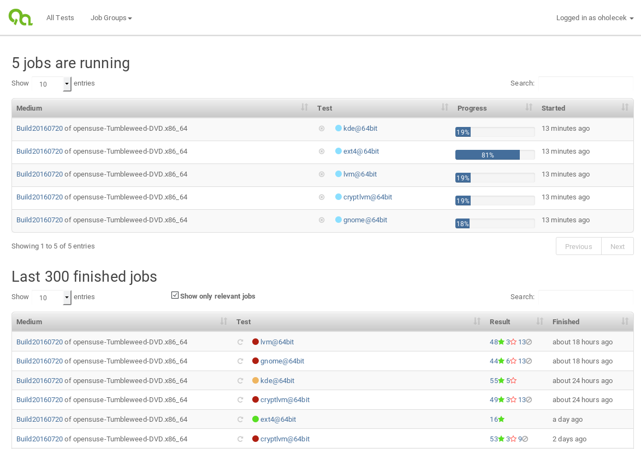
Shiny user interface

Slide 19
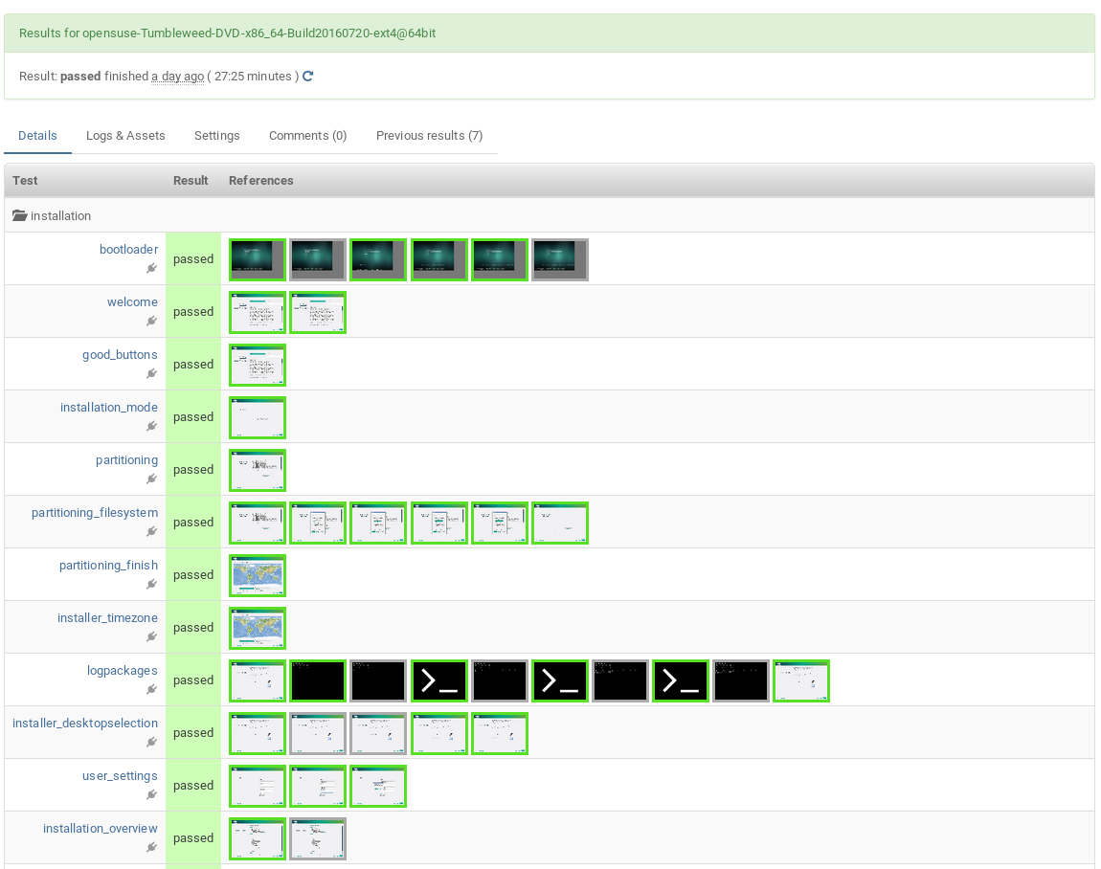
Shiny user interface

Slide 20
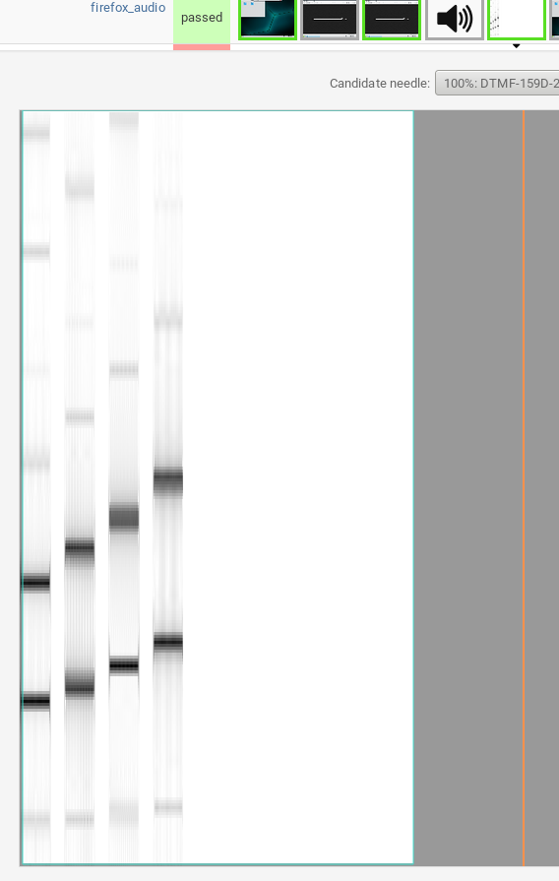
Shiny user interface

Slide 21
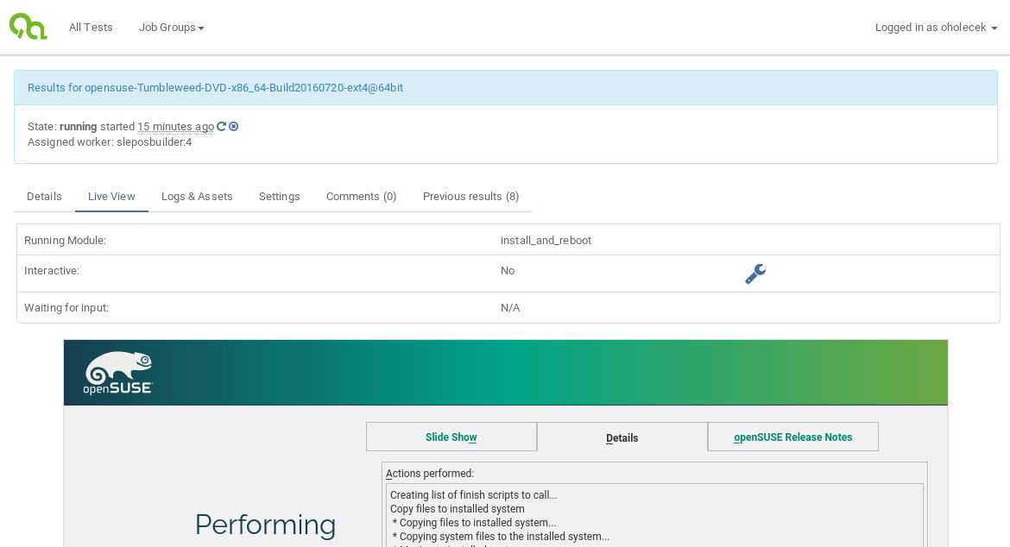
Shiny user interface

Slide 22
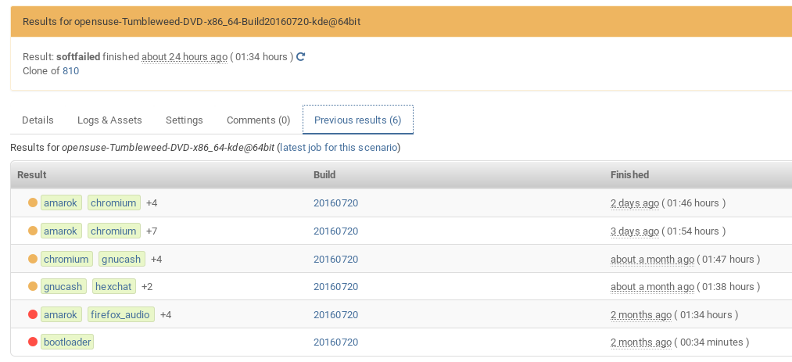
Shiny user interface

Slide 23
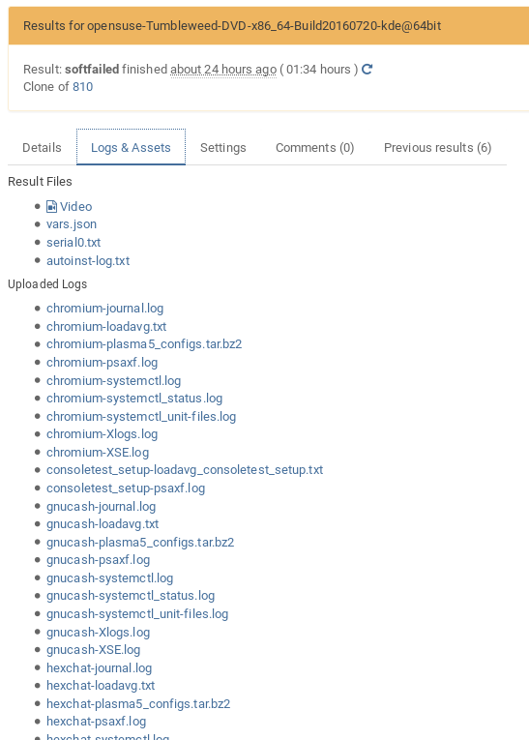
Shiny user interface

Slide 24
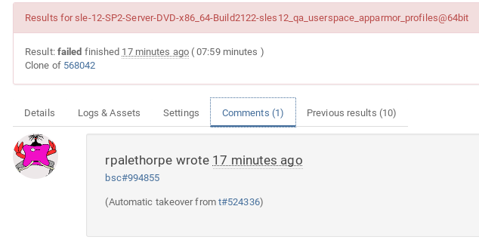
Shiny user interface

Slide 25
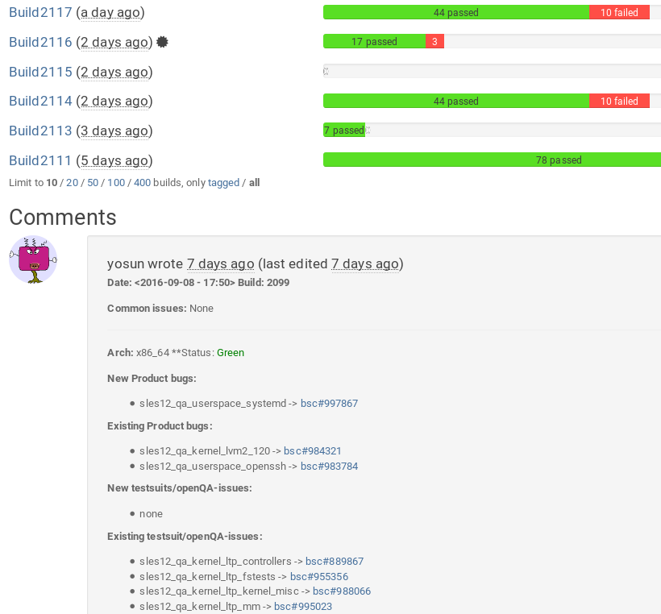
Shiny user interface

Slide 26
openQA tests
There’s more than one way to do it

Slide 27
openQA tests
There’s more than one way to do it, but sometimes consistency is not a bad thing either

Slide 28

openQA tests
There’s more than one way to do it, but sometimes consistency is not a bad thing either

Slide 29
“You can't ever go wrong with pearls.”
Yes, it’s perl

Slide 30
“You can't ever go wrong with pearls.”
Yes, it’s perl
  Deal with it

Slide 31
“You can't ever go wrong with pearls.”
Yes, it’s perl
  Deal with it
    can run anything

Slide 32
“You can't ever go wrong with pearls.”
Yes, it’s perl
  Deal with it
    can run anything from perl
      just saying...

Slide 33
“You can't ever go wrong with pearls.”
Yes, it’s perl
openQA test = test code + test loader + needles

Slide 34
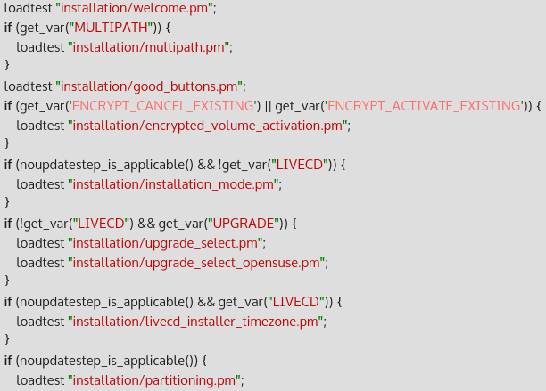
openQA test loader
‘main.pm’
loads individual modules
maintains test order

Slide 35
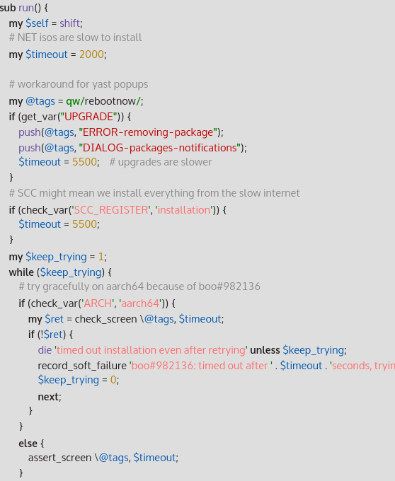
test code
openQA/os-autoinst APIs
  testapi
  mmapi
  lockapi

Slide 36
test code
openQA/os-autoinst APIs
  testapi
  mmapi
  lockapi
whatever you want
  just don’t forget to die when appropriate

Slide 37
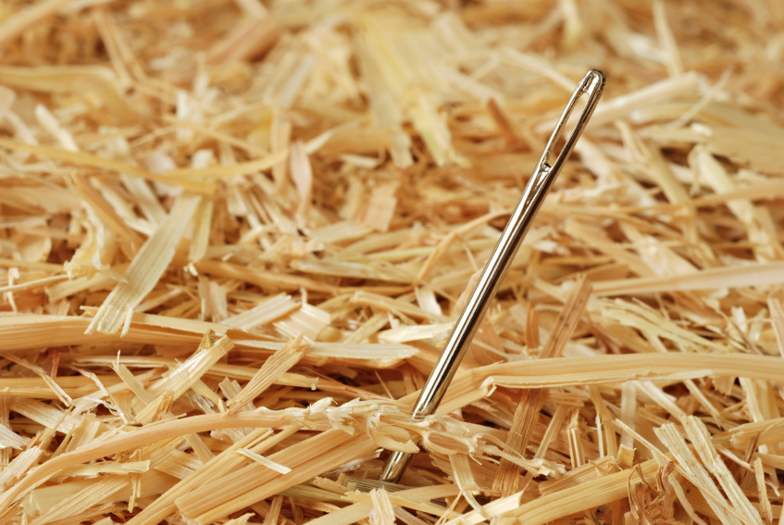
needles
picture
  screenshot from SUT
  generated image
  ...

Slide 38
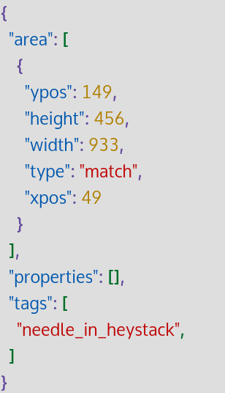
needles
picture
  screenshot from SUT
  generated image
  ...
JSON metadata
  match areas
  needle tags
  ...

Slide 39
support for text based tests
monitoring SUT serial port
matching against regexp(s)
included in testapi

Slide 40
Things to come

Slide 41
The Future
fixing damn disk image uploading (poo#12838)
stop suicidal behavior (poo#13814)
UI improvements
easier test development
not caring about MySQL CVEs
expecting more contributions outside of SUSE
“Make SUSE great again!”

Slide 42
The Future
fixing damn disk image uploading (poo#12838)
stop suicidal behavior (poo#13814)
UI improvements
easier test development
not caring about MySQL CVEs
expecting more contributions outside of SUSE
“Make SUSE great again! even greater!”

Slide 43
Contacts
irc://chat.freenode.net/opensuse-factory
mailto: opensuse-factory@opensuse.org
git@github.com:os-autoinst/openQA
git@github.com:os-autoinst/os-autoinst
git@github.com:os-autoinst/os-autoinst-distri-openSUSE
https://progress.opensuse.org/projects/openqav3

Slide 44
Questions?

Slide 45
Join the conversation,
contribute & have a lot of fun!
www.opensuse.org

Slide 47
License
This slide deck is licensed under the Creative Commons Attribution-ShareAlike 4.0 International license. It can be shared and adapted for any purpose (even commercially) as long as Attribution is given and any derivative work is distributed under the same license.
Details can be found at https://creativecommons.org/licenses/by-sa/4.0/
Credits
Template
Richard Brown
rbrown@opensuse.org
Design & Inspiration
openSUSE Design Team
http://opensuse.github.io/branding-guidelines/

