Slide 1
openQA making QA interesting since 2013
Ondrej Holecek /aaannz/
oholecek@suse.com

Slide 2
openSUSE storytime

Slide 3
openSUSE walking
packaging stuff
build
check
release
time?
manual
QA
release/
milestone

Slide 4
openSUSE Leap-ing
packaging stuff
build
check
openQA
release
time?
QA
release/
mistone

Slide 5
testing of operating systems
bootloader
installation
desktop
text applications
graphical applications
dual boot setups
…

Slide 6
openQA - user focused
Watching the screen
Keyboard and mouse input

Slide 7
openQA - user focused
Watching the screen
Keyboard and mouse input

Slide 8
releasing of operating systems
new features
new bugs
regressions
overall state
…

Slide 9
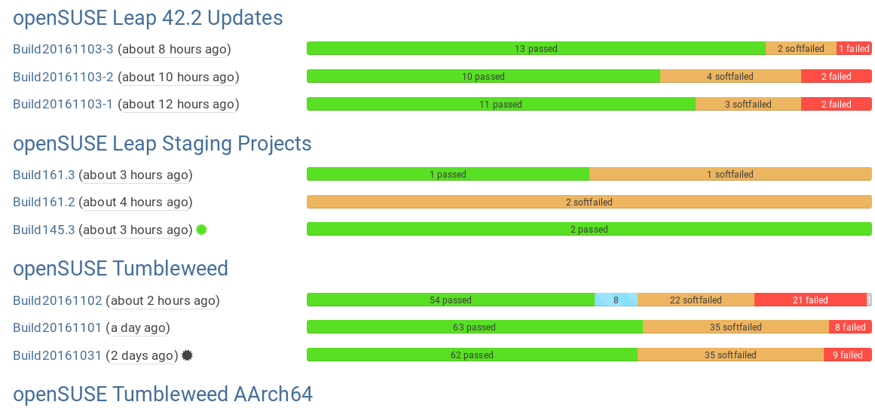
projects status and overview

Slide 10
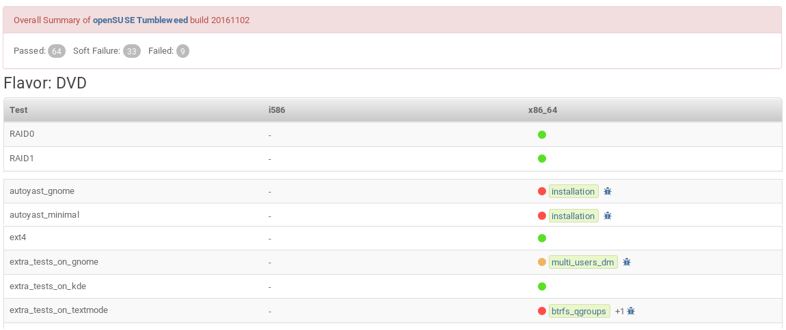
build overview

Slide 11
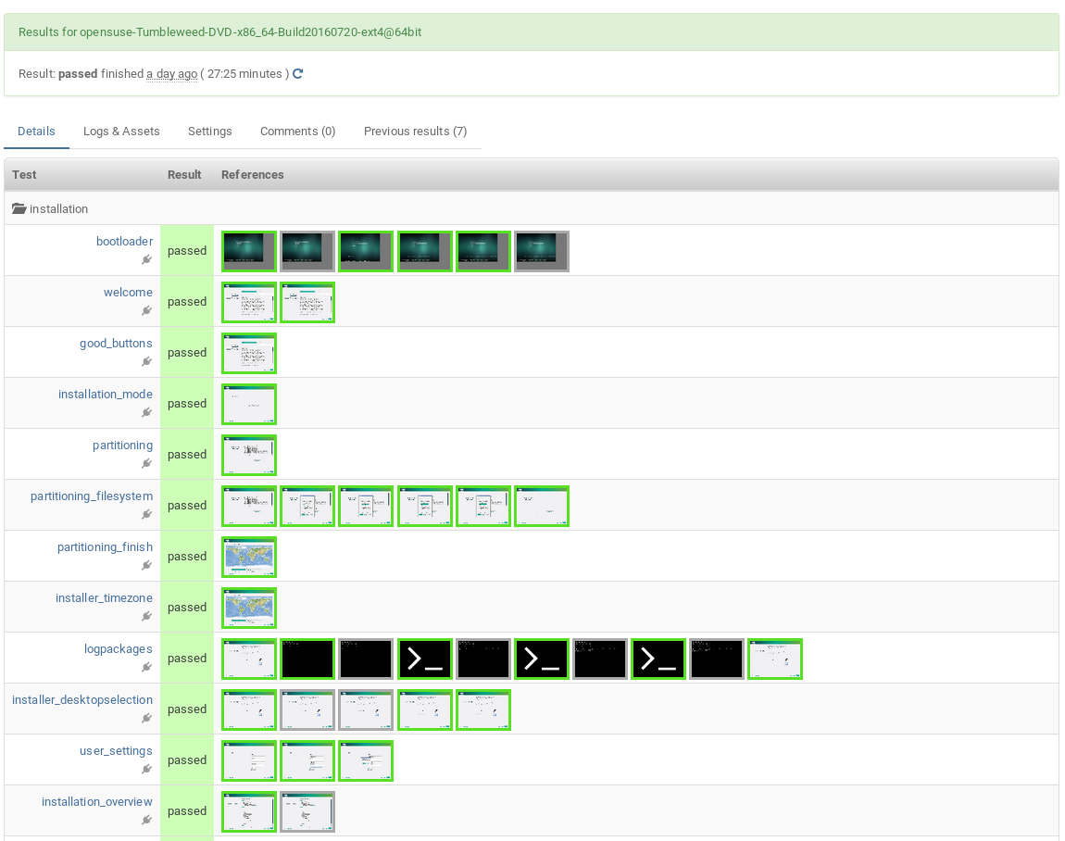
test job overview

Slide 12
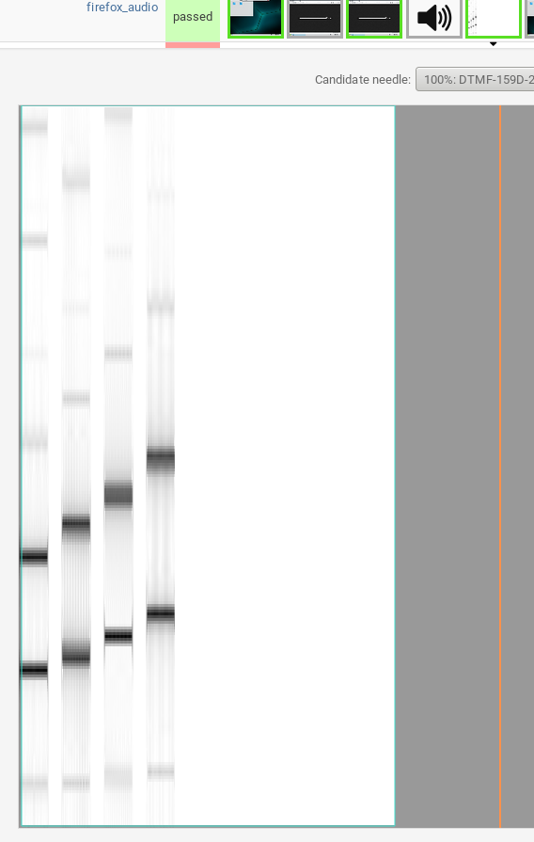
test job overview

Slide 13
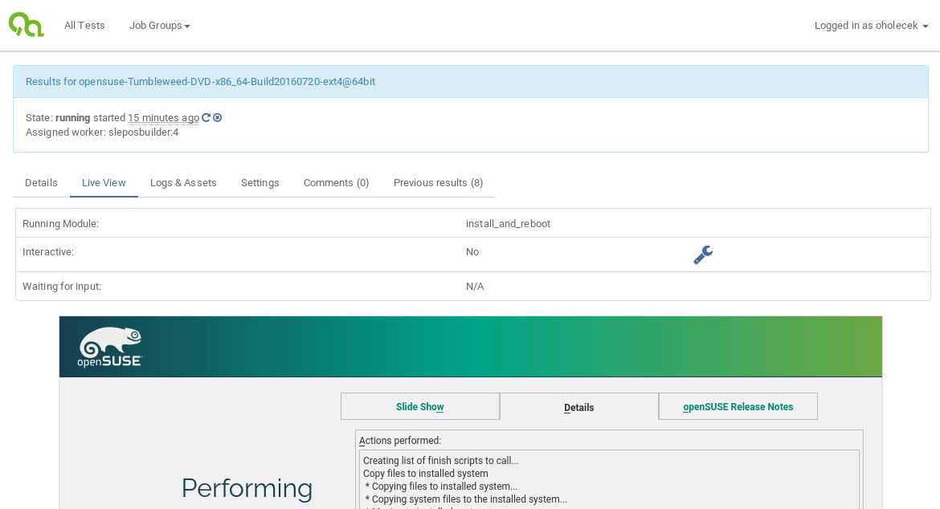
live view

Slide 14
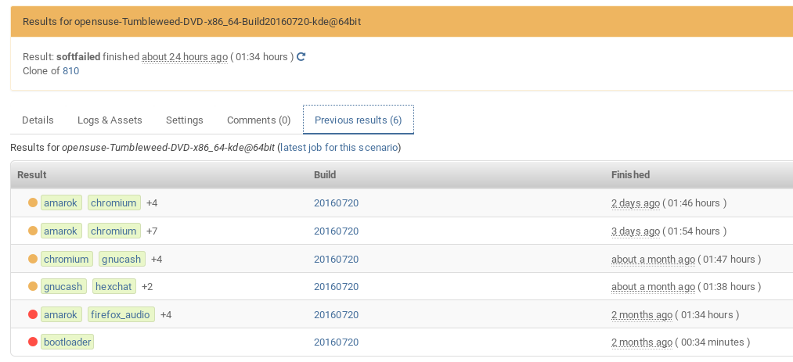
test job history

Slide 15
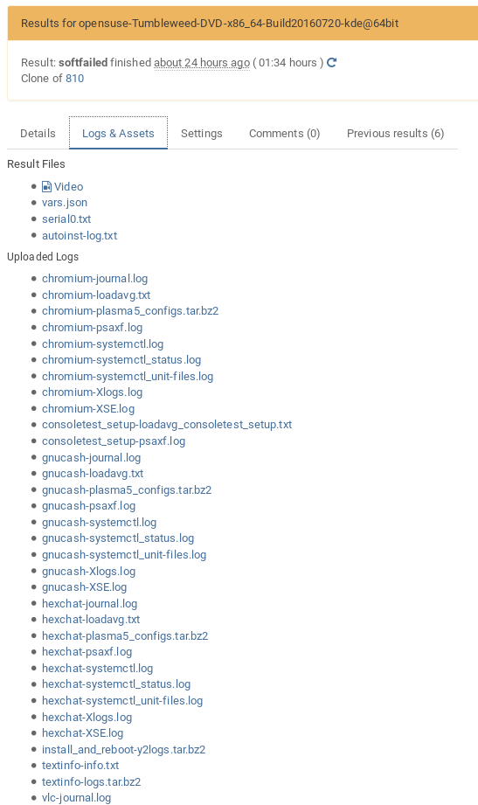
test job logs

Slide 16
case AutoYaST

Slide 17
AutoYaST
system description in XML
testing YaST installer
  source from local file, HTTP, FTP, NFS, …
  correct configuration
testing YaST modules
  valid XML format
  correct and accurate description of system in XML

Slide 18
test job dependencies
Serial dependency (“Chained”)
  validation test jobs
  test job preparing environment for others

Slide 19
test job dependencies
Serial dependency (“Chained”)
  validation test jobs
  test job preparing environment for others
Parallel dependency (“Parallel”)
  client-server scenarios
  High-Availability testing

Slide 20
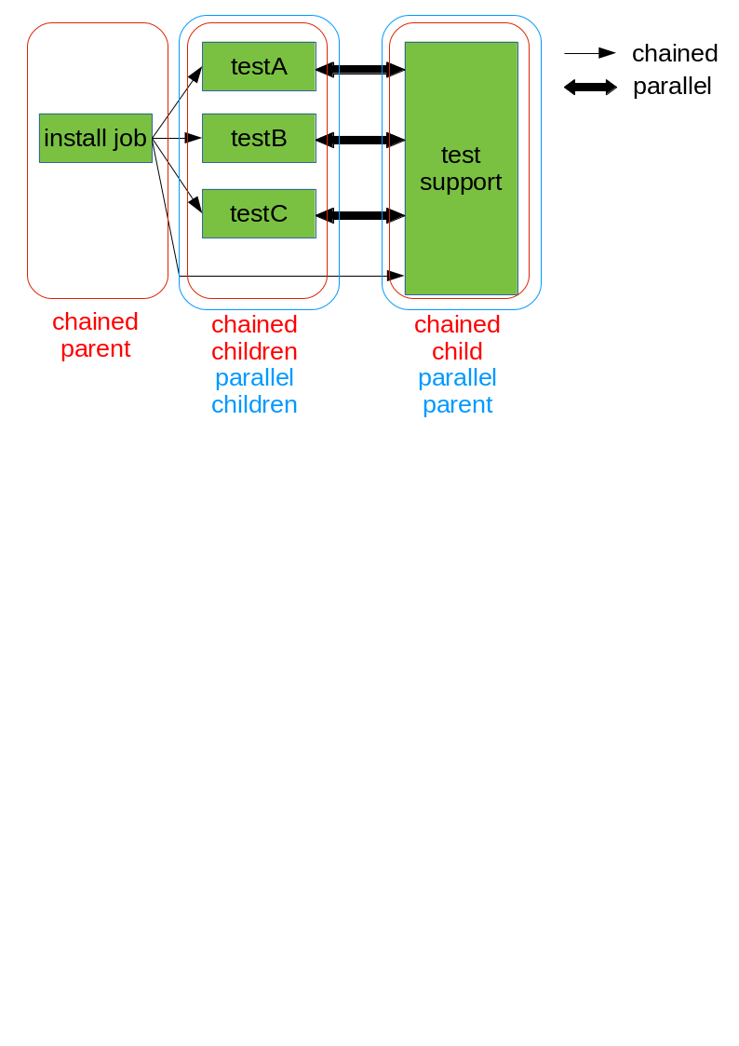
test job dependencies

Slide 21
test job dependencies - perks
delayed start (chained)
asset reuse (chained)
locks and barriers (parallel)
information sharing between test jobs (parallel)

Slide 22
“Is There Anybody Out There?”
QEMU user networking
  no SUT-SUT communication
  no inbound access
  outbound access allowed
  default

Slide 23
“Is There Anybody Out There?”
QEMU user networking
TAP devices
  manual configuration required
  all-you-can-do

Slide 24
“Is There Anybody Out There?”
QEMU user networking
TAP devices
Open vSwitch
  initial configuration required
  dynamically creates network for MM tests
  SUT-SUT communication
  allows network between worker nodes

Slide 25
Enterprise world

Slide 26
SUSE Linux Enterprise Server
“On what architectures and hardware does SLES run?”
SUSE Linux Enterprise Server is supported by leading hardware vendors. You can run SUSE Linux Enterprise Server 12 on the following 64-bit architectures: Intel 64 and AMD64, IBM POWER and IBM z Systems.
https://www.suse.com/products/server/frequently-asked-questions/#q5

Slide 27
Wide range of SUTs
Virtual machines FTW!
  QEMU (x86_64, ARM), libvirt, PowerVM, s390

Slide 28
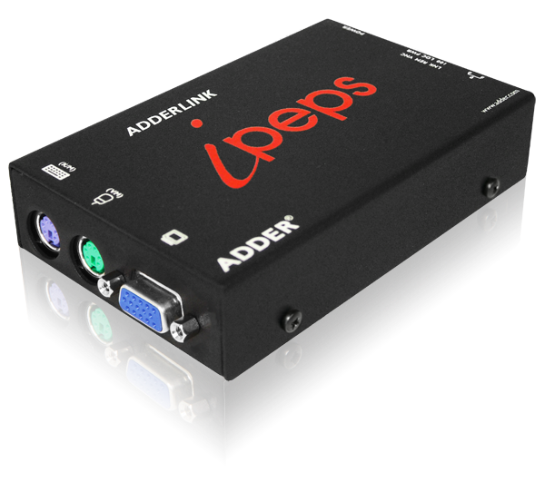
Wide range of SUTs
Virtual machines FTW!
  QEMU (x86_64, ARM), libvirt, PowerVM, s390
Reality still real though
  IPMI, ADDERLink

Slide 29

Lifecycle

Slide 30
Lifecycle
infrastructure integration
  REST
  fedmsg
specialized maintenance update tests
works well with OpenBuildService
  see “openSUSE Leap 42.1 Maintenance” group

Slide 31
Linux Test Project

Slide 32
Linux Test Project (“LTP”)
“The LTP testsuite contains a collection of tools for testing the Linux kernel and related features”
https://linux-test-project.github.io/

Slide 33
Linux Test Project (“LTP”)
mostly text based tests
screen asserting expensive

Slide 34
text based tests support
testapi support
  monitoring SUT serial port
  matching against string or regexp(s)

Slide 35
text based tests support
testapi support
  monitoring SUT serial port
  matching against string or regexp(s)
VNC based (user, root console)
  input simulating keystrokes (slow)
  outputs redirected to serial device

Slide 36
text based tests support
testapi support
  monitoring SUT serial port
  matching against string or regexp(s)
VNC based (user, root console)
virtio-serial (virtio-serial console)
  sending raw bytestream (3 orders of magnitude faster)
  no need for output redirection
  does not support pressing special/function keys

Slide 37
text based tests support
testapi support
  monitoring SUT serial port
  matching against string or regexp(s)
drawback
  SUT must be set to enable and use serial device
  done in tests, not part of test engine

Slide 38
openQA tests
There’s more than one way to do it

Slide 39
“You can't ever go wrong with pearls.”
Yes, it’s perl

Slide 40
“You can't ever go wrong with pearls.”
Yes, it’s perl
openQA test = test loader + test code (+ needles)

Slide 41
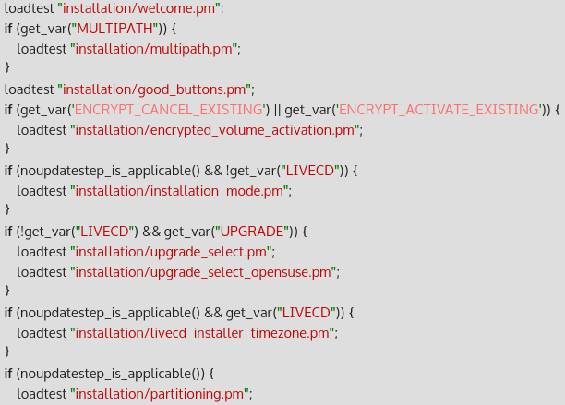
openQA test loader
‘main.pm’
loads individual modules
maintains test order

Slide 42
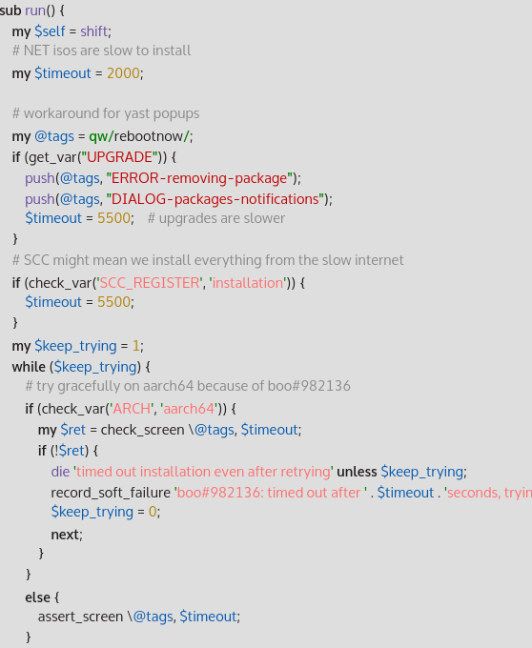
test code
openQA/os-autoinst APIs
  testapi
  mmapi
  lockapi

Slide 43
test code
openQA/os-autoinst APIs
  testapi
  mmapi
  lockapi
whatever you want

Slide 44

needles
picture
  screenshot from SUT
  generated image
  ...

Slide 45
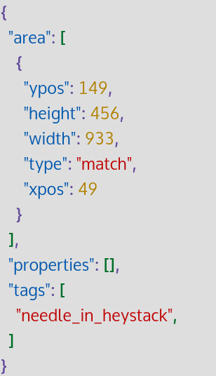
needles
picture
  screenshot from SUT
  generated image
  ...
JSON metadata
  match areas
  needle tags
  ...

Slide 46
Live demo

Slide 47
Contacts
irc://chat.freenode.net/opensuse-factory
mailto: opensuse-factory@opensuse.org
git@github.com:os-autoinst/openQA
git@github.com:os-autoinst/os-autoinst
git@github.com:os-autoinst/os-autoinst-distri-openSUSE
https://progress.opensuse.org/projects/openqav3

Slide 48
Questions?

Slide 49
Join the conversation,
contribute & have a lot of fun!
www.opensuse.org

Slide 51
License
This slide deck is licensed under the Creative Commons Attribution-ShareAlike 4.0 International license. It can be shared and adapted for any purpose (even commercially) as long as Attribution is given and any derivative work is distributed under the same license.
Details can be found at https://creativecommons.org/licenses/by-sa/4.0/
Credits
Template
Richard Brown
rbrown@opensuse.org
Design & Inspiration
openSUSE Design Team
http://opensuse.github.io/branding-guidelines/

