Slide 1
JUNE 06, 2020, NÜRNBERG, GERMANY
A quest for test automation
Santiago Zarate
QA at SUSE foursixnine
Testing operating system builds, multiple times a day, in different architectures

Slide 2
Quick outline
openQA
01
Web UI
Definitions
Scheduling
Reviews
Asset Provisioning
02
Worker
Setup
Execution
Reporting
03
Test distribution
DSL
Interaction with System under Test
Logging
https://open.qa

Slide 3
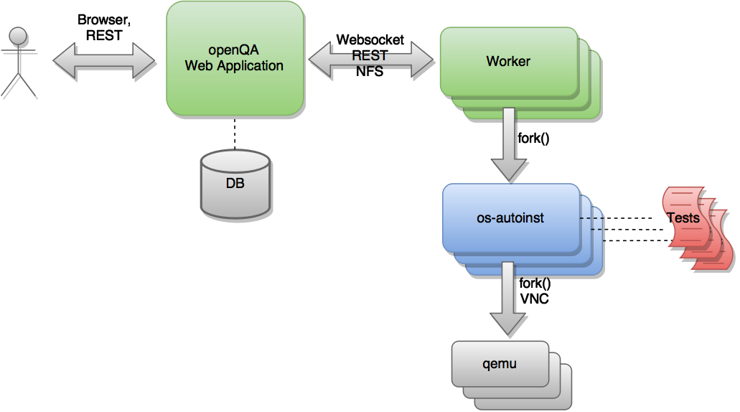

Slide 5
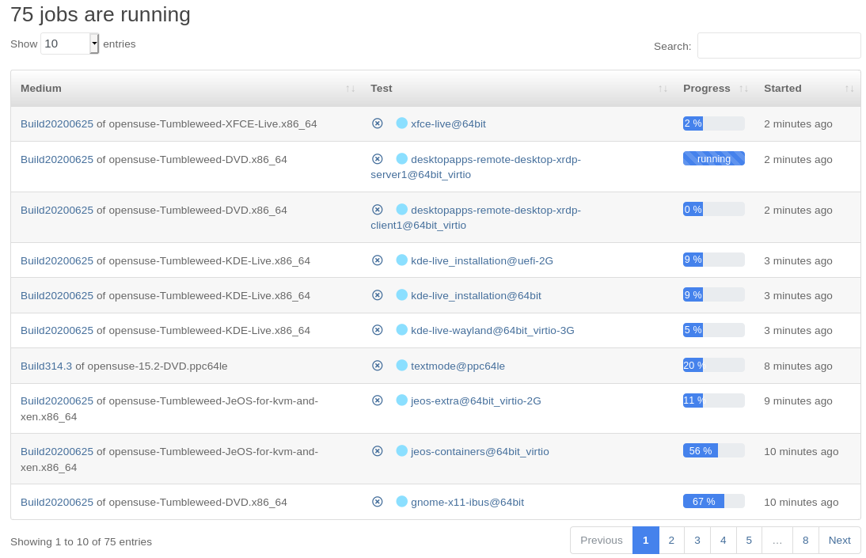
Written in Perl with Mojolicious
PostgreSQL as database
Exposes a REST api
  Users
  Workers
  Thirdparty apps/scripts

Slide 6
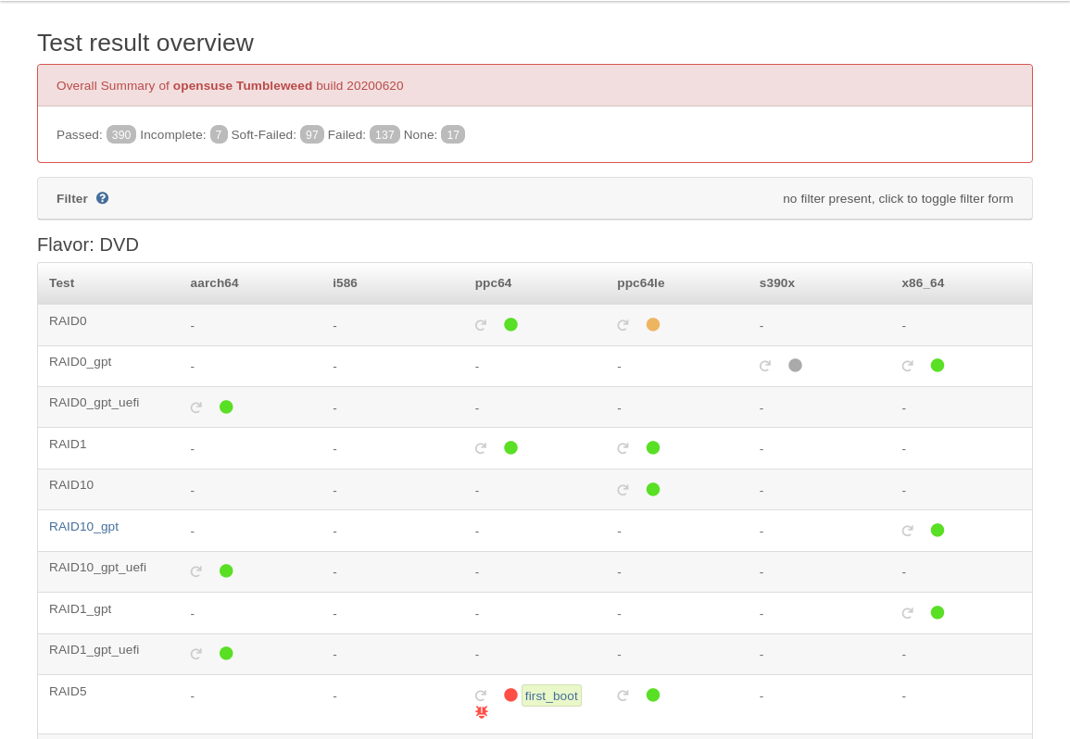
Test result overview
  State of the build
  Scenarios
  Failures

Slide 7
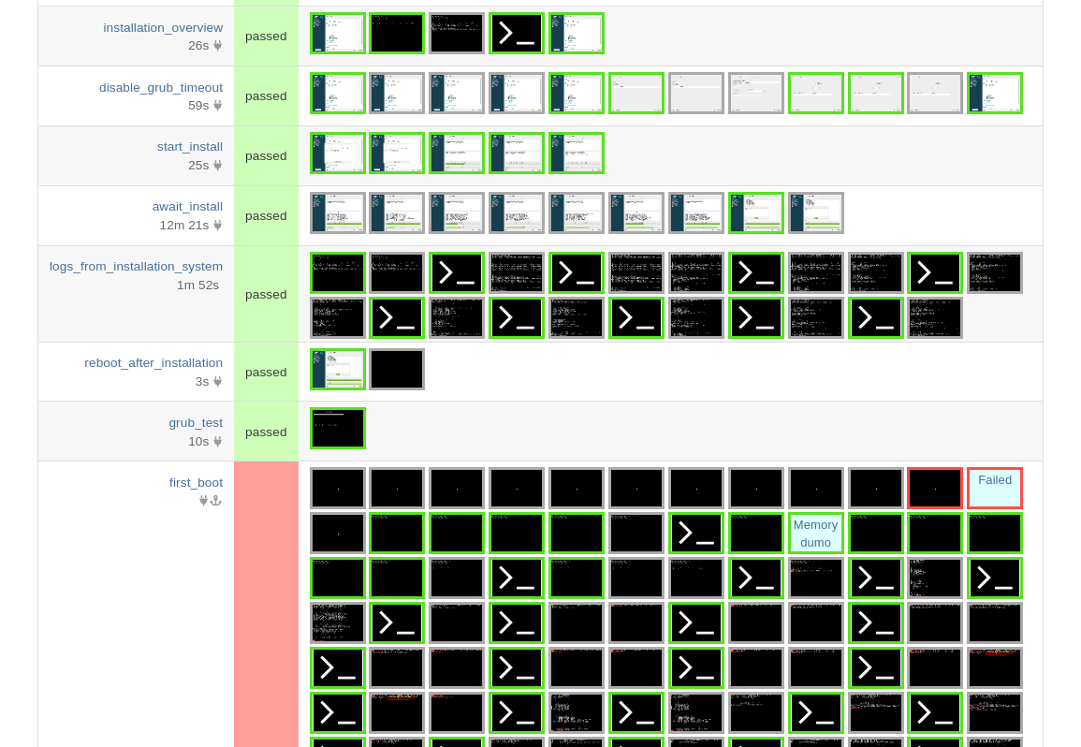
Displays test results
Provisions assets
Help with investigation

Slide 8
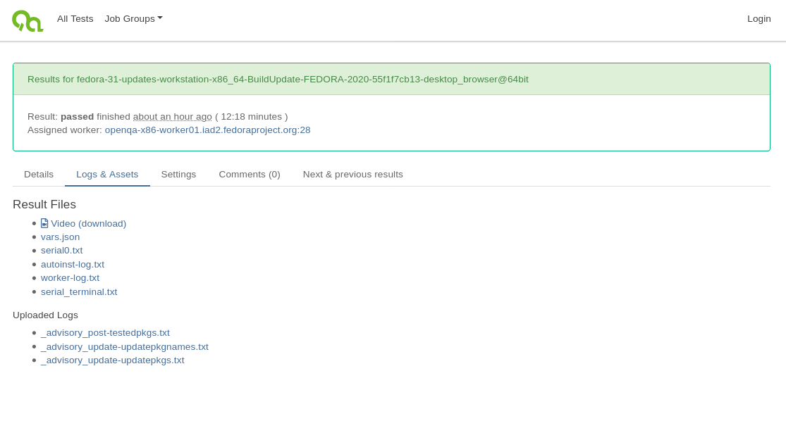
Displays test results
  Video
  Test Data
  Test driver logs
  Test logs
Help with investigation

Slide 9
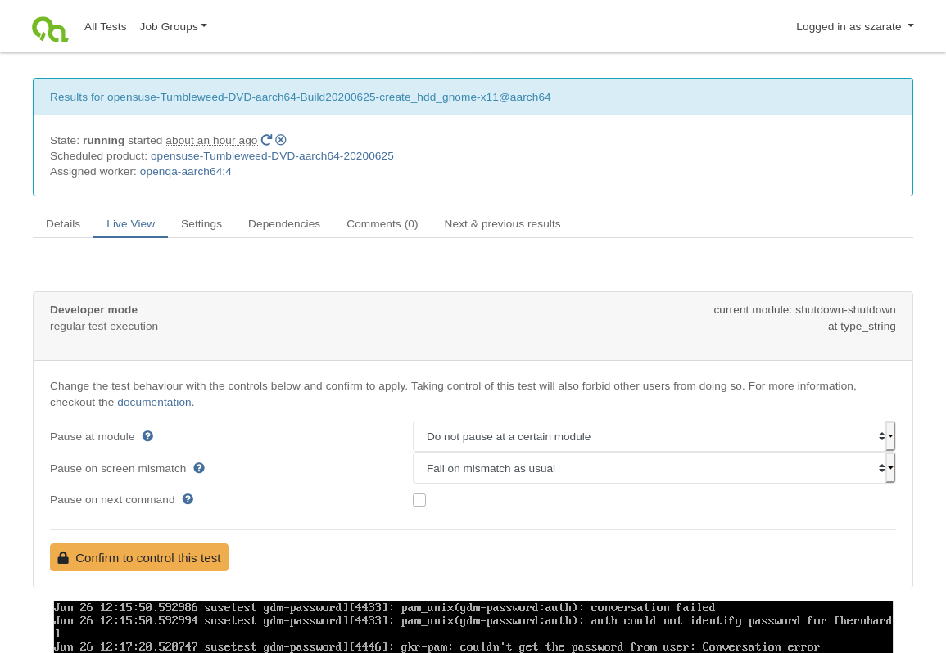
Displays test results
Provisions assets
Help with investigation
  Control SUT
  Connect via VNC
  Stop at screen match
  Stop at a test module
  Stop on next command

Slide 10
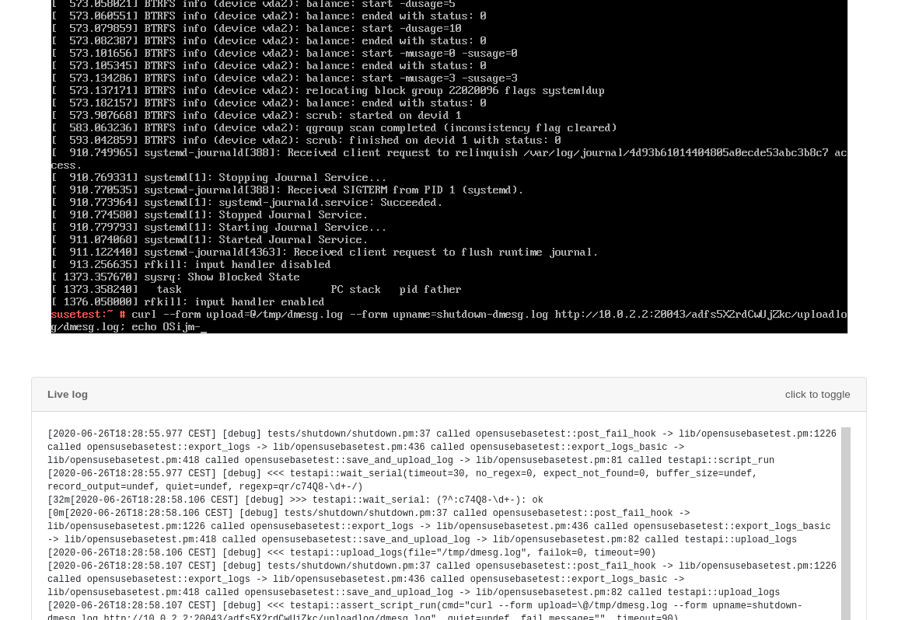
Displays test results
Provisions assets
Help with investigation
  Test driver live log
  SUT Serial console log

Slide 11
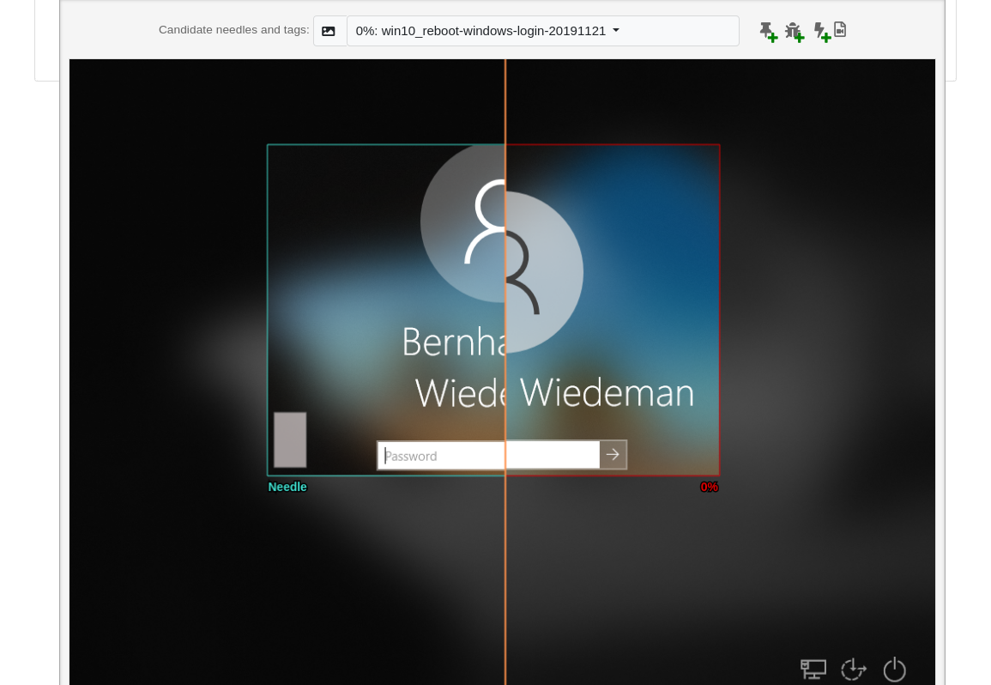
Displays test results
Provisions assets
Help with investigation
  Why a screen didn’t match

Slide 12
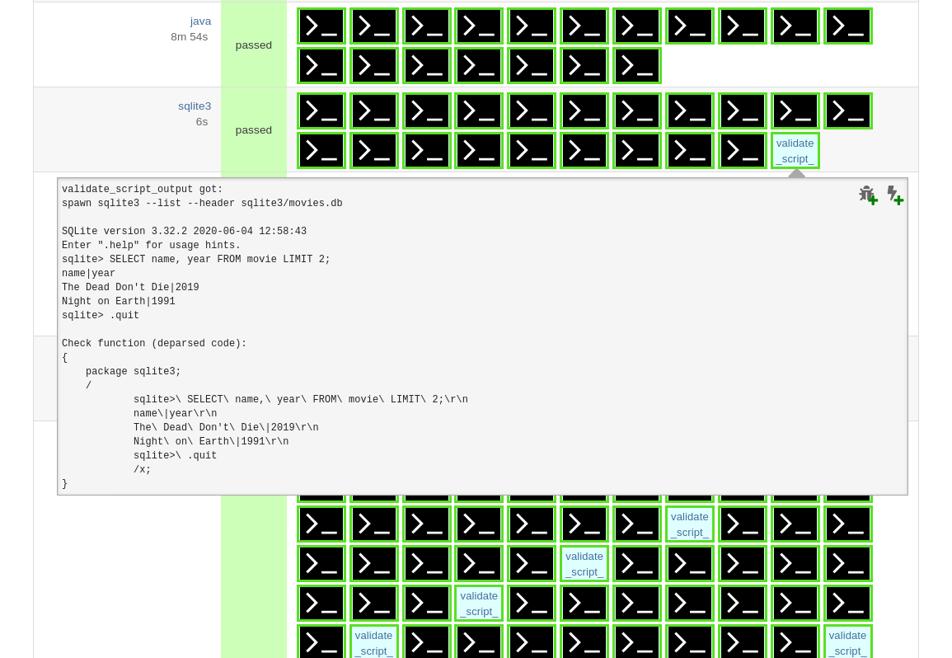
Displays test results
Provisions assets
Help with investigation
  Why a screen didn’t match
  How did that validate?

Slide 13
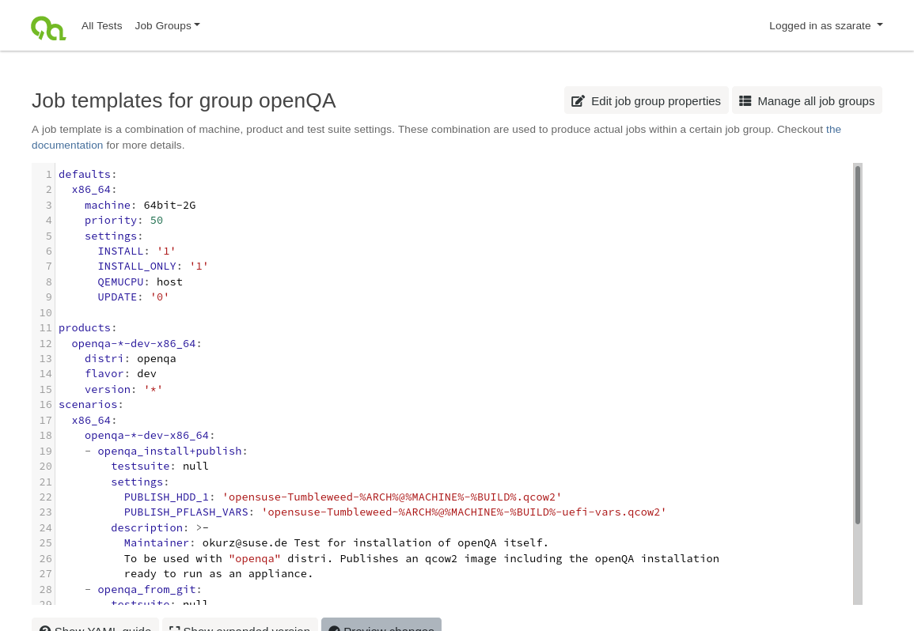
Products
  What do we test
Scenarios
  How the test should look like
Machines
  Where do we test
    Architectures
    Worker Classes
We’re loving YAML!

Slide 15
X86
ARM64
PowerPC
  PowerKVM
  PowerVM
Libvirt
Mainframe (s390)
We’re loving YAML!

Slide 18
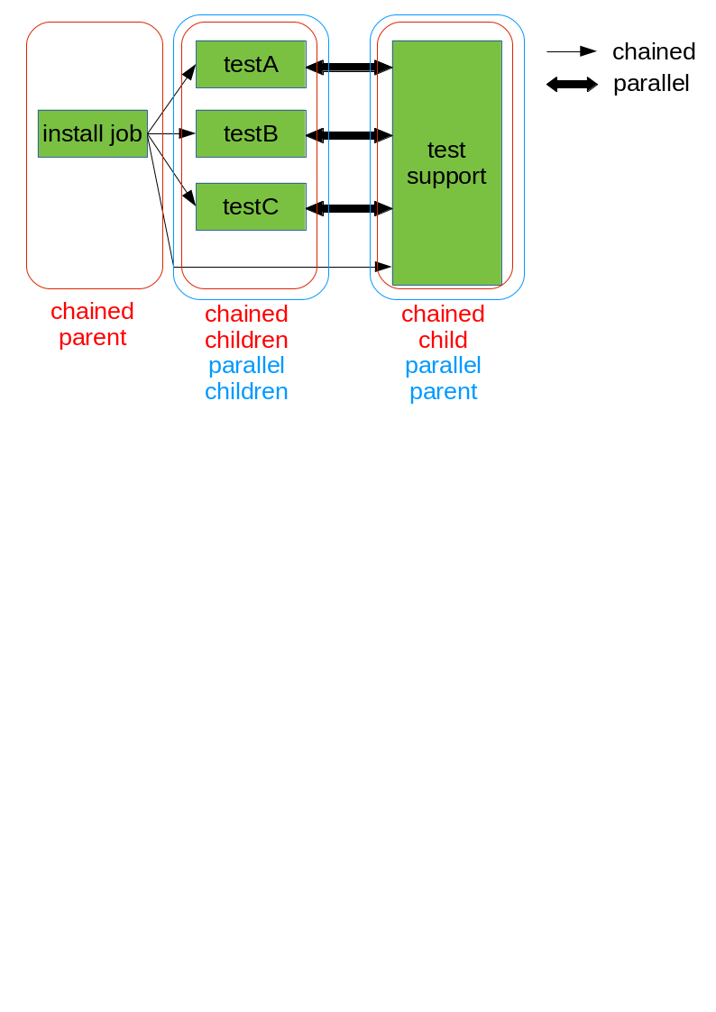
os-autoinst
(aka isotovideo)
Is the test Driver
Sets up the environment
Reports results back to the Web UI
Written in Perl (naturally)!
A lot of Mojolicious love
But also a lot of old code :(
Provides Locking API
Parallel
Chained
N+1 nodes

Slide 19
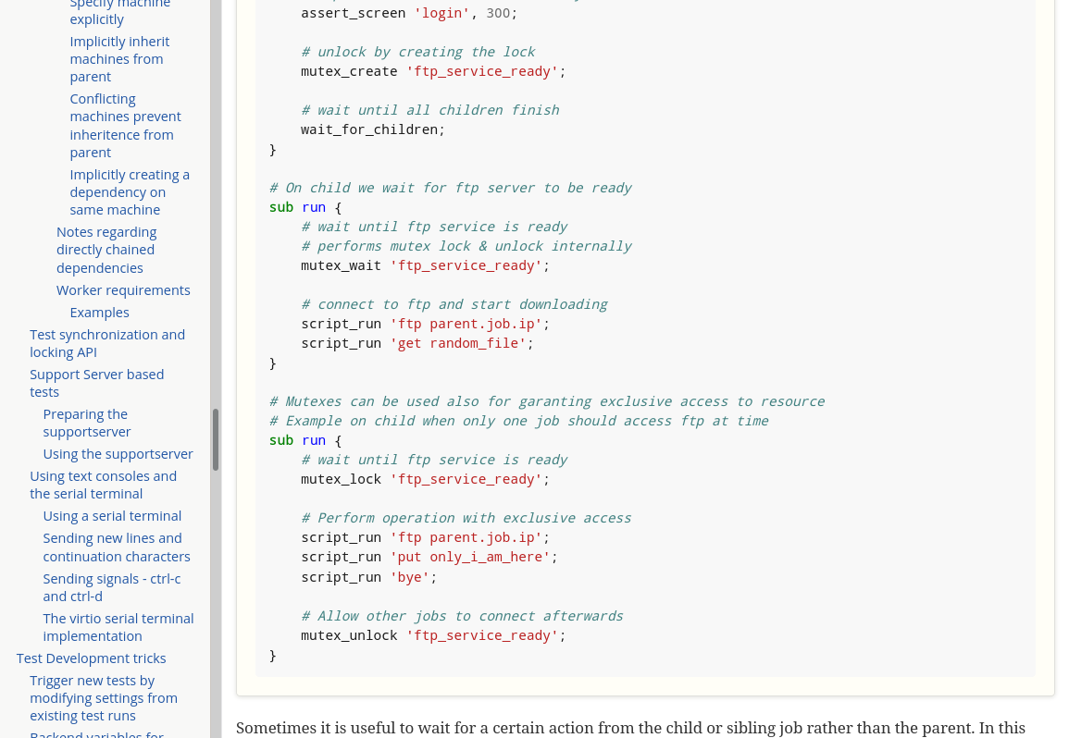
os-autoinst
(aka isotovideo)
Is the test Driver
Sets up the environment
Reports results back to the Web UI
Written in Perl (naturally)!
A lot of Mojolicious love
But also a lot of old code :(
Provides Locking API
Parallel
Chained
N+1 nodes

Slide 20
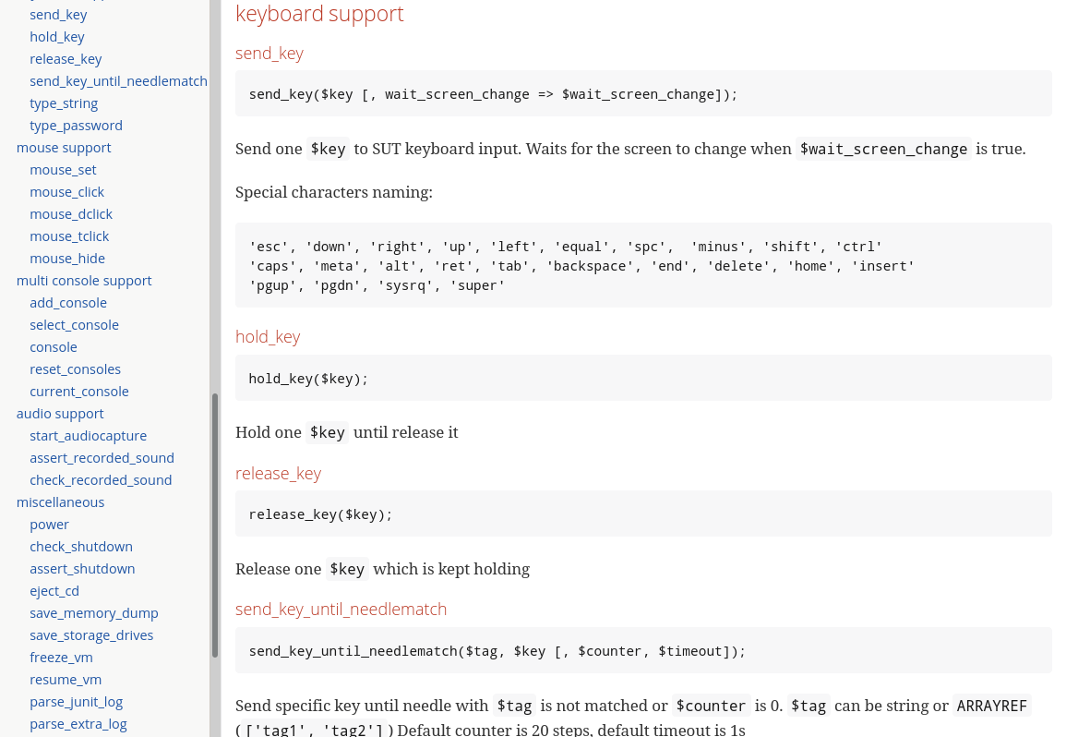
os-autoinst
(aka isotovideo)
Provides DSL via testapi.pm
Provides type_string
Provides assert_screen
Provides wait_serial
Provides select_console
… and much more

Slide 21
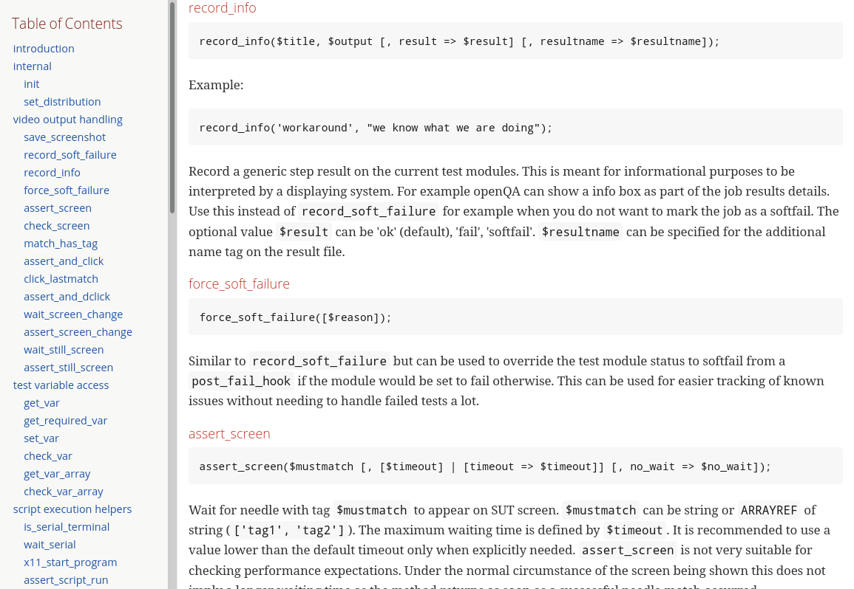
os-autoinst
(aka isotovideo)
Provides DSL via testapi.pm
Provides type_string
Provides assert_screen
Provides wait_serial
Provides select_console
… and much more

Slide 23
X86
ARM64
PowerPC
  PowerKVM
  PowerVM
Libvirt
Mainframe (s390)
Also Baremetal :)
We’re loving YAML!

Slide 24

X86
ARM64
PowerPC
  PowerKVM
  PowerVM
Libvirt
Mainframe (s390)
Also Baremetal :)
We’re loving YAML!

Slide 25
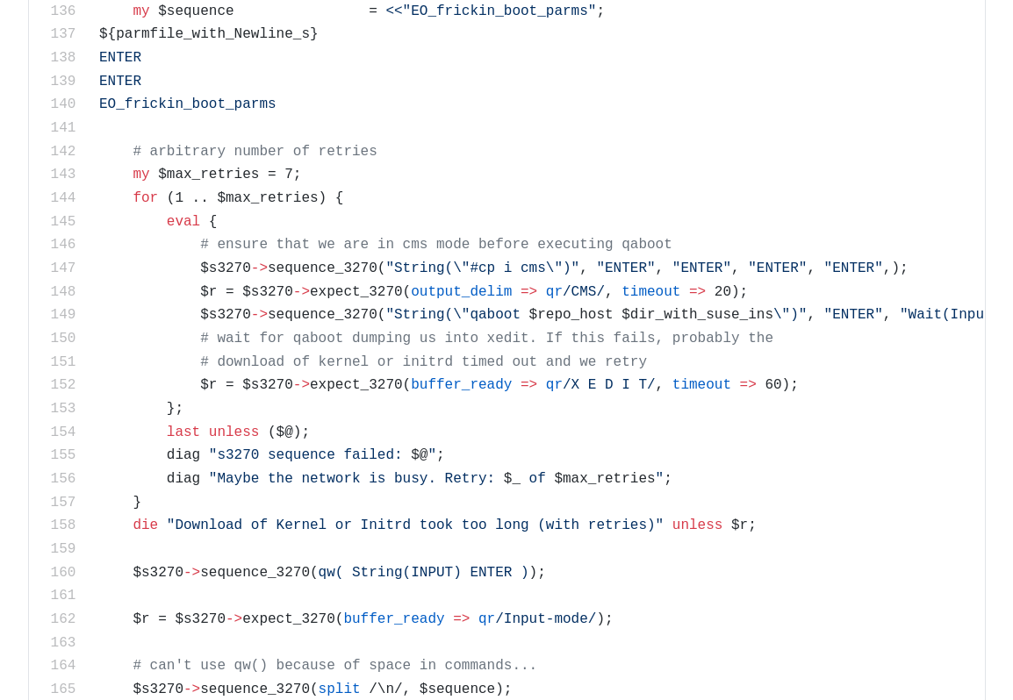
Talking about Mainframe
Picture

Slide 26
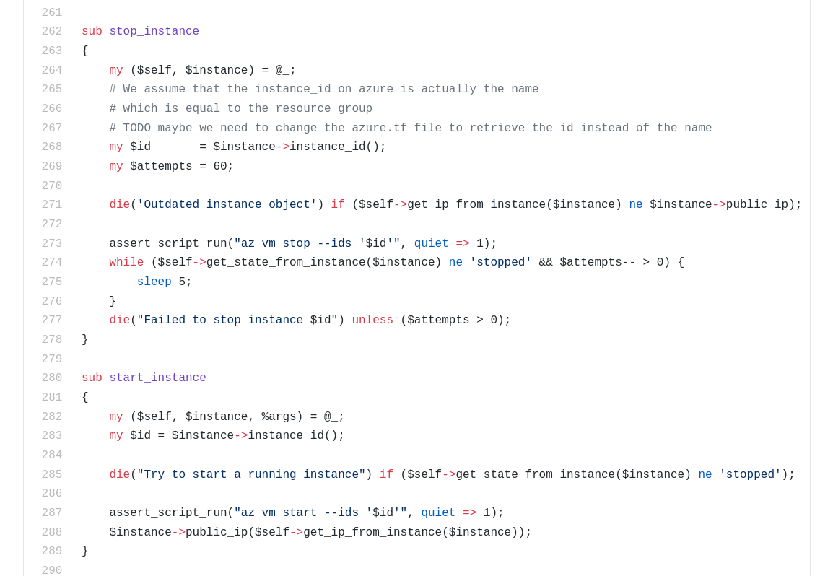
Say you want interact with Azure
Picture

Slide 27
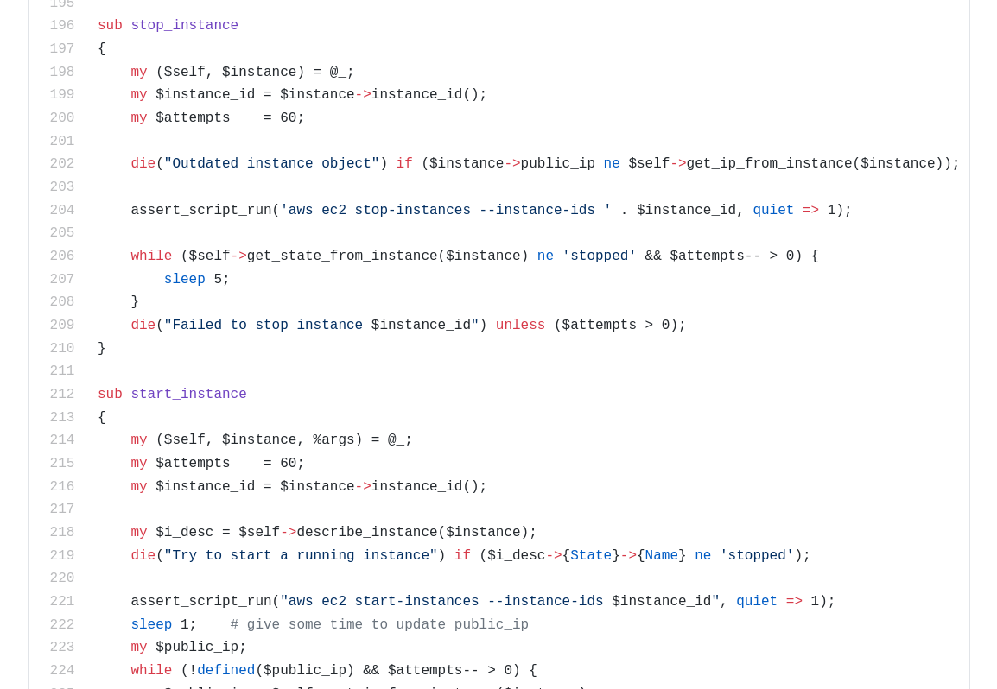
Say you want interact with Amazon Cloud
Picture

Slide 28
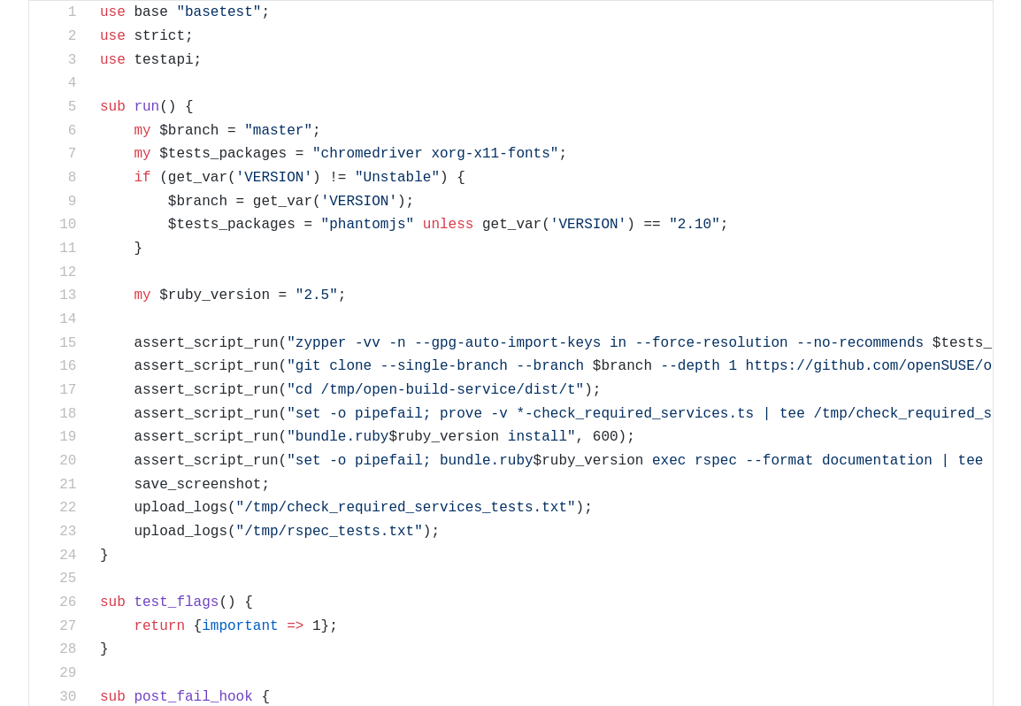
Say you have your own test suite
Picture

Slide 29
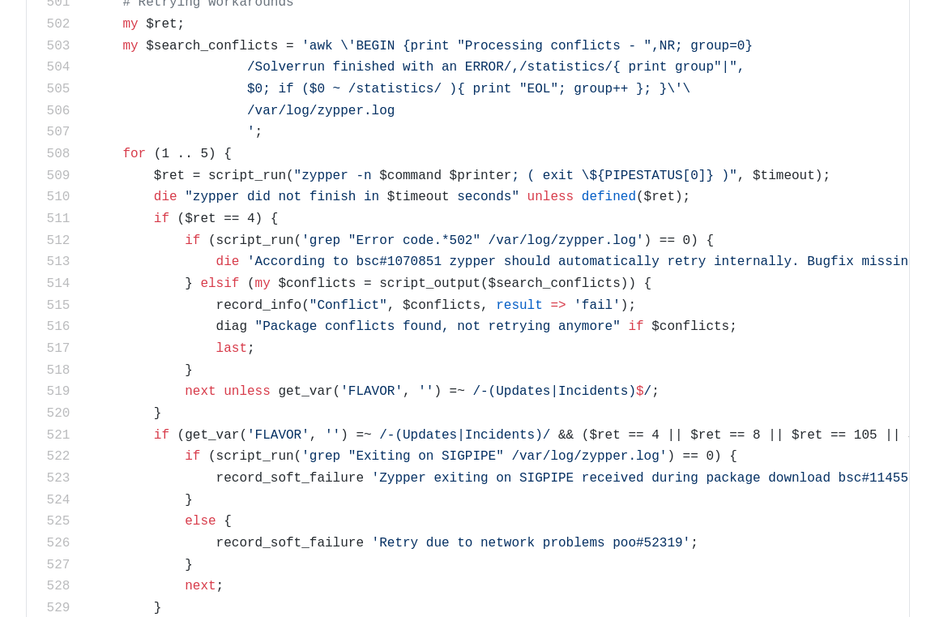
I want to run a script and capture the output!
Picture

Slide 30
Check it out!
https://open.qa
https://openqa.opensuse.org
https://openqa.fedoraproject.org
http://openqa.debian.net *
https://github.com/os-autoinst

Slide 31
Thank you.

