Slide 1
openQA automated testing for everything*
Ondrej Holecek /aaannz/
oholecek@suse.com

Slide 2
Once upon a time in a geekos lair...
build
check
is it
time?
QA
mess with
packages
release

Slide 3
Next time in a geekos lair...
mess with
packages
build
check
is it
time?
QA
release
QA

Slide 4
OpenQA #1
See what user sees
  record VNC output
  compare recorded images with reference pictures

Slide 5
OpenQA #1
See what user sees
  record VNC output
  compare recorded images with reference pictures
Do what user does
  emulate keyboard presses and mouse movement
  do not install helpers on target system (SUT)

Slide 6
OpenQA #1

Slide 7
Distribution combinatorics
Images
  DVD, USB, Net, Rescue, Live
Disks and filesystems
  RAID, LVM, LUKS, BTRFS, EXT4, …
Desktops
  GNOME, KDE, Text mode, …
...

Slide 8
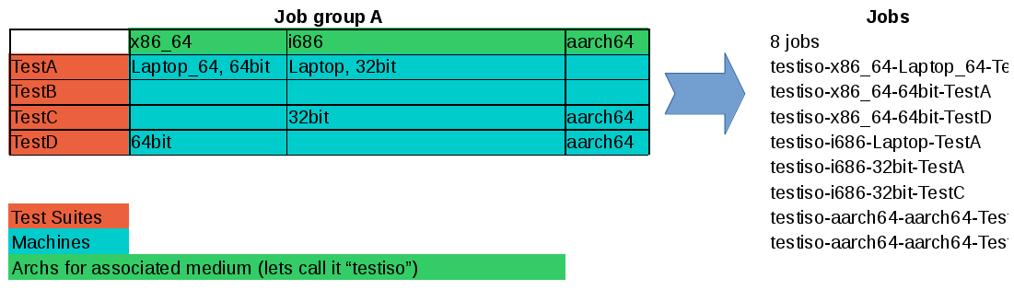
OpenQA #2
Machines
  arch, CPUs, RAM, disks, networking, ...
Test templates
  GNOME, KDE, LUKS, BTRFS, ...
Products/Medias
  DVD, NET, Rescue, …

Slide 9
OpenQA #3
no vacation
no wage
no sleep
always focused

Slide 10
OpenQA #3
no vacation
no wage
no sleep
always focused
x 18*
*) completely random value, substitute for how many workers you run

Slide 11
Architecture

Slide 12
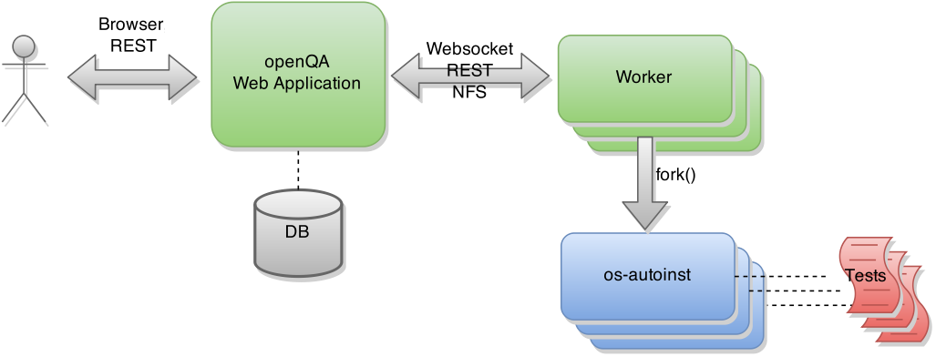
Architecture

Slide 13
os-autoinst backends
KVM/QEMU (default)
IPMI (real HW)
s390, PowerPC, PowerVM

Slide 14

Test architecture
test loader
  main.pm
test
  tests/*
needles
  screenshot + metadata
more tomorrow at workshop
  A113 @ 9:00

Slide 15
Features

Slide 16
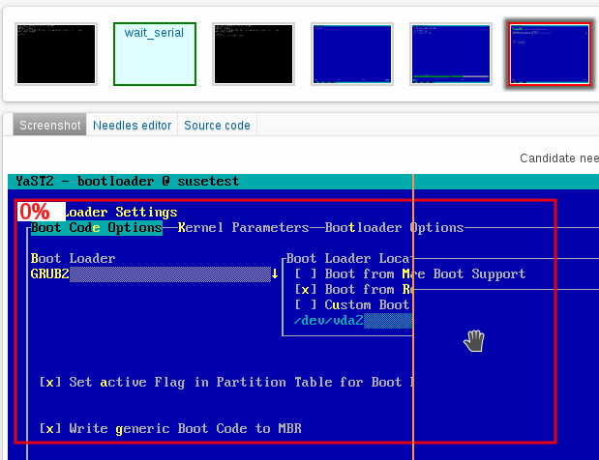
Powerful reporting
video recording
screenshots with highlighted errors

Slide 17
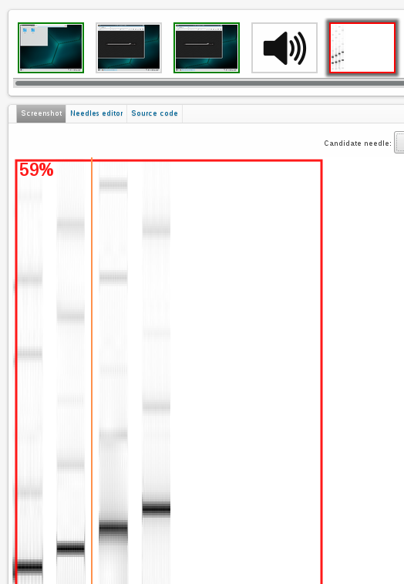
Powerful reporting
video recording
screenshots with highlighted errors

Slide 18
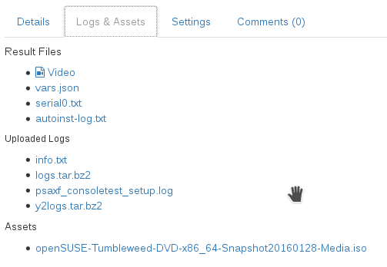
Powerful reporting
video recording
screenshots with highlighted errors
test API for log and assets upload

Slide 19
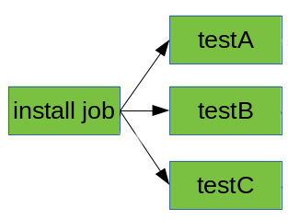
Complex test cases (all backends)
dependent tests
  prune unfeasible jobs
  assets reuse

Slide 20
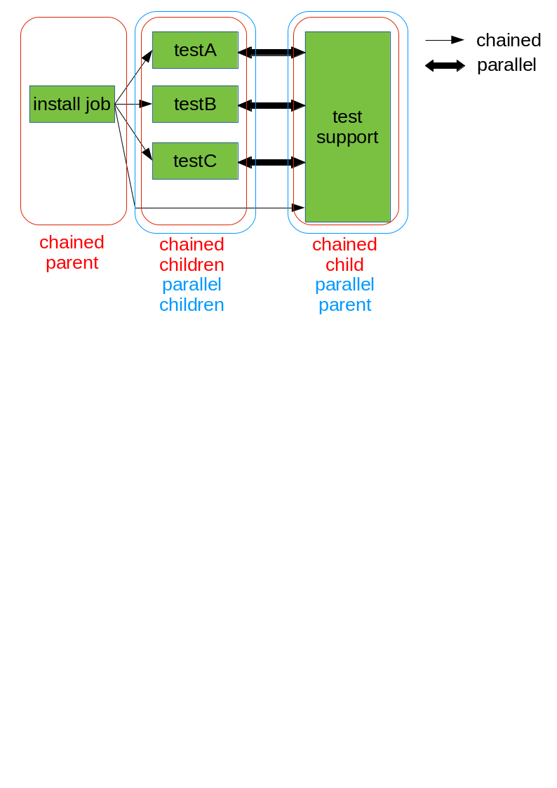
Complex test cases (all backends)
dependent tests, assets reuse
multi-machine tests

Slide 21
Complex networking (QEMU)
QEMU user networking (default)
TAP (custom networking)
VDE
Open vSwitch

Slide 22
SUT and test bug hunting (QEMU)
VM snapshots
  store snapshots after each test module
  continue where left

Slide 23
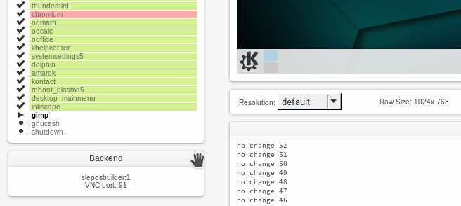
SUT and test bug hunting (all backends)
VM snapshots
Interactive mode and remote VNC
  pauses needle matching and test execution

Slide 24
Infrastructure integration
REST interface
background tasks
  ISO download on test run
  compacting and removing of old results
MySQL, PostgreSQL, SQLite support
OpenID 2.0, iChain authentication

Slide 25
Scalability
OpenQA WebUI
  Apache + Mojolicious::Prefork
  scale up

Slide 26
Scalability
OpenQA WebUI
  Apache + Mojolicious::Prefork
  scale up
OpenQA Workers
  multiple workers per server
  remote workers
  scale up & out

Slide 27
Contacts
IRC
  freenode #opensuse-factory
email
  opensuse-factory@opensuse.org
issues
  https://progress.opensuse.org/projects/openqav3/
code
  https://github.com/os-autoinst/openQA https://github.com/os-autoinst/os-autoinst

Slide 28
Questions?

Slide 29
About
Ondřej Holeček
  software engineer at SUSE
  oholecek@suse.com
  GPG key ID 0xAAF9AA30
aaannz
  the same person as above
  twitter.com/aaannz
  G+, Steam, WhatsApp, Telegram_{/phone# for a beer/}

Slide 31
License
This slide deck is licensed under the Creative Commons Attribution-ShareAlike 4.0 International license. It can be shared and adapted for any purpose (even commercially) as long as Attribution is given and any derivative work is distributed under the same license.
Details can be found at https://creativecommons.org/licenses/by-sa/4.0/
Credits
Template
Richard Brown
rbrown@opensuse.org
Design & Inspiration
openSUSE Design Team
http://opensuse.github.io/branding-guidelines/

