Slide 1
SPI User Guide
Nov 19th 2021

Slide 2
SPI Master And Slave IP Functional Diagram

Slide 3
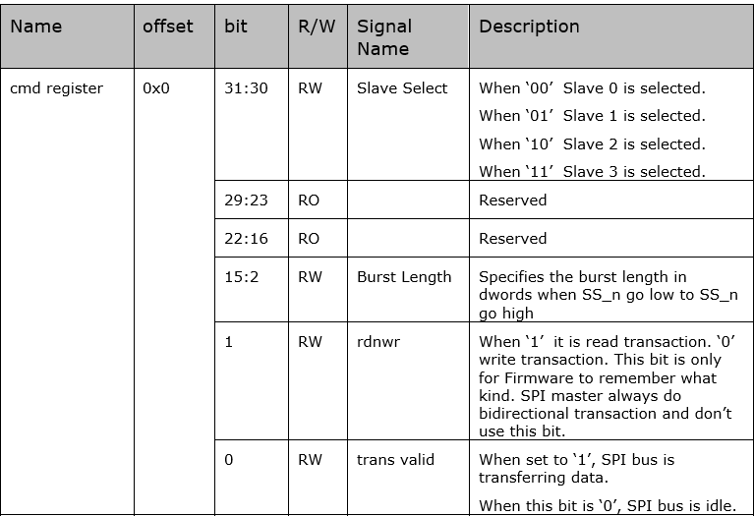
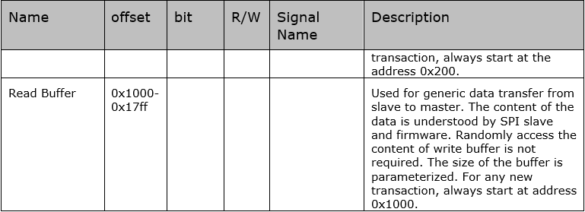
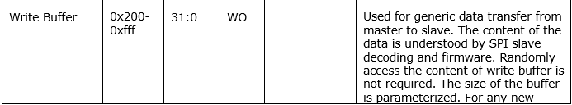
SPI Master CSR

Slide 4
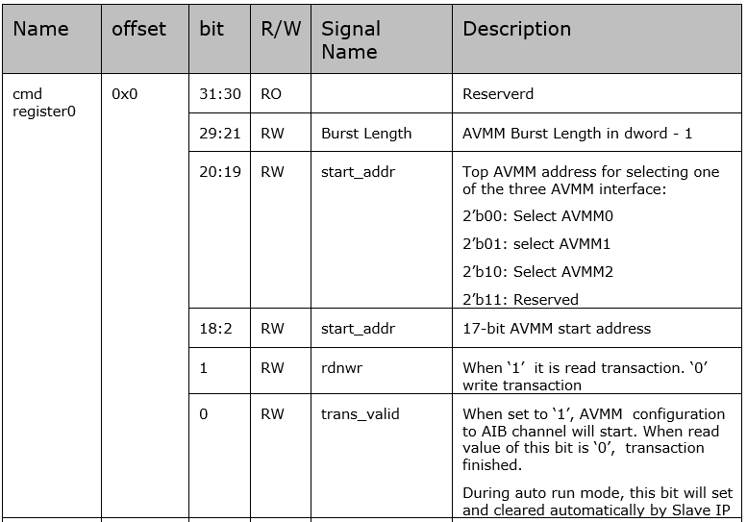
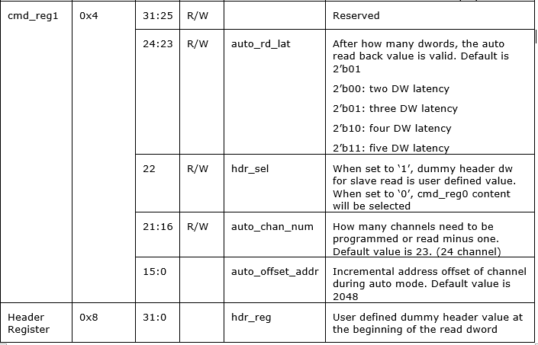
SPI Slave CSR

Slide 5
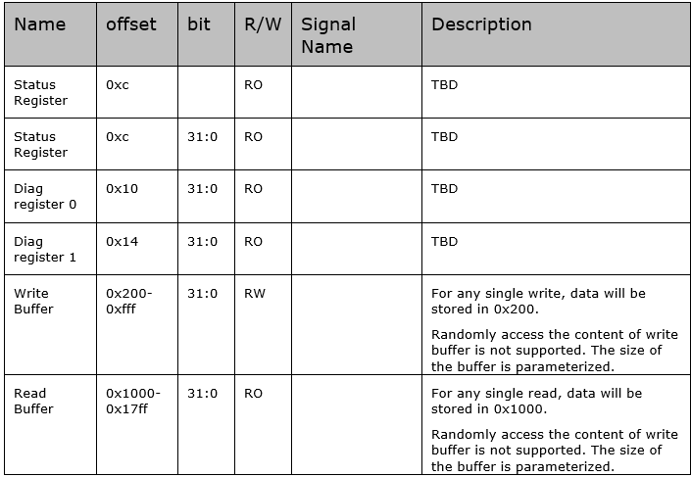
SPI Slave CSR

Slide 6
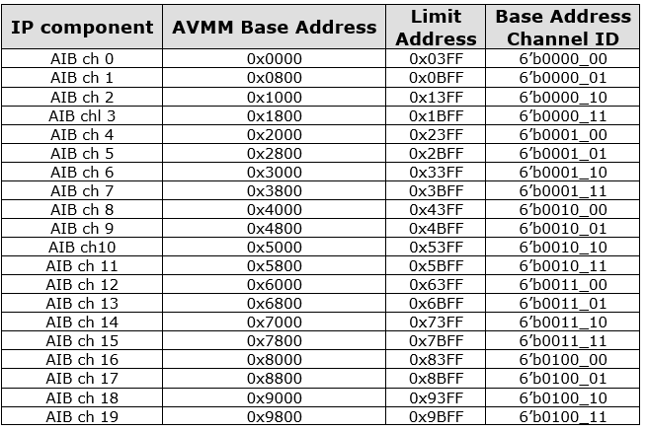

The Purpose of SPI Slave CSR

Slide 7
SPI Master Writing Program
Always check bit 0 of CMD Register to make sure all the interfaces are free.
NIOS will decide which slave to write by config CMD Register bit 31:30. Currently this SPI master will support four Slave total.
NIOS does AVMM writes to write buffer for the total data that needs to transfer to SPI.
Write to CMD Register bit 1 for write operation. Write burst length on bit 15:2 for total burst dword on SPI bus.
set TRANS_VALID bit to 1. Now SPI master will send the data across the SPI bus.
Keep checking bit 0 of CMD Register. If it is zero, write procedure is finished. SPI bus is idle.
Master does not care about the content of the writing. Only Slave cares.

Slide 8
SPI Master Write SPI Slave CSR Setup (One Time)
//Program SPI master write buffer. Always start at 17’h200
avmm_if_mspi.cfg_write(17'h200, 4'hf, 32'h1010_0000);
avmm_if_mspi.cfg_write(17'h204, 4'hf, 32'h0080_0200);
avmm_if_mspi.cfg_write(17'h208, 4'hf, 32'h0017_0800);
avmm_if_mspi.cfg_write(17'h20c, 4'hf, 32'hdead_beef);
//Program SPI master command register and
//set the bit zero to 1’b1 to start the transaction
avmm_if_mspi.cfg_write(17'h000, 4'hf, 32'h0000_000d);
//Keep polling SPI master command register bit [0] until it goes to 1’b0
//In later example this portion is replaced by master_polling ()
while (rdata_reg[0] !== 1'b0) begin
avmm_if_mspi.cfg_read (17'h000, 4'hf, rdata_reg);
$display("%0t: cmd polling: rdata_reg = %x", $time, rdata_reg);
end

Slide 9
SPI Master Reading Program
Always check bit 0 of CMD Register to make sure all the interfaces are free.
NIOS will decide which slave to write by config CMD Register bit 31:30.
NIOS does AVMM writes to write buffer for setting up read request write transaction.
Write to CMD Register bit 1 for write operation. Write burst length on bit 15:2 for total burst word on SPI bus.
Set TRANS_VALID bit to 1. Now SPI master will send the data across the SPI bus.
Keep checking bit 0 of CMD Register. If it is zero, read request procedure is finished.
AVMM master can check the content of read buffer.

Slide 10
SPI Master Read SPI Slave CSR
//Program write buffer first. Slave read command.
avmm_if_mspi.cfg_write(17'h200, 4'hf, 32'h0010_0000);
//Program command register. The read/write bit does not matter.
avmm_if_mspi.cfg_write(17'h000, 4'hf, 32'h0000_000d);
//Keep polling SPI master command register bit [0] until it goes to 1’b0
master_polling ();
//Read back slave registers from read buffer
avmm_if_mspi.cfg_read (17'h1000, 4'hf, rdata_reg); //Ignore the dummy value
avmm_if_mspi.cfg_read (17'h1004, 4'hf, rdata_reg);
avmm_if_mspi.cfg_read (17'h1008, 4'hf, rdata_reg);
avmm_if_mspi.cfg_read (17'h100c, 4'hf, rdata_reg);

Slide 11
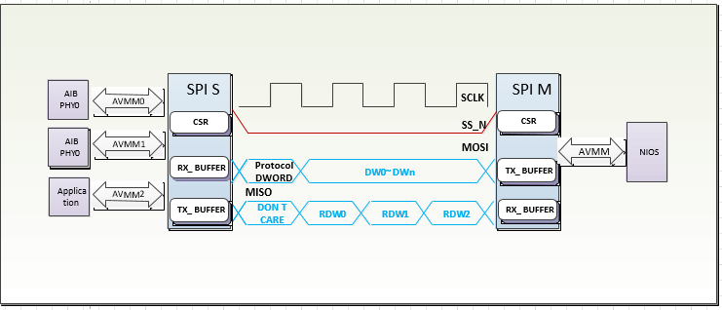
SPI Slave Protocol DWORD

Slide 12
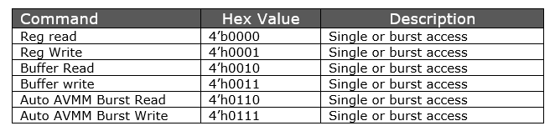
SPI Slave Command Type
Reg Write and Reg Read examples have been illustrated in SPI master example code
Buffer Write and Buffer Read are similar to Reg Write and Reg Read. Always start at the beginning of the buffer. They are optional commands.
The Auto AVMM operation involves AVMM and SPI operation in one SPI transaction. And they can be single/burst/multi-channels.

Slide 13
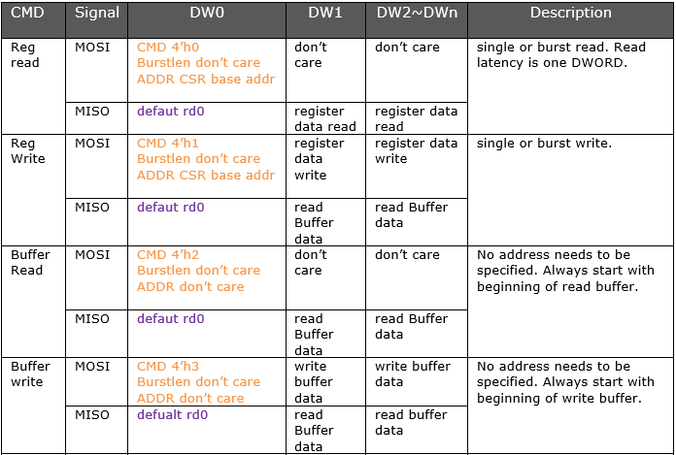
Protocol DWORD Table

Slide 14
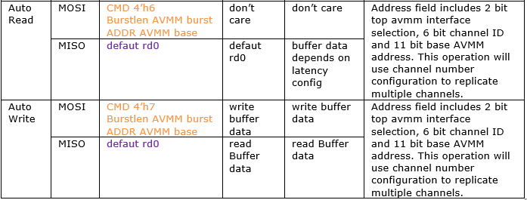
Protocol DWORD Table

Slide 15
Auto Write Example
The following example is equivalent of direct programming of for 24 Channels:
/* avmm_if_m1.cfg_write({i_m1,11'h31c}, 4'hf, 32'haaaa_bbbb);
avmm_if_m1.cfg_write({i_m1,11'h320}, 4'hf, 32'hcccc_dddd);
avmm_if_m1.cfg_write({i_m1,11'h324}, 4'hf, 32'heeee_ffff);
avmm_if_m1.cfg_write({i_m1,11'h328}, 4'hf, 32'h5555_6666); */
status = " Auto Write 4 burst for 24 channel ";
avmm_if_mspi.cfg_write(17'h200, 4'hf, {4'h7, 9'h3, 19'h31c}); // Write spim wbuf
avmm_if_mspi.cfg_write(17'h204, 4'hf, 32'haaaa_bbbb); //Write spim wbuf
avmm_if_mspi.cfg_write(17'h208, 4'hf, 32'hcccc_dddd); //Write spim wbuf
avmm_if_mspi.cfg_write(17'h20c, 4'hf, 32'heeee_ffff); //Write spim wbuf
avmm_if_mspi.cfg_write(17'h210, 4'hf, 32'h5555_6666); //Write spim wbuf
avmm_if_mspi.cfg_write(17'h000, 4'hf, 32'h0000_0011); //burst_len is bit[15:2]
master_polling (); //Check if write command/data has been sent to slave
slave_polling (); //Procedure to keep reading cmd register in Slave till
//bit [0] is 1’b0 indicate AVMM interface finished.

Slide 16
Auto Write Procedure
The Auto Write purpose is to programming AIB PHY AVMM regiters through SPI bus.
SPI master needs to write five entries in master transmit buffer. The protocol DWORD is 4’h7 for auto write. The burst length is three means four AVMM register data for slave to write into AVMM slave of AIB PHY. The base address is 31C is the AIB channel base address. After that, master command register needs to programmed. There will be five total DWORD send through SPI bus. The burst length is four for master command register.
After slave received protocol dword, it will take the four write data content into its receiver buffer and then write them to AVMM register. The slave will also check command register 1. If channel number is more than one, it will repeating programming for all the channel based on the offset value.
User need to first polling master command register to see SPI bus goes to idle. Then it needs to poll slave command register to make sure it is idle in the AVMM interface.

Slide 17
Auto Read Diagram

Slide 18
Auto Read Example
Want to read back the following content that has been done by AUTO Write:
/* avmm_if_m1.cfg_write({i_m1,11'h31c}, 4'hf, 32'haaaa_bbbb);
avmm_if_m1.cfg_write({i_m1,11'h320}, 4'hf, 32'hcccc_dddd);
avmm_if_m1.cfg_write({i_m1,11'h324}, 4'hf, 32'heeee_ffff);
avmm_if_m1.cfg_write({i_m1,11'h328}, 4'hf, 32'h5555_6666); */
status = " Auto burst read for 24 channel ";
avmm_if_mspi.cfg_write(17'h200, 4'hf, {4'h6, 9'h3, 19'h31c});
//burst 4 x 24 channel + 2 dummy= h61
avmm_if_mspi.cfg_write(17'h000, 4'hf, {16'h0, 14'h61, 2'h1});
master_polling (); //Check if write command/data has been sent to slave
//User can read all 4x24 data from the read buffer or just one channel
for (int i=0; i<97; i++) begin //97 is hex61
avmm_if_mspi.cfg_read ((17'h1000 + i*4), 4'hf, rdata_reg);
end
status = " End of Auto burst read for 24 channel ";

Slide 19
Design Example
Left side AIB interface is 2.0
Right side is Gen1 and 1.0
Program three AIB in purple x24 channel
Generate traffic for both pair after conf_done
Self checking for traffic receiving

Slide 21
Backup

Slide 22
