Slide 1

What Changed app

Slide 2

Introduction
Sometimes files change in the file-system without the user knowing.
Could cause file-corruption and errors.
Could be avoided if a modified/missing file was reported.

Slide 3

Requirements specifications
Compare old file-state with the new one, and generate a report containing the differences.
Keep track of changes in real-time.
Light to allow for real-time operation without loading the system.
Interface should be user-friendly.
Free-license database should be used.
Operating environment:
Tested on Window 7 x64.
Requires JRE 7.
User manual in .doc format.

Slide 4
Features
Select files to be kept track of.
Save file-state in a database when snapshotted.
Generate a report for the current file-state.
Generate a report of the difference between the old state and current state.
Show a summary of changed files.
Show a detailed report of all files.
Monitor files in real-time and pop a notification when something happens.

Slide 5
Engine
Central hub for different parts of the system.
It connects the main UI with reporting, and monitoring.
It also controls links to the database, and contains the main file lists/maps.

Slide 6
UI
MainUI
Contains the file selection system, the file-list, the action buttons, and the file-changes log.
ReportUI
Shows a summary of the file changes.
Shows a detailed list of all the files.
NotificationUI
A popup to notify of file changes in real-time.

Slide 7
States
OldState
Creates a ‘state’ which contains a table of the files attributes when a snapshot was taken.
NewState
Creates a ‘state’ which contains a table of the files attributes as they’re that moment.
It also calculates the difference in size of all files and adds them to the table.

Slide 8
File/Folder
FileObject
Saves a File object linking to a physical file.
In addition contains some methods which help in dealing with the meta-data of files.
Over-rides compareTo to allow for ‘path’ comparison in the right way.
Folder
Same as FileObject, but for a folder.
Doesn’t over-ride the compareTo method, but has a method to list all files in a folder.

Slide 9
FileWatcher
Allows real-time monitoring of files.
Creates a WatcherService for a certain folder to be notified of changes to the files in it.
Contains a list of files to be watched in this folder, to filter-out un-needed notifications.
Notifies the Engine of file-changes.
Multi-threading enabled.

Slide 10
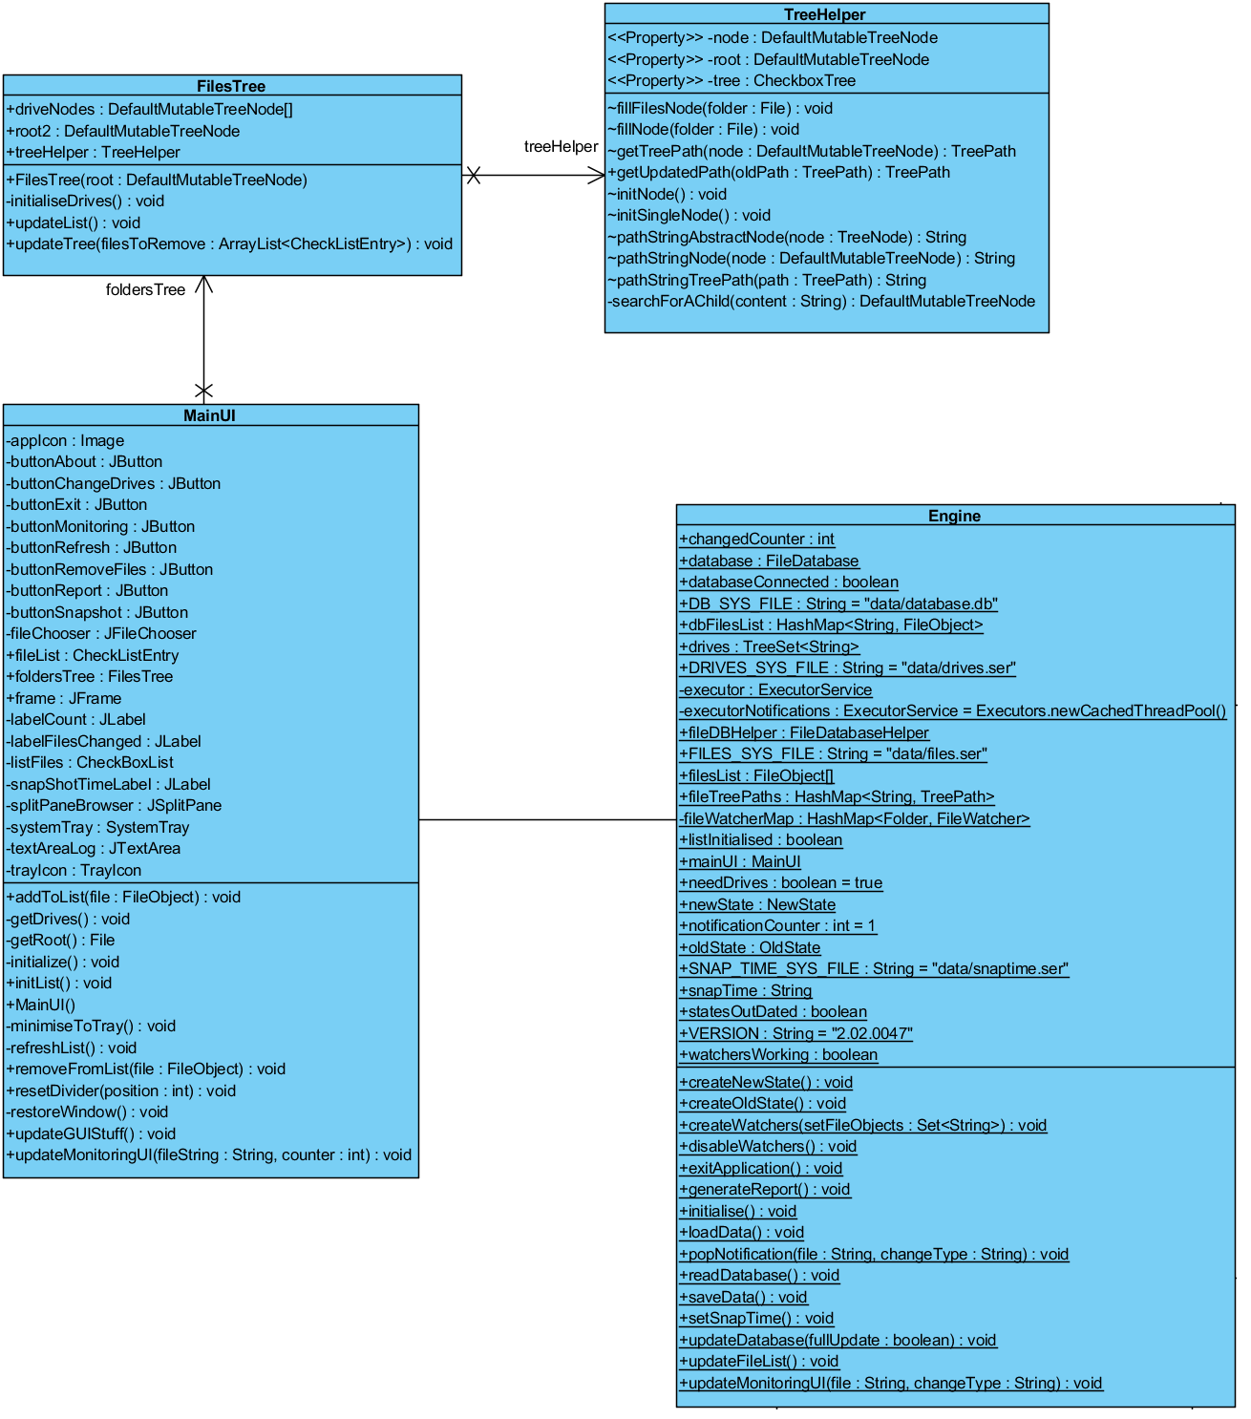

Slide 11
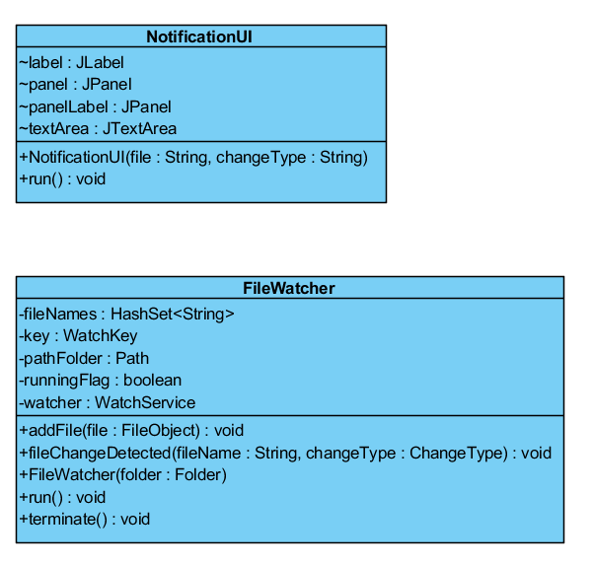

Slide 12
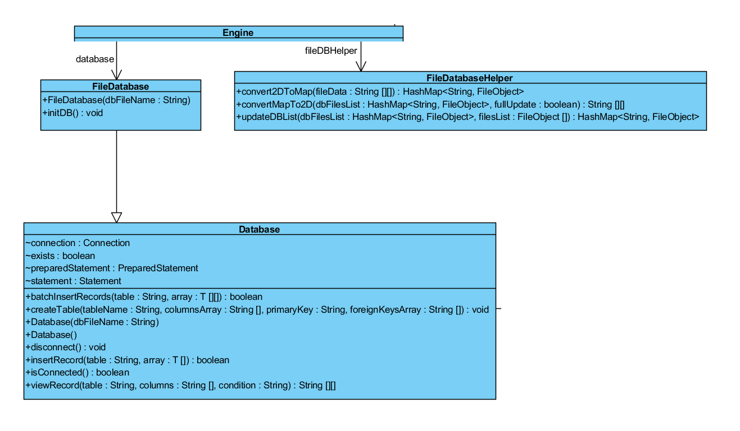

Slide 13
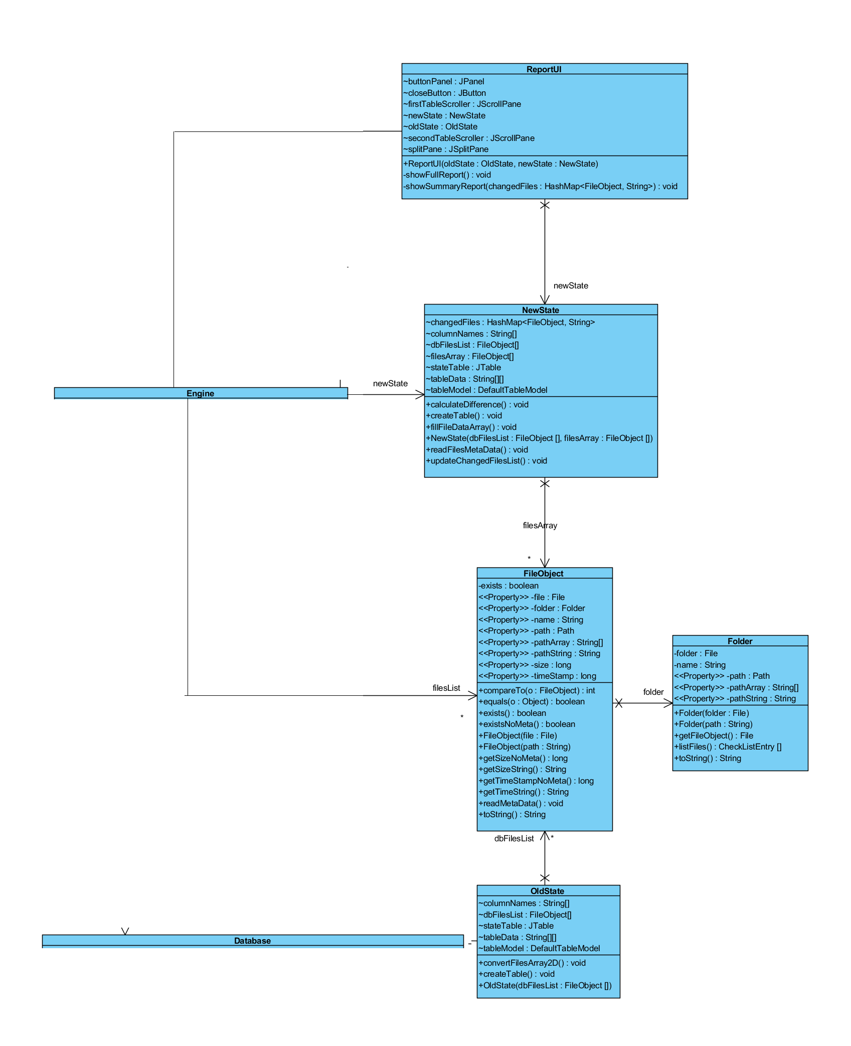

Slide 14
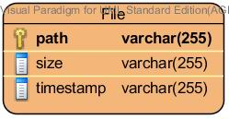
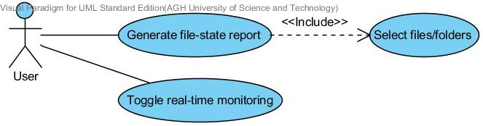
ERD and use cases

Slide 15
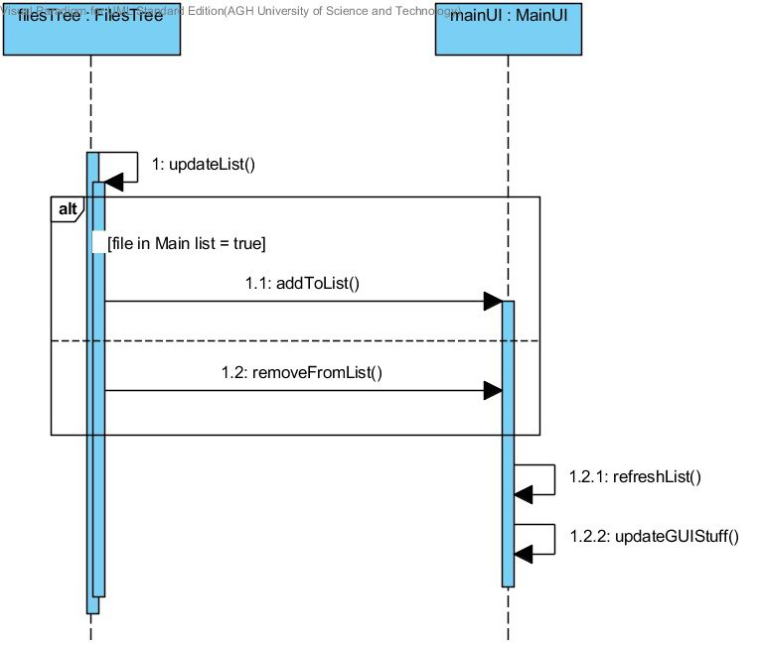
Select files

Slide 16
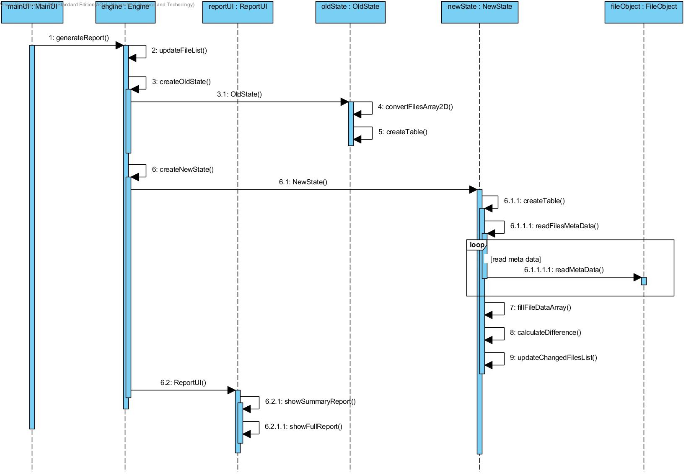
Generate Report

Slide 17
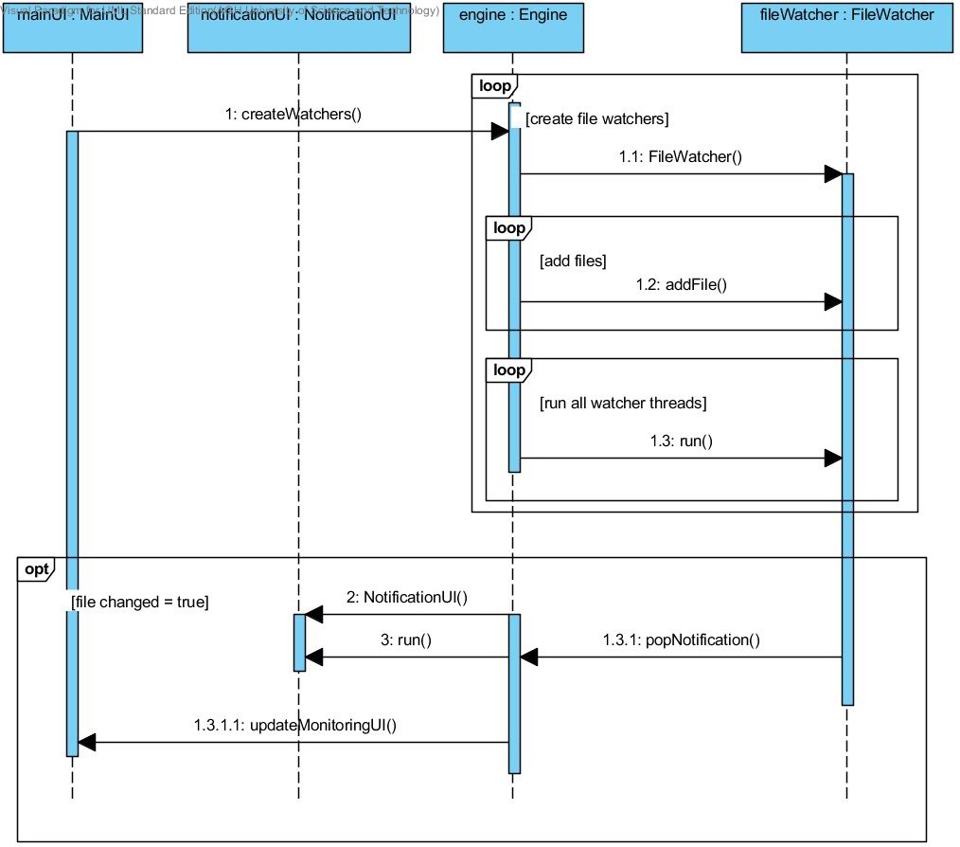
Toggle monitoring

Slide 18
‘Generate Report’ test case
When the program starts, it should present an ‘open-file’ dialogue, showing the list of root entries in the file-system.
Deliberately choose the wrong entries, and then change the entries after the main-window appears.
Make sure the tree mirrors the actual file-system.
Expand the tree to a level greater than 2, and make sure it still mirrors the file-system.
Choose random files from random levels greater than 2, then make sure the files are accurately listed on the right-side, in-order.
Remove a file from the list and make sure its tick is removed from the left-side.

Slide 19
‘Generate Report’ test case
Take a snapshot, and then make sure its time is correct.
Generate a report, but a message should say everything is intact.
Change any file listed, and then re-generate a report; a summary should appear listing the files changed, each under the appropriate type of change. The number of files should be reflected on top.
The full-report should show the file-state at snapshot-time, and the current file-state with difference in size represented as a percentage.
Upon restarting the program, the file-list should be restored, the snapshot time, and the file-state at that snapshot time.
To make sure, change a file, and then check the full-report, it should reflect a time before the snapshot time on the right side.

Slide 20
‘Real-time monitoring’ test case
Perform steps 1-6 in the previous test-case.
Enable monitoring, and then change a file from the list. A pop-up should appear within 1 second reflecting the change-type, and the file-name. In addition, a log entry and the file-counter should reflect such change.
If more than one file is changed within 3 seconds, the pop-ups should appear above each other; without overlapping.
If a file is added or removed from the list, and then monitoring should be automatically disabled.
Disable monitoring, and then change a file, it shouldn’t pop a notification.

