Slide 1
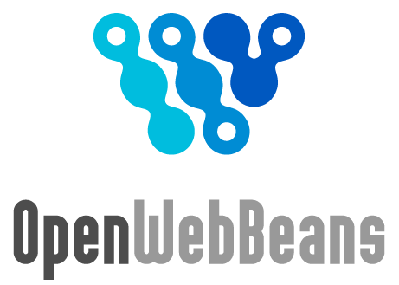
CDI @ Apache
OpenWebBeans and DeltaSpike Deep Dive
Mark Struberg
Gerhard Petracek

Slide 2
Agenda
CDI and its terms
Why OpenWebBeans?
Portable CDI Extensions
CDI by example with DeltaSpike

Slide 3
CDI is a ...
JCP specification started in ~2007
Contexts and Dependency Injection for
the Java EE platform (CDI) as JSR-299
component model designed for Java EE
(can be used with Java SE)

Slide 4
CDI Features
Type-safe Dependency Injection
Interceptors
Decorators
Events
SPI for implementing "Portable Extensions"
Unified EL integration

Slide 5
What is Dependency Injection?
"Inversion Of Control" object creation
No more hardcoded dependencies when working with Interfaces
MailService ms = new VerySpecialMailService();
Basically the old Factory Pattern
Hollywood Principle:
"Don't call us, we call you!"
Macho Principle
"Dude, gimme that bloody stuff!"

Slide 6
Singletons and Contexts
What is a 'Singleton'
"exactly one single instance
in a well specified context"

Slide 7
Built-in CDI Scopes
NormalScoped with well defined lifecycle:
  @ApplicationScoped
  @SessionScoped
  @RequestScoped
  @ConversationScoped
'Pseudo Scope':
  @Dependent

Slide 8
Terms - Managed Bean
... a Java Class and all it's rules to create (contextual) instances of that bean.
'Managed Beans' in JSR-299 and JSR-346 doesn't mean JavaBeans!
Interface
Bean<T> extends Contextual<T>

Slide 9
Terms - Contextual Instance
... a Java instance created with the rules of the Managed Bean Bean<T>
Contextual Instances usually don't get injected directly!

Slide 10
Terms - Contextual Reference
... a proxy for a Contextual Instance.
Proxies will automatically be created for injecting @NormalScope beans and allow decoupled scope handling

Slide 11
Bootstrapping & Runtime
Creating the meta information at startup
  Bean meta-data can be changed
  Fail fast (e.g. AmbiguousResolutionException)
Contextual Instance creation at runtime
  based on the Managed Beans
  the Context will maintain the instances
Well defined contextual instance termination

Slide 12
Why Apache OpenWebBeans?
Fast
Stable
Modular Plugin Architecture
Usable
(e.g. alternative approach for BDAs)

Slide 13
Portable CDI Extensions
Apache MyFaces CODI
http://myfaces.apache.org/extensions/cdi
JBoss Seam3
http://seamframework.org/Seam3
Apache DeltaSpike
http://incubator.apache.org/deltaspike

Slide 14
DeltaSpike closes the gaps between ...
... Java-EE and the needs of
real-world applications
... different CDI communities

Slide 15
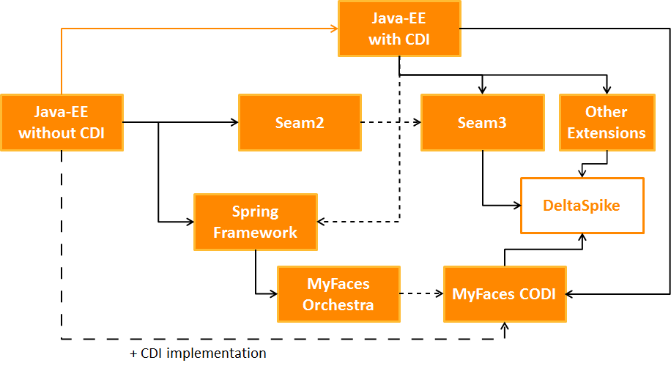
History of Apache DeltaSpike

Slide 16
CDI in Action with Apache DeltaSpike

Slide 17
DeltaSpike 0.3 - Overview
Core
JPA
Security
Container-Control

Slide 18
Interceptors and Producers in action

Slide 19
@Transactional - 1
Transactional bean in the application
@Transactional
public class MyBean {
@Inject
private EntityManager em;
}

Slide 20
@Transactional - 2
Producer and disposer in the application
@Produces
@TransactionScoped
protected EntityManager defaultEntityManager() {
return …;
}
protected void dispose(@Disposes EntityManager em) {
if (em.isOpen()) {
em.close();
}
}

Slide 21
@Transactional - 3
Interceptor annotation in DeltaSpike
@InterceptorBinding
public @interface Transactional {
//...
}

Slide 22
@Transactional - 4
Interceptor implementation in DeltaSpike
@Interceptor @Transactional
public class TransactionalInterceptor implements Serializable {
@Inject private TransactionStrategy ts;
@AroundInvoke
public Object executeInTransaction(
InvocationContext invocationContext)
throws Exception {
return ts.execute(invocationContext);
}
}

Slide 23
Qualifiers in action

Slide 24
@Transactional - 5
Transactional bean in the application
@Transactional
public class MyBean {
@Inject
private @First EntityManager em1;
@Inject
private @Second EntityManager em2;
}

Slide 25
@Transactional - 6
Producer implementations in the application
@Produces @RequestScoped @First
protected EntityManager firstEntityManager() {
//...
}
@Produces @RequestScoped @Second
protected EntityManager secondEntityManager() {
//...
}

Slide 26
@Transactional - 7
Producers and disposers in the application
protected void disposeFirst(@Disposes @First
EntityManager em) {
if (em.isOpen()) {
em.close();
}
}
protected void disposeSecond(@Disposes @Second
EntityManager em) {
if (em.isOpen()) {
em.close();
}
}

Slide 27
@Transactional - 8
Qualifier implementations in the application
@Qualifier
public @interface First {
}
@Qualifier
public @interface Second {
}

Slide 28
Events in action

Slide 29
@BeforeJsfRequest - 1
Observer in the application
public void onBeforeJsfRequest(
@Observes @BeforeJsfRequest
FacesContext facesContext) {
//…
}

Slide 30
@BeforeJsfRequest - 2
Fired event in DeltaSpike
@Inject
@BeforeJsfRequest
private Event<FacesContext> beforeJsfRequestEvent;
this.beforeJsfRequestEvent.fire(facesContext);

Slide 31
@Specializes and @Alternative

Slide 32
@Specializes configs - 1
Specialized type-safe config in the application
@Specializes
public class CustomWindowContextConfig
extends WindowContextConfig {
public int getWindowContextTimeoutInMinutes() {
return 240;
}
}

Slide 33
@Specializes configs - 2
Config implementation in CODI (/DS)
@ApplicationScoped
public class WindowContextConfig {
public int getWindowContextTimeoutInMinutes() {
return 60;
}
public int getMaxWindowContextCount() {
return 64;
}
//…
}

Slide 34
@Alternative - 1
Alternative implementation in the application
@Alternative
@Exclude(
exceptIfProjectStage = ProjectStage.Development.class)
public class MockedMailService
implements MailService {
}

Slide 35
@Alternative - 2
Primary implementation in the application
public interface MailService {
}
@ApplicationScoped
public class DefaultMailService
implements MailService {
}

Slide 36
Apache DeltaSpike.Next
Simple answer:
There is no fixed master plan!
The future depends on the community
-> get involved!

