Slide 1

The Apache MyFaces Universe in 2012
Gerhard Petracek
Mark Struberg

Slide 2
Agenda
What is MyFaces?
Why MyFaces?
  Core
  Extensions

Slide 3
Apache MyFaces is … - 1
… a great Community
… the umbrella project for
JSF related projects
… Core (JSF Implementation)
… Add-ons for JSF based projects
  Orchestra
  ExtVal (Extensions Validator)
  CODI (Extensions CDI)
  Ext-Scripting (Extensions Scripting)
  Portlet Bridge

Slide 4
Apache MyFaces is … - 2
… Component Libraries
  Tomahawk
  Trinidad (base for ADF-Faces)
  Tobago
… Utils
  Test (with Mocks)
  Commons
  Maven Plugins and Archetype
  (Sandbox)

Slide 5
JSF and Apache MyFaces
JSF 2 is easy
With MyFaces
  … Core JSF is fast
  … Add-ons JSF is awesome

Slide 6
Apache MyFaces Core is ...
... an implementation of the
JSF specification
... used by several application servers
... well tested
... well supported
  Community
  Commercial support
... currently the fastest JSF implementation
... faster than many other web-frameworks

Slide 7
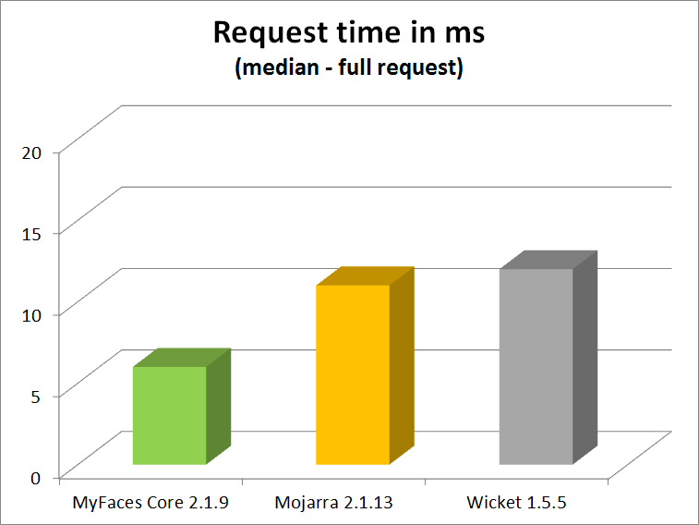
Request-Performance of MyFaces Core

Slide 8
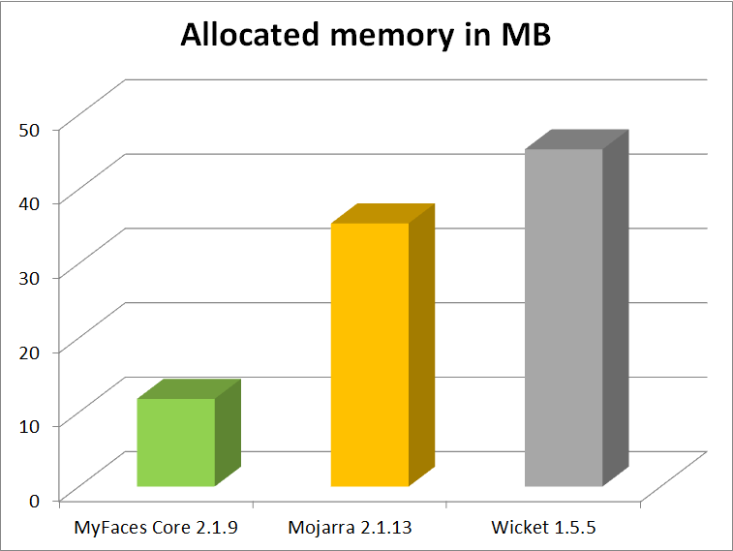
Memory Footprint of
MyFaces Core

Slide 9
MyFaces and Public Applications
One of many examples: TISS
TISS uses Tomcat with
OpenWebBeans, OpenJPA
MyFaces Core and MyFaces CODI
TISS serves
5 million full JSF requests
(excluding resources and AJAX requests) for 40.000 users
easily per day
Most requests take less than 15ms

Slide 10
jsf.js of MyFaces Core
Partial-Page-Submit
(only submit parts which get processed)
Advanced (dynamic) queue control
  Delayed requests (even before JSF 2.2)
  Timeout
  Size
Modularized OO JavaScript infrastructure
(e.g. allows to replace parts in a consistent way)
Build profiles to optimize the footprint
(e.g. drop IE6 support)

Slide 11
Apache MyFaces ExtVal is ...
… a pluggable validation-platform for
constraint based JSF validation
… compatible with JSF 1.x and 2.x
… tested with several servers
… not bound to MyFaces-Core

Slide 12
MyFaces ExtVal – TOP 10 - 1
Easy cross-property validation
Transparent JPA based validation
Component initialization
Constraint mapping and constraint-sources
Advanced Bean-Validation integration
  @Valid for properties with custom types
  Bypass validation via action methods
  (BV groups via add-on)

Slide 13
MyFaces ExtVal – TOP 10 - 2
Constraint severity
(warn once via add-on)
Constraint parameters
(BV payload is a subset of it)
Model validation (transactional via add-on)
Validation interceptors
DI Support
(different DI containers supported)

Slide 14
Apache MyFaces CODI is ...
... a portable CDI extension
(not a CDI implementation)
... compatible with Java-EE5+
... tested on most major servers
... not bound to
MyFaces-Core or OpenWebBeans
… easy to use, extensible, fast and stable
… optimized for large applications
… one of few popular CDI extensions

Slide 15
History of MyFaces CODI
Apache MyFaces Orchestra introduced interesting concepts in combination with Spring
12-2009 CDI 1.0
2-2010 MyFaces ExtCDI (aka CODI) started
11-2010 first stable release
12-2011 merged with Seam3 and others to
Apache DeltaSpike

Slide 16
MyFaces CODI – TOP 10 - 1
Scopes
Conditional bean activation
Type-safe CODI-Config
Type-safe and extensible Project-Stages
Type-safe View-Config and Navigation

Slide 17
MyFaces CODI – TOP 10 - 2
View-Controller
Extensibility
(Security, Interceptors, Factories, …)
I18n
Transactional beans without EJBs
Configurable JPA DataSource

Slide 18
Scopes
… with std. CDI and JSF
(JSF Scopes not integrated )
  Request-, Session-, Application-Scope
  View-, Flash-, Custom-, None-Scope (JSF)
  Conversation-, Dependent, Singleton-Scope (CDI)
… with MyFaces CODI
  Autom. converts JSF beans to CDI beans
  Window-, (Grouped-)Conversation-, ViewAccess-, Rest-Scope (for CDI + JSF)
  Transaction-Scope (for CDI)

Slide 19
CODI Scopes by Example
Without MyFaces CODI – e.g.:
@SessionScoped
public class Menu implements Serializable {
//…
}
-> multiple Browser-Tabs use the same instances
With MyFaces CODI – e.g.:
@WindowScoped
public class Menu implements Serializable {
//…
}

Slide 20
Destroy CODI Conversations
Close a conversation
@Inject
private Conversation conversation;
this.conversation.close();
Use the Window-Context
@Inject
private WindowContext windowContext;
this.windowContext.close(); //and #close*

Slide 21
JSF and Browser Windows
JSF 2.2 ClientWindow is inspired by
CODI Window-Handler and others
CODI Window-Handler implementations
  ServerSideWindowHandler
  DefaultWindowHandler (URL)
  ClientSideWindowHandler
    Lazy Window-ID dropping
    Intermediate windowhandler.html page

Slide 22
DEMO
Client-Side Window-Handler

Slide 23
Apache MyFaces ExtScript is ...
... dynamic recompilation and reloading of
JSF artifacts without redeployment
... compatible with Groovy and Scala
... going to support JRuby
... compatible with CDI and Spring
... somewhere in between
Mojarra-Scripting and JRebel
... tested with several servers
... currently bound to MyFaces Core

