Slide 1

MINOR PROJECT SEMESTER VI
Viva – 1 Presentation
Generating Indian Sign Language Animation using HamNoSys and SiGML
Prepared by
Harshit Singh (20103003)
Arpit Jain (20103041)
Divya Disha (20103006)
Under the guidance of Dr. Ashish Mishra

Slide 2
Problem Statement
Currently there is no way for hearing and vocally impaired people to understand content delivered by video lectures
They have different set of educators who make videos for them in Sign Language
Limited academic content

Slide 3
Proposed Solution
Develop an automated system (A complete web application) to convert the given English text, first into ISL glosses and then to generate avatar out of it that can be understood by the specially abled
For achieving this Hamburg Notation System (HamNoSys) and Signing Gesture Markup Language (SiGML) will be used
Our module consists of converting sequences of sentences to animated gestures and integrating all modules into a Web Application.

Slide 4
Workflow for Module
Sequences of sentences (for example - paragraphs)
(initially for single alphabets and numbers)
2. ISL Gloss
3. HamNoSys notation
4. SiGML
Avatar Playing
Web Application

Slide 5
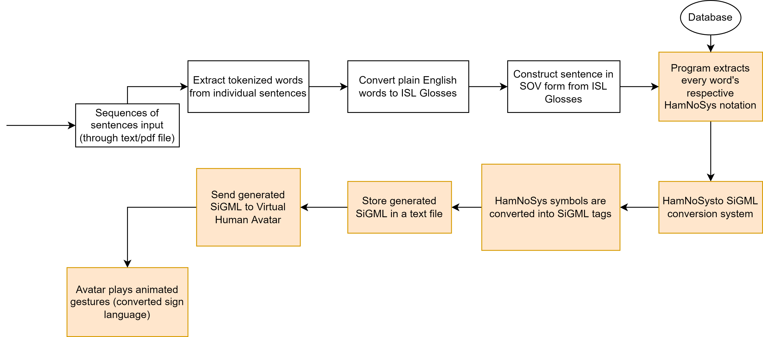
Workflow Chart

Slide 6
Workflow Chart
AUTOMATED PIPELINE
Integrating into a Web App using WebGL.

Slide 7
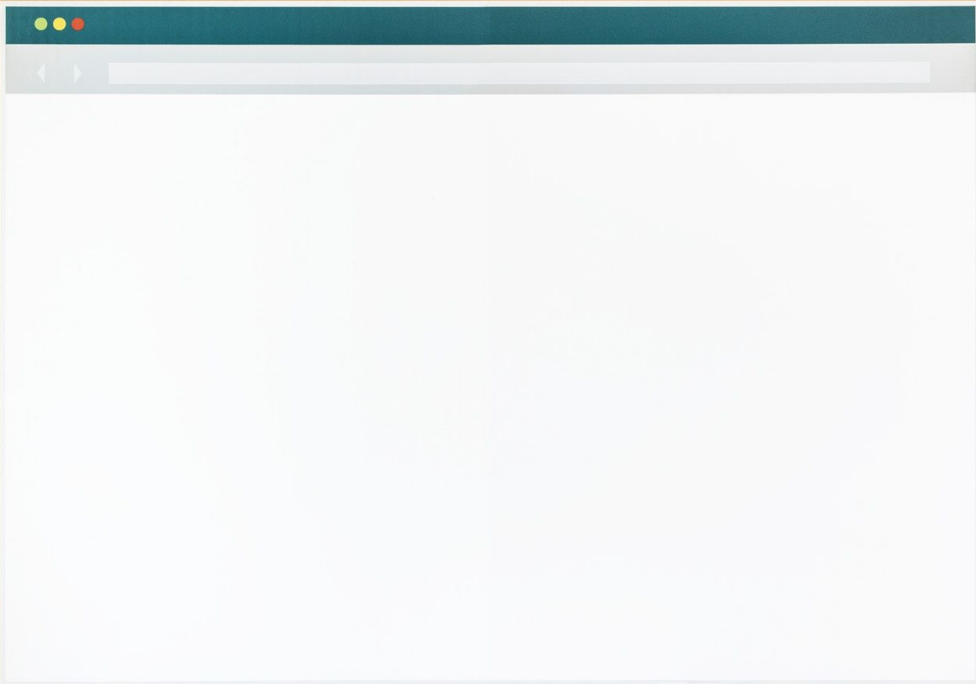
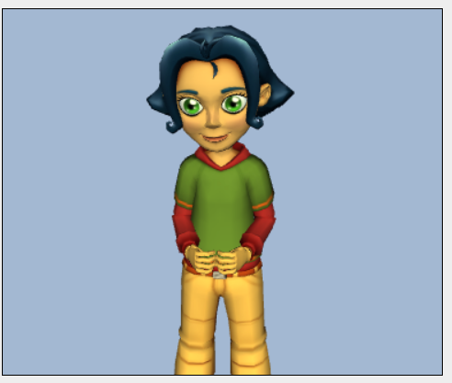
Upload Video

Slide 8
Backend: Automated Pipeline
1. Upload video
2. System understands words/sentences
3. Words/Sentences to ISL Gloss
4. SiGML Generation
Avatar gets SiGML as input (WebGL)
Animation playing
Upload Video

Slide 9
Challenges
Some words do not have a corresponding ISL Gloss
Some word do not have HamNoSys notation
Eliminating stop words
Handling imperative sentences
Verification of correct animation generation
Automation of the entire workflow

