Slide 1

THE osDFS MANIFESTO
Our open source community osDFS which stands for open source digital freedom society is a community which helps young men and women regardless of the field they are in and are interested in information science and want to contribute for the development in information science globally.
We believe that learning, innovation and opportunity are the main keys which can help a learner to excel in his/her field and help professionals to share their knowledge with the learners as well as contribute in the development of technology globally.
We use a community-based approach to create world-class open source learning platform and to develop new types of collaborative activities.
We need to make our platform participatory - people acting as individuals, working together in groups, and leading others. We invite others to join us and make this platform a better place to learn and excel.
ROHIT RATHORE
FOUNDER AND
PRESIDENT

Slide 2
PRINCIPLES
1. Online learning platform is an integral part of modern education.
2. The effectiveness of the open source learning platform as a public resource depends upon interoperability (protocols, data formats, content), innovation and decentralized participation worldwide.
3. Transparent community-based processes promote participation, accountability and trust.
4. Commercial involvement in the development of the learning platform brings many benefits; a balance between commercial profit and public benefit is critical.
5. Magnifying the public benefit aspects of the online learning is an important goal, worthy of time, attention and commitment.

Slide 3

INVITATION
We invite all others who support the principles of the osDFS Manifesto to join with us, and to find new ways to make this vision of online learning a reality.

Slide 4
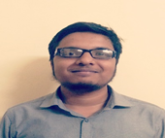
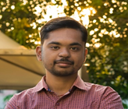
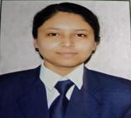
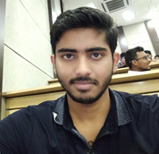
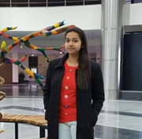
FOUNDER MEMBERS
MD.ABDAL KHAN
CO-FOUNDER &
VICE DESIGN CHAIR
SHUBHENDU MISHRA
TREASURER & CONTENT CHAIR
RUCHIKA
OUTREACH CHAIR
YUVRAJ MISHRA
CURRICULUM DEVELOPER
RUBINA
COMMUNITY PARTNERSHIPS & OUTREACH CHAIR

