Slide 1

Exploratory Data Analysis of Posey Database
An Overview of Key Insights and Visualizations

Slide 2
Introduction
Objective: This analysis aims to provide insights into the Posey database by exploring key data points and visualizing trends.
Tables Analyzed:
Orders Table: This table appears to be a record of orders, with each row representing a single order. The columns include the order ID, account ID, date and time the order occurred, quantities of different types of products (standard, gloss, poster), and the total amount spent in USD.
Accounts Table: This table contains information about 351 accounts, including their id, name, website, location (latitude and longitude), primary point of contact, and sales representative id.
Sales Reps Table: This table has 50 rows and 3 columns. The columns are: id, name, region_id. The data types are: int64, object, int64
Region Table :The table contains information about different regions. It has 2 columns and 4 rows. The columns are: id, name
Web event Table: This table contains 9073 rows and 4 columns. The columns are: id, account_id, occurred_at, channel. The data types are: int64, int64, object, object.

Slide 3
Between 2013 and 2017, the average number of orders per month quadrupled, growing from 90 to 360.
Additional context
Although 2017 records only cover two days, 25 orders were made during that period. In contrast, 2013 saw 90 orders completed over 26 days. This reflects a significant increase in order activity, showing much higher demand in a shorter time frame by 201

Slide 4
Over the 3 years (2014-2016), monthly sales show steady growth, starting lower in the early months and increasing consistently towards the end of the year.
Additional context
This indicates a seasonal pattern where sales peak towards the end of the year, potentially due to increased consumer activity during the holiday season..

Slide 5
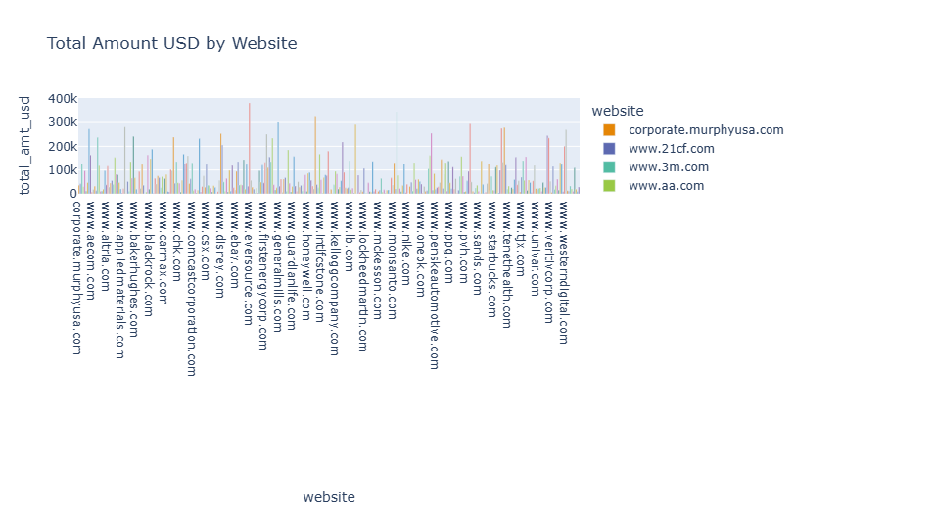
The chart shows the total amount in USD by website.
Key Trends and Patterns:
The total amount in USD is generally low for most websites, with most websites having less than 10,000𝑖𝑛𝑡𝑜𝑡𝑎𝑙𝑎𝑚𝑜𝑢𝑛𝑡.>∗𝑇ℎ𝑒𝑟𝑒𝑖𝑠𝑜𝑛𝑒𝑜𝑢𝑡𝑙𝑖𝑒𝑟,𝑤ℎ𝑖𝑐ℎ𝑖𝑠"𝑤𝑤𝑤.ℎ𝑜𝑛𝑒𝑦𝑤𝑒𝑙𝑙.𝑐𝑜𝑚,"𝑤𝑖𝑡ℎ𝑎𝑡𝑜𝑡𝑎𝑙𝑎𝑚𝑜𝑢𝑛𝑡𝑜𝑓𝑜𝑣𝑒𝑟10,000intotalamount.>∗Thereisoneoutlier,whichis"www.honeywell.com,"withatotalamountofover70,000.
Notable Performance Differences:
"www.honeywell.com" significantly outperforms all other websites in terms of total amount.
Actionable Insights:
Focus on Improving Performance of "www.honeywell.com": The website "www.honeywell.com" is a clear outlier and has the highest total amount. It's important to understand why this website is performing so well and try to replicate its success on other websites. This could involve analyzing the website's content, marketing strategies, and user experience.
Investigate Other Underperforming Websites: While most websites have low total amounts, there are still some websites that are underperforming. It's worth investigating these websites to understand why they are not generating as much revenue as they could be. This could involve analyzing their website traffic, conversion rates, and customer engagement.
Overall, the chart suggests that there is a significant opportunity to improve the performance of most websites in terms of total amount. The analysis above provides actionable insights to improve the website performance.

Slide 6
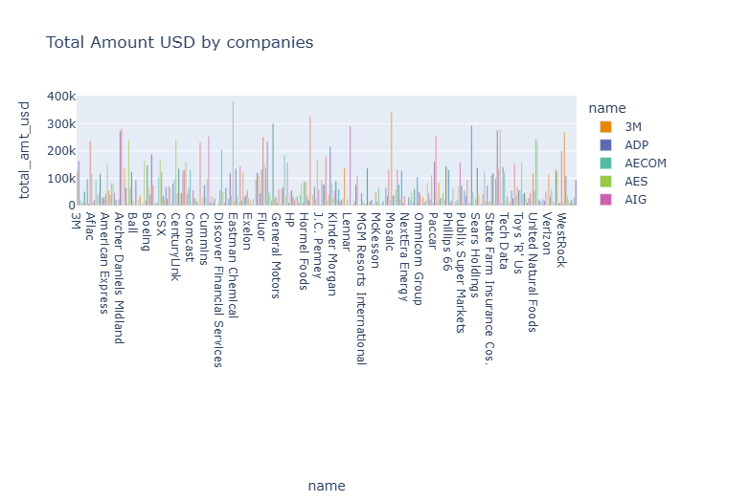
The plot shows the total amount in USD by name. Key Trends and Patterns The total amount is generally low for most names, with a few exceptions. There are a few names with significantly higher total amounts than others. Notable Performance Differences Health Net has the highest total amount by a large margin. Other names with notably high total amounts include PBF Energy and NextEra Energy. Most other names have total amounts below 10k USD. Actionable Insights Focus on understanding why Health Net has such a high total amount. Is this due to a specific product or service, a strong customer base, or other factors? Investigate the performance of PBF Energy and NextEra Energy to see if there are opportunities to replicate their success with other names. Consider whether the low performance of most names is due to a lack of focus, limited resources, or other factors. Identify areas where resources could be reallocated to improve performance. Overall, the data suggests that there are significant differences in performance between the names. By understanding the reasons behind these differences, you can develop strategies to improve the performance of all names. Image: The image shows the plot of total amount in USD by name. It highlights the performance differences between names and identifies the names with the highest total amounts.

Slide 7
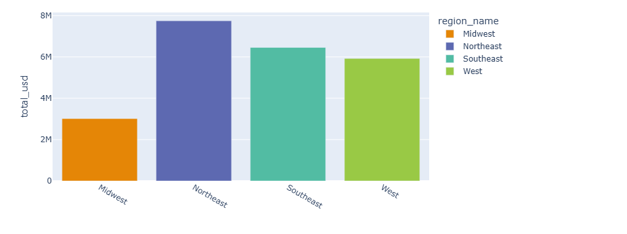
The bar chart shows the total amount in USD by region.
Key Trends and Patterns:
Northeast region has the highest total amount in USD, followed by Southeast, West and Midwest.
The total amount in USD for Northeast is significantly higher than the other regions.
Performance Differences:
Northeast region outperforms other regions significantly, while the Midwest region has the lowest total amount in USD.
Southeast and West regions show similar performance levels, but lower than Northeast.
Actionable Insights:
Focus on the Northeast region for growth and expansion, as it shows the highest potential.
Investigate the reasons for the lower performance in the Midwest region, and consider strategies to improve its performance.
Continue to maintain the performance levels in the Southeast and West regions, while exploring opportunities to increase their contribution.
Overall, the Northeast region is the top performer, while the Midwest region needs improvement.

Slide 8
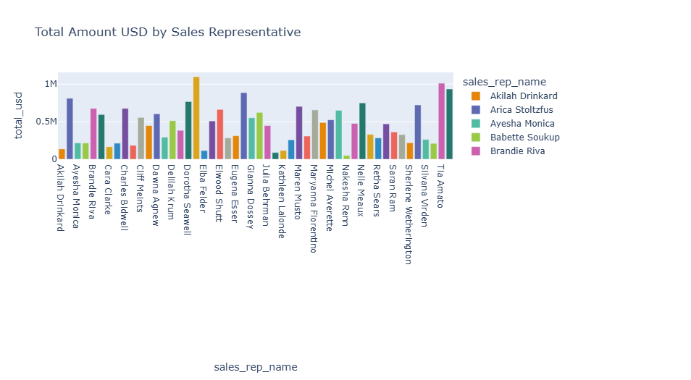
Sales Performance Analysis
This chart shows the total amount in USD generated by each sales representative. Here's a breakdown of the key trends, differences, and actionable insights:
Key Trends & Patterns:
Overall Sales: The total sales volume varies significantly between sales representatives, with some generating significantly more revenue than others.
Top Performers: Tia Amato is the top performer with the highest total sales amount, followed by Elba Felder and Arica Stoltzfus.
Consistent Performance: A few representatives seem to have consistently above-average performance, while others are more inconsistent.
Notable Performance Differences:
Top Performers: As mentioned before, Tia Amato, Elba Felder, and Arica Stoltzfus are the top performers, generating significantly higher revenue compared to others.
Underperformers: Some representatives like Akilah Drinkard, Caralee Bidwell, and Cliff Meints have significantly lower sales compared to the top performers.
Actionable Insights:
Focus on Top Performers: Identify the strategies and best practices of top performers (like Tia Amato, Elba Felder, and Arica Stoltzfus) and share those with the rest of the sales team.
Training & Development: Provide targeted training and development programs to underperforming sales representatives to help them improve their skills and knowledge.
Performance Coaching: Implement a coaching program for all sales representatives to provide personalized guidance and support, helping them improve their performance and achieve their targets.
Incentives & Recognition: Reward top performers and acknowledge their contributions to motivate the entire team and encourage healthy competition.
Important Note: It's crucial to remember that this analysis is based solely on the total amount in USD. Additional factors like the number of deals closed, average deal size, and customer satisfaction should also be considered for a comprehensive evaluation of sales performance.

Slide 9
Conclusion and Actionable Insights
Key Findings:
Significant differences in total revenue between websites, names, and regions.
"www.honeywell.com" and Health Net outperformed others in total sales.
Northeast region led in revenue generation compared to Midwest.
Actionable Recommendations:
Focus on replicating success factors from top-performing websites and names.
Enhance underperforming regions and sales representatives through targeted strategies.
Maintain and scale the growth in high-performing regions and accounts.
Next Steps:
Further investigation into top performers to identify best practices.
Implement strategies to uplift the performance of lower-tier websites and sales representatives.

