Slide 1
Data Platform for Travel Agency
Building a Scalable Data Pipeline for Predictive Analytics

Slide 2
Project Overview
This project creates a data platform that processes data from the Country REST API to enable predictive analytics for a travel agency. It utilizes Apache Airflow, cloud storage, and DBT for an efficient data pipeline.

Slide 3
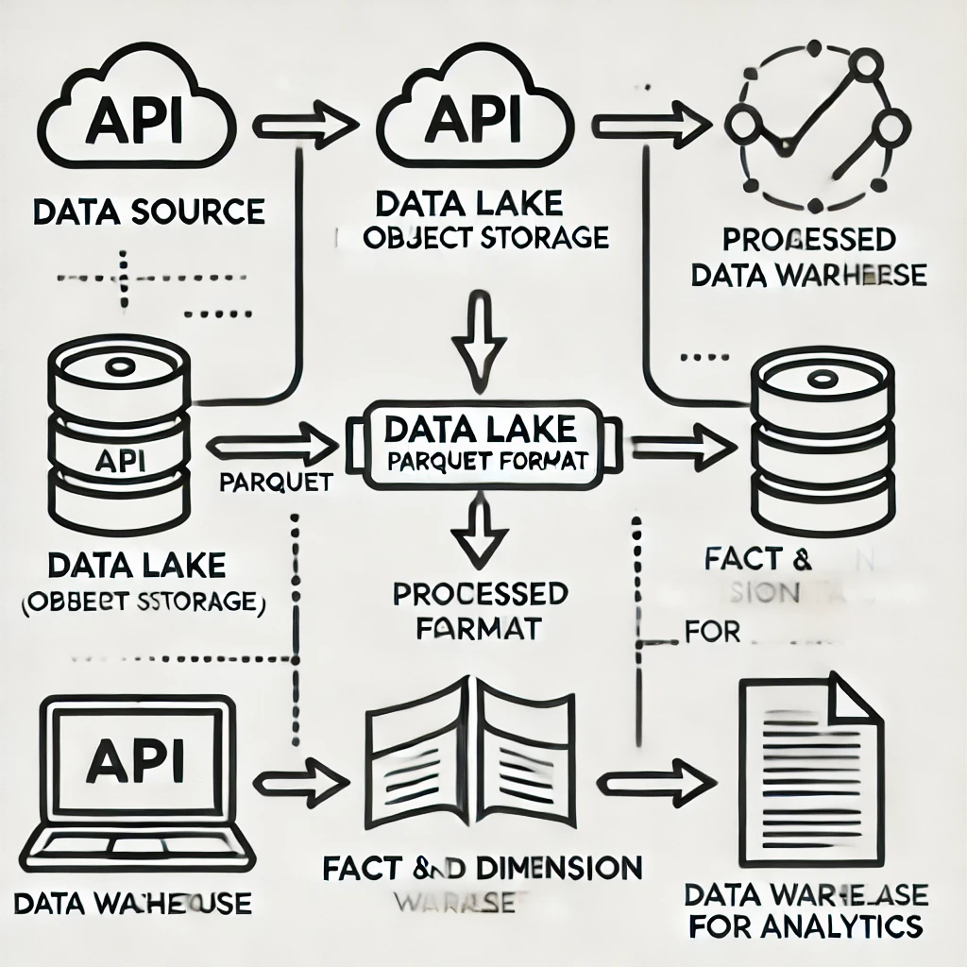
Data Architecture
The architecture includes the following steps:
1. Extract raw data from the Country REST API.
2. Store raw data in Cloud Object Storage (Data Lake) in Parquet format.
3. Extract necessary attributes and store them in a Cloud Database/Data Warehouse.
4. Model data into Fact and Dimension tables using DBT.

Slide 4
Tools and Technologies
Apache Airflow: Orchestrates the data pipeline.
Cloud Object Storage: Stores raw and processed data.
Parquet Format: Ensures efficient storage and performance.
DBT: Models data into Fact and Dimension tables.
Terraform: Automates infrastructure provisioning.
CI/CD: Ensures code quality and deployment automation.

Slide 5
Implementation Steps
1. Extract raw data from the Country REST API using Apache Airflow.
2. Store the raw data in Cloud Object Storage in Parquet format.
3. Process and extract required attributes for analytics.
4. Load processed data into the Data Warehouse.
5. Use DBT to create Fact and Dimension tables for analytics.
6. Automate infrastructure provisioning and CI/CD pipelines.

