Slide 1

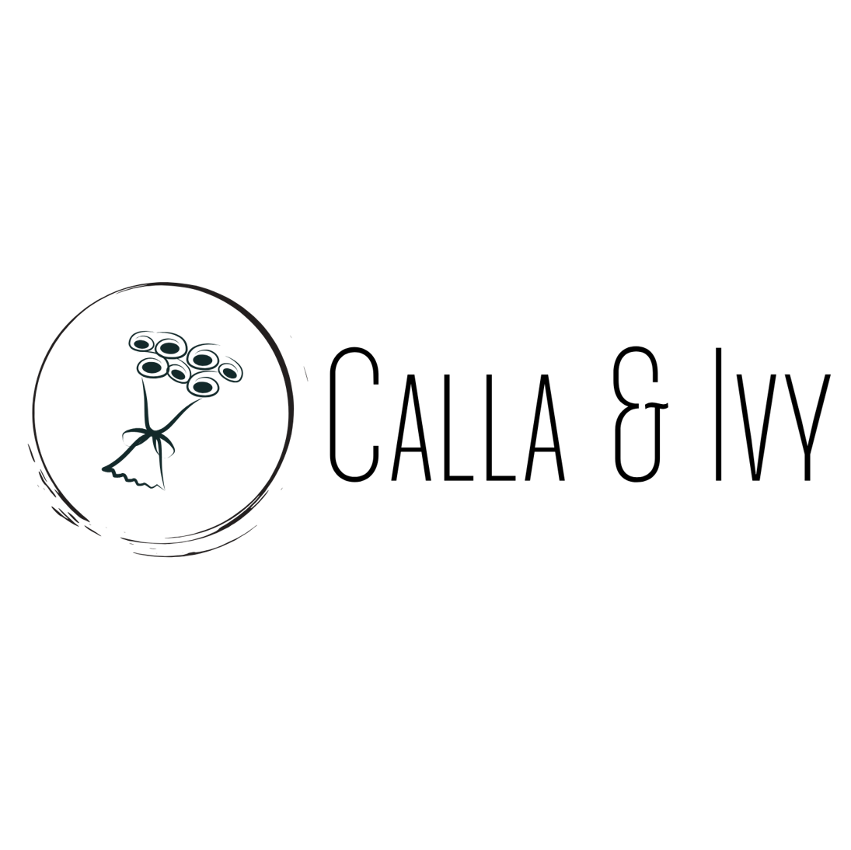

Calla & Ivy Advertising Campaign Results SMART Goal for Calla & Ivy Specific: Increase online sales by 20% within three months. Measurable: Track online sales through the website analytics. Achievable: Utilize targeted online advertising campaigns. Relevant: Increase in sales aligns with the business growth strategy. Time-bound: Achieve this goal by the end of the third quarter.
Image placeholde

Slide 2
Goal
Text
Campaign Objective:
The primary goal of the Calla & Ivy advertising campaign was to drive traffic to the website, with a secondary objective of converting visits into purchases.
KPI:
Website Visits: Number of clicks leading to the website
Conversion Rate: Percentage of website visits resulting in purchases.
Average Purchase Value: Average amount spent per purchase.
Return on Ad Spend (ROAS): Revenue generated from ads divided by the cost of ads.
Return on Investment (ROI): (Revenue - Total Investment) / Total Investment.

Slide 3

Creative
Assets
Image placeholder

Slide 4
Campaign
Settings
Objective:
Drive website traffic and increase online sales
Audience:
Target demographic includes individuals aged 25-45.
Interested in floral products
online shopping
Placement:
Ads placed on social media platforms and search engines.
Duration:
Three months campaign period.
Budget:
$10,000 allocated for the entire campaign

Slide 5
Results
Campaign Result
Total Clicks: 15,000
Total Purchases: 300 (2% conversion rate)
Total Revenue: $12,000
Campaign Cost
Advertising Spend: $10,000
Cost per Purchase: $15 (excluding advertising costs)
ROAS:1.2
Revenue
$1200
Total Investment
Advertising: $10000
Cost: $4,500
Total Investment: $14500
ROI:
-0.172

Slide 6



Results
Ad A: Higher click-through rate but lower conversion rate
Ad B: Lower click-through rate but higher conversion rate
Winner: Ad B Explanation: Ad B resulted in more purchases per click, indicating higher effectiveness in converting website visits
to sales.
Image placeholder
Image placeholder

Slide 7
Conclusion & Next Steps
Total Clicks: 15,000
Total Purchases: 300
Total Revenue: $12,000
ROAS: 1.2
ROI: -0.172
Recommendations for Future Campaigns:
Optimize Ad Spend: Focus on ads with higher conversion rates to improve ROI.
Enhance Targeting: Refine audience targeting to attract higher-value customers.
Increase Average Purchase Value: Implement upselling and cross-selling strategies.
Continuous Testing: Continue A/B testing to identify the most effective ad creatives.
Budget Adjustment: Allocate budget towards the most cost-effective channels.

Slide 8


Thank
You!
Image placeholder

