Slide 1
Celery
A distributed task queue system
abstractions to deal with tasks (input)
abstractions to manage results (output)
services to run tasks from the task queue
Can use a database or a queue and it supports several types of each.

Slide 2
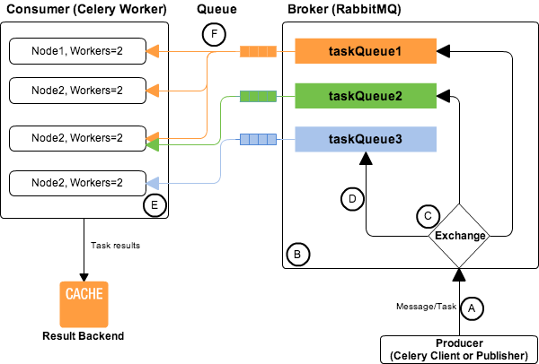
https://abhishek-tiwari.com/amqp-rabbitmq-and-celery-a-visual-guide-for-dummies/

Slide 3
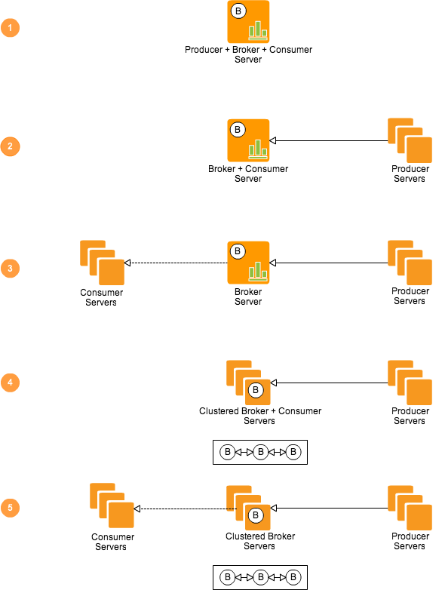
https://abhishek-tiwari.com/amqp-rabbitmq-and-celery-a-visual-guide-for-dummies/

Slide 4
Brokers & backends Choices
Rabbitmq
Redis
Mongodb
Amazon SQS
SQL (sqlalchemy or django)
Beanstalk

