Slide 1
BUSINESS INTELLIGENCE PRESENTATION
AUTHOR:OSCAR ROBIRO
On Uol-thesis-topics

Slide 2

Review of the given data
The data was in Html ,was in in different languages, nested in different folders and was also in different structures.

Slide 3
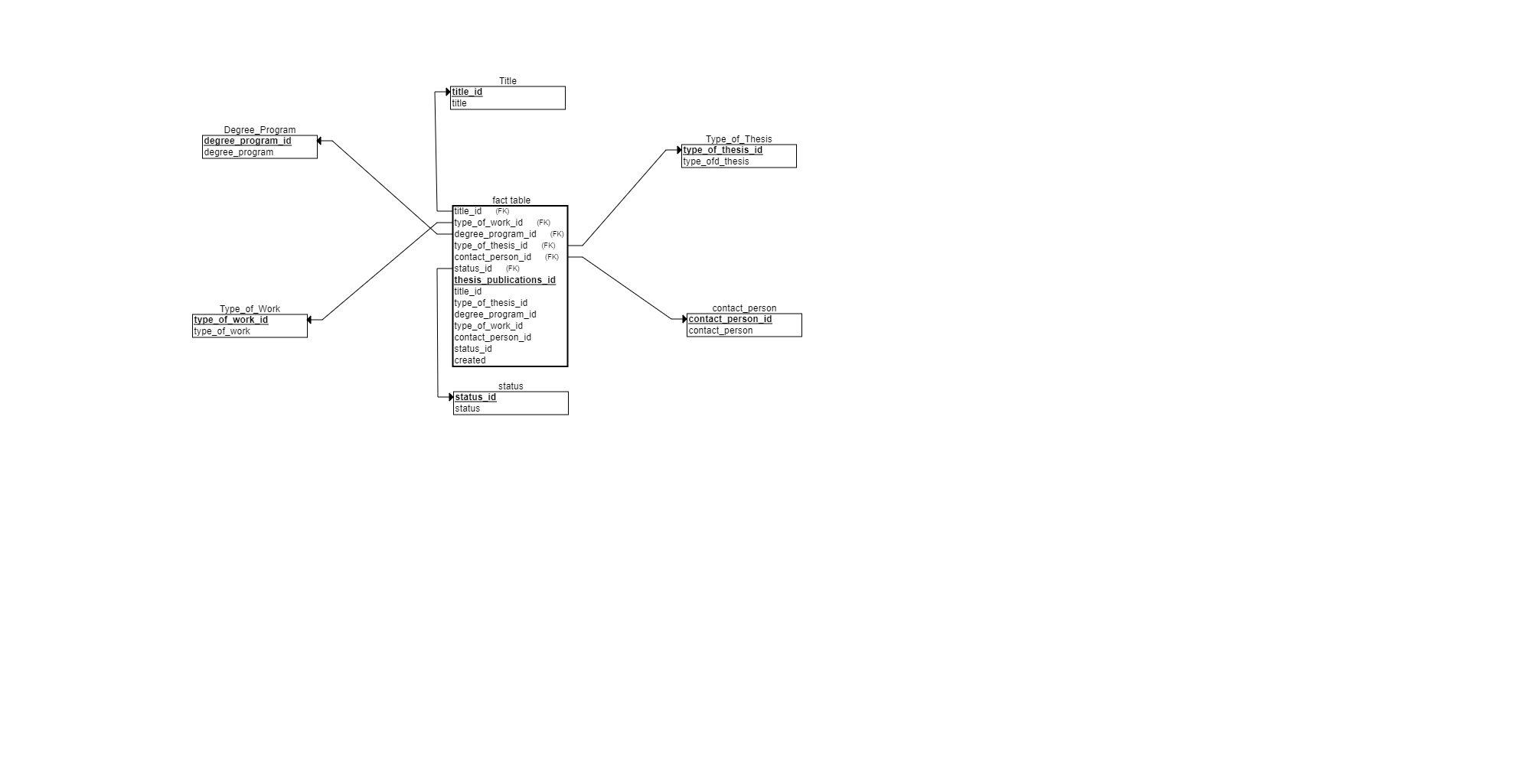
Creation of the star schema

Slide 4
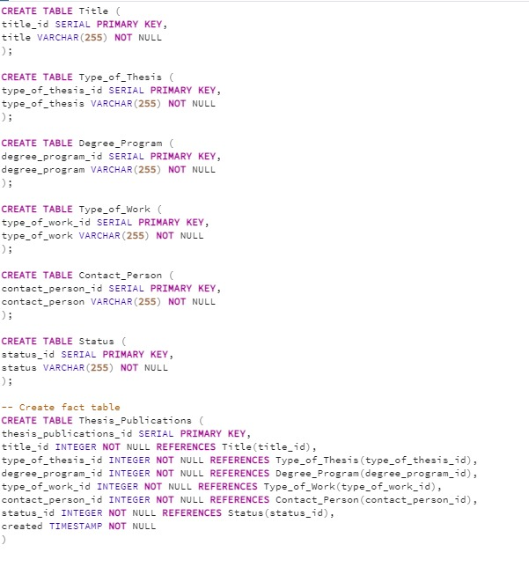
Creation of the database schema
Created the following database schema from the star schema;

Slide 5
Extraction, transformation and loading of the data
Walk through individual folders with python os package
Read each html file into a dataframe using pandas
Removed duplicates and redundant data
Move data into respective databases with psycopg2

Slide 6
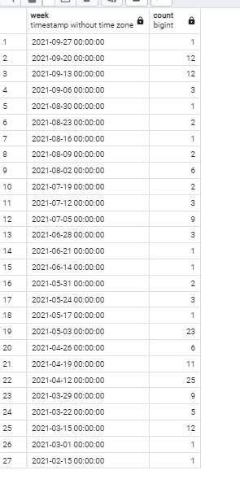
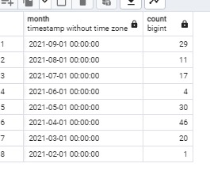
Queries for the tasks
In did the queries on the tasks and I found the following results

Slide 7
Kpi task queries
I did queries on the kpi queries and I had the following results

