Slide 1

FIRE ME 177K · BIOMECHANICS · FALL 2026
Taking the Motion Capture Lab Anywhere
Validating a two-smartphone OpenCap setup against the lab's Theia3D system, from the treadmill to the outdoors
Oaj Saini · Asiya Sunesara · Tarun Muruganandham
Graduate mentor: Finn Eagen | Faculty: Dr. Nicholas P. Fey
SAHM Lab, Walker Department of Mechanical Engineering, UT Austin
Notes:
Open with the one-line pitch: lab motion capture is accurate but stuck in one room; we want to find out if two phones running OpenCap are good enough to take it anywhere. Introduce the team and mentors.

Slide 2



ABSTRACT
The project in one slide
Lab motion capture measures joint mechanics well, but it is expensive, slow to set up, and fixed to one room. OpenCap estimates 3D movement from as few as two smartphone videos, which could let the SAHM Lab study people on ramps, stairs, and outdoors.
We will test a two-phone OpenCap setup against the lab's Theia3D markerless system, add Bertec treadmill forces to compute joint moments in OpenSim, and then take the setup out to the terrain park and outdoors.
The result is a validated protocol, a processed dataset, and a setup guide the lab can reuse.
Aim 1 · Validate
Joint angles from OpenCap vs. Theia3D on the treadmill
Aim 2 · Add kinetics
OpenCap + Bertec forces → OpenSim inverse dynamics
Aim 3 · Leave the lab
Terrain park and outdoor captures
2
Notes:
This is the abstract from the lecture's proposal structure. If a reviewer only reads one slide, it should be this one: the problem, what we will do (three aims), and what the lab gets at the end.

Slide 3


PROBLEM & RATIONALE
Good biomechanics data is stuck in the lab
Lab motion capture today
What smartphone capture could offer
Hardware
Many synchronized cameras, force plates, dedicated space
Hardware
Two iPhones, tripods, a printed checkerboard
Setup
Fixed install; people come to the lab
Setup
Minutes, anywhere with Wi-Fi
Tasks
Limited to what fits in the capture volume
Tasks
Ramps, stairs, sidewalks, open ground
Reach
Hard to use in clinics, homes, or real terrain
Reach
Free, open-source, cloud-processed
The open question: is a two-phone setup accurate enough to trust for the lab's own studies? We need to check it against the system we already rely on.
3
Notes:
Rationale. The lecture says reviewers decide on the first page, so lead with the problem, not the tools. Keep the comparison qualitative; we are not claiming exact costs.

Slide 4





BACKGROUND
How OpenCap turns two videos into joint angles
1. Calibrate
›
2. Record
›
3. Detect
›
4. Augment
›
5. Solve
Checkerboard gives each phone's position
2+ iPhones film the same movement
Pose model finds body keypoints per frame
Neural net predicts a full anatomical marker set
OpenSim scales a model and runs inverse kinematics
Our checkerboard holder supports step 1
Reported by the OpenCap developers against marker-based motion capture [1]
Our reference: Theia3D
The lab's current markerless system. It uses many synchronized lab cameras and has published validation against markers [2].
4.5°
6.2%
1.2%
mean absolute error,
joint angles
of body weight,
ground reaction force error
of body weight × height,
joint moment error
4
Notes:
Walk the pipeline left to right. Numbers are from Uhlrich et al. 2023 (PLOS Comp Bio); double-check them against the paper before presenting. Point out that the OpenCap validation was against markers in the developers' lab. Our contribution is checking it against Theia3D in our lab, on our tasks.

Slide 5
RESEARCH QUESTION
Can two phones running OpenCap match the lab's Theia3D system closely enough to take gait studies out of the lab?
AIM 1
AIM 2
AIM 3
Validate kinematics
Add kinetics
Leave the lab
Record treadmill walking and jogging with OpenCap and Theia3D at the same time. Compare hip, knee, and ankle angles.
Feed OpenCap kinematics and Bertec treadmill forces into OpenSim inverse dynamics. Compare joint moments to the Theia3D pipeline.
Repeat captures on ramps and stairs in the terrain park and outdoors. Log setup time, failures, and data quality.
Hypothesis: sagittal-plane angles agree within 5° mean absolute error.
Hypothesis: moment curves match in shape (r > 0.9) with small peak differences.
Goal: a setup guide the lab can follow without us.
5
Notes:
Aims are ordered by priority: Aim 1 must happen, Aim 2 builds on it, Aim 3 is the payoff. The 5° hypothesis comes from the OpenCap paper's 4.5° error vs markers; agree the exact thresholds with Finn.

Slide 6

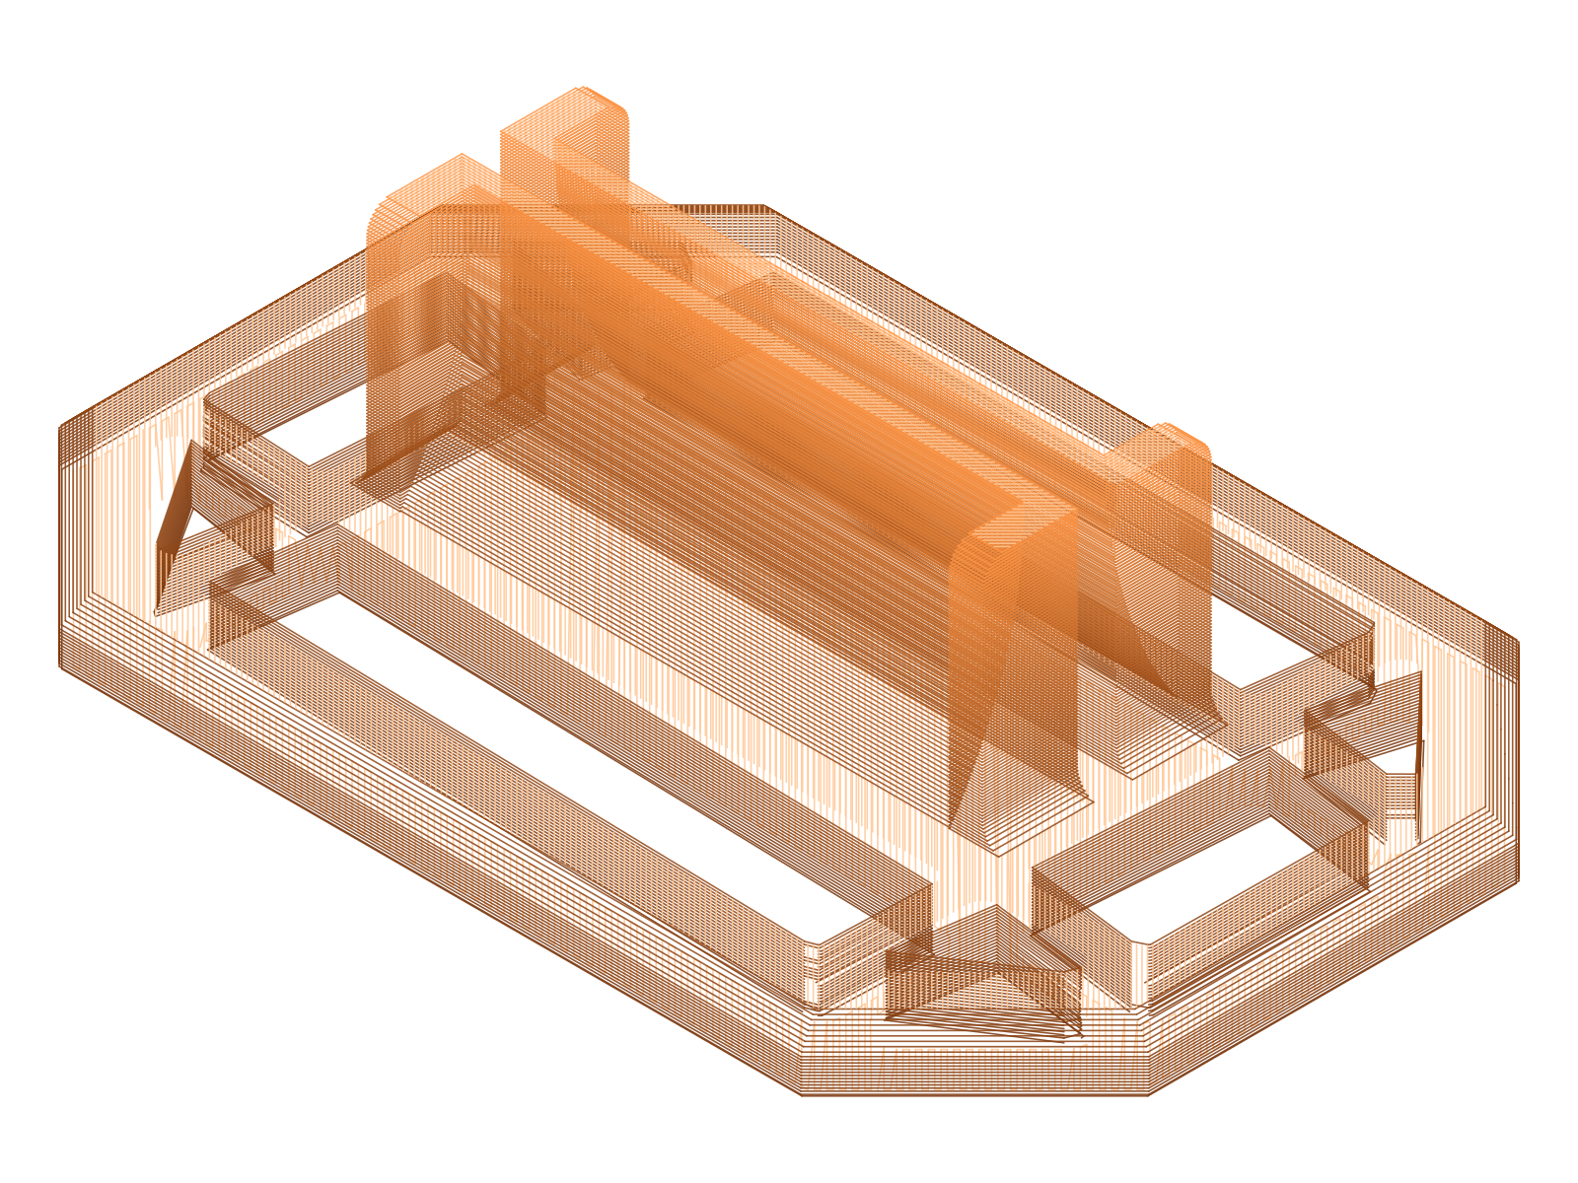
PROGRESS SO FAR
We already have OpenCap running
Two-phone OpenCap session
Calibrated, recorded, and processed a capture with two cameras
Checkerboard holder
Designed in SolidWorks, sliced for PLA: 114 layers, about 50 min, 31 g
Scope set with Finn (9/9)
Main project: mobile motion capture; side projects listed
Project proposal
This document: aims, plan, budget, timeline
Theia3D + Bertec training
Checkerboard holder, rendered from our print file
Next step before any concurrent collection
Holds the calibration board upright and repeatable between sessions
6
Notes:
Show we are not starting from zero. If you have them, swap in or add a photo of the printed holder and a screenshot of the OpenCap skeleton from your two-camera session. Real photos help more than any render.

Slide 7


PLAN · AIM 1
Record once, measure with both systems
Joints: hip, knee, ankle (sagittal); hip frontal and transverse
2 iPhones on tripods, about 45° to either side of the treadmill
Same capture volume as Theia3D cameras
Checkerboard calibration each session
Metric | What it tells us
Mean absolute error, RMSE | Average angle disagreement (°)
Waveform correlation (r) | Do the curves have the same shape?
Bland–Altman limits [6] | Bias and spread of peak angles
Stride time, cadence | Spatiotemporal agreement
1. Set up
Participants: our team (n = 3)
Walk at slow, preferred, and fast speeds; jog
3 trials × 30 s per condition
Stomp at trial start to sync systems
2. Collect
Align trials on the stomp event
Split into gait cycles, normalize 0–100%
Compute agreement metrics (right)
Framing: Theia3D is also an estimate, not ground truth. We report agreement between two systems and lean on Theia3D's published marker validation [2] for context.
3. Compare
7
Notes:
Confirm with Finn: whether the lab's existing IRB covers team members as participants, treadmill speeds, and whether Theia3D cameras can see around the treadmill handrails. The stomp gives a sharp vertical ankle event both systems can see.

Slide 8
PLAN · AIM 2
Same forces, two kinematic sources
OpenCap
Scaled model + joint angles (.osim, .mot)
Inverse dynamics A
OpenSim ID with OpenCap kinematics
Compare joint moments
Bertec treadmill
Hip, knee, ankle moments (% body weight × height), scored with the Aim 1 metrics
Ground reaction forces + center of pressure, filtered
Inverse dynamics B
Theia3D
OpenSim ID with Theia3D kinematics
Joint angles from the lab system
Why this design: both pipelines get identical force data, so any difference in joint moments comes from the kinematics alone.
8
Notes:
This is the Bertec + OpenSim piece from Finn's list. The hard part is syncing Bertec forces with phone video; the stomp event from Aim 1 shows up in both. If time allows, compare OpenCap's own video-only force estimate to the measured Bertec forces.

Slide 9





PLAN · AIM 3
Three environments, increasing difficulty
Treadmill
Terrain park
Outdoors
Lab
Lab
Campus
Walking speeds + jogging
Reference: Theia3D + Bertec
Ramps and stairs
Reference: Theia3D where cameras reach
Sidewalk and slope walking
No reference: OpenCap only
Angles
Moments
Angles
Angles
Setup data
less control, more real-world
What we log every session
Setup + calibration time
% of trials that process
Lighting and failure notes
9
Notes:
Outdoors has no reference system, so the result there is practical: does it work, how long does setup take, what breaks? That feeds the lab setup guide deliverable. Confirm Theia3D camera coverage in the terrain park with Finn.

Slide 10



BEYOND THE CORE AIMS
Stretch goals, if time allows
ExoBoot pilot
Overground forces
Do Dephy ExoBoot assistance settings change ankle and knee moments? Uses the Aim 2 pipeline.
Use Finn's GRFpredict model to estimate forces outdoors, then run inverse dynamics without force plates.
Needs: ExoBoot sessions with Finn; Aim 2 working
Needs: GRFpredict access; Aim 3 outdoor data
Laser-level phone holder
MyoAssist simulation
CAD/print a holder with laser levels to aim cameras the same way every session.
Simulate ExoBoot use and compare with real data. Coding-heavy.
Needs: 2 laser levels (~$40); print time
Needs: Python and machine-learning experience
The ExoBoot pilot is first in line: it reuses the Aim 2 pipeline directly.
10
Notes:
Keeping these separate protects the core aims: if we fall behind, we drop stretch goals, not Aims 1–3. The phone holder could move into the core plan if camera placement turns out to matter a lot.

Slide 11
COST ESTIMATE
Low cost: the expensive hardware already exists
Item | Notes | Cost
Personnel
Student team (3) | 3–5 lab hours/week each | $0
Mentor + faculty | Weekly check-in with Finn; 1 h/week with Dr. Fey | $0
Equipment (existing lab)
Theia3D, Bertec treadmill, terrain park | SAHM Lab resources; need scheduled time | $0
iPhones (2), OpenCap | Team-owned phones; OpenCap is free | $0
Materials
Phone tripods + mounts (2) | Only if the lab has none spare | $50
PLA filament (1 kg) | Holder uses ~31 g; rest for iterations | $25
Laser levels (2) | For the phone-holder side project | $40
Checkerboard print + backing | Rigid, flat calibration board | $15
Travel
None | All collection on campus | $0
~$130
new spending, estimated
~140
student hours (3 people × ~4 h/week × 12 weeks), for course credit
11
Notes:
Costs are estimates; check prices and ask Finn what the lab already has. The filament number comes from our actual slicer output (31 g for the holder). The lecture's budget categories are personnel, equipment, and travel, so all three appear even where they are $0.

Slide 12




TEAM & REPORTING
Who does what, and who we report to
Dr. Nicholas P. Fey
How we report
Faculty advisor · weekly consultation hour
Weekly
Progress update to Finn during lab hours
Finn Eagen
Graduate mentor · weekly lab check-in
Weekly
Consultation hour with Dr. Fey
Every session
Oaj Saini
Asiya Sunesara
Tarun Muruganandham
Shared log: date, setup, trials, problems
Hardware & setup: cameras, calibration, holders
Pipeline: OpenCap, Bertec sync, OpenSim
Analysis: metrics, figures, poster
Always
Raw videos and data backed up to the lab drive
Everyone collects data together; the lead owns that piece and keeps it on schedule.
12
Notes:
The role split is a draft. Reassign leads to match what each of you wants to learn (see the first-meeting questions in the group doc). The lecture asks for a reporting structure, so the org chart shows who we answer to.

Slide 13

MILESTONES & DELIVERABLES
Checkpoints in time vs. finished work
A milestone is a point in the schedule. A deliverable is work that is actually finished and handed over.
Milestones
Deliverables
M1
Two-phone OpenCap capture working
Done ✓
D1
Checkerboard holder CAD + print files
Done ✓
M2
First synced OpenCap + Theia3D trial
Oct 16
D2
Project proposal
Oct
M3
First joint moments from OpenCap + Bertec
Oct 30
D3
Lab setup guide for mobile capture
Nov
M4
All environments captured
Nov 13
D4
Dataset + processing scripts
Dec
M5
Analysis complete
Nov 25
D5
Poster, presentation, final report
Dec
13
Notes:
The lecture specifically called out the difference between milestones and deliverables, so we split them. Dates are targets; adjust them once you know the proposal and poster due dates.

Slide 14
SCHEDULE
Gantt chart: Sep 7 to Dec 13
SEP
OCT
NOV
DEC
7
14
21
28
5
12
19
26
2
9
16
23
30
7
Onboarding + OpenCap demo
Checkerboard holder CAD
Proposal
Literature review
Theia3D + Bertec training
Aim 1: treadmill captures
Aim 2: OpenSim ID pipeline
Aim 3: terrain park + outdoors
Analysis + figures
Phone holder (side project)
Poster, talk, final report
today
Done
Core aims
Side project
Course deliverable
14
Notes:
Week labels are Mondays. Aims overlap on purpose: we can build the OpenSim pipeline while treadmill captures are still going. Shift bars once the course gives exact dates for the poster session and final report.

Slide 15



RISKS
What could go wrong, and our plan
Systems are not time-synced
Occlusion with only two phones
OpenCap, Theia3D, and Bertec each keep their own clocks.
Treadmill handrails or the far leg can block a camera.
Plan: Stomp at trial start; align on the ankle event; check with cross-correlation.
Plan: Test camera angles early; laser-level holder for repeatable placement; try a third phone.
No true ground truth
Outdoor calibration fails
Theia3D is also a model-based estimate.
Glare, shadows, and wind move the board or phones.
Plan: Report agreement, not accuracy; cite Theia3D's marker validation.
Plan: Rigid holder; check calibration before each trial; pick shaded times.
Cloud processing delays
Schedule slips
OpenCap needs internet and a processing queue.
Lab time and equipment are shared.
Plan: Process the same day; back up raw videos to the lab drive.
Plan: Book Theia3D and Bertec time early; drop stretch goals first.
15
Notes:
Reviewers trust a plan more when it names its own weak points. The 'no ground truth' risk is the one to say out loud: it shows we understand what the comparison can and can't prove.

Slide 16
REFERENCES
Sources
[1] Uhlrich SD, Falisse A, Kidziński Ł, et al. OpenCap: Human movement dynamics from smartphone videos. PLOS Computational Biology. 2023;19(10):e1011462.
[2] Kanko RM, Laende EK, Davis EM, Selbie WS, Deluzio KJ. Concurrent assessment of gait kinematics using marker-based and markerless motion capture. Journal of Biomechanics. 2021;127:110665.
[3] Delp SL, Anderson FC, Arnold AS, et al. OpenSim: open-source software to create and analyze dynamic simulations of movement. IEEE Transactions on Biomedical Engineering. 2007;54(11):1940–1950.
[4] Seth A, Hicks JL, Uchida TK, et al. OpenSim: Simulating musculoskeletal dynamics and neuromuscular control to study human and animal movement. PLOS Computational Biology. 2018;14(7):e1006223.
[5] Cotton RJ, et al. Portable biomechanics laboratory enables clinically accessible movement analysis from a handheld smartphone. 2025.
[6] Bland JM, Altman DG. Statistical methods for assessing agreement between two methods of clinical measurement. The Lancet. 1986;1(8476):307–310.
16
Notes:
Verify every citation on Google Scholar before submitting, especially [5]: fill in the full author list and venue for the Cotton lab paper Finn pointed us to.

Slide 17
WHAT WE NEED
Two phones, one lab, and a clear answer by December
Scheduled time on Theia3D and the Bertec treadmill
Access to the terrain park for Aim 3
About $130 in materials
Feedback on scope and hypotheses
Questions?
Notes:
End with the ask. Reviewers should leave knowing exactly what resources we need and when they'll see results.

