Slide 1

FIRE ME 177K · FALL 2026
Taking the Motion Capture Lab Anywhere
Can two phones replace a lab full of cameras?
Oaj Saini · Asiya Sunesara · Tarun Muruganandham
Mentor: Finn Eagen · Faculty: Dr. Nicholas Fey
SAHM Lab · UT Austin Mechanical Engineering
Notes:
[~15 s] Hi, we're Oaj, Asiya, and Tarun, working with Finn Eagen and Dr. Fey in the SAHM Lab. Our project asks whether two smartphones can stand in for a motion capture lab.

Slide 2


Better prostheses start with joint loads
Joint angles
+
Ground forces
→
OpenSim
→
Joint moments
cameras
treadmill
model
hip · knee · ankle
Prosthesis design needs these loads. But the angles still need a lab full of cameras.
Dr. Nicholas Fey, lab director
Finn Eagen, graduate mentor
2
Notes:
[~30 s] We're working in Dr. Nicholas Fey's SAHM Lab with our graduate mentor, Finn Eagen. Lower-limb prostheses are designed around how the hip, knee, and ankle are loaded during natural movement. Inverse dynamics gives us those loads: joint angles from cameras plus ground forces from a force plate go into an OpenSim model, which calculates the joint moments. The joint-angle step is the one that needs a lab full of cameras, and that's the step we're testing.

Slide 3



Can phones replace the lab's cameras?
Aim 1
Aim 2
Aim 3
Joint angles
Joint moments
Leave the lab
Phones vs. Theia3D on the treadmill
OpenSim with treadmill forces
Ramps, stairs, and outdoors
Target: < 5° error
Target: r > 0.9
Goal: setup guide
If time: ExoBoot pilot
3
Notes:
[~25 s] Our question: are phone-based joint angles close enough to Theia3D to trust for inverse dynamics? Aim 1 compares joint angles, targeting under five degrees of error. Aim 2 compares the joint moments OpenSim computes from each. Aim 3 takes the setup to the terrain park and outdoors, ending in a setup guide the lab can reuse. If time permits, we extend to the ExoBoot.

Slide 4




One walk, recorded by every system
WE COMPARE
Joint angles (Aim 1)
Joint moments (Aim 2)
Synced by a stomp
OpenCap vs. Theia3D, plus PBL if it runs
iPhone
Checkerboard
iPhone
Theia3D
Theia3D
Bertec treadmill
records forces
4
Notes:
[~35 s] Here's the setup. Every trial is recorded several ways at once. Two iPhones film the treadmill from the front corners, and a checkerboard calibrates where each phone is. The Bertec treadmill records ground forces under each foot, and the lab's Theia3D cameras record the same trials as our reference. We process the video with OpenCap, and with the Portable Biomechanics Lab if we get it running, then compare joint angles and joint moments against Theia3D.

Slide 5
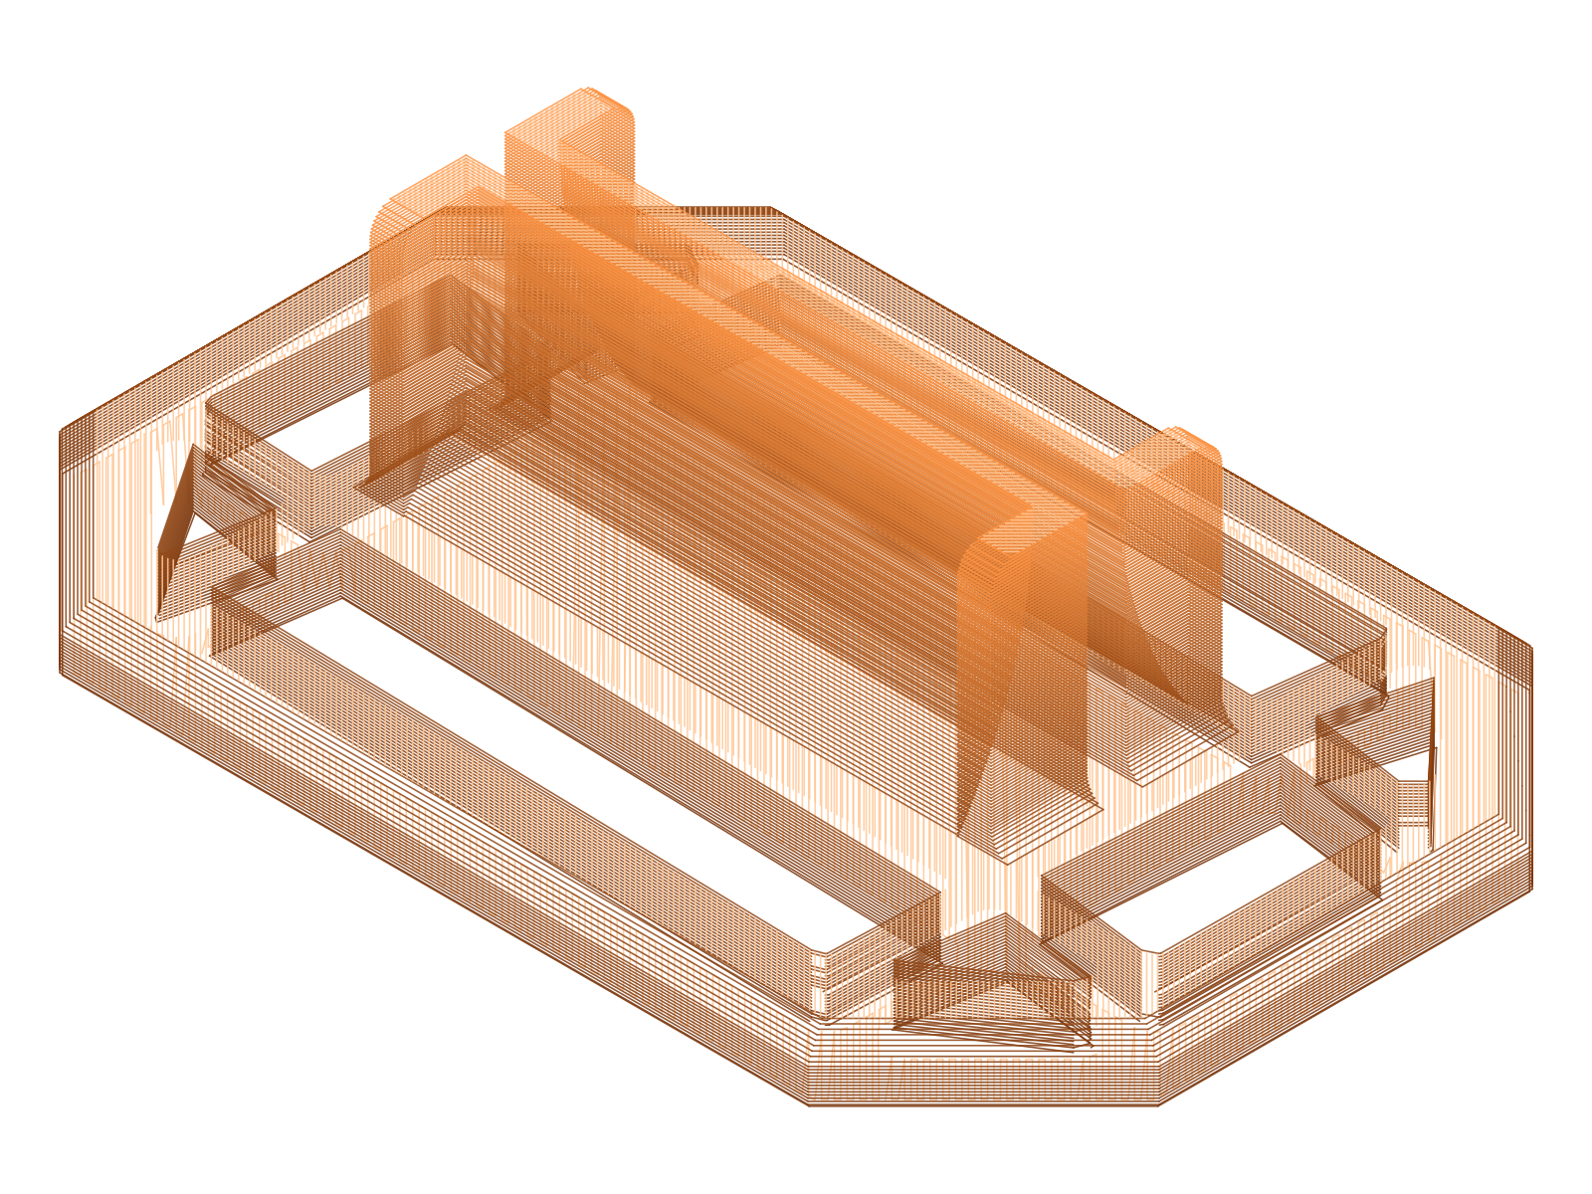

OpenCap works; OpenSim is next
Add OpenCap video
Add OpenSim screenshot
board slot
OpenCap
OpenSim
CAD
Tested with 2+ phones
Learning inverse dynamics
Board holder designed
Next: laser-guide phone holder, Theia3D training
5
Notes:
[~25 s] We've run several OpenCap sessions with two or more phones, and it works end to end. We're learning OpenSim's inverse dynamics workflow. On the CAD side, we designed this holder, which keeps the calibration board upright in the same spot every session. Next up is the laser-guide phone holder and training on Theia3D. (Replace the two dashed boxes with your OpenCap video and an OpenSim screenshot before presenting.)

Slide 6
Timeline
SEP
OCT
NOV
DEC
OpenCap + holder
Proposal
Training
Phone holder
Aim 1: treadmill
Aim 2: OpenSim
Aim 3: outdoors
Analysis
Poster + report
= deliverable
today
6
Notes:
[~45 s] So here's our timeline. The gray bar up top is what's already done: OpenCap is running and the checkerboard holder is designed. Right now we're wrapping up this proposal, working through the OpenSim tutorial, and starting on the laser-guide phone holder. In October, Finn trains us on Theia3D and the treadmill, and then we start recording with everything at the same time. While that's going, we build the OpenSim pipeline and poke at the PBL code to see if it's worth adding. November, we take the setup out to the terrain park and outdoors, and start crunching numbers. If we're ahead of schedule, we'll try the ExoBoot. December is the poster and the final report. And those diamonds are our five deliverables.

Slide 7



Three workstreams, low cost
MoCap OpenCap, Theia3D, PBL
~$130
CAD phone and board holders
in materials
Sim OpenSim inverse dynamics
The lab already owns the expensive equipment. The software is free.
Weekly check-ins with Finn and Dr. Fey
7
Notes:
[~25 s] We split the work into three streams: motion capture, CAD, and simulation, and we collect data together. We check in with Finn weekly and meet Dr. Fey during the consultation hour. The cost is about 130 dollars: tripods and mounts, about 50; laser levels, 40; PLA filament, 25; and a rigid checkerboard, 15. The lab already has Theia3D, the treadmill, and the terrain park, and OpenCap and OpenSim are free.

Slide 8





Risks and what we need
Systems aren't synced
→ Stomp to sync
We need
Theia3D + Bertec time
Phones get blocked
→ Test angles early
Terrain park access
~$130 in materials
Your feedback
Theia3D isn't ground truth
→ Report agreement
Questions?
8
Notes:
[~25 s] Three main risks. The systems aren't synced, so we use a stomp as a shared event. Phones can get blocked, so we test camera angles early. And Theia3D isn't ground truth, so we report agreement rather than accuracy. What we need is time on Theia3D and the treadmill, terrain park access, about 130 dollars, and your feedback. Thank you, any questions?

Slide 9
Sources
[1] Uhlrich SD et al. OpenCap: Human movement dynamics from smartphone videos. PLOS Comput Biol. 2023.
[2] Kanko RM et al. Concurrent assessment of gait kinematics using marker-based and markerless motion capture. J Biomech. 2021.
[3] Delp SL et al. OpenSim: open-source software to create and analyze dynamic simulations of movement. IEEE TBME. 2007.
[4] Seth A et al. OpenSim: simulating musculoskeletal dynamics and neuromuscular control. PLOS Comput Biol. 2018.
[5] Cotton RJ et al. Portable biomechanics laboratory: movement analysis from a handheld smartphone. 2025.
[6] Bland JM, Altman DG. Statistical methods for assessing agreement between two methods of clinical measurement. Lancet. 1986.
9
Notes:
Backup slide, not presented. Verify every citation on Google Scholar before submitting, especially [5]: fill in the full author list and venue.

