Slide 1
Numerical benchmark of Warp code for a Solenoid Magnetic Fields
AdSM, Hiroshima University
Kazuya Osaki

Slide 2
Overview
・Add magnetic field of thin solenoid on gridded field in warp.
Br(r,z) and Bz(r,z) given from the following formulas.
Ref : Edward Lee and Matthaeus Leitner (LBNL,2007)
R : Solenoid Radius, l : Solenoid Length
・Carry out single particle simulations with Warp, to test evolution
consistent with P_{θ} and β conservation in magnetic field.

Slide 3
Canonical angular momentum
Kinetic term
Potential term
P_{θ} should be conserved according to Hamiltonian theory

Slide 4
Main Simulation Parameters
Simulation parameters
Species | U³⁴⁺
Bρ [rigidity] | 2.19
P_{θ}/mc | 0.04, 0.4, 4.0 [mm・mrad]
Grid size of r | 0.8mm, 1.1mm, 1.6mm,3.2mm
Grid size of z | 0.67mm, 1.0mm,2.0mm, 4.0mm
Simulation range of z | -10m ~ 10m
Simulation step | 5e3, 1e4, 5e4, 1e5
Length of solenoid | 30 cm
Radius of solenoid | 8 cm

Slide 5
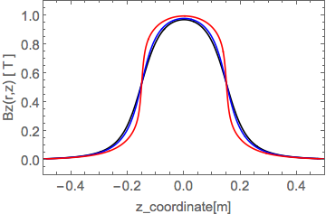
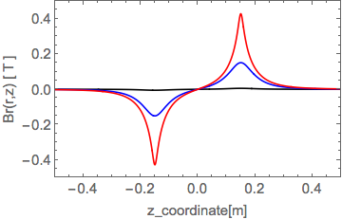
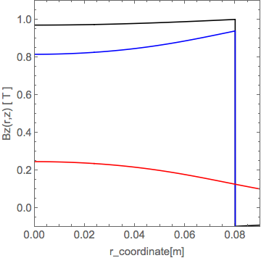
Add magnetic field on grid + check with Formula
Formula
Warp

Slide 6
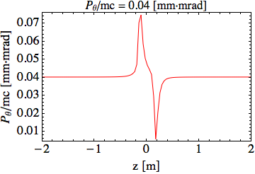
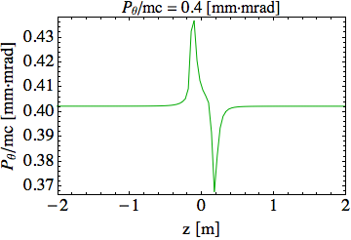
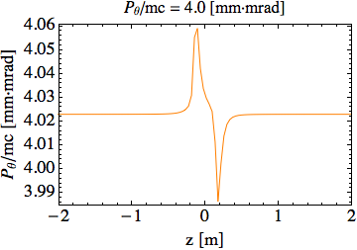
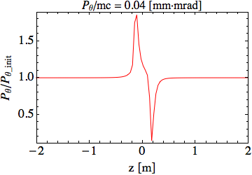
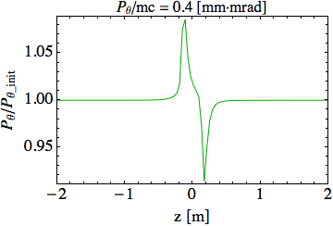
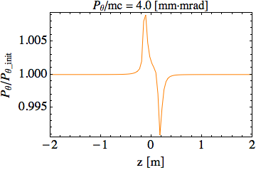
Oscillation in P_{θ} observed for broad range of simulation steps
・Field Grid dr = 1.6 mm, dz = 0.67 mm
Normalized by P_{θ_init}

Slide 7
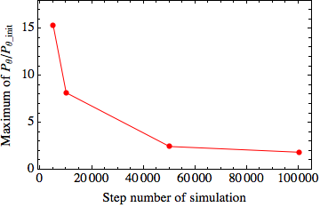
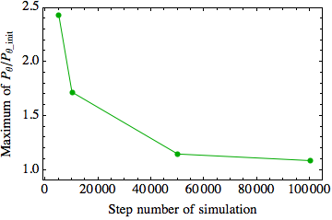
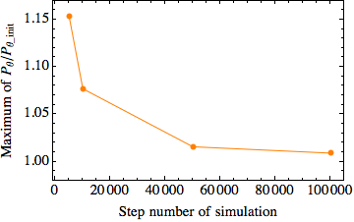
Maximum amplitude of P_{θ} for each step
P_{θ}/mc=0.04 [mm・mrad]
P_{θ}/mc=0.4 [mm・mrad]
P_{θ}/mc=4.0 [mm・mrad]
・If we specify the simulation step size, the absolute value
of errors are almost same for different values of P_{θ}.
・Absolute value of errors tend to be small with small
simulation step size. (large step number)

Slide 8
Oscillation amplitude in P_{θ} for varying axial field grid resolution
・Radial dr = 1.6 mm, Simulation step size = 0.2 mm
Normalized by P_{θ_init}

Slide 9
Maximum amplitude of P_{θ} for varying field grid dz
P_{θ}/mc=0.04 [mm・mrad]
P_{θ}/mc=0.4 [mm・mrad]
P_{θ}/mc=4.0 [mm・mrad]
・If we specify the grid size of z direction, absolute value of
errors are almost same for different P_{θ}.
・Absolute value of errors tend to be small when choose small
the grid size of z direction. (large z gird number)

Slide 10
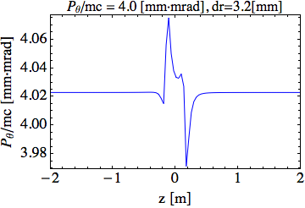
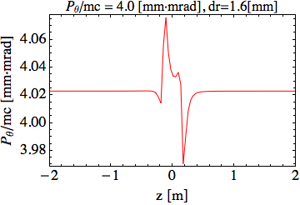
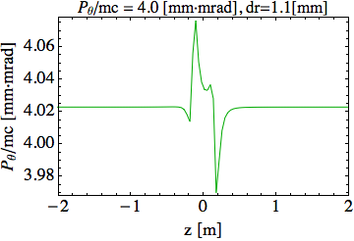
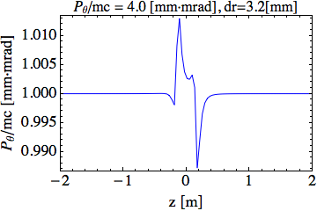
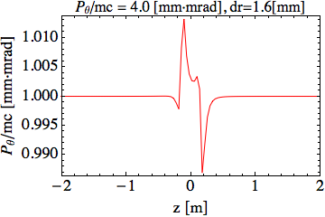
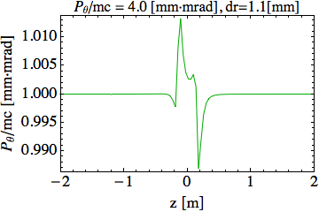
Oscillation amplitude in P_{θ} for varying radial field grid resolution
・Field grid dz = 1.0 mm, Simulation step size = 0.2 mm
Normalized by P_{θ_init}

Slide 11
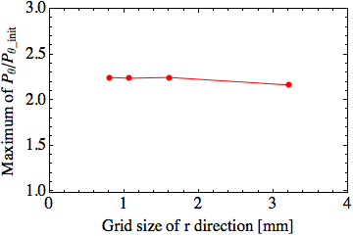
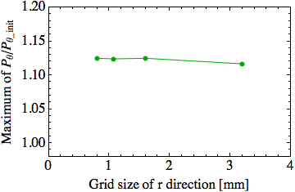
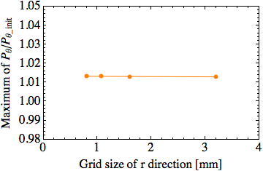
Maximum amplitude of P_{θ} for varying field grid resolution dr
P_{θ}/mc=0.04 [mm・mrad]
P_{θ}/mc=0.4 [mm・mrad]
P_{θ}/mc=4.0 [mm・mrad]
・If we specify the grid size of r direction, absolute value of
errors are almost same for different P_{θ}.
・Absolute value of errors are similar if we change the grid size
of r direction. (large r gird number)

Slide 12
Summary
・Oscillates significantly canonical angular momentum in
warp using leapfrog mover.
・When we specify simulation step size and field grid size
of z direction, the absolute value of numerical errors are
similar for different values of P_{θ}.
・Amplitude of canonical angular momentum oscillations
tend to be small when we choose both small simulation
step size and small field grid dz.
・There appears to be little sensitivity of results on the
choice of radial field grid dr.

